Slide 1
Money and Monetary Policy (1): Money Supply
Thorn Pitidol
Faculty of Economics, Thammasat University
EE212, Semester 2/2556-7

Slide 2
Topics
An overview of money
Money supply
  How banks create money
  Controlling the money supply

Slide 3
Questions
We have studied the role of the government in managing the economy through fiscal policy.
However, another important tool that can be used to manage the economy is “monetary policy”, by affecting the money market.
In what ways do think the government can affect the “money market”? And how would doing so in turn affect the economy?

Slide 4
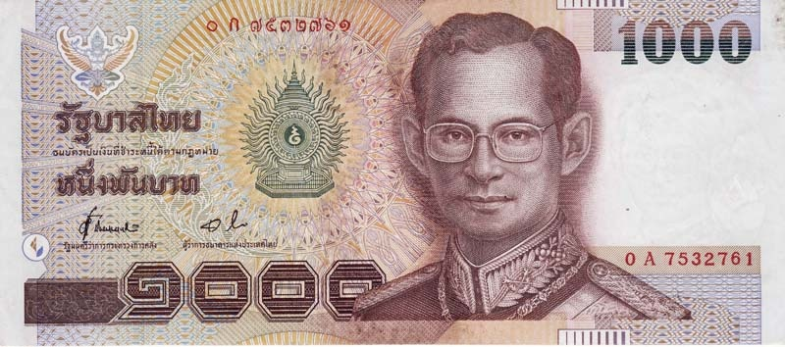
What is money?
How is it that you are willing to exchange goods with pieces of paper that are essentially worthless?

Slide 5
What is money?
Money functions as;
  A means of payment, or medium of exchange
    Without money, we will need to resort to the use of “________________”.
    But with the barter system, you’ll always need “_________________” of wants for trade to take place.
    Using a commonly accepted form of money eliminates the need for a double coincidence of wants, help enabling transactions to occur.

Slide 6
What is money?
Money functions as;
  A store of value
    Money also serves as an asset that can be used to transport purchasing power from one time period to another.
    Other asset such as gold and diamond can also store value. But they will not have as much “liquidity” as money.
      Liquidity:

Slide 7
What is money?
Money functions as;
  A unit of account
    Finally, money also serves as “unit of account” – a consistent way of quoting prices. Money gives a standard in which all prices can be quoted and compared .

Slide 8
Types of money
Commodity monies
  Are the items used as money that also have an intrinsic value in some other use.
    For example:
Fiat money
  Money that is intrinsically worthless. Its uses are only backed by a “legal tender” declared by the government.
  Trust of the government is needed to facilitate the use of fiat money.

Slide 9
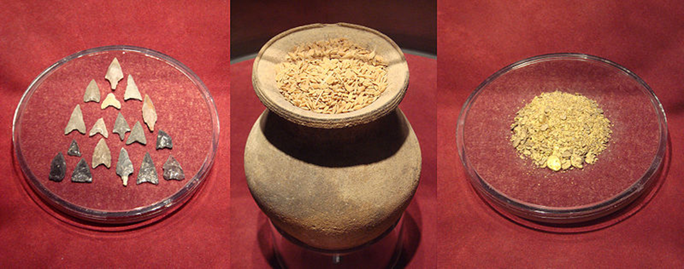
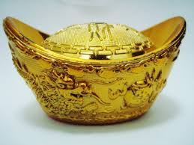
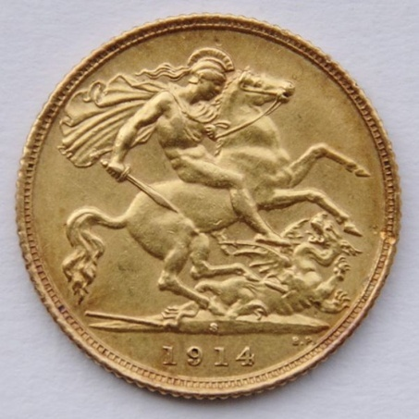
Types of money
Commodity monies

Slide 10
Types of money
Fiat money
Look more closely

Slide 11
Money supply
Measurement of money supply
  M1: Transactions money
    =
    These are money that can be readily used to engage in transactions
    M1 is most commonly used to measure money supply
  Is M1 a stock or flow variable?

Slide 12
Money supply
Measurement of money supply
  M2: Broad money
    =
    M2 essentially expands from M1 to include money stored in accounts that cannot be readily spent, but can be easily transferred to accounts ready for spending.
  The measurement of money can go beyond M2 to include other means of payment, such as that of the credit card, resulting in other measurements.

Slide 13
Money supply
Check data from BOT
  http://www2.bot.or.th/statistics/BOTWEBSTAT.aspx?reportID=6&language=ENG

Slide 14
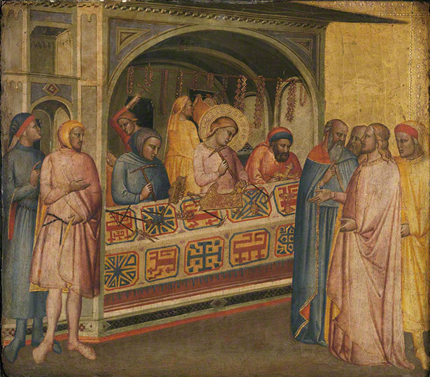
Money supply
How banks create money?
  Historical perspective: the goldsmiths
    Goldsmiths store gold and issue receipts for depositors.
    As goldsmiths issues loads of receipts, receipts functioned as a perfect substitute for gold. People deal with each other direct through gold-receipts.

Slide 15
Money supply
How banks create money?
  Historical perspective: the goldsmiths
    Goldsmiths then have “extra” gold sitting around. They can use the extra gold to create lending (issuing gold receipts) and earn interests.
    Their lending add money supply to a nation.
    The goldsmiths, like modern banks, have power to create more money.
    But there is one major problem! People cannot all withdraw their deposit at the same time.

Slide 16
Money supply
How banks create money?
  Banks creation of money
    Banks role in keeping deposits and issuing lends means they engage in creating “money”
    Banks are required by law, however, to keep a certain ratio of each deposit as a reserve. This ratio is called “________________________”.
    The amount of deposit in excess of the “required reserve” is called “__________________”

Slide 17
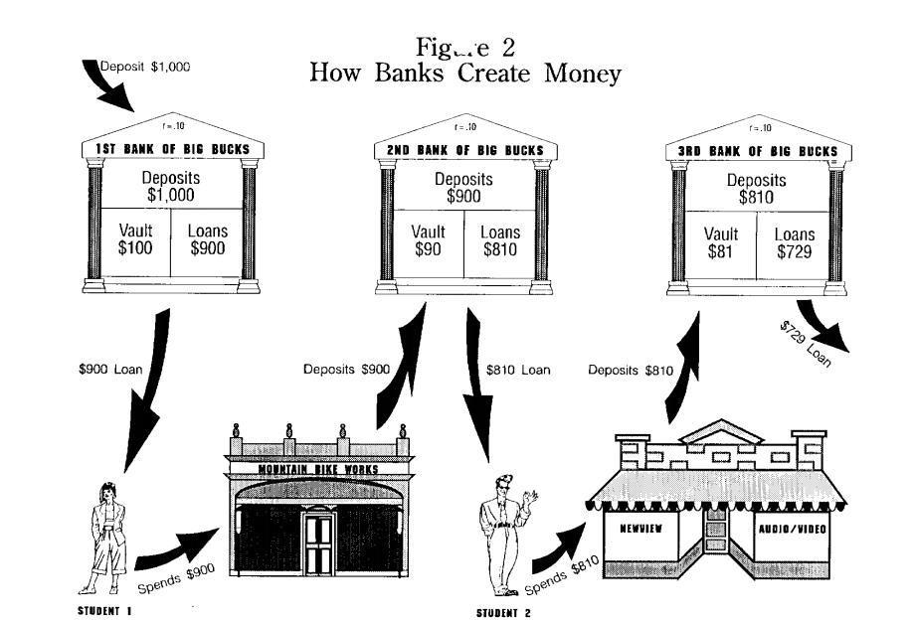
How banks create money
Let’s suppose initial deposit is 100 and required reserve ratio is 0.2
Assumptions: all excess reserves are lend, and all lend are deposited back.

Slide 18
Money supply
How banks create money?
  Banks creation of money
    Assumptions: all excess reserves are lend, and all lends are subsequently deposited.
    If initial deposit = 100, and required reserve ratio = 0.2
Round/bank no. | Primary Deposit | Required Reserve | Excess Reserve
1 | 100 | 20 | 80
2 | 80 | 16 | 64
3 | 64 | 12.8 | 51.2
↓ | ↓ | ↓ | ↓
n | 500 | 100 | 400

Slide 19
How banks create money?
D = P (1-r) + P(1-r)²+ P(1-r)³ + … + P(1-r)^{n}
= P [(1-r) + (1-r)² + (1-r)³ + … + (1-r)^{n}]
D = P x
Money Multiplier)
When
D =
P =
r =
Deposits created by banks
=

Slide 20
How banks create money?
Example:
  Initial deposit = 500
  Required reserve ratio = 0.1
  Calculate the total deposits in the banks, money multiplier, and the deposits created by banks

Slide 21
How the central bank controls money supply?
The central bank controls the money supply through the use of
  Open market operation:
  Open market operation change the monetary base.
    Monetary base =
  In relation to banks creation of money, monetary base can be seen as the potential amount of initial deposit.

Slide 22
How the central bank controls money supply?
The central bank controls the money supply through the use of
  The required reserve ratio: the ratio of reserve that banks are required to hold
  Changing this directly affect

Slide 23
How the central bank controls money supply?
Using the open market operation, or changing the required reserve ratio, will have the following effect on money supply
where Money Multiplier = 1/r

Slide 24
How the central bank controls money supply?
The central bank controls the money supply through the use of
  The discount rate:

Slide 25
Controlling the money supply
In sum, if the government wants to increase the money supply, it can do so by buying bonds, lowering the discount rate, and lowering the required reserve ration
  If it wants to lower the money supply, it does the opposite
In reality, with the economy growing, the central bank usually allows money to grow to accommodate the growth. The control is actually on how fast it allows the money supply to grow.
  Loose monetary policy: allowing money supply to grow faster than it has previously been growing
  Tight monetary policy: making the money supply grow slower than previously.

Slide 26
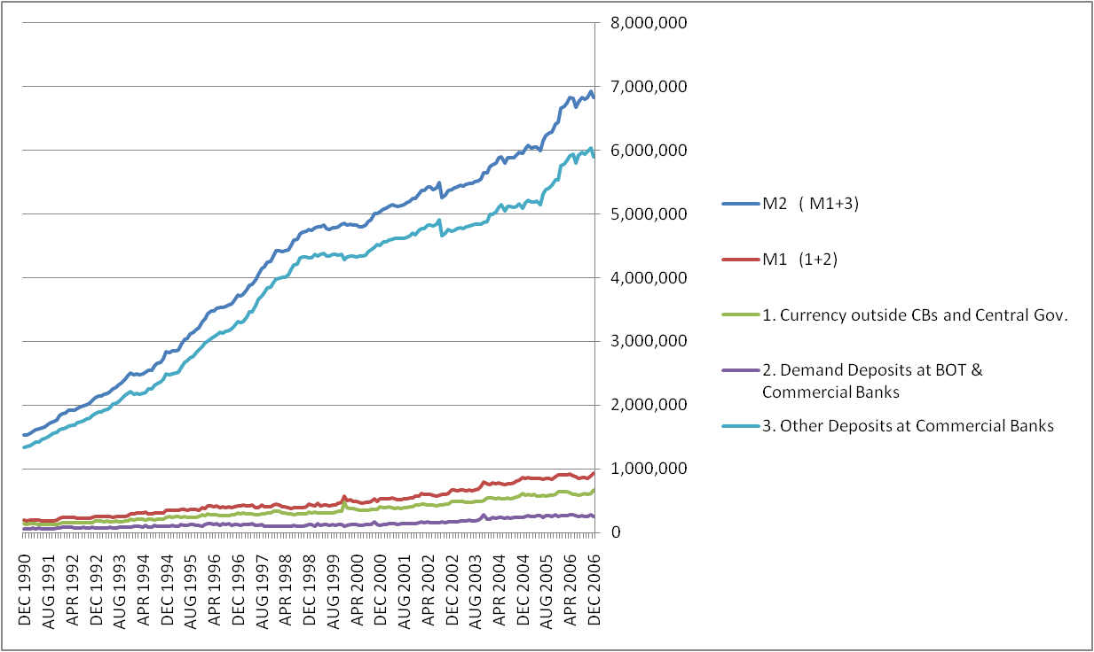
The actual growth of money supply in Thailand

Slide 27
Monetary policy
The central bank controls of money supply will produce its effect on the economy through affecting the “interest rate” and the ability of banks to give “loans”.
In order to understand how the effect on interest rate arises, and how that can subsequently affect the macro economy, you will need to first understand the other side of the money market, the “money demand”.

Slide 28
Money supply curve
The working in money market produce effects through equilibrium “interest rate”
That is why, in plotting the money supply curve, we will have the following graph.

