Slide 1

Trade Finance Product/FX
Reference: KTB Trade Finance service
http://www.ktb.co.th/ktb/en/product.aspx?cid=XSfkez6Z6dFvS5ye3ojc4A%3d%3d

Slide 2


Electronic International Trade

Slide 3
e-Export Bills
Service Features
- Export Bills online (Internet) directly from company to the bank
Service Objectives
- providing convenience for customers who run export business: the system operation will check the accuracy of the documents for fast collecting payment
Service Application
- Customers can contact the bank international trade department or international business center or business office or customers’ loan department
- Service Agreement will be sign online
Benefits
- Quick and Convenient Export Products Ticket Sale

Slide 4
Internet L/C Opening and Amendment
Service Features
- Fast and convenient L/C opening and amendment with time reduction
Service Objectives
- For the convenience of the customer to open / amend L/C with the bank without having to submit the documents to the bank before initiating the work.
Service Terms/Conditions
- Having L/C credit line for product payment with the bank
- Having high liquidity of L/C payment
- Agreeing with L/C conditions
- After the transaction is done, hard copy of L/C/ Amendment printed online with authorized signature should be sent to the bank
Benefits
- Fast and convenient L/C opening - L/C opening tracking
- Self service

Slide 5


Letter of Guarantee : Standby L/C

Slide 6
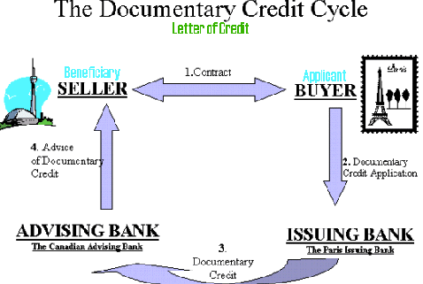
Letter of Credit

Slide 7
Letter of Credit
A mechanism, which allows importers/buyers to offer secure terms of payment to exporters/sellers in which a bank gets involved
Letters of credit deal in documents, not goods
  Commercial invoice, transportation documents, insurance documents etc.
Shift the risk from the actual buyer to a bank.
Seller gets assured that the payment will be made
Exporter can take the LC to the bank for a pre-shipment loan (usually the packing credit = 80% of the value of the shipment)
LC sold at discount
  Exporter can sell the LC to the bank at a discount post-shipment loan (Usually up to 100% of the value + interest rate)

Slide 8
Actors
  The Buyer is the Applicant
  Seller is the Beneficiary.
  The Bank that issues the LC is the Issuing Bank (generally in the country of the Buyer).
  The Bank that Advises the LC to the Seller is the Advising Bank (generally in the country of the Seller).

Slide 9
Irrevocable LC
  cannot be changed unless both the buyer and seller agree
Revocable LC
  changes can be made without the consent of the beneficiary.
Sight LC
  payment is made immediately to the beneficiary/seller/exporter upon presentation of the correct documents in the required time frame.
Time/Date LC
  specify when payment will be made at a future date and upon presentation of the required documents.

Slide 10


Foreign Exchange Business

Slide 11
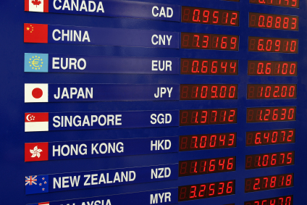
Foreign Exchange Trading Service
- Provides foreign exchange service that makes purchase and sale of foreign currencies.
- Accept foreign bills or Baht deposit
- No charge for cash exchange or Baht deposit

Slide 12
Foreign Bank Draft Service
- Provides bank draft service which helps the customers save money and the assurances of high security.
Payments
- Pay in cash/ direct debit from Baht account/ credit card by overseas financial institutions/ foreign checks/ direct debit from FCD account;
- Proofs of bank draft purchase intent, e.g. education-related invoice, passport or ID Card.
Charges
- THB200 per draft and THB3 revenue stamp per bank draft.

Slide 13


Export Business Services

Slide 14
Forward Exchange Bought
- A service for preventing floating exchange rate and allowing customers to know a fixed income earned by product export. The bank agrees to purchase forward foreign currency with currently fixed rate.
Service Objectives
- To prevent floating exchange rate predicted the weak of Thai Baht (Receiving less foreign currency because of strong value of Thai Baht)
Applicants’ Qualifications
- Being international exporters with foreign currency business
- Having Forward Contract with the bank
Benefits
- Preventing risks from floating exchange rate
- Knowing fixed income earning from exporting

Slide 15
Transferable L/C
-This serves as succeeding service of notification service for L/C opening and amendment where the L/C is transferable and the sellers or beneficiaries under L/C (First Beneficiary) require to transfer L/C to other exporters (Second Beneficiary)
Service Objectives
- To provide customers (sellers / beneficiary under L/C) the fast and convenient L/C transfer service to the second beneficiary
Applicants’ Qualifications
- Being customers (beneficiary by L/C / seller) whose business are international export
- Being or not being customer of the bank is also available
Benefits
- Customers will receive the convenience of L/C transfer to another sellers in case of not ready for selling by earning commission from the other sellers

Slide 16


Import Business Services

Slide 17
International Money Transfers: Advance Payment
- Payment before shipment e.g. wire transfer and credit card
Objective
- To attract foreign exporters
Benefits
- Maintaining a successful trade relationship by building creditworthiness

Slide 18
International Money Transfers: Open Account
- The goods are shipped and delivered before payment is due
Objective
- To support working capital for the importers
Benefits
- Receiving product without instant payment
- Having working capital for purchasing products and then repay back to the bank later

Slide 19
Group Member
Athicha Aungurapibul 5204640063
Jaruwat Juengsappaisan 5204640287
Ploypailin Sripan 5204640857
Pornnisa Anantapattanapong 5204640865
Suppakit Paka-akkaraloetkul 5204641103
Christian Skovgaard Thorsen 5504930073

