Slide 1

D
BA 291 Human Resource Management
by Parichat Jantori

Slide 2
Anyone want to work in HR area?
Got an idea, what HR professional are doing?

Slide 3
„Your organization can create a new product, and it is easily copied. Lower your prices and your competitor will follow. Go after a lucrative market and someone is there right after you, careful to avoid making your initial mistakes. But replicating a high quality, highly engaged workforce is nearly impossible. The ability to effectively hire, retain, deploy and engage talents at all levels – is really the only true competitive advantage an organization possesses“
(Wellins, R. & Smith A.B., 2009)

Slide 4
HR Challenge
  Driving internationalization. Working with diversity.
  Closing leadership gap. (30% of middle management not capable to lead)
  Become employer of choice
  Talent management and successor planning
  Aging workforce
  Employee engagement and life-time employability

Slide 5
Humans are an organization's greatest assets; without them, everyday business functions such as managing cash flow, making business transactions, communicating through all forms of media, and dealing with customers could not be completed.
Humans and the potential they possess drive an organization.

Slide 6
Therefore, all companies need good and effective HR professionals.
Good HR knows how attract good people.
Good HR knows the right people for the job.
Good HR knows how to handle people.
Good HR knows how to develop and train people.
It’s not just putting people on the job, but putting the right people on the right job at the right time.

Slide 7
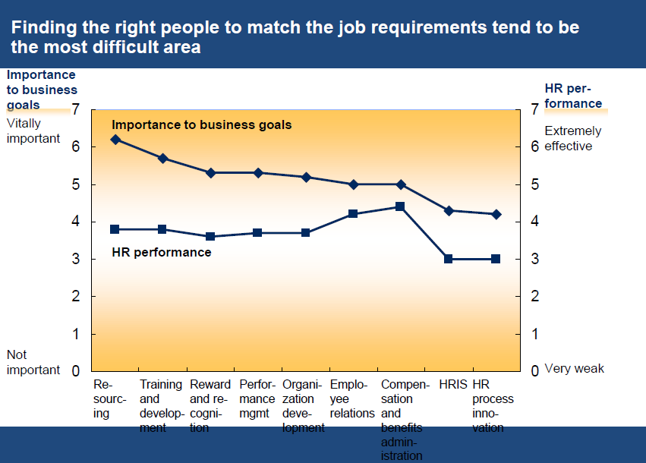

Slide 8
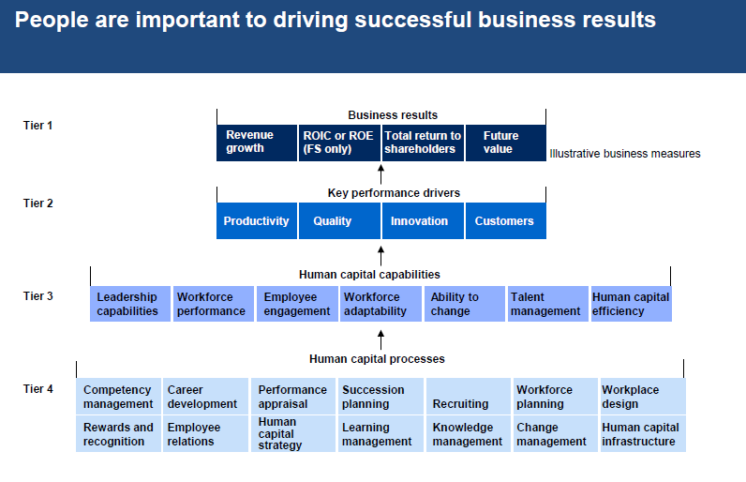

Slide 9
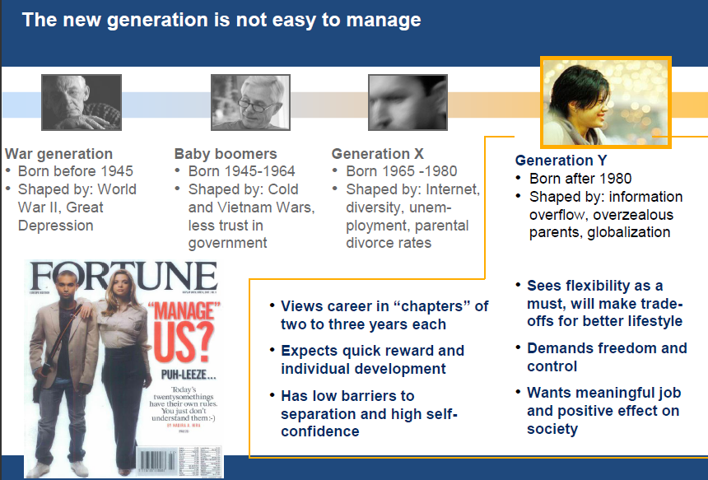

Slide 10
Activity:
You and your friends want to open a clean food restaurant (or a small minimart), what are the activities that you have to do in term of staffing?
How would you estimate the number of workers you need?
How would you announce the vacancy? Where would you search for people?
How would you know who is the right one?
How would you increase work performance?

Slide 11
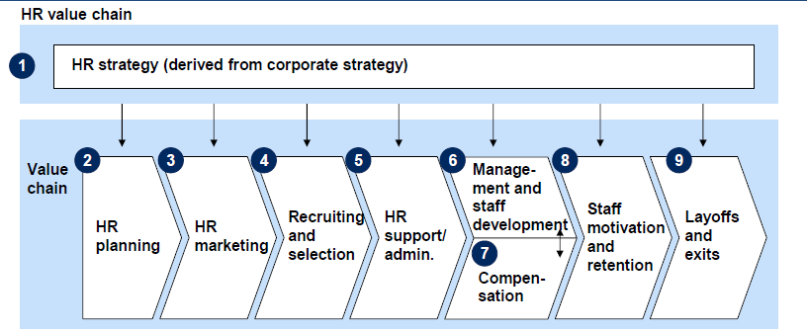
HR Value Chain & activities

Slide 12
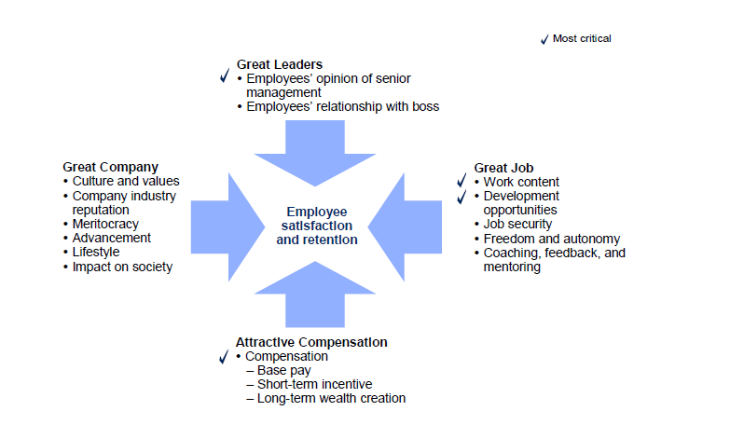
Employee value proposition

Slide 13
Human Resource Planning
The assessing and forecasting of human resource needs and the projected matching of individuals with expected vacancies
Demand Forecast:
Determining how many and what type of people are needed.
Supply Forecast:
Estimating the number and quality of its current employees and available external supply of workers.
Deficit/ Surplus?
Job analysis:
systematic process of gathering and interpreting information about the essential duties, tasks and responsibilities of a job
Job description: task, duties and responsibility
Job specification: knowledge, skills, education, physical abilities, other characteristic

Slide 14
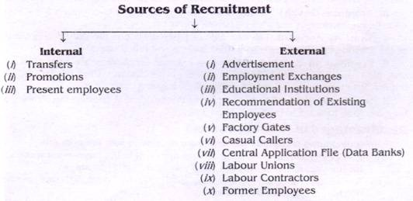
Staffing the organization
Recruitment: Activities help increase the pool of candidate. The process of finding and attracting job candidates who are qualified to fill job vacancies

Slide 15
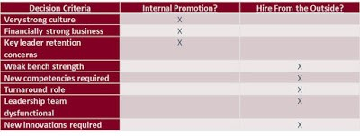
Internal or external recruitment

Slide 16
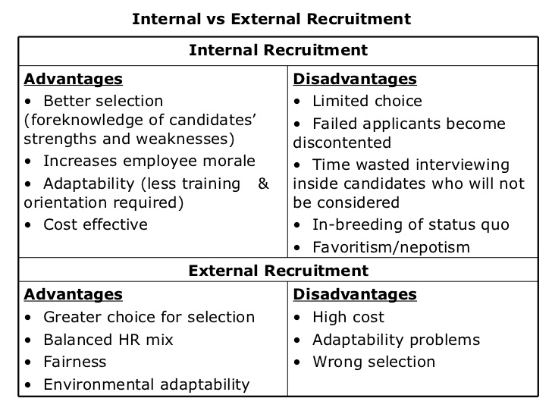
Internal or external recruitment

Slide 17
Selection
Selection: The process of collecting information about applicants and using that information to make hiring decision
The application & resumé (CV, cover letter)
Interview
Employment test (Cognitive ability, aptitude test, personality test, performance test)
Reference checks/ Background checks/ Online checks
Select a Candidate & Negotiate and offer

Slide 18
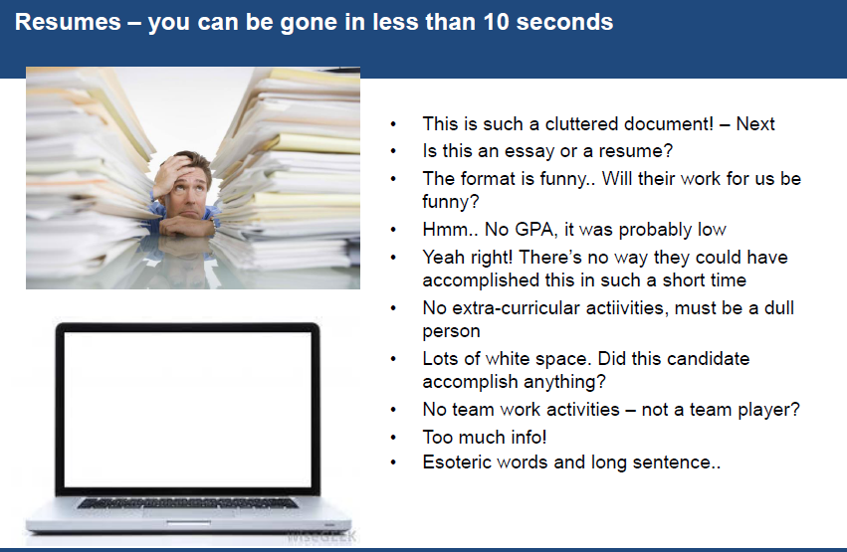

Slide 19
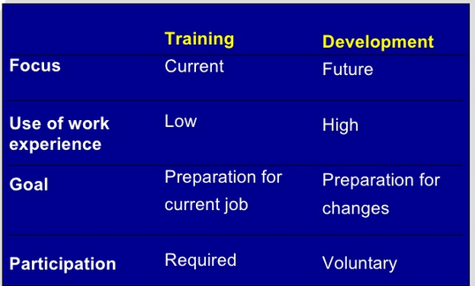
Training and development

Slide 20
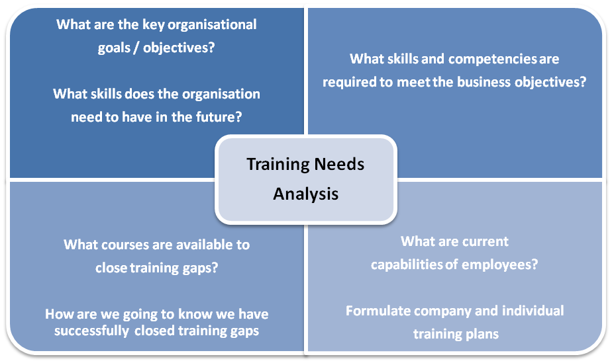
Training and development
  Training: teaching lower-level employees how to perform their present job.
  Need assessment – Design training program and method – Evaluate

Slide 21
Training Methods
  On-the-job: Employee learn how to do tasks simply by performing them, usually after an initial introduction to the task
  Job rotation: Employees work at different jobs in a particular area, getting exposure to a variety of tasks
  Mentoring and Coaching: Employees work with an experience worker who provides information, support and encouragement
  Experimental Exercise: Employee participate in role playing, simulations or other face to face types of training
  Workbooks/ Manuals: Employees refer to training workbooks or manuals for information
  Classroom lectures/ Corporate University: Employees attend lectures designed to convey specific information

Slide 22
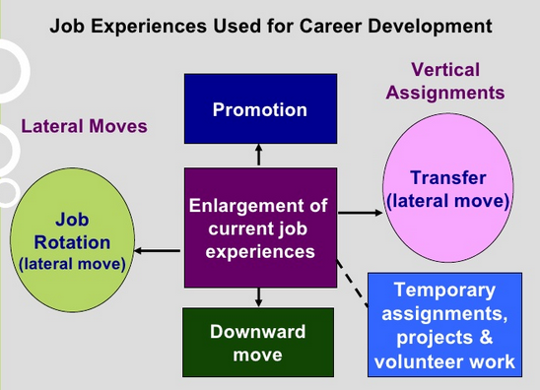
Training and development
  Developing: teaching managers and professional employees broad skills needed for their present and future jobs

Slide 23
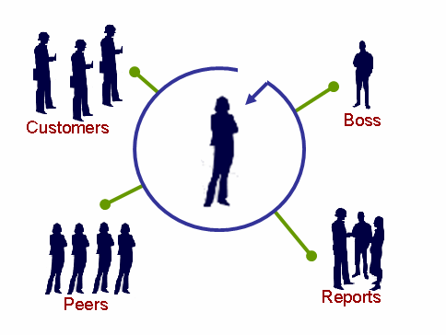
Performance Appraisal
  The process of observing and evaluating an employee‘s performance, recording the assessment, identifying strengths or weakness of employees, providing feedback and determining ways to improve performance
360-degree feedback:
A process that use multiple sources to gain comprehensive perspective of one‘s performance and guide development

Slide 24
Appraisal Methods
Rating scale
Critical incidents - With a critical incident appraisal, the manager records examples of the employee’s effective and ineffective behavior during the time period between evaluations
Ranking - The manager will have a list of all employees and will first choose the most valuable employee and put that name at the top. Then he or she will choose the least valuable employee and put that name at the bottom of the list
Behaviorally Anchored Rating Scales (BARs) - there is a specific narrative outlining what exemplifies a “good” and “poor” behavior for each category.
Notes:
http://2012books.lardbucket.org/books/beginning-management-of-human-resources/s15-02-appraisal-methods.html#portolesedias_1.0-ch11_s02_s01_f01

Slide 25
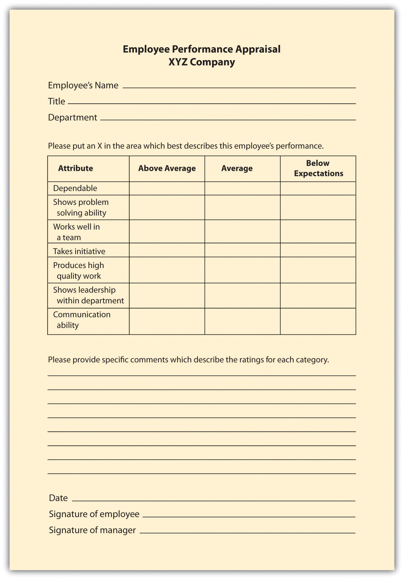

Slide 26
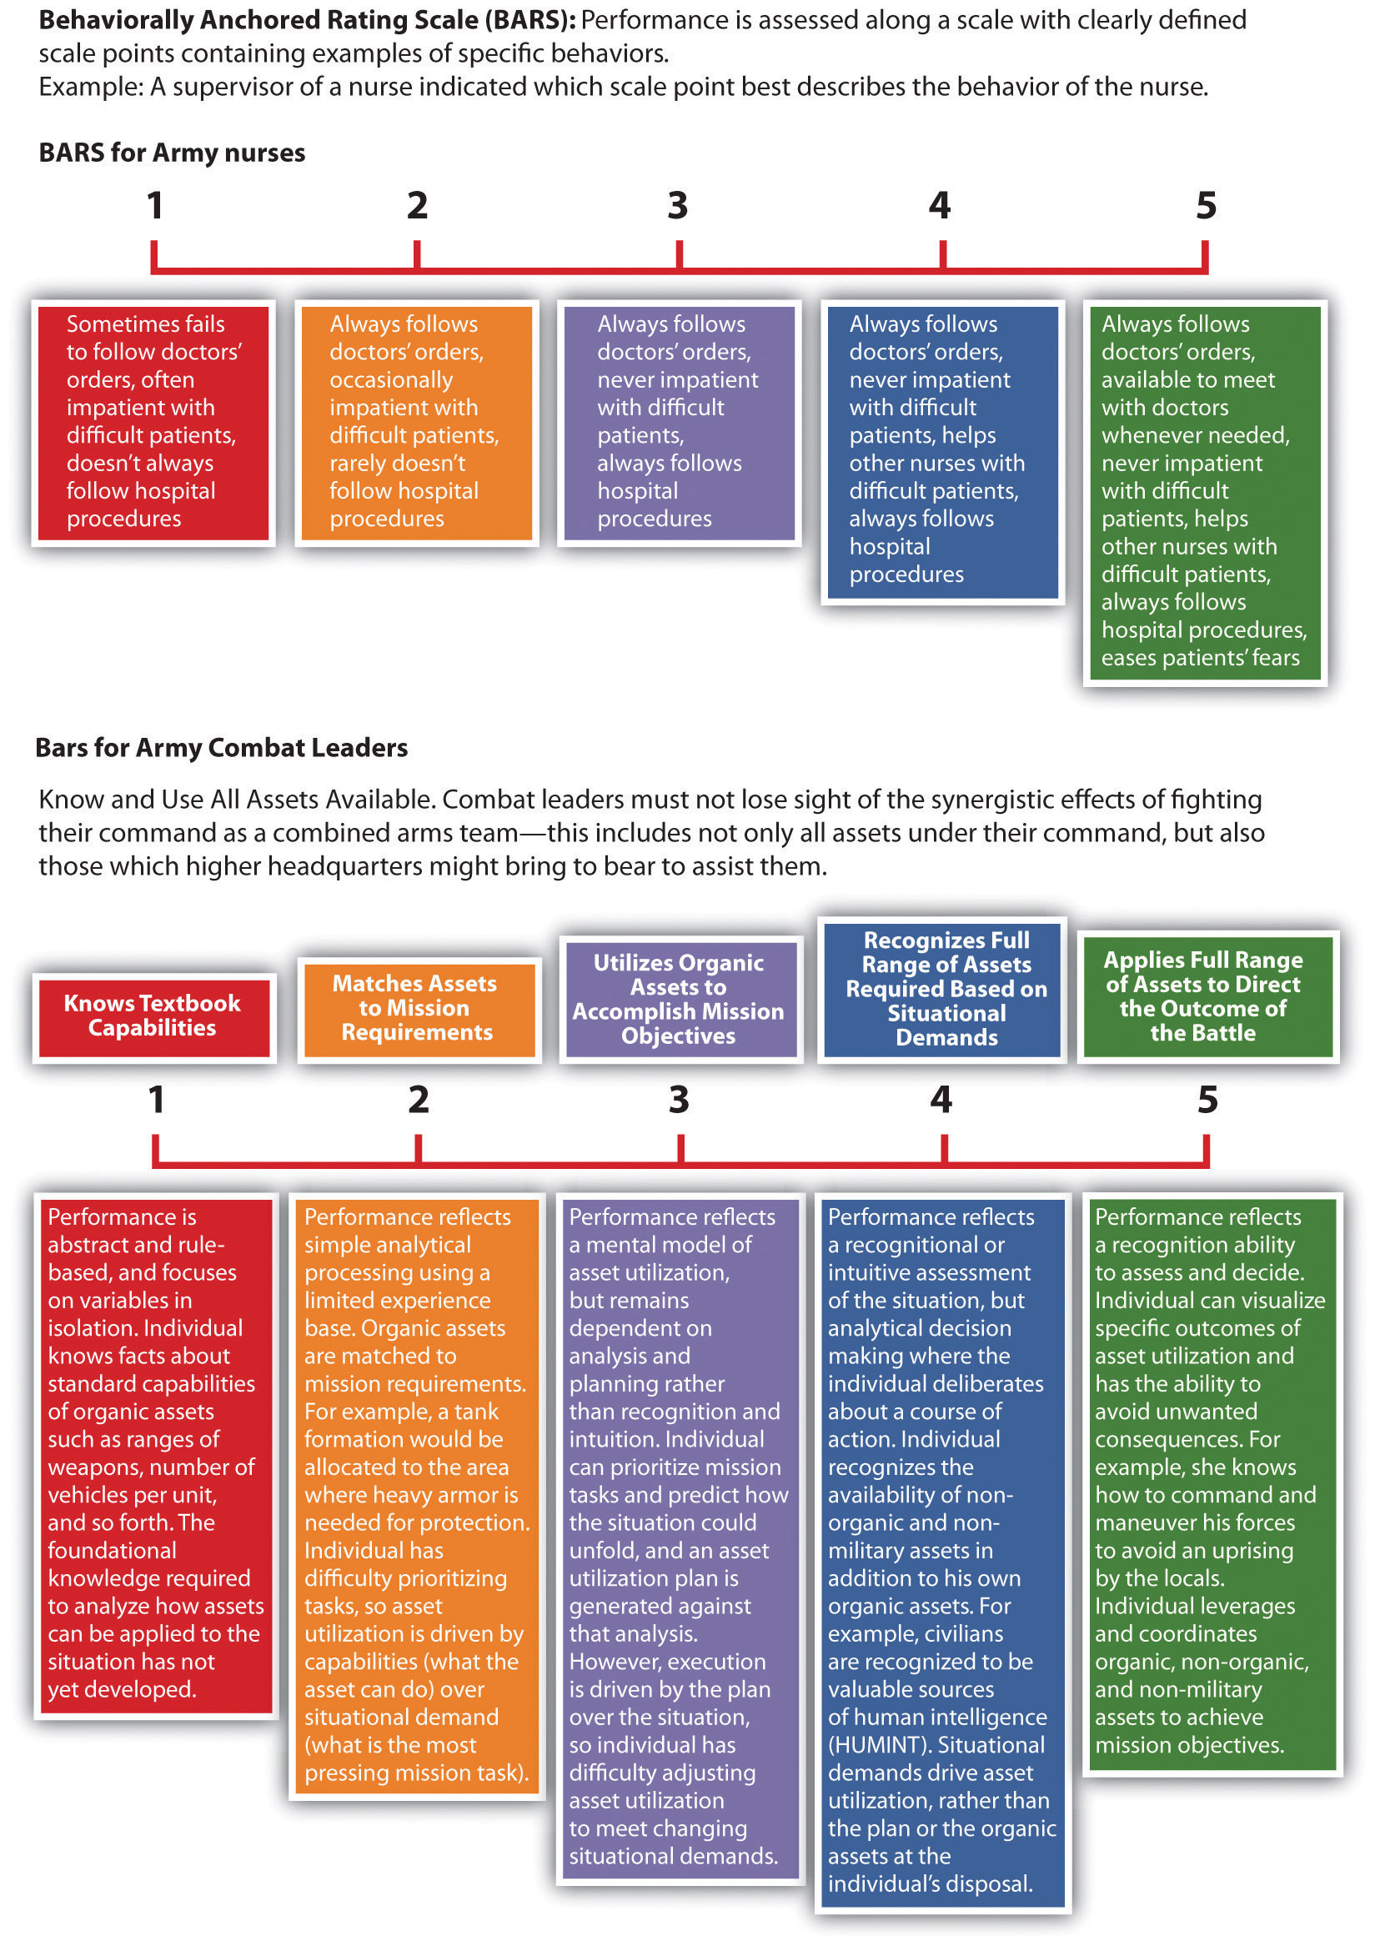

Slide 27
Compensation
Wage and salary systems:
Job-based pay: linking compensation to the specific tasks an employee performs.
Skill-based pay: linking compensation to the skill required by a specific task. It will encourage employees to develop their skills and competencies
Pay-for-performance (Incentive pay): trying at least part of compensation to employee effort and performance e.g. bonuses, team incentives, profit sharing plan

Slide 28
Compensation
Benefits
Rewards employees receives as part of their employment relationship with the organization (indirect compensation).
Some benefits are required by law, such as social security, unemployment compensation and worker compensation.
- health insurance, vacations, on-site daycare, educational reimbursements, cafeteria etc.

Slide 29
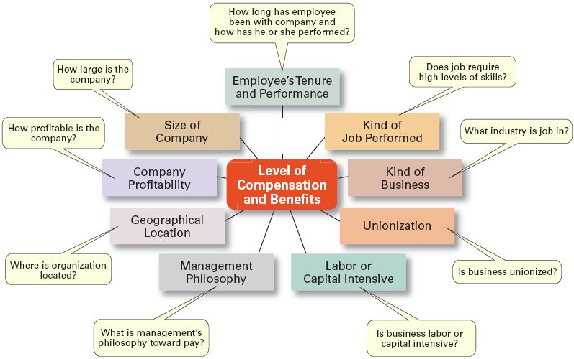
Factors that influence compensations and benefits

Slide 30
Employee termination
  Downsizing, reduce surplus
  Dismiss poor performer/ Misconduct

