Slide 1
Chapter 5: Security-Market Indexes
Analysis of Investments &
Management of Portfolios
10TH EDITION
Reilly & Brown

Slide 2
Uses of Security-Market Indexes
As benchmarks to evaluate the performance of professional money managers
To create and monitor an index fund
To measure market rates of return in economic studies
For predicting future market movements by technicians
As a substitute for the market portfolio of risky assets when calculating the systematic risk of an asset

Slide 3
Factors Affecting Market Indexes
The Sample
  Size
  Breadth
  Source
Weighting of Sample Members
  Price-weighted index
  Value-weighted index
  Unweighted (equally weighted) index
  Fundamental weighted index

Slide 4
Factors Affecting Market Indexes
Computational Procedure
  Arithmetic average
  Compute an index and have all changes, whether in price or value, reported in terms of the basic index
  Geometric average

Slide 5
Stock-Market Indexes
Price Weighted Index
  Dow Jones Industrial Average (DJIA)
  Nikkei-Dow Jones Average
Value-Weighted Index
  NYSE Composite
  S&P 500 Index
Unweighted Index
  Value Line Averages
  Financial Times Ordinary Share Index
Fundamental Weighted Index

Slide 6
Dow Jones Industrial Average (DJIA)
Best-known, oldest, most popular index
Price-weighted average of thirty large well-known industrial stocks, leaders in their industry, and listed on NYSE
Total the current price of the 30 stocks and divide it by a divisor (adjusted for stock splits and changes in the sample)

Slide 7
DJIA-Effect of Stock Split
Assume the index price-weighted index consists of three stocks, A, B, and C. This example illustrates how the index and the new divisor are computed before and after a 3-for-1 stock split for Stock A.
  Exhibit 5.1
  Stock Price Before Split Price After Split
A 30 10
B 20 20
C 10 10
Index 60 / 3 = 20 40 / X = 20
Divisor 3 X=2

Slide 8
DJIA-Effect of Stock Split
The example demonstrates the impact of differently priced shares on a price-weighted index. It shows that higher priced stock will affect the index more (Case A) than lower priced stock (Case B).
  Exhibit 5.2
    Period T Case A (T+1) Case B (T+1)
    A 100 110 100
    B 50 50 50
    C 30 30 33
    Sum 180 190 183
    Divisor 3 3 3
    Average 60 63.3 61
    Percentage Change 5.5% 1.7%

Slide 9
Criticism of the DJIA
Limited to 30 non-randomly selected blue-chip stocks
Does not represent a vast majority of stocks
The divisor needs to be adjusted every time one of the companies in the index has a stock split
Introduces a downward bias by reducing weighting of fastest growing companies whose stock splits

Slide 10
Nikkei-Dow Jones Average
Arithmetic average of prices for 225 stocks on the First Section of the Tokyo Stock Exchange (TSE)
Best-known series in Japan
Price-weighted series formulated by Dow Jones and Company
The 225 stocks represent 15 percent of all stocks on the First Section

Slide 11
Value-Weighted Index
Derive the initial total market value of all stocks used in the series
  Market Value = Number of Shares Outstanding
    X Current Market Price
Assign an beginning index value (100) and new market values are compared to the base index
Automatic adjustment for splits
Weighting depends on market value
See Exhibit 5.4

Slide 12
Value-Weighted Index
where:
Index _{t} = index value on day t
P_{t} = ending prices for stocks on day t
Q_{t} = number of outstanding shares on day t
P_{h} = ending price for stocks on base day
Q_{h} = number of outstanding shares on base day

Slide 13
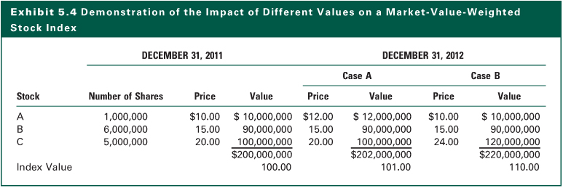
Exhibit 5.4

Slide 14
Unweighted Index
All stocks carry equal weight regardless of price or market value
May be used by individuals who randomly select stocks and invest the same dollar amount in each stock
Some use arithmetic average of the percent price changes for the stocks in the index
Value Line and the Financial Times Ordinary Share Index compute a geometric mean of the holding period returns
See Exhibit 5.5

Slide 15
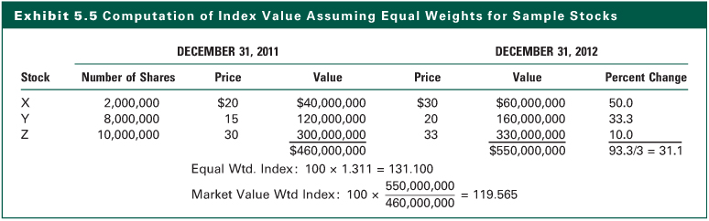
Exhibit 5.5

Slide 16
Fundamental Weighted Index
Rationale
  Market-value weighting scheme results in overweighting overvalued stocks and underweighting undervalued stocks over time
  The tech boom in 1998-2000 was a good example
Fundamental measures of firm size
  Sales
  Profits (cash flow)
  Net asset (book value)
  Distributions to shareholders (dividends)

Slide 17
Style Indexes
Small-cap growth
Mid-cap growth
Large-cap growth
Small-cap value
Mid-cap value
Large-cap value
Socially responsible investment (SRI) indexes
  By country
  Global ethical stock index

Slide 18
Global Equity Indexes
There are stock-market indexes available for most individual foreign markets
These are closely followed within each country
These are difficult to compare due to differences in sample selection, weighting, or computational procedure
Groups have computed country indexes

Slide 19
Global Equity Indexes
FT/S&P-Actuaries World Indexes
  Jointly compiled by The Financial Times Limited, Goldman Sachs & Company, and Standard & Poor’s in conjunction with the Institute of Actuaries and the Faculty of Actuaries
  Measures 2,500 securities in 30 countries
  Covers 70% of the total value of all listed companies in each country
  Includes actively traded medium and small corporations along with major international equities
  Securities included must allow direct holdings of shares by foreign nationals

Slide 20
Global Equity Indexes
FT/S&P-Actuaries World Indexes
  Index is market-value weighted with a base date of December 31, 1986 = 100
  Index results are reported in U.S. dollars, U.K. pound sterling, Japanese yen, German mark, and the local currency of the country included
  Results are calculated daily after the New York markets close and published the following day in the Financial Times
  Geographic subgroups are also published

Slide 21
Global Equity Indexes
Morgan Stanley Capital International (MSCI) Indexes
  Three international, nineteen national, and thirty-eight international industry indexes
  Include 1,673 companies listed on stock exchanges in 22 countries with a combined capitalization representing approximately 60 percent of the aggregate market value of the stock exchanges of these countries
  All the indexes are market-value weighted
  Reporting is in U.S. dollars and the country’s local currency

Slide 22
Global Equity Indexes
The MSCI Indexes
  Also provides
    price to book value (P/BV) ratio
    price to cash earnings (earnings plus depreciation) (P/CE) ratio
    price to earnings (P/E) ratio
    dividend yield (YLD)
  The Morgan Stanley group index for Europe, Australia, and the Far East (EAFE) is used as the basis for futures and options contracts on the Chicago Mercantile Exchange and the Chicago Board Options Exchange

Slide 23
Global Equity Indexes
Dow Jones World Stock Index
  Introduced in January 1993
  2,200 companies worldwide
  Organized into 120 industry groups
  Includes 33 countries representing more than 80 percent of the combined capitalization of these countries
  Countries are grouped into three major regions: Asia/Pacific, Europe/Africa, and the Americas
  Each country’s index is calculated in its own currency as well as in the U.S. dollar

Slide 24
Global Equity Indexes
Comparison of World Stock Indexes
  The three indexes by Financial Times (FT), Morgan Stanley (MS), and Dow Jones (DJ) are closely correlated
  Correlations between the three series since December 31, 1991 to December 31, 2007, indicates an average correlation coefficient in excess of 0.99
  See Exhibit 5.10

Slide 25
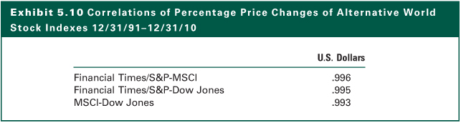
Exhibit 5.10

Slide 26
Bond-Market Indexes
Basic Concept
  Relatively new and not widely published
  Growth in fixed-income mutual funds increase need for reliable benchmarks for evaluating performance
  Many managers have not matched aggregate bond market return
    Increasing interest in bond index funds
    Requires an index to emulate

Slide 27
Bond-Market Indexes
Difficulties in Creating the Bond Index
  Universe of bonds is much broader than that of stocks
  Range of bond quality varies from U.S. Treasury securities to bonds in default
  Bond market changes constantly with new issues, maturities, calls, and sinking funds
  Bond prices are affected by duration, which is dependent on maturity, coupon, and market yield
  Correctly pricing individual bond issues without current and continuous transaction prices available poses significant problems

Slide 28
Bond-Market Indexes
U.S. Investment-Grade Bond Indexes
  Four investment firms maintain indexes for Treasury bonds and other investment grade (rated BBB or Baa or higher) bonds
  Relationship among these bonds is strong (correlations average 0.95)
  Returns for all these bonds are driven by aggregate interest rates - shifts in the government yield curve

Slide 29
Bond-Market Indexes
High-Yield Bond Indexes
  Non-investment-grade bonds
    Rated Ba, B, Caa, Ca, and C
  Four investment firms and two academicians created indexes
  Relationship among alternative high-yield bond indexes is weaker than among investment grade indexes

Slide 30
Bond-Market Indexes
Global Government Bond Indexes
  Global bond market dominated by government issues
  Several indexes created by major investment firms
    Measure total rates of return
    Use market-value weighting
    Use trader pricing
    But sample sizes and numbers of countries differ
  Differences affect long-term risk-return performance
  Low correlation among several countries
  Significant exchange rate effect on volatility and correlations

Slide 31
Composite Stock-Bond Indexes
Beyond separate stock indexes and bond indexes for individual countries, a natural step is a composite series that measures the performance of all securities in a given country
This allows examination of benefits of diversification with a combination of asset classes such as stocks and bonds in addition to diversifying within the asset classes of stocks or bonds

Slide 32
Composite Stock-Bond Indexes
Merrill Lynch-Wilshire U.S. Capital Markets Index (ML-WCMI)
  Market-value weighted index measures total return performance of the combined U.S. taxable fixed income and equity markets
  Combination of Merrill-Lynch fixed-income indexes and the Wilshire 5000 common-stock index
  Tracks over 10,000 stocks and bonds

Slide 33
Composite Stock-Bond Indexes
Brinson Partners Global Security Market Index (GSMI)
  Includes:
    U.S. stocks and bonds
    Non-U.S. equities
    Non-dollar bonds
    Allocation to cash
  Matches a typical U.S. pension fund allocation policy
  Close to the theoretical “market portfolio of risky assets” referred to in the CAPM literature

Slide 34
Comparison of Indexes Over Time
Correlations Among Monthly Equity Price Changes
  Most differences are attributable to sample differences
  Different segments of U.S. stock market or from different countries
  Lower correlations between NYSE series and AMEX series or NASDAQ index than between NYSE alternative series (S&P 500 and NYSE composite)
  See Exhibit 5.13

Slide 35
Comparison of Indexes Over Time
Correlations Among Monthly Bond Indexes
  Among investment-grade bonds correlations range from 0.90 to 0.99
  Interest rates differ by risk premiums
  Rates of return are determined by systematic interest rate variables
  Low correlation in global returns to U.S. returns support global diversification
  See Exhibit 5.13

Slide 36
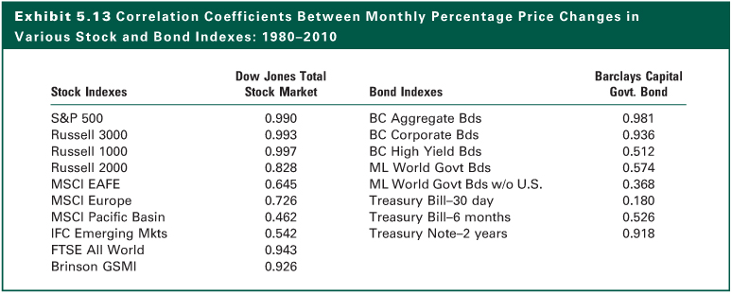
Exhibit 5.13

Slide 37
Comparison of Indexes Over Time
Mean Annual Security Returns and Risk
  There are clear differences among the series due to different asset classes (e.g., stocks vs. bonds) and different samples within asset classes
  There is a positive relationship between the average rate of return on an asset and its measure of risk
  The security market indexes can be used
    To measure the historical performance of an asset class
    As benchmarks to evaluate the performance of a money manager for a mutual fund, a personal trust, or a pension plan

Slide 38
The Internet Investments Online
http://www.bloomberg.com
http://barra.com
http://msci.com
https://ecommerce.barcap.com/indices/
http://www.barcap.com
http://datastream.com/product/investor/index.html
http://www.dir.co.jp/InfoManage/dbi/menu.html

