Slide 1
Amartya Sen
Development as Freedom
Thorn Pitidol
EE468
Semester 2/2018

Slide 2
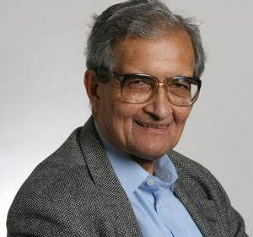
Amartya Sen
Background
  Born in Dhaka (Back then still India)
  Childhood experiences in famine and sectoral conflicts
  Educated in India and Cambridge
  Held positions at Dheli School of Economics, LSE, Oxford, Cambridge, and is now at Harvard
  Won Nobel prize in economics in 1998
  But works pervades wide range of disciplines, ranging from economics, philosophy, political science, etic.

Slide 3
Development as Freedom
What is “good life”?
What is “development”?

Slide 4
Development as Freedom
What is “development”?
  Development as a process of expanding the real freedom that people enjoy
  Expanding the consideration from a narrow view of economic development (focusing on raising income).
    Income becomes just an instrument to expand freedom

Slide 5
Development as Freedom
Development as the expansion of freedom
  Types of “unfreedom”
    (Economic) restriction of equal access to markets, (politics) restrictions in political rights, (social) lack of access to education and health care.
  Development is a holistic process of expanding different types of freedoms
    Not about trading-off
    Political, social, and economic development are all dimensions of development.

Slide 6
Development as Freedom
Freedom as means and ends of development
  Three roles of freedom
    Constitutive role: freedom as having an intrinsic value
    Instrumental role: freedom as an instrument in achieving ends, this also include that of interrelation between freedoms
    Constructive role: freedom as essential in the process of value formation
  Taking development as freedom for evaluative and effectiveness reasons

Slide 7
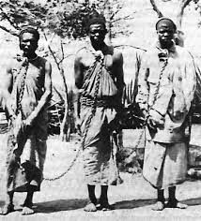
Freedoms as Constitutive to Development
The low life-expectancy of African American in the US
“Market” as freedom to engage in transaction.
  The “slave” example

Slide 8
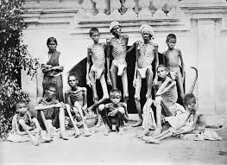
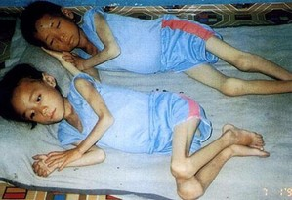
Complementarities of Freedoms
Different types of freedom also complement each other
  Political rights and famine prevention

Slide 9
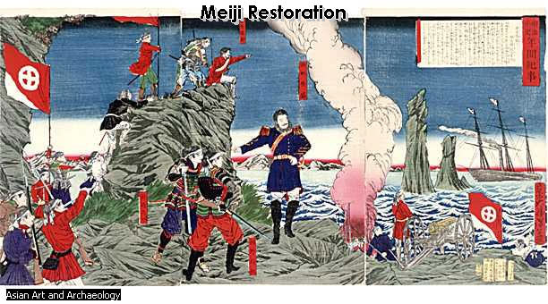
Complementarities of Freedoms
Different types of freedom also complement each other
  Education/health care and growth
    The East Asia example

Slide 10
Constructive Roles of Freedom
Value formation process
  Deciding about objectives of development
Scrutinizing ideas&choices, and the force of traditions
Also about encouraging “human-agency”
  Development not about solving “patients’ problems”

Slide 11
Development as Freedom
The capability approach
  Capability is a set of valued functionings
    Functionings = what one reasonably values in life
    Capability set = the ability to achieve what one values in life
Capability approach is pluralist in nature
  Difficulty at the societal level lies in the exercise of weighting, valuation of different capability to promote

Slide 12
Development as Freedom
Application of development as freedom
  Poverty as capability deprivation
    Poverty as a multi-dimensional phenomena
  Can also expand the consideration of inequality to other variables (not just income but also for things as political rights).

Slide 13
Development as Freedom
Application of development as freedom
  Capability set to be decided by each society
    Deliberation and use of public reason
  Sen’s capability approach different from others who prefers using the role of “experts” more

Slide 14
Development as Freedom
Some questions to ponder
  How is the “freedom” perspective helpful?
  Aren’t the “trade-offs” more legitimate?
  How to resolve conflict between
    Utilitarianism VS Libertarianism
    Equality of Resources VS Equality of Opportunity
  How to select “capability”

