Slide 1
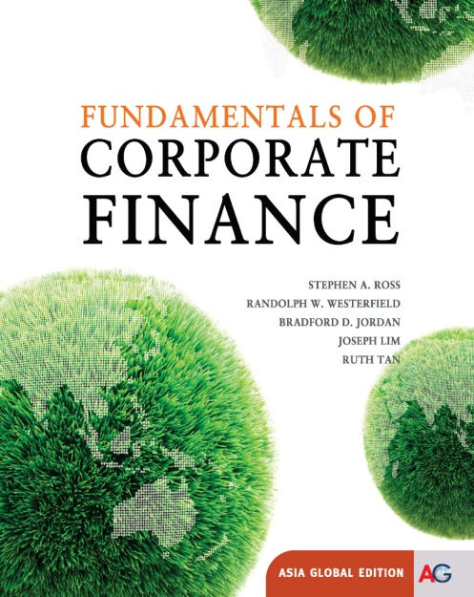
Chapter 16
Financial Leverage and Capital Structure Policy
Copyright © 2012 by McGraw-Hill Education (Asia). All rights reserved.
McGraw-Hill/Irwin

Slide 2
Key Concepts and Skills
16-1
Understand the effect of financial leverage on cash flows and the cost of equity
Understand the impact of taxes and bankruptcy on capital structure choice
Understand the basic components of the bankruptcy process

Slide 3
Chapter Outline
The Capital Structure Question
The Effect of Financial Leverage
Capital Structure and the Cost of Equity Capital
M&M Propositions I and II with Corporate Taxes
Bankruptcy Costs
Optimal Capital Structure
The Pie Again
The Pecking-Order Theory
Observed Capital Structures
A Quick Look at the Bankruptcy Process
16-2

Slide 4
Capital Restructuring
We are going to look at how changes in capital structure affect the value of the firm, all else equal
Capital restructuring involves changing the amount of leverage a firm has without changing the firm’s assets
The firm can increase leverage by issuing debt and repurchasing outstanding shares
The firm can decrease leverage by issuing new shares and retiring outstanding debt
16-3

Slide 5
Choosing a Capital Structure
What is the primary goal of financial managers?
  Maximize stockholder wealth
We want to choose the capital structure that will maximize stockholder wealth
We can maximize stockholder wealth by maximizing the value of the firm or minimizing the WACC
16-4
Notes:
Remind students that the WACC is the appropriate discount rate for the risk of the firm’s assets. We can find the value of the firm by discounting the firm’s expected future cash flows at the discount rate – the process is the same as finding the value of anything else. Since value and discount rate move in opposite directions, firm value will be maximized when WACC is minimized. Remind students that a firm is just a portfolio of projects, some with positive NPVs and some with negative NPVs when evaluated at the WACC. The value of the firm is the sum of the NPVs of its component projects. We already know that lower discount rates increase NPVs; consequently, decreasing the WACC will increase firm value.

Slide 6
The Effect of Leverage
How does leverage affect the EPS and ROE of a firm?
When we increase the amount of debt financing, we increase the fixed interest expense
If we have a really good year, then we pay our fixed cost and we have more left over for our stockholders
If we have a really bad year, we still have to pay our fixed costs and we have less left over for our stockholders
Leverage amplifies the variation in both EPS and ROE
16-5
Notes:
Remind the students that if we increase the amount of debt in a restructuring, we are implicitly decreasing the amount of outstanding shares.

Slide 7
Example: Financial Leverage, EPS and ROE – Part I
We will ignore the effect of taxes at this stage
What happens to EPS and ROE when we issue debt and buy back shares of stock?
16-6
Notes:
Click on the Excel icon to go to a spreadsheet that contains all of the information for the example presented in the instructors manual.

Slide 8
Example: Financial Leverage, EPS and ROE – Part II
Variability in ROE
  Current: ROE ranges from 6.25% to 18.75%
  Proposed: ROE ranges from 2.50% to 27.50%
Variability in EPS
  Current: EPS ranges from $1.25 to $3.75
  Proposed: EPS ranges from $0.50 to $5.50
The variability in both ROE and EPS increases when financial leverage is increased
16-7
Notes:
Lecture Tip: You may wish to provide the following example to better solidify the students’ understanding of the variability in ROE due to leverage. Ask the class to consider the difference between ROE and ROA for an all equity firm given various sales levels. It’s easy to show that ROE = ROA in this case because total equity = total assets. The substitution of debt for equity will cause ROE and ROA to be different. The lower number of common shares outstanding cause ROE to change by a larger percentage than the change in ROA, for any given change in sales.
Mathematically and ignoring tax,
EPS = (EBIT - Int) / number of shares
ROE = (EBIT – Int) / Total Equity
For a levered firm, interest expense >0 and number of shares is lower so any increase (decrease) in EBIT will cause a larger change in EPS and ROE because it is spread over fewer shares.

Slide 10
Example: Homemade Leverage
Current Capital Structure
Investor borrows $2000 and uses $2000 of her own to buy 200 shares of stock
Payoffs:
  Recession: 200(1.25) - .1(2000) = $50
  Expected: 200(2.50) - .1(2000) = $300
  Expansion: 200(3.75) - .1(2000) = $550
Mirrors the payoffs from purchasing 100 shares of the firm under the proposed capital structure
Proposed Capital Structure
Investor buys $2000 worth of stock (100 shares).
Payoffs:
  Recession: 100(.50) = $50
  Expected: 100(3.00) = $300
  Expansion: 100(5.50) = $550
16-9
Notes:
The exercise aims to show that the investor can attain the same payoffs as a levered firm by borrowing on his own.
Why?
The choice of capital structure is irrelevant if the investor can duplicate the cash flows on his own.
Note that both positions require an investment of $2000 of the investor’s money.
We are still ignoring taxes and transaction costs. If we factor in these market imperfections, then homemade leverage will not work quite as easily, but the general idea is the same.

Slide 11
Capital Structure Theory
Modigliani and Miller (M&M) Theory of Capital Structure
  Proposition I – firm value
  Proposition II – WACC
The value of the firm is determined by the cash flows to the firm and the risk of the assets
Changing firm value
  Change the risk of the cash flows
  Change the cash flows
16-10

Slide 12
Capital Structure Theory Under Three Special Cases
Case I
  No corporate or personal taxes
  No bankruptcy costs
Case II
  Corporate taxes, but no personal taxes
  No bankruptcy costs
Case III
  Corporate taxes, but no personal taxes
  Bankruptcy costs
16-11

Slide 13
Case I – Propositions I and II
Proposition I
  The value of the firm is NOT affected by changes in the capital structure
  The cash flows of the firm do not change; therefore, value doesn’t change
Proposition II
  The WACC of the firm is NOT affected by capital structure
16-12
Notes:
The main point with case I is that it doesn’t matter how we divide our cash flows between our stockholders and bondholders, the cash flow of the firm doesn’t change.
Since the cash flows don’t change; and we haven’t changed the risk of existing cash flows, the value of the firm won’t change.

Slide 14
Case I - Equations
WACC = R_{A} = (E/V)R_{E} + (D/V)R_{D}
Rearranging the above gives
R_{E} = R_{A} + (R_{A} – R_{D})(D/E)
  R_{A} is the “cost” of the firm’s business risk, i.e., the risk of the firm’s assets
  (R_{A} – R_{D})(D/E) is the “cost” of the firm’s financial risk, i.e., the additional return required by stockholders to compensate for the risk of leverage
16-13
Notes:
Remind students that Case I is a world without taxes. That is why the term (1 – T_{C}) is not included in the WACC equation.
As more debt is used, the return on equity increases, but the change in the proportion of debt versus equity just offsets that increase and the WACC does not change.
Lecture Tip: Many students wonder why we are even considering a situation in which taxes do not exist. We are trying to determine what risk-return trade-off is best for the firm’s stockholders. One way to get a good understanding of what is relevant to the capital structure decision is to start in a “perfect” world and then relax assumptions as we go. By relaxing one assumption at a time, we can get a better idea of the impact on the capital structure decision. This is the classic process of “model building” in economics – start simple and add complexity one step at a time.
Lecture Tip: According to Proposition II, R_{E} = R_{A} + (R_{A} – R_{D})(D/E). An alternative explanation is as follows: In the absence of debt, the required return on equity equals the return on the firm’s assets, R_{A}. As we add debt, we increase the variability of cash flows available to stockholders, thereby increasing stockholder risk. This is a good time to remind students that investors are risk averse and require a higher return for higher risk (as defined by the possibility that return deviates from expectation whether positively or negatively).

Slide 15
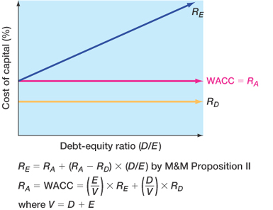
Figure 16.3
16-14
Notes:
It is good to explicitly point out why MM Proposition 1 implies that R_{wacc} stays constant. Since a levered firm has the same value as an unlevered firm and there is no change in the cash flows, it must follow that the discount rate is the same.
In addition, R_{wacc} stays constant as any increase in R_{e} due to leverage is exactly offset by the increase in the weight of debt. This is not true in the presence of tax because of the lower after-tax cost of debt.

Slide 16
Case I - Example
Data
  Required return on assets = 16%; cost of debt = 10%; percent of debt = 45%
What is the cost of equity?
  R_{E} = 16 + (16 - 10)(.45/.55) = 20.91%
Suppose instead that the cost of equity is 25%, what is the debt-to-equity ratio?
  25 = 16 + (16 - 10)(D/E)
  D/E = (25 - 16) / (16 - 10) = 3/2 =1.5
Based on this information, what is the percent of equity in the firm?
  E/V = 2 / 5 = 40%
16-15
Notes:
Remind students that if the firm is financed with 45% debt, then it is financed with 55% equity.
The second question is used to reinforce that R_{A} does not change when the capital structure changes
Many students do not immediately see how to get the % of equity from the D/E ratio. Remind them that D+E = V. We are looking at ratios, so the actual dollar amount of D and E is not important. All that matters is the relationship between them. So if D/E = 3/2 ➔ D is 3 parts, E is 2 parts, V = 3 + 2 = 5 parts. Thus E/V = 2/5 = 40%.

Slide 17
The CAPM, the SML and Proposition II
How does financial leverage affect systematic risk?
CAPM: R_{A} = R_{f} + β_{A}(R_{M} – R_{f})
  Where β_{A} is the firm’s asset beta and measures the systematic risk of the firm’s assets
Proposition II
  R_{E} = R_{A} + (R_{A} – R_{D})(D/E)
  Replace R_{A} with the CAPM above and assume that the debt is riskless (R_{D} = R_{f}) gives
  R_{E} = R_{f} + β_{A}(1+D/E)(R_{M} – R_{f})
16-16
Notes:
Intuitively, an increase in financial leverage should increase systematic risk since changes in interest rates are a systematic risk factor and will have more impact the higher the financial leverage.
The assumption that debt is riskless is for simplicity and to illustrate that even if debt is default risk-free, it still increases the variability of cash flows to the stockholders, and thus increases the systematic risk.

Slide 18
Business Risk and
Financial Risk
16-17
R_{E} = R_{f} + β_{A}(1+D/E)(R_{M} – R_{f})
CAPM: R_{E} = R_{f} + β_{E}(R_{M} – R_{f})
  β_{E} = β_{A}(1 + D/E)
Therefore, the systematic risk of the stock depends on:
  Systematic risk of the assets, β_{A} (business risk)
  Level of leverage, D/E (financial risk)
Notes:
Point out once again that this result assumes that the debt is risk-free. The effect of leverage on financial risk will be even greater if the debt is not default free.

Slide 19
Case II – Cash Flow
16-18
Interest is tax deductible
Therefore, when a firm adds debt, it reduces taxes, all else equal
The reduction in taxes increases the cash flow of the firm
How should an increase in cash flows affect the value of the firm?
Notes:
Point out that the government effectively pays part of our interest expense for us; it is subsidizing a portion of the interest payment.

Slide 20
Case II - Example
 | Unlevered Firm | Levered Firm
EBIT | 1,000 | 1,000
Interest | 0 | 80
Taxable Income | 1,000 | 920
Taxes (30%) | 300 | 276
Net Income | 700 | 644
Cash Flow From Assets | 700 | 724
16-19
Notes:
We are comparing a levered and an unlevered firm that have the same assets and EBIT. The only difference between the two firms is their capital structure.
The levered firm has $1,000 in 8% debt, so the interest expense = .08($1,000) = $80
Cash Flow From Assets (CFFA) = EBIT – taxes
Depreciation expense is the same in either case, so it will not affect CFFA on an incremental basis.

Slide 21
Interest Tax Shield
Annual interest tax shield
  Tax rate times interest payment
  $1,000 in 8% debt = $80 in interest expense
  Annual tax shield = .30($80) = $24
Present value of annual interest tax shield
  Assume perpetual debt for simplicity
  PV = $24 / .08 = $300
  PV = D(R_{D})(T_{C}) / R_{D} = DT_{C} = $1,000(.30) = $300
16-20
Notes:
For an unlevered firm, CFFA = EBIT (1-T)
For a levered firm, CFFA = (EBIT – Int) (1-T) + Int = EBIT (1-T) + Int (T)
Point out that the increase in cash flow in the example is equal to the interest tax shield every period.
The assumption of perpetual debt makes the equation easier to work with, but it is useful to ask the students what would happen if we did not assume perpetual debt.

Slide 22
Case II – Proposition I
The value of the firm increases by the present value of the annual interest tax shield
  Value of a levered firm = value of an unlevered firm + PV of interest tax shield
  Value of equity = Value of the levered firm – Value of debt
Assuming perpetual cash flows
  V_{U} = EBIT(1-T) / R_{U}
  V_{L} = V_{U} + DT_{C}
16-21
Notes:
R_{U} is the cost of capital for an unlevered firm = R_{A} for an unlevered firm
V_{U} is the PV of the expected future cash flow from assets for an unlevered firm.

Slide 23
Example: Case II – Proposition I
16-22
Data
  EBIT = $1,000; Tax rate = 30%; Debt = $1,000; Cost of debt = 8%; Unlevered cost of capital = 10%
V_{U} = 1,000(1-.30) / .10 = $7,000
  V_{L} = V_{U} +DT_{C} = $7,000 + 0.30 x 1,000 = $7,300
E = $7,300 - $1,000 = $6,300

Slide 24
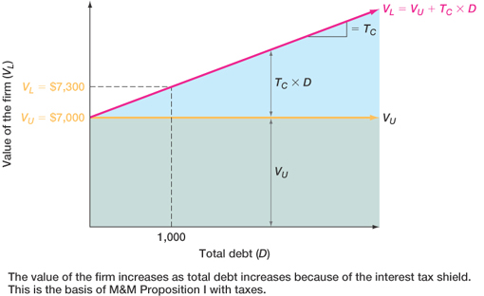
Figure 16.4
16-23

Slide 25
Case II – Proposition II
The WACC decreases as D/E increases because of the government subsidy on interest payments
  R_{A} = (E/V)R_{E} + (D/V)(R_{D})(1 – T_{C})
  R_{E} = R_{U} + (R_{U} – R_{D})(D/E)(1 – T_{C})
Example
  R_{E} = 10 + (10-8)(1,000/6,300)(1 –.30) = 10.22%
  R_{A} = (6,300/7,300)(10.22) + (1,000/7,300)(8)(1 –.30)
  R_{A} = 9.6%
16-24

Slide 26
Example: Case II –
Proposition II
Suppose that the firm changes its capital structure so that the debt-to-equity ratio becomes 1.
What will happen to the cost of equity under the new capital structure?
  R_{E} = R_{U} + (R_{U} – R_{D})(D/E)(1 – T_{C})
  R_{E} = 10 + (10 – 8)(1)(1 – .30) = 11.4%
What will happen to the weighted average cost of capital?
  R_{A} = (E/V)R_{E} + (D/V)(R_{D})(1 – T_{C})
  R_{A} = .5(11.4) + .5(8)(1 – .30) = 8.5%
16-25
Notes:
Remind students that a D/E ratio = 1 implies 50% equity and 50% debt.
The amount of leverage in the firm increased, so the cost of equity increased. But, the overall cost of capital decreased.

Slide 27
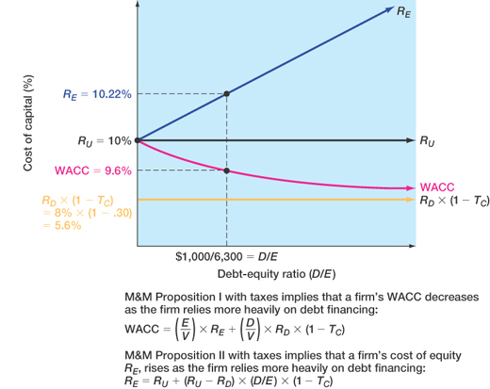
Figure 16.5
16-26

Slide 28
Case III
Now we add bankruptcy costs
As the D/E ratio increases, the probability of bankruptcy increases
This increased probability will increase the expected bankruptcy costs
At some point, the additional value of the interest tax shield will be offset by the increase in expected bankruptcy cost
At this point, the value of the firm will start to decrease, and the WACC will start to increase as more debt is added
16-27
Notes:
Note that we are talking about “expected” in a statistical sense.
If the firm goes bankrupt, it will incur a certain level of costs.
If the firm is all equity, then the expected bankruptcy cost is 0 since the probability of bankruptcy is 0. Why? By definition, bankruptcy occurs when a firm is unable to pay off its debts.
As the firm adds debt, the probability of incurring the bankruptcy costs increases, and thus the expected bankruptcy cost increases.

Slide 29
Bankruptcy Costs
Direct costs
  Legal and administrative costs
  Ultimately cause bondholders to incur additional losses
  Disincentive to debt financing
Financial distress
  Significant problems in meeting debt obligations
  Firms that experience financial distress do not necessarily file for bankruptcy
16-28
Notes:
Real-World Tip: In 1997, the remaining assets of Fruehauf Corporation, described by Barrons as “the once-dominant” manufacturer of truck trailers, were sold off for a mere $50 million, bringing an end to the story of a great firm laid low by over-reliance on debt financing. More on this case is provided in the IM.

Slide 30
More Bankruptcy Costs
Indirect bankruptcy costs
  Larger than direct costs, but more difficult to measure and estimate
  Stockholders want to avoid a formal bankruptcy filing
  Bondholders want to keep existing assets intact so they can at least receive that money
  Assets lose value as management spends time worrying about avoiding bankruptcy instead of running the business
  The firm may also lose sales, experience interrupted operations and lose valuable employees
16-29

Slide 31
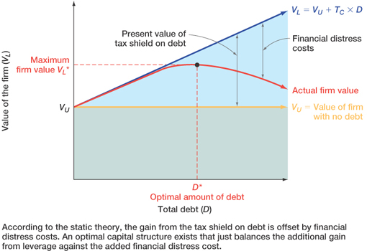
Figure 16.6
16-30

Slide 32
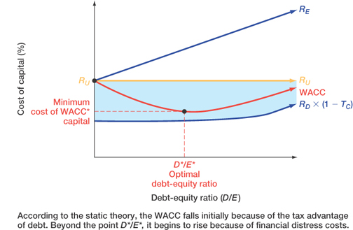
Figure 16.7
16-31

Slide 33
Conclusions
Case I – no taxes or bankruptcy costs
  No optimal capital structure
Case II – corporate taxes but no bankruptcy costs
  Optimal capital structure is almost 100% debt
  Each additional dollar of debt increases the cash flow of the firm
Case III – corporate taxes and bankruptcy costs
  Optimal capital structure is part debt and part equity
  Occurs where the benefit from an additional dollar of debt is just offset by the increase in expected bankruptcy costs
16-32

Slide 34
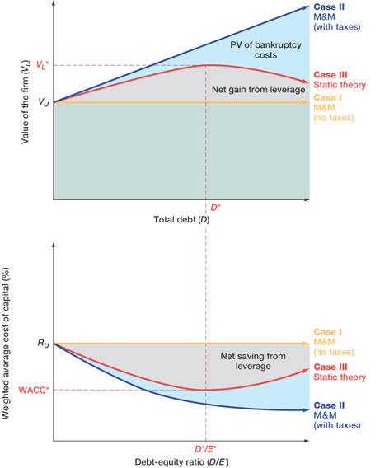
Figure 16.8
16-33

Slide 35
Managerial Recommendations
The tax benefit is only important if the firm has a large tax liability
Risk of financial distress
  The greater the risk of financial distress, the less debt will be optimal for the firm
  The cost of financial distress varies across firms and industries, and as a manager you need to understand the cost for your industry
16-34
Notes:
International Note: In theory, the static model of capital structure described in this section applies to multinational firms as well as to domestic firms. The multinational firm should seek to minimize its global cost of capital by balancing the debt-related tax shields across all of the countries in which the firm does business against global agency and bankruptcy costs. However, this assumes that worldwide capital markets are well-integrated and that foreign exchange markets are highly efficient. In such an environment, financial managers would seek the optimal global capital structure. In practice, of course, the existence of capital market segmentation, differential taxes, and regulatory frictions make the determination of the global optimum much more difficult than the theory would suggest.

Slide 36
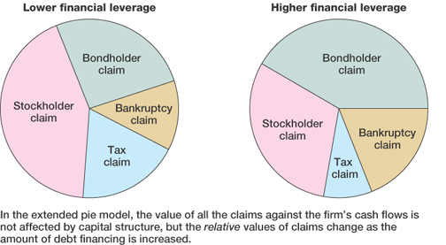
Figure 16.9
16-35

Slide 37
The Value of the Firm
16-36
Value of the firm = marketed claims + nonmarketed claims
  Marketed claims are the claims of stockholders and bondholders
  Nonmarketed claims are the claims of the government and other potential stakeholders
The overall value of the firm is unaffected by changes in capital structure
The division of value between marketed claims and nonmarketed claims may be impacted by capital structure decisions

Slide 38
The Pecking-Order Theory
Theory stating that firms prefer to issue debt rather than equity if internal financing is insufficient.
  Rule 1
    Use internal financing first
  Rule 2
    Issue debt next, new equity last
The pecking-order theory is at odds with the tradeoff theory:
  There is no target D/E ratio
  Profitable firms use less debt
  Companies like financial slack
16-37

Slide 39
Observed Capital Structure
16-38
Capital structure does differ by industry
Differences according to reuters.com as of August 2011
  Lowest levels of debt
    Petroleum refining with 15% debt
    Drugs with 15% debt
  Highest levels of debt
    Airlines with 66% debt
    Paper with 57% debt
Notes:
See Table 16.7 in the book for more detail

Slide 40
Work the Web Example
16-39
You can find information about a company’s capital structure relative to its industry, sector and the S&P 500 at Reuters
Go to www.reuters.com
  Choose a company and get a quote
  Choose Ratio Comparisons
  http://www.reuters.com/finance/stocks/financialHighlights?symbol=AAPL.O

Slide 41
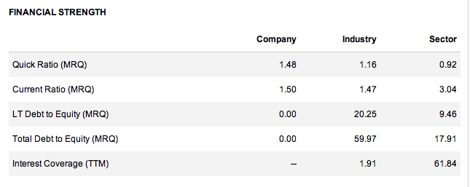
Apple, Inc (AAPL)
Info from Reuters

Slide 42
Bankruptcy Process – Part I
16-41
Business failure – business has terminated with a loss to creditors
Legal bankruptcy – petition federal court for bankruptcy
Technical insolvency – firm is unable to meet debt obligations
Accounting insolvency – book value of equity is negative

Slide 43
Bankruptcy Process – Part II
16-42
Liquidation
  Chapter 7 of the Federal Bankruptcy Reform Act of 1978
  Trustee takes over assets, sells them and distributes the proceeds according to the absolute priority rule
Reorganization
  Chapter 11 of the Federal Bankruptcy Reform Act of 1978
  Restructure the corporation with a provision to repay creditors
Notes:
Lecture Tip: It has been said that Carl Icahn’s takeover of TWA in the early 1980s represents the quintessential example of the “80s two-step” – borrow extensively to take the firm private, then file for bankruptcy. Icahn, one of the most noted takeover artists of the period, was not as successful at running TWA as he had been with some of his other businesses. Following repeated losses, he sold the firm to the employees, who struggled mightily to put the firm back on its feet. Nonetheless, TWA filed for bankruptcy reorganization in 1992 and again in 1995. In each case, a portion of firm ownership was transferred from the owners to the creditors in return for the latter’s willingness to eliminate a portion of the outstanding debt.

Slide 44
Quick Quiz
Explain the effect of leverage on EPS and ROE
What is the break-even EBIT and how do we compute it?
How do we determine the optimal capital structure?
What is the optimal capital structure in the three cases that were discussed in this chapter?
What is the difference between liquidation and reorganization?
16-43

Slide 45
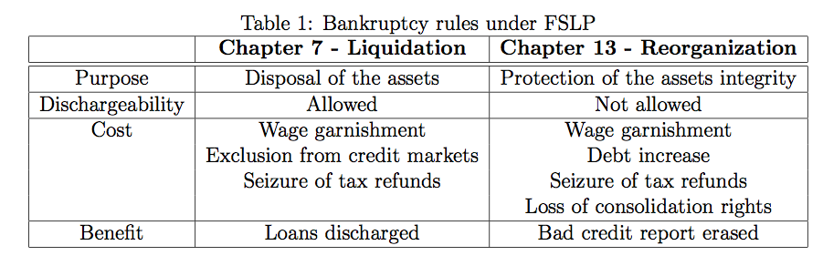

Slide 46
Ethics Issues
Suppose managers of a firm know that the company is approaching financial distress.
  Should the managers borrow from creditors and issue a large one-time dividend to shareholders?
  How might creditors control this potential transfer of wealth?
16-45
Notes:
Managers may do that.
Use positive and/or negative covenants. For example, the firm may not pledge any of its assets to other lenders. Limitations are placed on the amount of dividends the company may pay.

Slide 47
Comprehensive Problem
16-46
Assuming perpetual cash flows in Case II - Proposition I, what is the value of the equity for a firm with EBIT = $50 million, Tax rate = 40%, Debt = $100 million, cost of debt = 9%, and unlevered cost of capital = 12%?
Notes:
V_{U} = $50 million (1 - .4) / .12 = $250 million
V_{L} = $250 million + $100 million (.4) = $290 million
E = V_{L} – Debt = $290 million - $100 million = $190 million

Slide 48
End of Chapter
16-47

