Slide 1

Chapter 8: Homework

Slide 2

Group Homework
Group Homework #1: Chapter Presentations
1.Each group will be assigned 2 cases/class
& presented in the following class.
2. You are allowed on more than 3 page ppt slides, and 7 minutes presentation for each case
3. Contents should include :Summary of case and answers, suggestions etc.
4. After each presentation, we will have class discussion therefore everyone should read the cases before coming to class.
Notes:
1

Slide 3

Chapter Presentation 8.1
Page 210
Due July 5th
Notes:
1

Slide 4
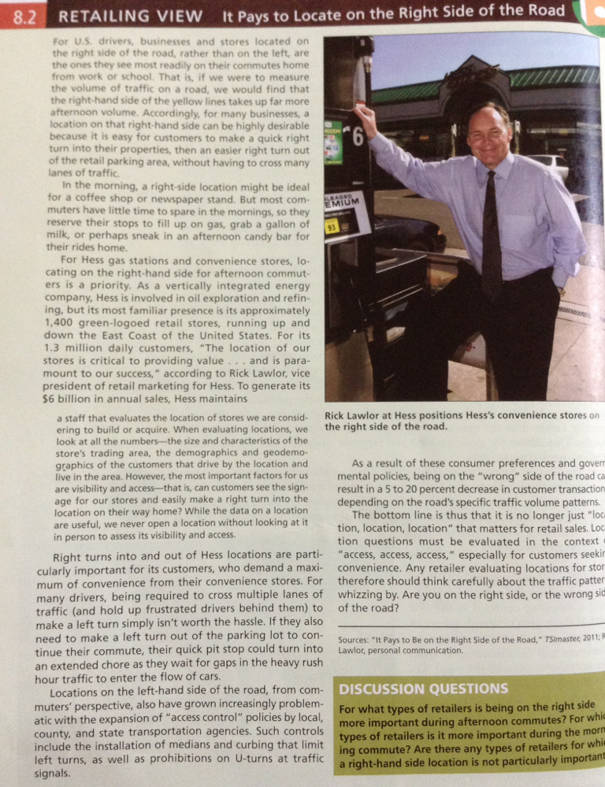
Chapter Presentation 8.2
Page 214
Due July 5th
Notes:
1

Slide 5


