Slide 1

MK 322 Retail Management
Chapter 4: Consumer Buying Behavior Part II
By Ajarn Suwalya K.

Slide 2

Types of Buying Decisions

Slide 3
Extended Problem Solving
Extended problem solving: is a purchase decision process in which customers devote considerable time to analyze their alternatives
Customers typically engage in extended problem solving when the purchase decision involves a lot of risks and uncertainty
Notes:
1

Slide 4
Extended Problem Solving
Financial risks: arise when customers purchase an expensive product or service
Physical risks:are important when customers feel that a product or service may affect their health and safety
Social risks: arise when customers believe a product will affect how others view them.
Lasik eye surgery is good example of 3 risks
Notes:
1

Slide 5

Extended Problem Solving
Notes:
1

Slide 6
Limited Problem Solving
Limited Problem Solving: is a purchase decision process involving a moderate amount of effort and time
Customers engage in this buying behavior if they have some prior experience about product and experience and their risk is moderate
Notes:
1

Slide 7
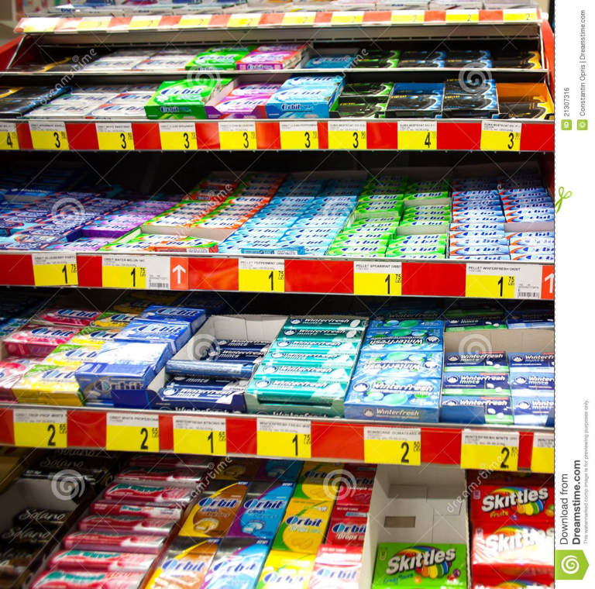
Limited Problem Solving
Impulse buying or unplanned purchasing: which is a buying decision made by customers on the spot after seeing the merchandising
Notes:
1

Slide 8
Habitual Decision Making
Habitual decision making: is a purchase decision involving little or no conscious effort
Brand Loyalty: means that customers like and consistently buy a specific brand in a product category. They are reluctant to switch
Retailer Loyalty: means that all customers like and habitually visit the same retailer to purchase a type of merchandise
Notes:
1

Slide 9

Social Factors Influencing Buying Behavior
The Economy
Notes:
1

Slide 10
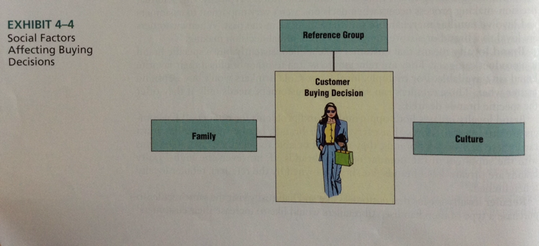
Social Factors Influencing Buying Behavior
Notes:
1

Slide 11
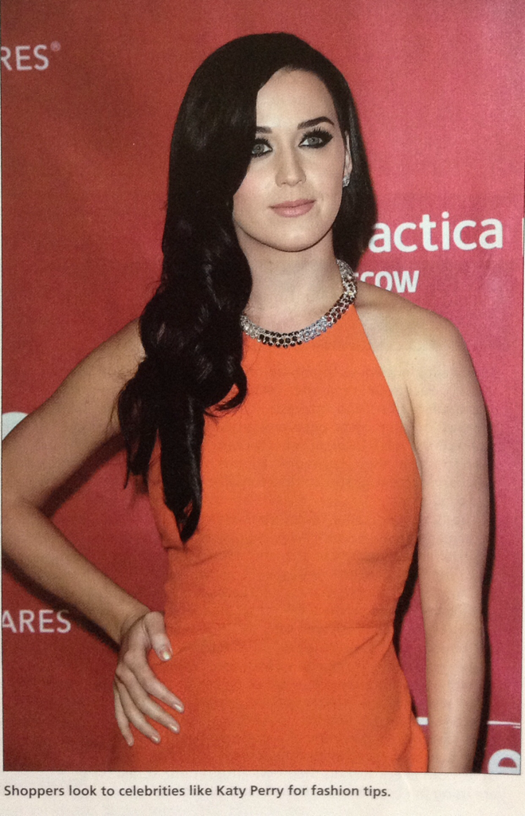
Social Factors Influencing Buying Behavior
Notes:
1

Slide 12
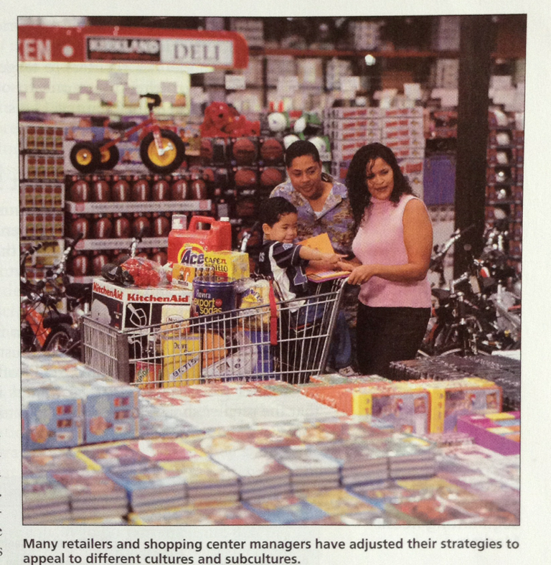
Social Factors Influencing Buying Behavior
Notes:
1

Slide 13

Notes:
1

Slide 14
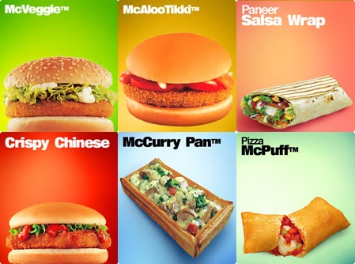
Notes:
1

Slide 15

Market Segmentation

Slide 16

Market Segmentation
A retail market segment: is a group of customers who attracted to the same retail mix because they have similar needs.
Notes:
1

Slide 17
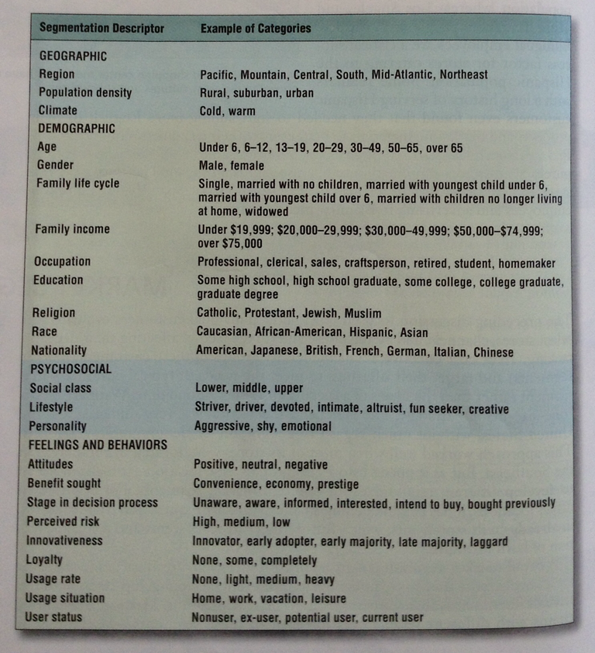
Approaches for Segmenting Markets
EXHIBIT 4-5
Methods for Segmenting Retail Markets
Notes:
1

Slide 18
Criteria for Evaluating Market Segments
Actionable: meet needs of the segment
Identifiable: customer target and size
Substantial: is it big enough
Reachable: retailer can target promotions and other elements of retail mix
Notes:
1

Slide 19
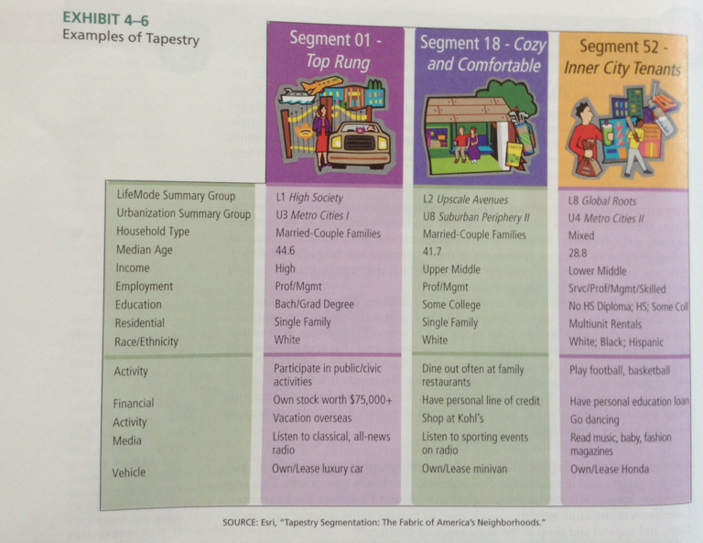
Approaches for Segmenting Markets
Notes:
1

Slide 20
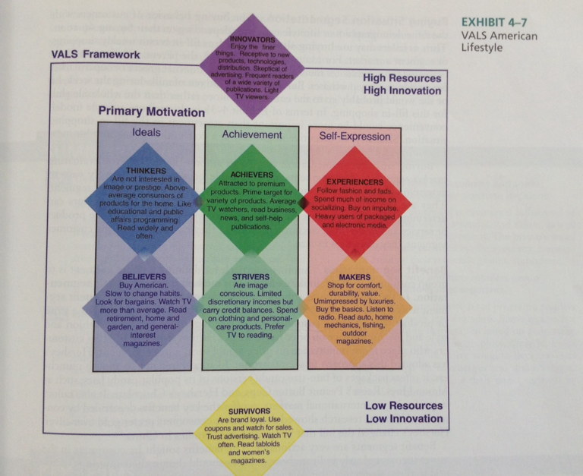
Approaches for Segmenting Markets
Notes:
1

Slide 21
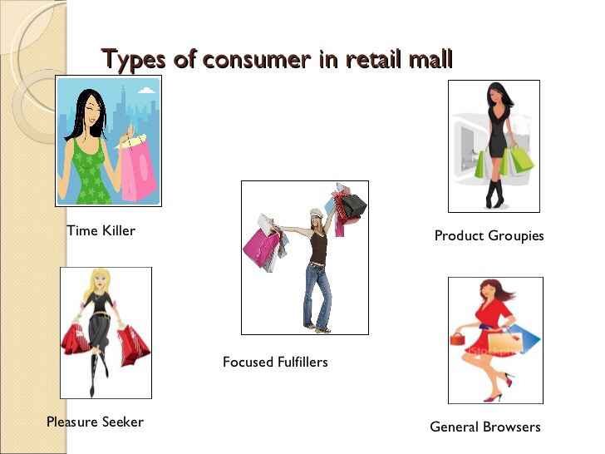
Approaches for Segmenting Markets
Notes:
1

Slide 22

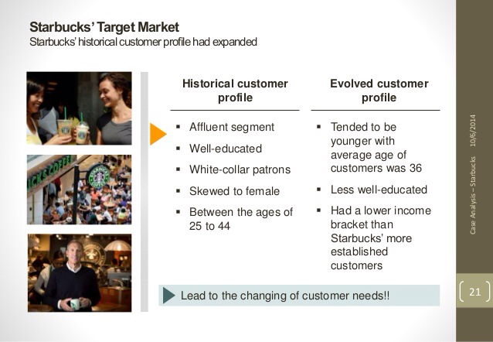
Approaches for Segmenting Markets
Notes:
1

Slide 23
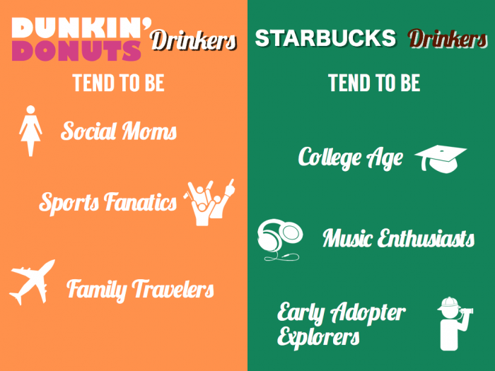
Approaches for Segmenting Markets
Notes:
1

Slide 24

Sawasdee Krub

