Slide 1

MK 322 Retail Management
Chapter 12: Managing the Merchandise Planning Process Part II
By Ajarn Suwalya K.

Slide 2

Forecasting Category Sales

Slide 3

Forecasting Staple Merchandise
Use of Historical Data- sales
Adjustments for Controllable and Uncontrollable Factors
Notes:
1

Slide 4
Forecasting Staple Merchandise
Controllable
Uncontrollable
Opening and closing of stores
Price set for merchandise in category
Special promotions for category
Pricing and promotions of complementary categories
Placement of merchandise categories in store
Weather
General economic conditions
Special Promotions
New Product introductions by vendors,
New product, pricing and promotion activities by competitors
Notes:
1

Slide 5
Forecasting Fashion Merchandise Categories
Challenging since need to place orders and commit to buying specific quantities between 3-6 months
No opportunity to increase or decrease quantity ordered before selling season has ended
Suppliers of popular merchandise usually have orders for for more merchandise than they can produce and excess inventory of unpopular items
Some or all items are new or different from the previous season
Notes:
1

Slide 6
Forecasting Fashion Merchandise Categories
Forecasting
Previous Sales Data
Market Research (In-depth interview or focus group)
Fashion Trend Services
Vendors - have proprietary information about their marketing plans, ie.new product launches, special promotions, etc.
Notes:
1

Slide 7

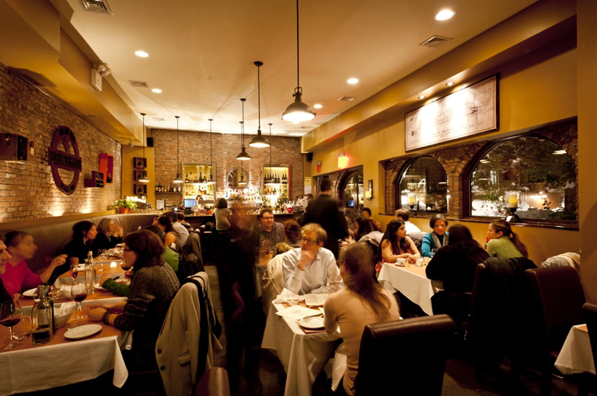
Sales Forecasting for Service Retailers
Perishable in nature is very challenging -events, concert
Match supply and demand by taking reservations and bookings
Ie. Restaurants, reservations help in staffing
Notes:
1

Slide 8
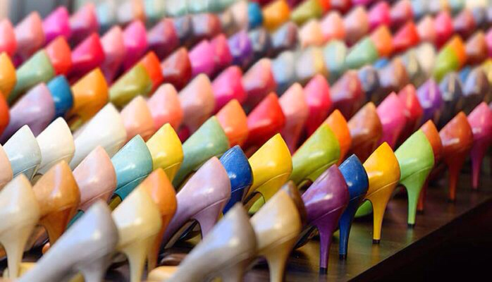
Developing an Assortment Plan

Slide 9
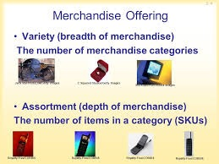
Category Variety and Assortment
Variety or breadth- is the number of different merchandising subcategories
Assortment or Depth – is the number of SKUs within a subcategory
Notes:
1

Slide 10
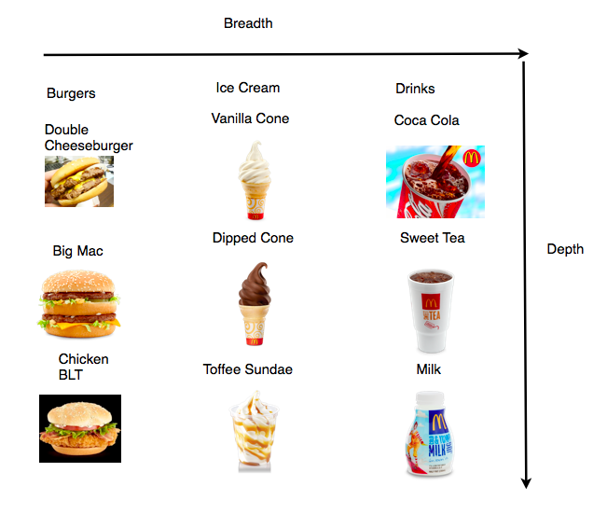
Category Variety and Assortment
Notes:
1

Slide 11
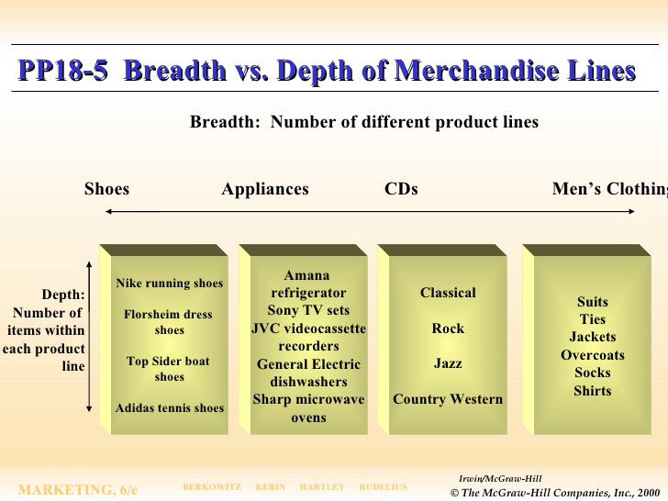
Category Variety and Assortment
Notes:
1

Slide 12
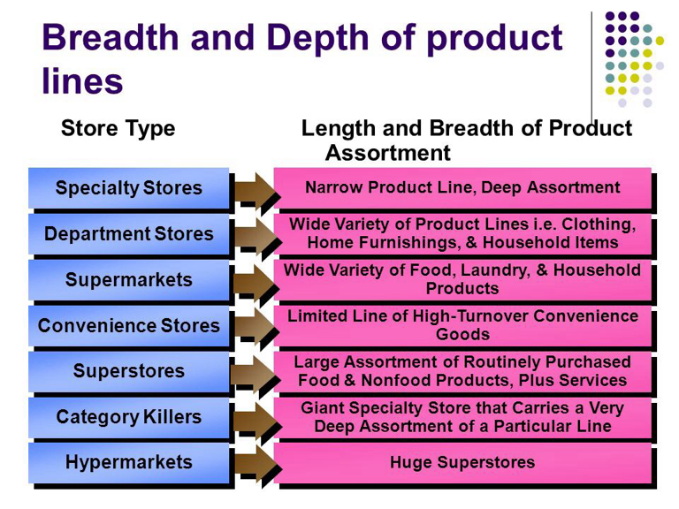
Category Variety and Assortment
Notes:
1

Slide 13

Determining Variety and Assortment
Editing the assortment is the process of determining the variety and assortment for a category
Notes:
1

Slide 14
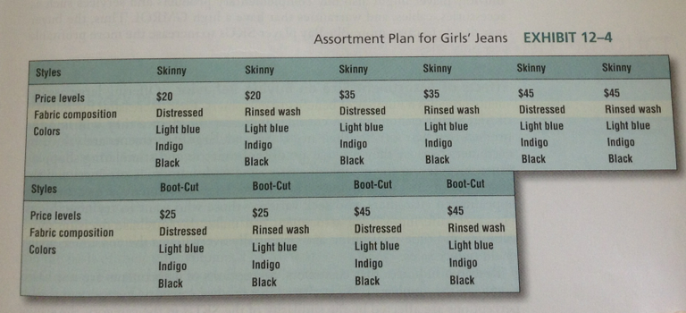
Determining Variety and Assortment
Notes:
1

Slide 15
Determining Variety and Assortment
Retail strategy- number of SKU
Assortments and GMROI
Complementary Merchandise – Blu-Ray player low GMROI, but may buy complementary products such as accessories, cables, etc
Effects of Assortment Size on buying behavior – increases chance of finding goods, valued by providing more informative and stimulated shopping experience, appealing for customers who seek variety
Notes:
1

Slide 16
Determining Variety and Assortment
Physical Characteristic of the store- need to consider how much space to devote to a category
More space for large assortments, SKUs
To display individual item ie.furniture
Multichannel retailers have space limitations, so they offer great assortment via internet or catelog channels
Notes:
1

Slide 17
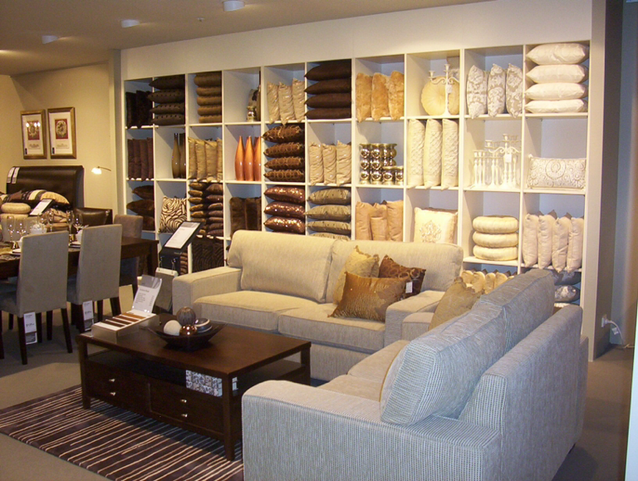
Determining Variety and Assortment
Notes:
1

Slide 18
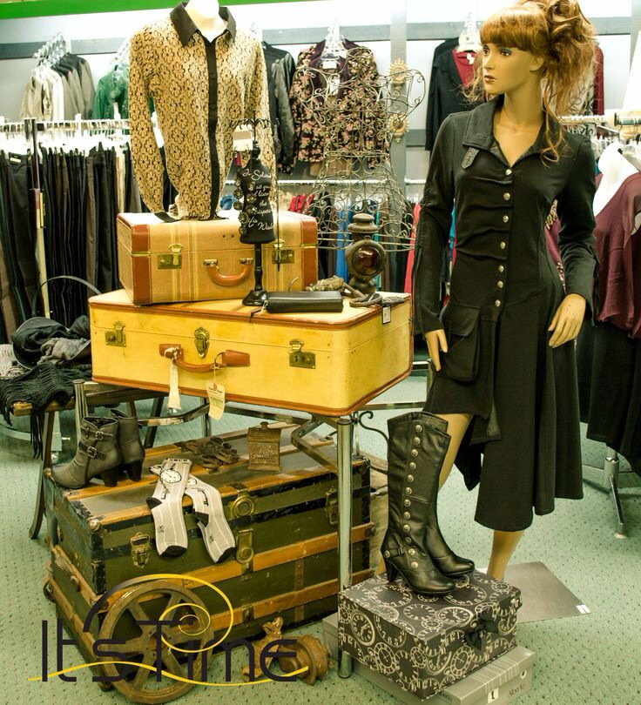
Determining Variety and Assortment
Notes:
1

Slide 19
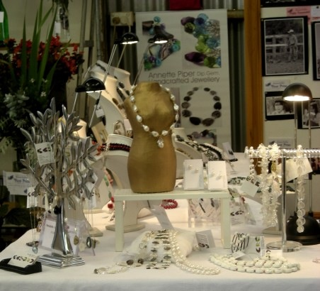
Determining Variety and Assortment
Notes:
1

Slide 20
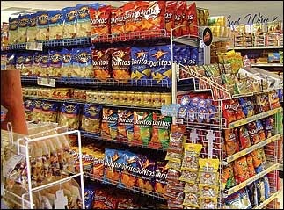
Setting Inventory and Product Availability Levels

Slide 21
Model Stock Plan
The model stock plan is the number of each SKU in the assortment plan the buyer wants to have available for purchase in each store
Retailers have model stock plans for different store sizes in a chain, classify their store as A,B, and C stores on basis of sales volume. C is stocked with basic assortment
Notes:
1

Slide 22
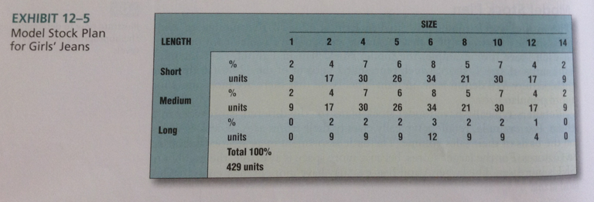
Model Stock Plan
Notes:
1

Slide 23
Product Availability
The number of units of backup stock, also called buffer or safety stock in the model stock determines product availability
Product Availability is defined as the percentage of the demand for a particular SKU that is satisfied – also called level of support or service level
Notes:
1

Slide 24
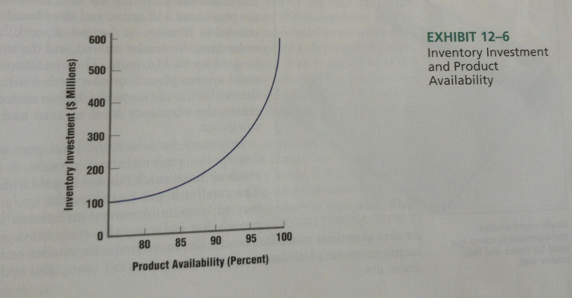
Product Availability
Notes:
1

Slide 25
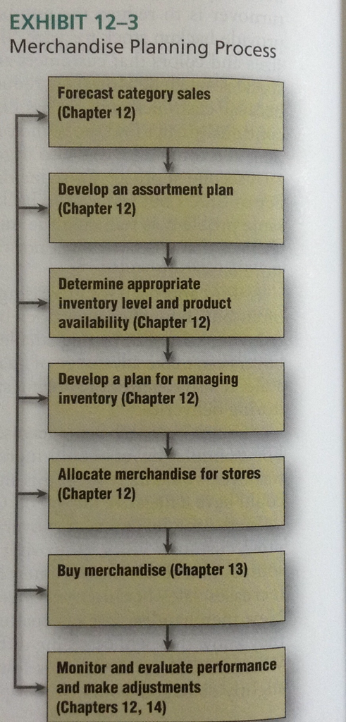
Merchandise Planning Process
Notes:
1

Slide 26


