Slide 1
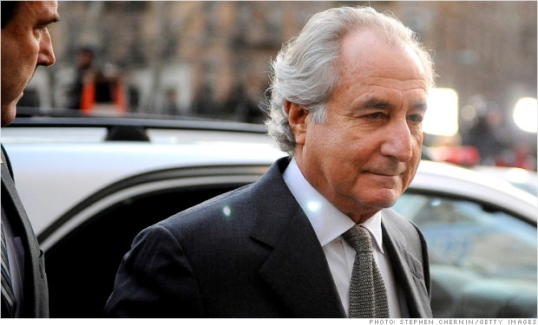
The Case of Bernard Madoff and
The Ponzi Scheme

Slide 2
Agenda of this Presentation
The Case of Bernard Madoff
Ponzi Scheme
The Cause of the Problem
Impact and Aftermath
Critique of the case study
The way to revert the situation

Slide 3
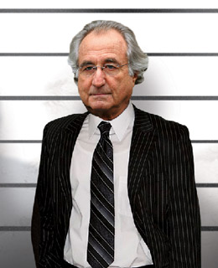
The Case of Bernard Madoff
Bernard Lawrence "Bernie" Madoff
is an American convicted of fraud and a former stockbroker, investment advisor, and financier. He is the former non-executive chairman of the NASDAQ stock market and the admitted operator of a Ponzi scheme that is considered to be the largest financial fraud in U.S. history.

Slide 4
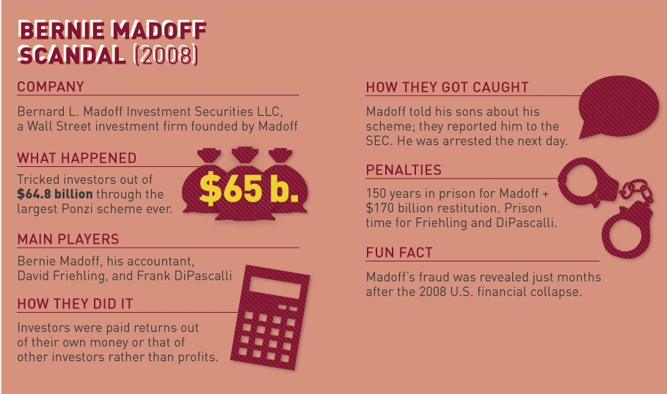
The Case of Bernard Madoff

Slide 5
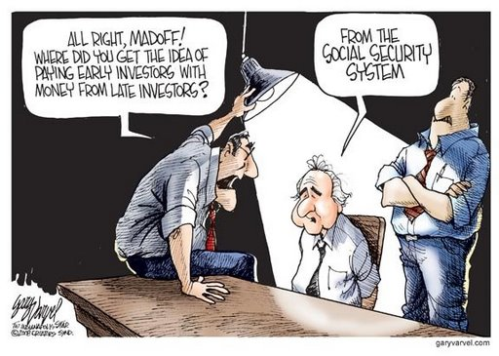
The Ponzi Scheme
A Ponzi scheme is a fraudulent investment operation that pays return to its investor from their own money or the money paid by subsequence investor rather than profit earned by the organization
Offering investment products with extreme high return in investments that actually don’t exist.

Slide 6
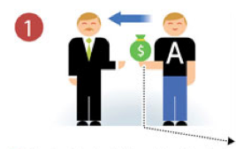
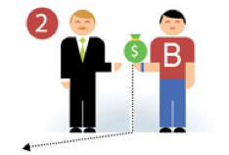

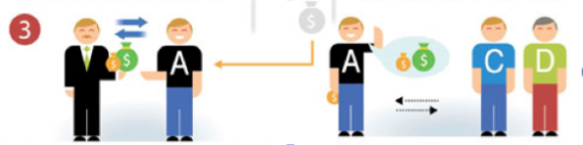
The Ponzi Scheme
They don’t invest the money, but pay the promised return with the investors own money.
The money of new investor is being used to pay the old investor.

Slide 7
The Ponzi Scheme
Key element of Ponzi Scheme
1.Benefit A promise that the investment will achieve an above normal rate of return.
2.Initial credibility The person running the scheme needs to be believable enough to convince the initial investor to leave their money with him.
i.e. chairman of the board of directors of NASDAQ, an American stock exchange
3. Initial investor paid off

Slide 8
The Ponzi Scheme
The scheme will always stop one of three ways.
1.The schemer runs away with the money they got.
2.The schemer runs out of money. They will be unable to promise money back right away.
3.Authorities find out about the scheme and stop it.

Slide 9
The Cause of the Problem
“Mr. Madoff said his scheme started in early 1990s, but Federal investigators believed that the scheme started since in early 1970s”

Slide 10
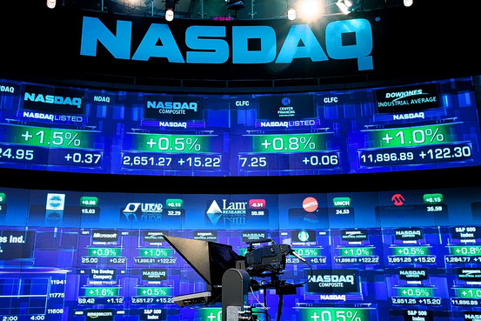
The Cause of the Problem
Why ?
In 1990
1. Mr. Madoff became the chairman of NASDAQ, the electronic stock market for 3 years .

Slide 11
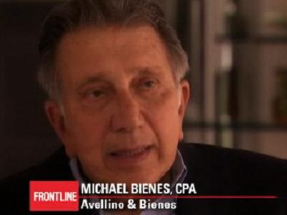
The Cause of the Problem
In 1992,
2. The SEC, security and exchange commission, received marketing materials showing that Avellino & Bienes had promised investors annual returns of up to 20 percent.
3. Originally, the firm was formed as an accounting firm.

Slide 12
The Cause of the Problem
In 1992,
4. The firm was oversaw approximately $440 million from 3,200 clients.
5. SEC only sanctioned Avellino & Bienes for running an unregistered investment advisor and ordered the firm to return all funds to their investors for selling unregistered shares.

Slide 13


The Cause of the Problem
In 1970
6. Mr. Madoff had spent over $250,000 to upgrade the computer equipment for Stock Exchange, where he began offering to buy and sell stocks that were listed on the Big Board. The exchange, in effect, was transformed into the first all-electronic computerized stock exchange

Slide 14
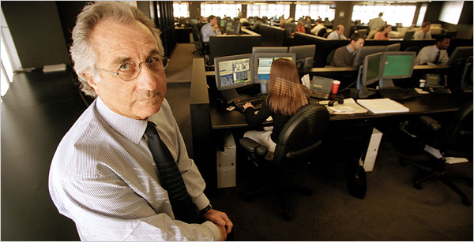
The Cause of the Problem
7. The question is if Mr. Madoff was really running a Ponzi scheme, what were the sources of the funds that Madoff used to return both the interest earned and investment principal Avellino & Bienes investors in 1992?

Slide 15
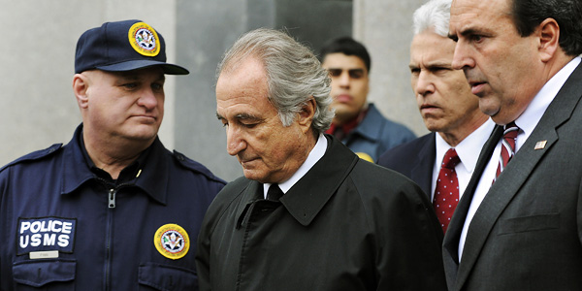
The Cause of the Problem
8. After Mr. Madoff has been arrested, the investigators found no evidence to indicate that securities were purchased for customers' accounts' for perhaps as much as 13 years.

Slide 16
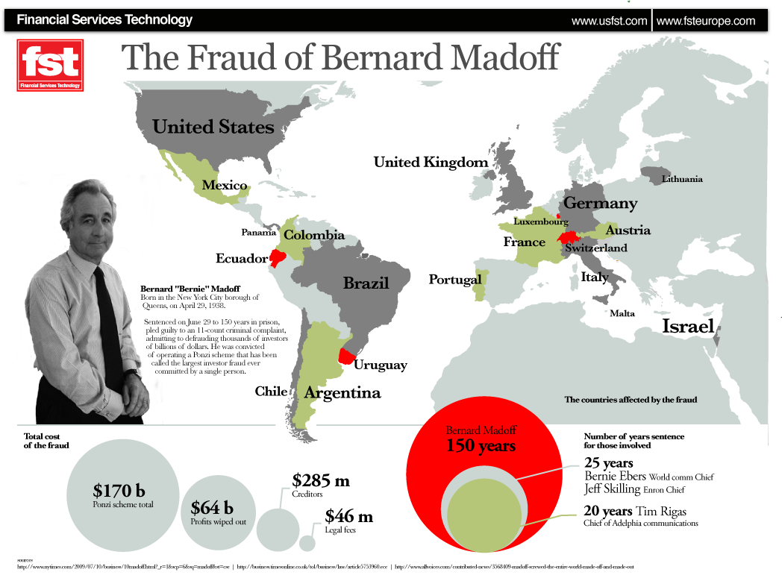
Impact and Aftermath

Slide 17
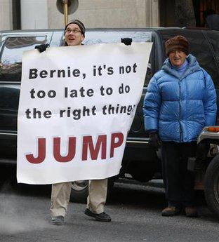
Impact and Aftermath
Here are some institutes that are affected from the case of Bernard Madoff
Criminal charges against Aurelia Finance
Grupo Santander
Union Bancaire Privee
Notz Stucki
Bank Medici (Austrian bank)
HSBC (British bank)
Nomura Holdings Japanese brokerage

Slide 18
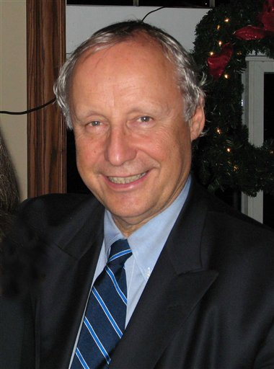
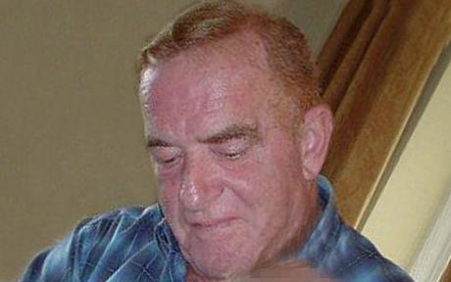
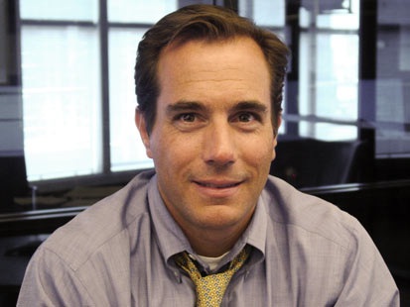
Impact and Aftermath
Suicides..
René-Thierry Magon de la Villehuchet
William Foxton
Mark Madoff

Slide 19
Impact and Aftermath
U.S. Securities and Exchange Commission
In September 2009, the SEC released a 477-page report on how the SEC missed these red flags and identifies repeated opportunities for SEC examiners to find the fraud and how ineffective their efforts were. In response to the recommendations in that report, eight SEC employees were disciplined; none were fired.
JPMorgan Chase
On January 7, 2014, Forbes magazine and other news outlets reported that the bank JPMorgan Chase, "where Madoff kept the bank account at the center of his fraud", would pay a settlement of $1.7 billion. This resolved any potential criminal case against the bank arising from the Madoff scandal.

Slide 20
Critique of the case study
The methodology is wrong since the first place.
Investors are paid by their money, not profit from the investment. His scheme involves “Affinity Fraud”
Affinity fraud
Madoff preyed on many charity organizations and his close friends with common interest is to receive stable return from investment.

Slide 21
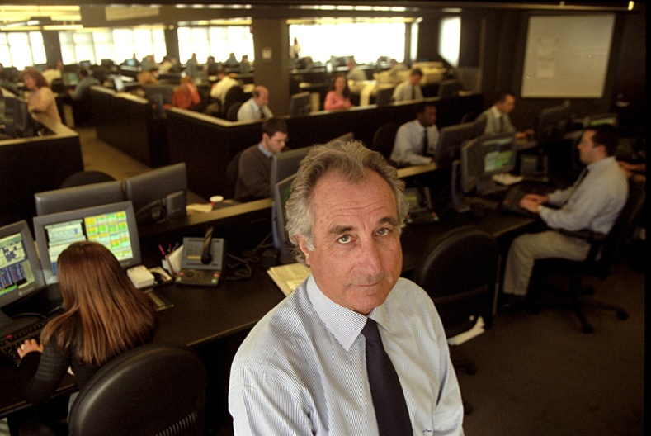
Critique of the case study
He lied to everyone.
He hadn’t actually traded, all of the money goes to his personal account to spend.
No transparency
He claimed that the methodology is too difficult to understand so no one should bother looking at it.

Slide 22
The way to revert the situation
Stronger law enforcement decreases the expected payoff of committing a crime
U.S. Securities and Exchange Commission (SEC) act aggressively to prevent scandals
However, unable to prevent all financial frauds and corporate scandals, it just increases the probability that a “thief” will be caught.

Slide 23
The way to revert the situation
Change in the relationship between a firm and its accounting auditor
Deal with for long periods of time, relationship involved
Auditor might accept small irregularities
Thus, should have to change auditor every five years
Each accounting firm would have a strong incentive to do its job properly

Slide 24
The way to revert the situation
For investors to notice…
Never settle for published or advertised track records
Double check account statements provided by the Advisor
Understand about the investment strategy
Open a test account with real money to monitor the program
Must not keep all of money with one manager
Check investments for the name of the firm that provides the audit

Slide 25
References
http://www.nytimes.com/2009/01/17/business/17ponzi.html
http://www.accounting-degree.org/scandals/accounting-scandals.jpg
http://www.eode.org/eode-books-economie-le-reve-de-madoff/
http://www.moneycrashers.com/bernie-madoff-ponzi-scheme-explained/
http://www.biography.com/people/bernard-madoff-466366

Slide 26
Q & A

