Slide 1
Industrialisation and Inequality in Thailand
Somboon Siriprachai
Faculty of Economics, Thammasat University
“Inconsistencies and Inequalities in Thai Industrialisation,” in Johannes D. Schmidt, Jacques Hersh and Niels Fold ( eds.) Social Changes in Southeast Asia (London: Longman, 1997), pp. 183-205.

Slide 2
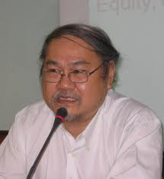
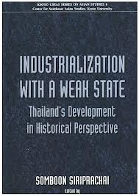
Professor Somboon Siriprachai
Thammasat University
Ph.D.(Economic History), Lund University, SWEDEN
Editor: Thammasat Economic Journal
WTO Watch
Died: December 25th, 2008

Slide 3
Introduction
Too early to cite Thailand as an NIE.
Thailand has not been successful in the areas of human development and income distribution
A trade-off between the agricultural and industrial sectors or between the rural and urban sectors or between Bangkok and the provinces
Objective:
To analyse whether the economic policy reforms of the early 1980s may have been too few and too late to solve a rising unbalanced growth, to eradicate poverty in rural areas and to lessen depletion of natural resources that is certainly a hazard of industrialisation.

Slide 4
Outline
A Conceptual Framework
State Promotion of Industrialisation
Export Promotion, the Legacy of ISI and the Squeeze on Agriculture
Economic Policy Reforms, Industrialisation and Poverty
The Thai State: Between Rent-seeking and Inequality

Slide 5
Process of Economic Policy Formulation
Super - Structure
Supply
- Power Elites
- Economic
Advisors
- Technocrats
- Political
Parties
- Parliament
Demand
- Interest Group
- People
- Mass Media
- Economists
- NGOs and Social
Movements
Economic Policy Market
World Capitalism

Slide 6
I. A Conceptual Framework
The outcome of economic development in the last four decades suggests that the Thai state was entirely controlled by the ruling elite
Thai state seems to be unique in the sense that it has been rather weak in making any coherent policy effective.
The main failure emerges from the fact that the Thai bureaucracy, which evolved from a Thai Sakdina (feudal) autocracy, has turned out to be huge and clumsy as a monster

Slide 7
I. A Conceptual Framework
Thai state has been unable to foster long-term entrepreneurial perspectives among indigenous private elites, thereby lacking the one crucial type of state action in Gerschenkron's typology; the state must create the so-called "state entrepreneurial actions to substitute for missing entrepreneurship.
The political regime has been mostly authoritarian (soft) in nature, albeit the very short period of a full democracy during 1973-1976 and after the 1990s. The agricultural sector (rice farmers) has been heavily squeezed to lend support to the industrial sector in Bangkok and the peripheries.

Slide 8
I. A Conceptual Framework
Concentration of growth and industrialisation in the metropolitan area has inevitably been giving rise to uneven development and inequality
There is no immunity to the rent-seeking activities in Thailand
The Thai state might have functioned well in protecting individual rights, persons and property and enforcing voluntarily negotiated private contracts, but it has failed to create a strong domestic market and eradicate poverty in the rural areas.
East Asian NIEs lay not much in FDI and MNCs, but in national capital and national industrialists and in building up an educated populace rapidly. This entails fostering internal articulation and achieving technological autonomy.

Slide 9
I. A Conceptual Framework
Import-substitution industrialisation might not have failed if it had been inseparable from substantial improvements in agricultural productivity and income distribution that could in turn absorb domestic manufactured goods
Such a process has always been taken for granted by the Thai ruling elite who were obsessed with a market mechanism in a neo-liberal paradigm which could have been a great help in linking the import-substituting industries to the relative backwardness of agriculture.
Thai agriculture was dominated by the vestiges of Sakdina (Thai feudalism) with cultivation techniques dating back to the previous century.
Income is distributed more unequally in Thailand than in the East Asian NIEs

Slide 10
I. A Conceptual Framework
Since the middle of the 1970s, the Thai state has been turning its strategy to export-led industrialisation, but the fundamental obstacles, i.e., the shortage of infrastructure, the lack of skilled labour and low secondary enrolment, the low productivity in the agricultural sector and impoverished rural inhabitants who are mostly farmers, are seldom overcome
to keep economic growth high mainly with the influx of direct foreign investment from Japan, the East Asian NIEs

Slide 11
II. State Promotion of Industrialisation
Sarit government, industrial promotion policy was renewed by the Promotion of Industrial Investment Act of 1959
The multiple exchange rate regime and large-scale state enterprises came to an end.
The role of the Thai state was also believed to be a social guardian ora benevolent dictator and to provide a stable investment environment for the private sector.
Investment incentives were given to selected import-substituting industries
The state even guaranteed and granted licences to foreign companies. In addition, labour unions were also suppressed

Slide 12
II. State Promotion of Industrialisation
the first easy stage of import substitution was inevitably successful in the late 1960s
BOI gave rise to inefficient, promoted manufacturing firms
American advisers manipulate the Thai policy-making process, in particular the first three national economic development plans (1961-1976)
Sarit-Thanom-Prapath regime contain unfair competition, rent-seeking and corruption
Thailand has hardly had social and economic bases for democratic development. The middle class which predominantly Chinese allied itself to the ruling elites.
the increased role of technocrats

Slide 13
II. State Promotion of Industrialisation
BOI was empowered to encourage domestic and foreign investments in industry or negotiate conditions of investment agreements subject to the cabinet's approval
It is misleading to take for granted that the high tariff barriers were made available as a tool for industrial policy protection under a strategic industrial policy regime. In contrast, it has from time to time been deployed as a source of government revenues by the Ministry of Finance.
Resources were instead transferred to the preferred industries by BOI through the provision of relatively cheap machinery and intermediates, mostly capital and inputs from abroad
Thailand has neither been guided by industrial sectoral planning nor had any industrial targeting strategy like the Asian NIEs

Slide 14
II. State Promotion of Industrialisation
The Thai State does not control the markets for credit and foreign exchange, thus depriving policy makers of perhaps the key tools for conducting industrial targeting.
There has been little co-ordination or coherence in the use of existing industrial policy instruments, tariffs, investment promotions, capacity controls and local content regulations.
BOI did not establish a coherent import-substitution policy per se; nor did it build up a clear-cut framework to enforce promoted firms to meet BOI's requirements.
No performance standards and follow-up have been imposed on the recipients of promoted certificates.
The pre-requisite to make ISI successful in the East Asian manner rests heavily on four crucial factors; (1) the strength of the state, (2) the competent bureaucrats, (3) independent technology learning capacity and (4) increased productivity in agriculture prior to export-oriented industrialisation.

Slide 15
II. State Promotion of Industrialisation
Question: Why is the performance of manufacturing sectors in Thailand by comparison inadequate in terms of labour absorption and technological content compared to them?
Answer: The contextual and institutional factors
A high degree of discretion and selectivity in the granting of incentives for a wide range of objectives without any accountability to civil society, accompanied by little monitoring or follow-up of promoted enterprises made it different.
Technology is more than tools, plants or machines; it is very complex and embedded in key institutions.
Thai state has not created an indigenous technological capacity to support technological transfer from foreign firms.

Slide 16
II. State Promotion of Industrialisation
What is the most essential contributor is the state capability to build up numerous literate populations with few natural resources in a short time?
Domestic-led growth industrialisation had brought about the changes in agricultural sectors before they shifted to export-oriented strategy. This success is highly dependent on the role of activist state or developmental state

Slide 17
III. Export Promotion, the Legacy of ISI and the Squeeze on Agriculture
ISI became the preferred strategy in Thailand because of expeditious policy actions to meet balance of payment crises.
How much ISI and how long it should continue to support protection is often debatable?
ISI in Thailand was not targeted according to systematic economic criteria like in Asian NIEs, but was pursued in an incoherent, inefficient manner and for too long by BOI.
Import-substitution industrialisation in Thailand left many problems to be resolved.
In the early 1970s and the early 1980s, the world economy was full of disturbing events

Slide 18
III. Export Promotion, the Legacy of ISI and the Squeeze on Agriculture
Though the first oil crisis in 1973 and 1974 took place almost simultaneously with the world commodity boom, rising prices of major exports, including rice, maize, rubber and tin helped to prevent a balance of payment's crisis.
The exports of primary products did not continue to supply foreign exchange.
Thailand's gradual shift to EOI was not the result of good planning. Rather, it was obstructed by the bureaucratic state.
the revision of the Investment Promotion law in 1972 was designed to offset the disincentive effects of import protection

Slide 19
III. Export Promotion, the Legacy of ISI and the Squeeze on Agriculture
Thai emphasis on promoting manufactured exports in the 3rd Plan (1972-1976).
Thailand shifted to an outward-looking strategy, again with the lack of a coherent industrial policy. To promote manufactured exports rested heavily on FDI and MNCs.
The backbone agricultural sector, regardless of improving productivity, has the same duty to supply cheap labour and raw materials to export sectors.
BOI still played a leading role in authorising and granting exemptions and privileges.
Baht devaluation (1981 and 1984) was coupled with the change in the exchange rate system.

Slide 20
IV. Economic Policy Reforms, Industrialisation and Poverty
Thai industrialisation process seems to have acquired little new technology owing to the lack of skilled labour
A promoted firm was required only to export a certain share of its output (%) to get promotion support, but the lack of effective monitoring and information to enforce performance criteria made industrial policy less effective.
Export-oriented manufactured goods were at best footloose.
The small size of the domestic market with consequent low effective demand could not absorb the excess capacity from the manufacturing sectors.
By the early 1980s, Thai economy faced economic crises.

Slide 21
IV. Economic Policy Reforms, Industrialisation and Poverty
Structural Adjustment Loans programmes (SALs) of the World Bank and with support from IMF helped Thailand to become more efficient in resource allocation?
The program were required to undertake major tax reform to raise more revenue and to make the tax system more efficient.
Thailand cannot be classified as being successful in the implementation of major economic reforms in at least three important policies, i.e. trade, tariffs and tax policies. Most ad hoc sectoral policies continue to prevail.
Why has Thailand been able to sustain high economic growth and to maintain positive macroeconomic indicators?
  Baht Devaluation and sound exchange rate policy

Slide 22
IV. Economic Policy Reforms, Industrialisation and Poverty
In 1982, Thailand became a contracting party of GATT
The lack of consistency in ad hoc sectoral policy can be attributed to the characteristics of a rent-seeking society prevailing in Thailand since the 1950s.
The most important hindrance is the discretionary legal mandates of individual departments.
Ministerial discretion in trade and industrial policies, quotas, licensing and factory promotions are often deployed to seek economic rents
East Asian NIEs might have had a rent-seeking to a considerable extent, but the social benefits of high productivity in agriculture and export-led industrialisation surpassed the social costs of rent-seeking activities.

Slide 23
IV. Economic Policy Reforms, Industrialisation and Poverty
SALs and IMF’s program did rescue the Thai economy which readjusted towards greater efficiency enhancing measures at the macroeconomic level, but that it might have been too little and too late to enhance balanced growth and equal distribution of income and opportunities for the rural poor and unskilled labour.
Baht had been over-valued for years, and caused by imposing high import duties to protect promoted firms.
Thailand did not use similar trade and pricing for key commodities in an effort to protect domestic farmers.
The strong performance of Thailand argues that free trade policies promote growth but Thailand paid a price for rural poverty
From Asian NIEs' experience domestic market was a crucial prerequisite before manufactured export goods could compete on the world market

Slide 24
IV. Economic Policy Reforms, Industrialisation and Poverty
The scale of land reform was very limited and ineffective at keeping poor farmers from becoming indebted.
the high or impressive growth since the 1960s has, of course, trickled down some benefits to the poor.
a decline in the incidence of absolute poverty can be quite consistent with worsening income distribution
Rising income inequality both between industrial and agricultural sectors and between regions reflects the nature and competence of the Thai state to cope with fundamental problems ➔inequality cannot be manifested through laissez-faire policy
Export-oriented industries are significantly more labour-intensive than import-substituting industries, but this was not for Thailand.
The monsoon weather affected seasonal fluctuations in labour demand.

Slide 25
IV. Economic Policy Reforms, Industrialisation and Poverty
Thailand's tax system has remained very regressive compared to the East Asian NIEs and has lacked transparency.
By 1992, the 7% VAT was confusedly replaced by complex, inefficient business taxes by the Anand government.
Tax policy has not served to generate social justice and human rights. The role of social security with transfer payments has been very limited in Thai society.
Why industrialisation seems to inhibit poverty eradication?
  agricultural wage-earners and unskilled workers are vulnerable to becoming poor
  high land prices have given rise to unproductive expenditures and social waste from speculation, while tax incentives granted by BOI have led to prevalent rent-seeking

Slide 26
IV. Economic Policy Reforms, Industrialisation and Poverty
The tariff reform in the 1980s seems to have had little effect. The import tax was still essential for increasing government revenue.
Thailand has the highest nominal rate of tariff protection (34 % ) of any of the Pacific Basin developing countries
the strong clientelistic relationships have been strengthened again and used to seek economic rents to finance political parties in the next general election.

Slide 27
V. The Thai State: Between Rent-seeking and Inequality
Thailand has a number of administrative laws that grant the authority to implement various aspects of national policy, especially in international trade and internal affairs.
Political pressure and vested-interest groups have been the exporters, industrialists and bankers, while a large number of peasants are less powerful and thereby unable to bargain with bureaucrats and vested-interest groups.
The fragmented political party systems and vote-buying remain evident.
The experience of industrialisation in Thailand over the last 40 years seems to have bred corruption and rent-seeking activities as well as unbalanced growth. Development at the expense of poverty and the depletion of natural resources in rural sectors.

Slide 28
V. The Thai State: Between Rent-seeking and Inequality
The redirection of policies reflects an emerging consensus that countries following an outward-oriented, market-based development strategy achieve relatively higher rates of growth and living standards.
The Thai state has been centering on more economic growth than on a fair income distribution.
There still remain some difficulties and restricting conditions that must be remedied to secure continued growth of the Thai economy.
  bottlenecks in the infrastructure
  the quality of the labour force

Slide 29
V. The Thai State: Between Rent-seeking and Inequality
The Thai economy needs economic, political, and institutional reforms. Rent-seeking and corruption should be kept at a minimum by making administrative regulations clear, transparent and accountable.
Most neo-classical economists (the Washington Consensus) seem to conceive that export-oriented policies will be likely to reduce inequality within developing countries, but the Thai case appears not to have supported this proposition.
The main contribution to the successful East Asian NIEs comes from a rapid expansion of higher education in which the relative supply of skilled labour has been increasing.
more expansion of manufactured exports to the world market does not necessarily lead to reduction of inequality.
Institutional constraint that shapes the Thai society into being neither a strong nor minimal interventionist state.
The predatory-cum-soft authoritarian state

Slide 30
Thailand
Government | Unitary parliamentary democracy and Constitutional monarchy
Total Area | 513,120 sq km or 198,115 sq miles (50th)
Water (%) | 0.4% (2,230 sq km)
Population 2010 Estimate 2000 Census Density | Population: 67 Million + Labor Force: 39 Million 63,878,267 (21st) 60,606,947 132.1/sq km or 342/sq mi (88th)
GDP (Nominal) 2010 GDP Per Capita | US$ 312.6 billion (30th) US$ 4,620 (89th) Upper-middle income economy in July 2011!!
Export Volume of Goods & Services (%) Export Value of Goods (USD bn) Growth Rate (%) Growth Rate (volume, %) | 2008 5.1 175.2 15.9 6 | 2009 -12.5 150.7 -14 -13.6 | 2010 -14.7 193.7 28.5 17.3 | Feb2011F 6.3 217.9 12.5 6.8
Imported Volume of Goods & Services (%) Imported Value of Goods (USD bn) Growth Rate (%) Growth Rate (volume, %) | 8.9 175.6 26.8 8.9 | -21.5 131.4 -25.2 -23.1 | 21.5 179.6 36.8 26.5 | 8.1 205.8 14.6 8.1
Trade Balance (USD bn) | -0.4 | 19.4 | 14 | 12.1

Slide 31
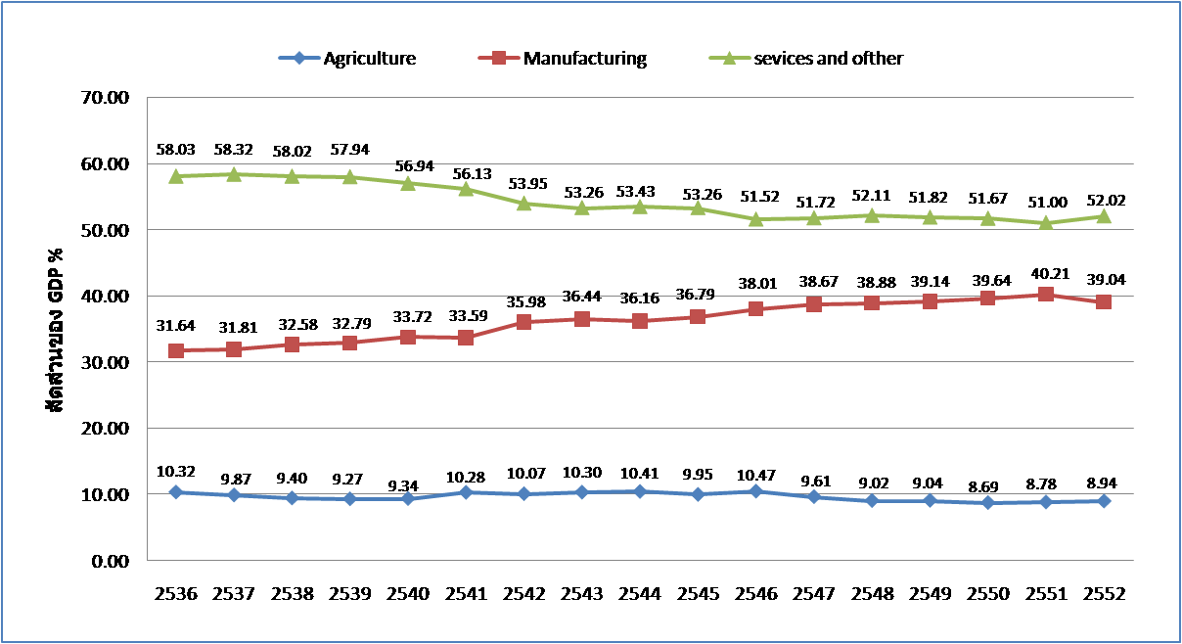
Thailand has achieve industrialization but not industrial development

Slide 32
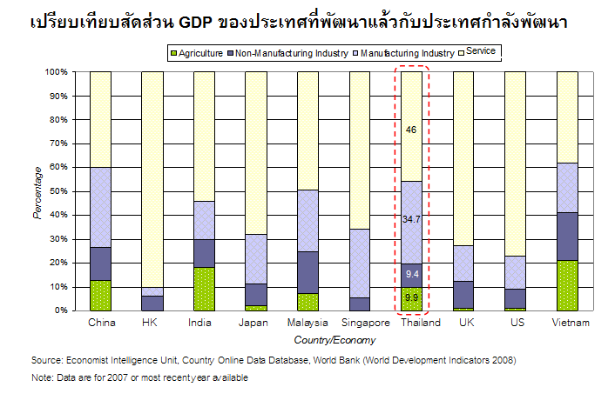
Economic Structure of Thailand

Slide 33
การวางแผนพัฒนาประเทศ แผนฯ 1-10
ยุคทองของการวางแผน
ยุคผันผวนทางการ
เมือง
แผนฯ 1
2504-09
ยุคประชาธิปไตย
ยุคเปลี่ยนผ่านสู่กระบวนทัศน์ใหม่
แผนฯ 2
2510-14
ยึดคนเป็นศูนย์กลางเน้นการมีส่วนร่วม
ใช้เศรษฐกิจเป็นเครื่องมือพัฒนาคน
แผนฯ 3
2515-19
แผนฯ 4
2520-24
เน้นการเติบโตทางเศรษฐกิจด้วยการพัฒนาโครงสร้างพื้นฐาน
แผนฯ 5
2525-29
ยึดปฏิบัติตามปรัชญาของเศรษฐกิจพอเพียงมุ่งสู่สังคมอยู่เย็นเป็นสุขร่วมกัน
แผนฯ 6
2530-34
เน้นการพัฒนาเศรษฐกิจควบคู่กับการพัฒนาสังคม
แผนฯ 7
2535-39
แผนฯ 8
2540-44
แผนฯ 9
2545-49
เน้นเสถียรภาพเศรษฐกิจ มุ่งพัฒนาภูมิภาค ชนบท
แผนฯ 10
2550-54

Slide 34
Electrical Machinery
Computer-Parts, Accessories
Seafood
Telecom Equipment
Apparel
Tourism
What’s Next???
Agri…
Manuf……
Service
GDP Mil Baht
Clothing
Electrical machinery
Seafood
Other Machinery
Rice & Rubber
Rice
Fruit & Vegetable
Non-ferrous Metal
Crude rubber
Electrical machinery
Rice
Crude Rubber
Fruit & Vegetable
Non-ferrous Metal
Textile Fiber
Rice
Crude Rubber
Ores & Metal Scrap
Textile Fiber
Fruit & Vegetable
1960
1970
1980
1990
2000
2010
Key Policies/Drivers:
Import Substitution, Export-led growth, FDI
Innovation + Knowledge

Slide 35
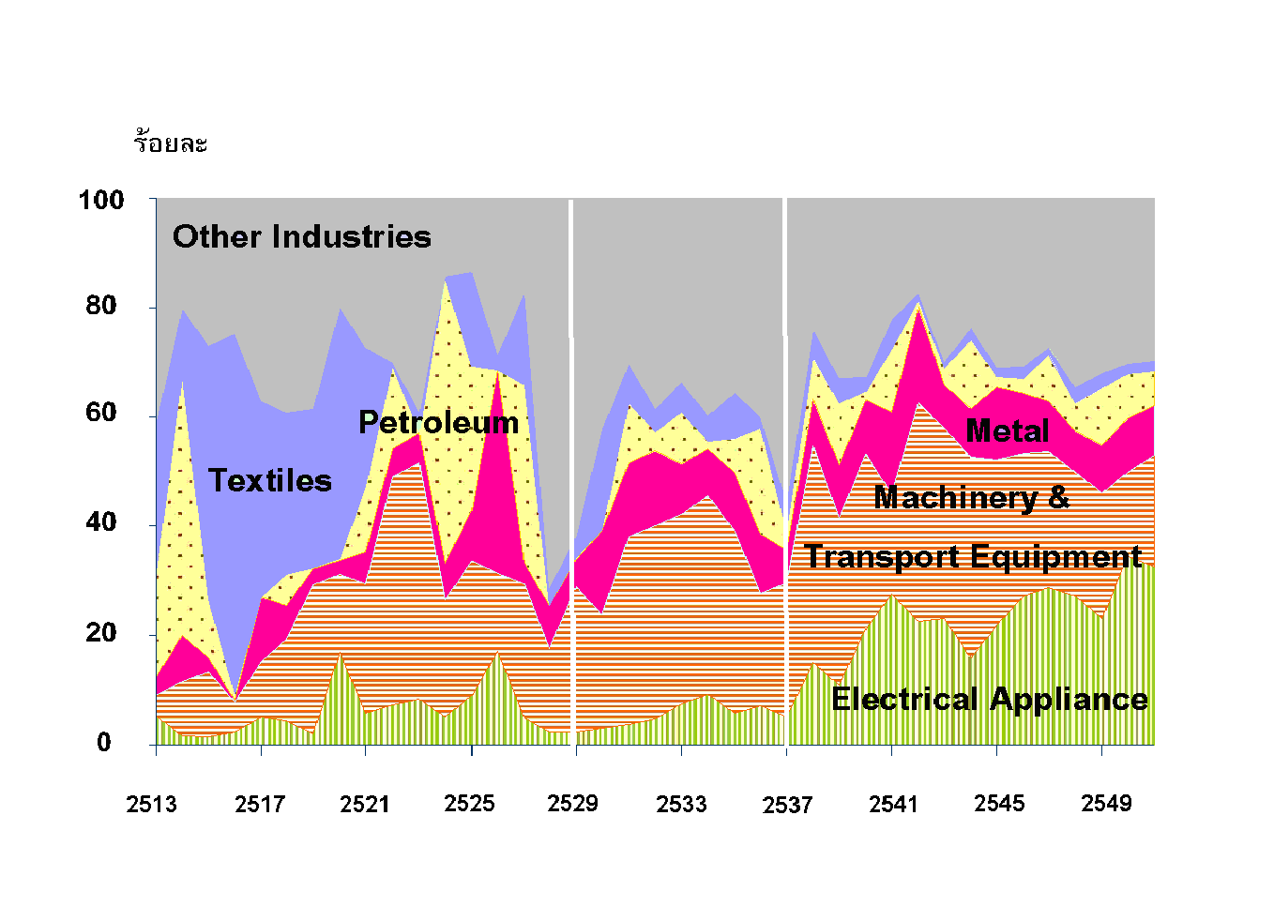
FDI and Thai Manufacturing Sector

Slide 36
GDP Contribution and Employment (2010)
GDP
Employment
Total employment 38.8 million people
1.Service = 17.01 million people
2.Agriculture = 16.39 million people
3.Manufacturing = 5.4 million people
GDP 2010 = US$ 312.6 billion

Slide 38
Thai Manufacturing Sector’s Competitive Position
High
Cluster I
Foods
Garment
Jewelry
Leather
Electronics
Auto
Rubber
Wood Products
Pulp & paper
Plastic
Ceramics & Glass
Chemicals
Level of Industry Attractiveness
Cluster II
Metals
Petrochemicals
Machinery
Low
Cluster III
Low
High
Thai Producers’ Competitiveness

Slide 39
Zooming in the First Cluster
?
FrozenChicken
Frozen Shrimp
80
60
Passenger Car
% Local Content
Footware
40
Pick Up
Fabric,Woven
Apparel
Jewellry
Computer Equipment
20
Precious Stones
Electric Appliances
1
2
3
4
5
6
7
8
9
10
11
12
13
% Export Share

Slide 40
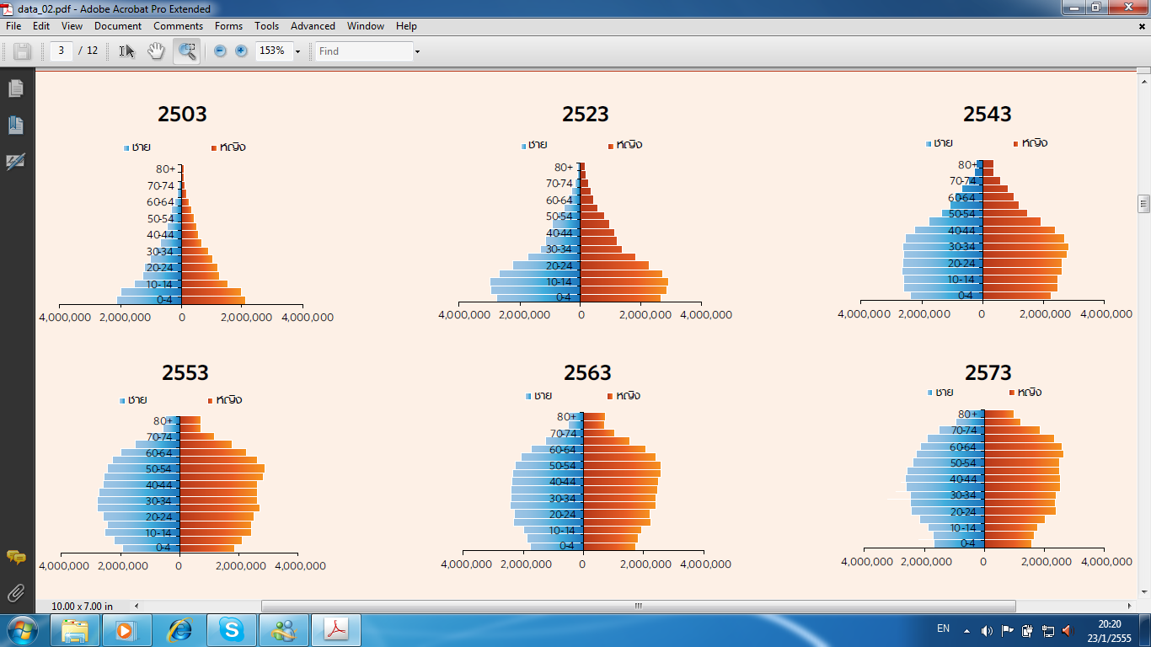
Percentage
2503
2548
2558
2573
2583
2523
2578
2533
2543
2553
2563
2513
2533
2543
2551
2560
2568
2570
2513
2568
Population Boom
Demographic Dividend
Aging Population
ช่วงทองจากการปันผลทางประชากร
ภาระพึ่งพิงสูงจากผู้สูงอายุ
ภาระพึ่งพิงสูง
จากเด็ก

Slide 41

Thailand in the “Middle-Income” Trap
Pressures from high-income economies
Leaders
Japan
Korea
Design
/
differentiation
based
Technology
competition
Technology Capability
Pressures from lower-wage economies
and Design
Innovation
China
Thailand
Low Cost-based
competition
Followers
Low Cost
Differentiation
Competitive Advantage

Slide 42
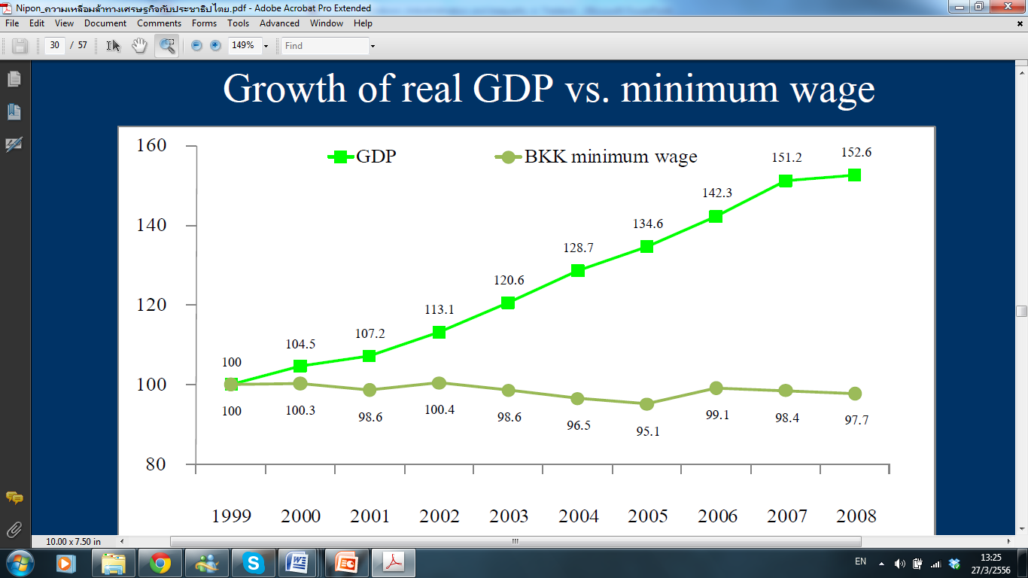
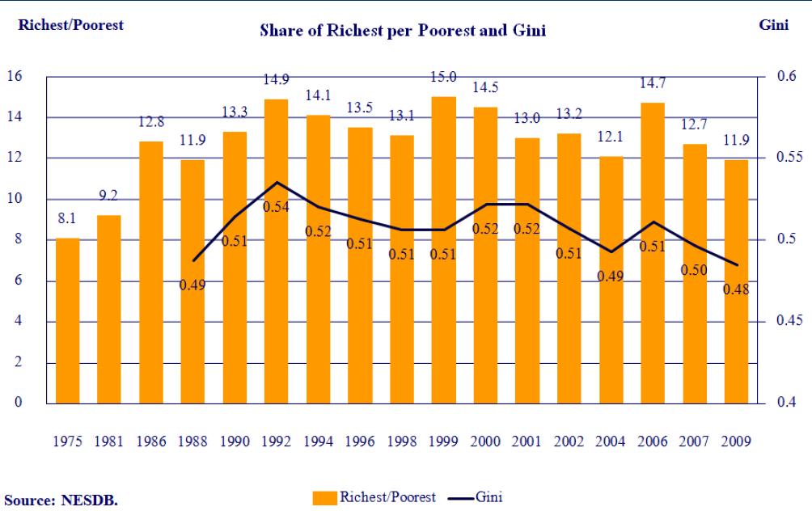

Slide 43
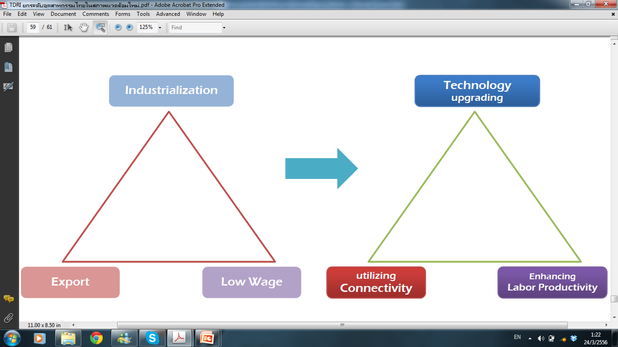
Out of Middle Income Trap

Slide 44
Economic growth is from expansion of factors
rather than productivity improvement
 |  |  |  |  |  |  |  |  |  | average
 | 1997 | 1998 | 1999 | 2000 | 2001 | 2002 | 2003 | 2004 | 2005 | 1982-2005
Whole Kingdom
GDP Growth | -1.37 | -10.51 | 4.45 | 4.75 | 2.17 | 5.32 | 7.14 | 6.28 | 4.49 | 6.03
Source of Growth
Labor | 0.60 | -1.56 | 0.82 | 0.54 | 0.89 | 0.93 | 0.83 | 1.01 | 0.44 | 0.60
Capital | 3.54 | -0.57 | 1.42 | 1.12 | 0.19 | 1.99 | 1.88 | 1.98 | 2.08 | 4.73
TFP | -5.51 | -8.38 | 2.20 | 3.07 | 1.07 | 2.39 | 4.41 | 3.28 | 1.90 | 0.70
Notes:
ความอ่อนแอเชิงโครงสร้างของอุตสาหกรรมไทย
5) การขยายตัวทางเศรษฐกิจเป็นผลจากการขยายตัวของทุนและแรงงานมากกว่าผลิตภาพ
พิจารณาแหล่งที่มาของการเจริญเติบโตทางเศรษฐกิจของประเทศ ในช่วงปี 2525 – 2548 พบว่า ประเทศไทยมีอัตราการขยายตัวเฉลี่ยร้อยละ 6.03 ต่อปี เป็นผลมาจากปัจจัยทางด้านแรงงานร้อยละ 0.6 ปัจจัยทุน ร้อยละ 4.73 และปัจจัยทางด้านผลิตภาพการผลิต (TFP)** เพียงร้อยละ 0.70 ซึ่งสะท้อนให้เห็นถึงการขาดประสิทธิภาพในการใช้ปัจจัยการผลิตในภาพรวม ที่ต้องพึ่งพาทุนและแรงงานเป็นตัวขับเคลื่อนเศรษฐกิจ ในขณะที่ผลิตภาพการผลิตโดยรวม มีส่วนสนับสนุนการขยายตัวทางเศรษฐกิจเพียงเล็กน้อย
• ในส่วนของภาคอุตสาหกรรม ในช่วงปี 2525 – 2548 มีอัตราการขยายตัวเฉลี่ยสูงถึงร้อยละ 8.13 ต่อปี เป็นผลมาจากปัจจัยทางด้านแรงงานร้อยละ 2.12 ปัจจัยทุนร้อยละ 5.45 และปัจจัยทางด้านผลิตภาพการผลิตเพียงร้อยละ 0.57 ซึ่งนับว่าเป็นอัตราที่ต่ำ ทั้งนี้ เนื่องจากที่ผ่านมาการขยายตัวของภาคอุตสาหกรรมไทยเป็นการเติบโตในเชิงปริมาณ และยังมีจุดอ่อนเชิงโครงสร้าง เช่น ขาดการบริหารจัดการที่ดี การผลิตสินค้าส่วนใหญ่เป็นการรับจ้างผลิตโดยอาศัยความได้เปรียบในด้านต้นทุนจากค่าจ้างแรงงาน แต่ยังจำเป็นต้องพึ่งพาการนำเข้าวัตถุดิบ เงินทุนและเทคโนโลยีจากต่างประเทศในสัดส่วนที่สูง ขณะที่แรงงานยังไม่สามารถปรับตัวให้ทันกับการเปลี่ยนแปลง และขาดทักษะที่จำเป็นต่อการทำงาน คุณภาพการศึกษาของแรงงานก็ยังไม่พอที่จะปรับตัวเข้าสู่เศรษฐกิจฐานความรู้ อีกทั้งการพัฒนาบุคลากรที่เข้าสู่ตลาดแรงงานยังขาดคุณภาพไม่สอดคล้องกับทิศทางและความต้องการของภาคอุตสาหกรรม ส่งผลให้ผลิตภาพแรงงานอยู่ในระดับต่ำ
** ผลิตภาพการผลิตโดยรวม (Total Factor Productivity: TFP) เป็นตัวชี้วัดการขยายตัวของมูลค่าเพิ่มที่เกิดจากปัจจัยอื่น นอกเหนือจากปัจจัยทุนและแรงงาน โดยส่วนใหญ่มักสะท้อนให้เห็นถึงการขยายตัวของมูลค่าเพิ่มที่เกิดขึ้นจากปัจจัยต่าง ๆ ในเชิงคุณภาพมากกว่าในเชิงปริมาณ เช่น ความได้เปรียบของระดับเทคโนโลยี หรือความสามารถในการบริหารจัดการ ระดับของการวิจัยและพัฒนา และความเชื่อมั่นในตราสินค้า รวมถึงปัจจัยด้านการตลาดต่าง ๆ ที่อาจส่งผลกระทบต่อมูลค่าเพิ่ม เป็นต้น ซึ่งค่า TFP จะสะท้อนให้เห็นถึงประสิทธิภาพของการใช้ปัจจัยการผลิตโดยรวม

