Slide 1
Topic 4 Part 2
Risk and Information
(Chapter 15)

Slide 2
Risk Preferences
Definition: The risk preferences can be classified as follows:
An individual who prefers a sure thing to a lottery with the same expected value is risk-averse.
An individual who is indifferent about a sure thing or a lottery with the same expected value is risk-neutral.
An individual who prefers a lottery to a sure thing that equals the expected value of the lottery is risk-loving.

Slide 3
Risk Preferences
Let X be a lottery.
U(E[X]) denotes Utility of the EV (sure thing) of the lottery X.
E[U(X)] denotes Expected Utility of the lottery X.
risk-averse: U(E[X]) > E[U(X)]
happiness from sure thing > expected happiness from lottery
risk-neutral: U(E[X]) = E[U(X)]
happiness from sure thing = expected happiness from lottery
risk-loving: U(E[X]) < E[U(X)]
happiness from sure thing < expected happiness from lottery

Slide 5
Risk Premium
Most people are risk-averse, but some are willing to take risks if they are fairly compensated. The money needed as the compensation is called the risk premium.
Definition: The certainty equivalence (CE) is the guaranteed amount of money (sure thing) such that an individual is indifferent between the lottery and the said money.
U(CE) = E[U(X)]
Definition: The risk premium (RP) of a lottery is the difference between the EV of the lottery and its CE.
RP = E[X] – CE

Slide 6
Risk Premium
Utility
Risk Premium = B – A = E[X] – CE
Utility Function
U(X₂)
U(E[X])
A
•
•
E[U(X)]
B
U(X₁)
Income
0
X₁
CE
E[X]
X₂

Slide 7
Risk Premium
Risk-Averse: CE < E[X] Risk Premium is positive
They are willing to accept a smaller sure thing rather than the lottery.
Risk-Loving: CE > E[X] Risk Premium is negative
They require a larger sure thing because they love the lottery.
Risk-Neutral: CE = E[X] Risk Premium is zero
They are indifferent between the sure thing and the lottery.
The larger the variance of the lottery, the riskier the lottery, and the larger the risk premium

Slide 8
Risk Premium – Example
Utility
Suppose X is a lottery with 50% to win 100 and 50% to win 16. Calculate EV, CE, and RP.
Utility Function
U = √I
A
•
•
B
Income (I)
0
16
CE
EV
100

Slide 9
Insurance
Risk Premium is the money that risk-averse people accept to take risks.
Insurance Premium is the “price” of the insurance that risk-averse people buy in order to eliminate the risks.
Fairly-Priced Insurance Policy is a policy where the insurance premium is equal to the expected value of the insurance payment.

Slide 10
Fairly-Priced Insurance – Example
Example
Insurance Premium (price) = $500
It promises to pay $10,000 if Bad Thing happens.
It promises to pay $0 if Nothing happens.
Pr(BadThings) = 5% Pr(Nothing) = 95%
500 = .05(10,000) + .95(0)
That is, insurance premium = expected payment.
Thus, this insurance is fairly priced.

Slide 12
Adverse Selection & Moral Hazard
Definition: Asymmetric Information is a situation in which one party knows more about its own actions or characteristics than another party.
Definition: Adverse Selection is opportunism characterized by an informed person's taking advantage of a less informed person who does not know about an unobserved characteristic of the informed person.
Definition: Moral Hazard is opportunism characterized by an informed person's taking advantage of a less informed person through an unobserved action.

Slide 13
Adverse Selection & Moral Hazard
Adverse Selection / Hidden Information:
Good and Bad cars in second-hand garages.
Healthy and Unhealthy people in health insurance markets.
Moral Hazard / Hidden Action:
People drive carelessly after buying car insurances.
Employers fails to observe lazing employees.
Doctors over-prescribe treatments for patients with health insurances.

Slide 14
Decision Trees
Definition: A decision tree is a diagram that describes the options available to a decision maker, as well as the risky events that can occur at each point in time.
Decision Tree has the following elements:
1. Decision Nodes
2. Chance Nodes
3. Probabilities
4. Payoffs
We analyze decision problems by working backward along the decision tree to decide the optimal decision.

Slide 15
Decision Trees
An oil company is considering whether it should build a large facility (good if the oil reservoir is large) or a small facility (good if the oil reservoir is small).
Pr(Small Reservoir) = 0.5 and Pr(Large Reservoir) = 0.5.
However, it can implement “free seismic test” before building a facility to determine if the reservoir is large or small.

Slide 16
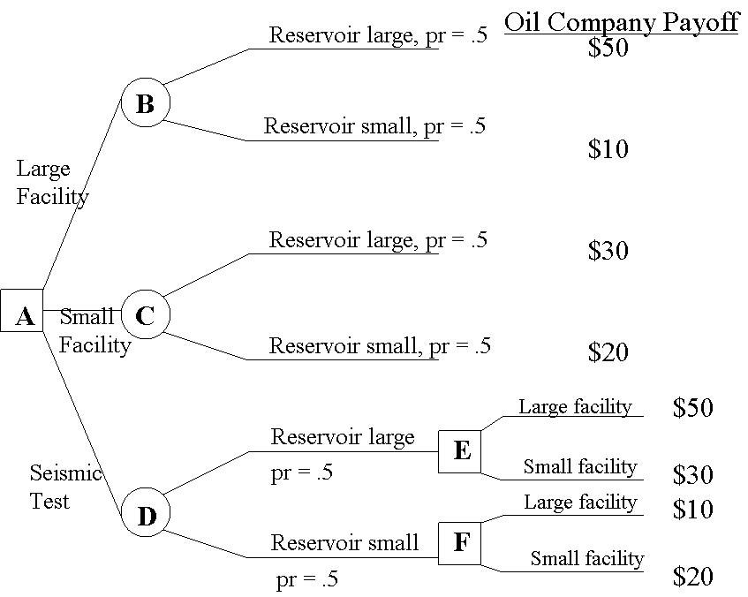
Decision Trees
EV = 30
EV = 25
Without Seismic Test, the company would build a large facility, and its expected payoff is 30.

Slide 17
Decision Trees
EV = 30
EV = 25
EV = 35
With Seismic Test, the expected payoff is 35.

Slide 18
Perfect Information
Definition: The value of perfect information is the increase in the decision maker's expected payoff when the decision maker can -- at no cost -- obtain information that reveals the outcome of the risky event.
Example:
Expected payoff to conducting test: $35M
Expected payoff to not conducting test: $30M
The value of information: $5M

