Slide 1
Topic 11 Part 3
Oligopoly
(Chapter 13)

Slide 2
Bertrand Oligopoly – Assumptions
Assumptions
Firms set prices
Simultaneous-move
Non-cooperative
Homogeneous Products VS Differentiated Products
We will study TWO versions of Bertrand Oligopoly:
Bertrand Duopoly with Homogeneous Products
Bertrand Duopoly with Differentiated Products
Note that in Bertrand, firms engage in Price Competition.
In Cournot, firms engage in Quantity Competition.

Slide 3
Bertrand – Homogeneous Products
Homogeneity implies that consumers will buy from the low-price seller.
Further, each firm realizes that the demand that it faces depends both on its own price and on the price set by other firms.
Any firm charging a higher price than its rivals will sell no output.
Any firm charging a lower price than its rivals will obtain the entire market demand.

Slide 4
Bertrand – Homogeneous Products
Any firm charging a higher price than its rivals will sell no output.
Any firm charging a lower price than its rivals will obtain the entire market demand.
Symbolically, the quantity sold of Firm 1 is given by
= D(P₁, P₂)/2 IF P₁ = P₂
Q₁ = D(P₁, P₂) = D(P₁) IF P₁ < P₂
= 0 IF P₁ > P₂
We use the following result to derive P₁* = BR₁(P₂).

Slide 5
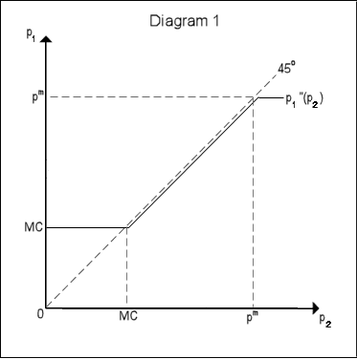
Bertrand – Homogeneous Products
P₁* = BR₁(P₂) refers to the profit-maximizing price (best response function) of Firm 1 which depends on the price of Firm 2.
P_{m} = monopoly price
P₁* = BR₁(P₂)
P₁ = MC when 0 ≤ P₂ ≤ MC
P₁ < P₂ when MC < P₂ ≤ P_{m}
P₁ = P_{m} when P_{m} < P₂

Slide 6
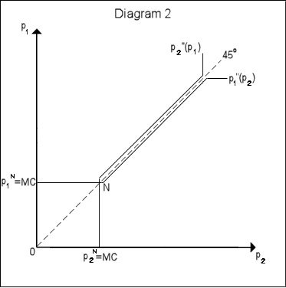
Bertrand – Homogeneous Products
Bertrand-NE occurs when P₁* = BR₁(P₂*) AND P₂* = BR₂(P₁*).
This is where P₁ = P₂ = MC.
P₁* = BR₁(P₂)
P₁ = MC when 0 ≤ P₂ ≤ MC
P₁ < P₂ when MC < P₂ ≤ P_{m}
P₁ = P_{m} when P_{m} < P₂
P₂* = BR₂(P₁)
P₂ = MC when 0 ≤ P₁ ≤ MC
P₂ < P₁ when MC < P₁ ≤ P_{m}
P₂ = P_{m} when P_{m} < P₁
NE

Slide 7
Bertrand – Homogeneous Products
Bertrand Paradox
The paradox describes a situation in which two players (firms) reach Nash equilibrium where both firms charge P = MC.
The paradox is that in models such as Cournot competition, an increase in the number of firms is associated with a convergence of prices to marginal costs.
In other words, even with very few firms, the oligopoly market can reach the perfectly competitive outcome.

Slide 8
Bertrand – Homogeneous Products
Bertrand Paradox (Explained)
Neither A nor B will set a higher price than the other because doing so would yield the entire market to their rival.
If they set the same price, the companies will share both the market and profits.
If either firm were to lower its price, even a little, it would gain the whole market and substantially larger profits.
Since both A and B know this, they will each try to undercut their competitor until the product is selling at zero economic profit.

Slide 9
Bertrand – Differentiated Products
Assumptions
Firms set prices
Simultaneous-move
Non-cooperative
Differentiated Products
Product Differentiation means that lowering price below your rivals' will not result in capturing the entire market, nor will raising price mean losing the entire market.

Slide 10
Bertrand – Differentiated Products
In this model, we solve for the Bertrand-NE in a similar way as when we solve for the Cournot-NE.
Find the best response function (BR) of each firm, i.e.
P₁* = BR₁(P₂) for Firm 1 and P₂* = BR₂(P₁) for Firm 2.
Bertrand-NE is determined where the two BR’s intersect, i.e. where
P₁* = BR₁(P₂*) AND P₂* = BR₂(P₁*)
That is, Firm 1 is doing its best given what Firm 2 is doing, AND Firm 2 is doing its best given what Firm 1 is doing.

Slide 11
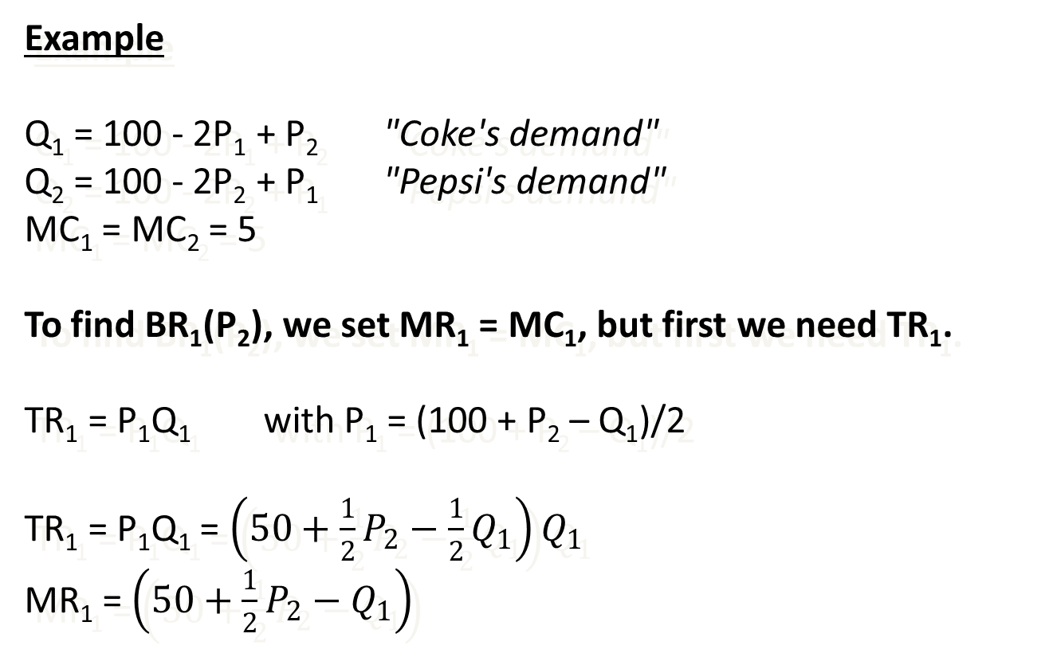
Bertrand – Differentiated Products
Example
Q₁ = 100 - 2P₁ + P₂ "Coke's demand"
Q₂ = 100 - 2P₂ + P₁ "Pepsi's demand"
MC₁ = MC₂ = 5
To find BR₁(P₂), we set MR₁ = MC₁, but first we need TR₁.
TR₁ = P₁Q₁ with P₁ = (100 + P₂ – Q₁)/2
TR₁ = P₁Q₁ = $\left(50+\frac{1}{2}P_{2}−\frac{1}{2}Q_{1}\right)Q_{1}$
MR₁ = $\left(50+\frac{1}{2}P_{2}−Q_{1}\right)$

Slide 12
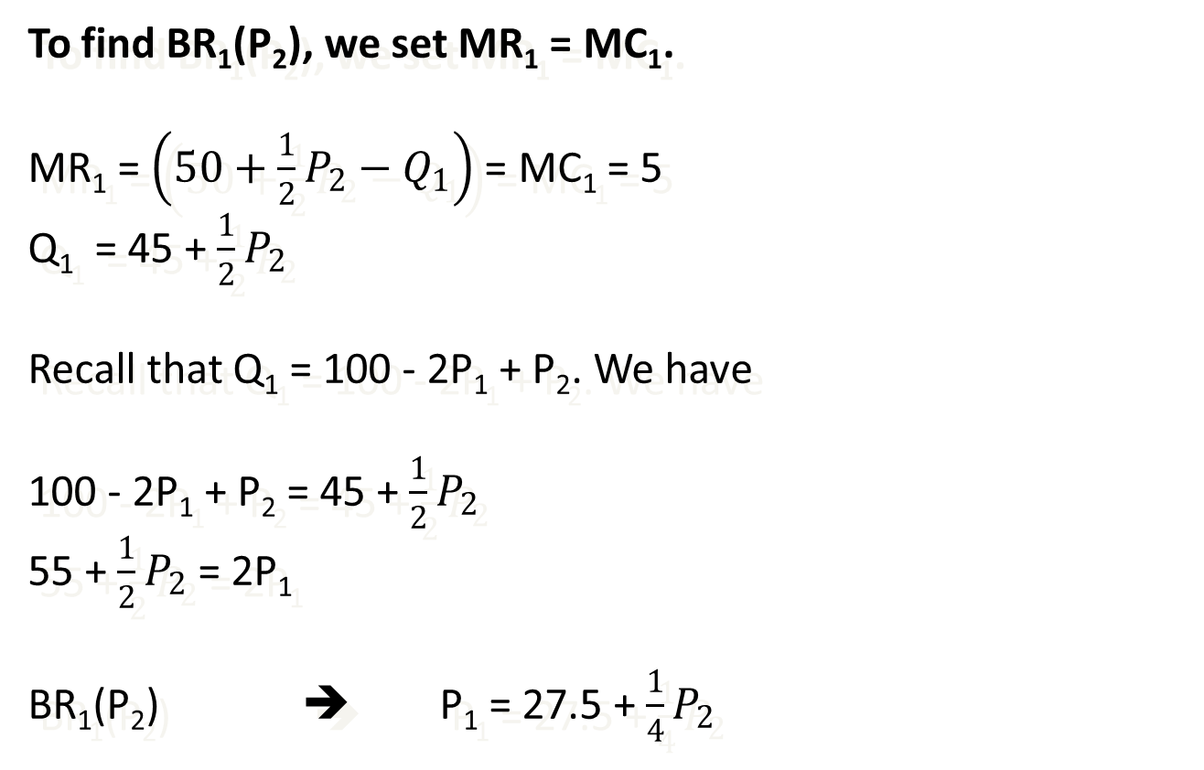
Bertrand – Differentiated Products
To find BR₁(P₂), we set MR₁ = MC₁.
MR₁ = $\left(50+\frac{1}{2}P_{2}−Q_{1}\right)$ = MC₁ = 5
Q₁ = 45 + $\frac{1}{2}P_{2}$
Recall that Q₁ = 100 - 2P₁ + P₂. We have
100 - 2P₁ + P₂ = 45 + $\frac{1}{2}P_{2}$
55 + $\frac{1}{2}P_{2}$ = 2P₁
BR₁(P₂) ➔ P₁ = 27.5 + $\frac{1}{4}P_{2}$

Slide 13
Bertrand – Differentiated Products
To find Bertrand-NE,
P₁ = 27.5 + P₂/4 P₂ = 27.5 + P₁/4
Solving these two equations yields
P₁* = P₂* = 110/3
Plugging these prices into demand, we have
Q₁* = Q₂* = 190/3
π₁* = π₂* = 2005.55 Π = 4011.10

Slide 14
Bertrand – Differentiated Products
Pepsi’s
Price (P₂)
P₁ = 27.5 + P₂/4
(Coke’s BR)
P₂ = 27.5 + P₁/4
(Pepsi’s BR)
P₂ =
110/3
•
Bertrand
Equilibrium
27.5
Coke’s
Price (P₁)
27.5
P₁ = 110/3

Slide 15
Bertrand – Differentiated Products

Slide 16
Oligopoly Models – Summary
Model | Product Diff. | Setting/ Timing | Cooperation | Max. Profit by setting
Cartel | NO | Simultaneous-move | Cooperative | As if it were a monopolist
Cournot | NO | Simultaneous-move | Quantity Competition | Quantity
Stackelberg (Quantity Leadership) | NO | Sequential-move | One firm is the quantity leader. | Quantity
Dominant Firm (Price Leadership) | NO | Sequential-move | One firm is the price leader. | Price
Bertrand Homogeneous | NO | Simultaneous-move | Price Competition | Price
Bertrand Differentiated | YES | Simultaneous-move | Price Competition | Price

