Slide 1
What is Psychology?
Why do we have to study Psychology?

Slide 2
What is Psychology
Psychology → Psyche (mind) + Logo (knowledge/ study of)
“Psychology is the scientific study of behaviours and mental processes”.
Scientific methods is the orderly, analytical process used in all sciences to analyse and solve problems
Behaviour is observable, measurable action or responses in both humans and animals.
Mental process is not directly observable. It is the private internal working of the mind
Notes:
Example: eating, speaking, laughing, running, reading and sleeping
Mental process is not directly observable. It is the private internal working of the mind
Examples: thinking, imagining, dreaming

Slide 3
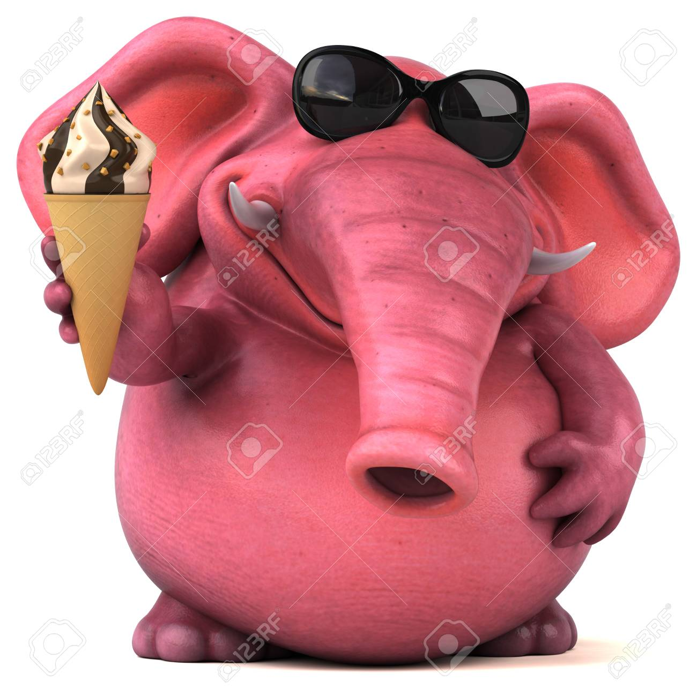

Slide 4
Goals of Psychology
Describe
Explain
Description
A careful description of behaviour
The different ways that organism behave
Description/ naming/ classifying – making detailed record of scientific observation
Fail to answer the “why”
Describe behaviours and mental processes of autistic children.
Understanding
The causes of a behaviour
The cause of Autism: genetics and biological factors that results in maldeveloped brain
Notes:
Description, or naming and classifying,
is typically based on making a detailed record of scientific
Observations
But a description doesn’t explain anything, does it? Right. Useful knowledge begins with accurate description, but descriptions fail to answer the important “why” questions. Why do more women attempt suicide, and why do more men complete it? Why are people more aggressive when they are uncomfortable? Why are bystanders often unwilling to help in an emergency?

Slide 5
Goals of Psychology
Predict
Control
Prediction
Ability to forecast behaviour accurately
How organism will behave in certain situation.
Autistic children are overwhelmed by strange stimuli and have difficulty paying attention. Based on these information, what psychologists can predict?
Ability to alter conditions that affect behaviour
Treatment/ intervention
How to help autistic children learn to control undesirable behaviours
Notes:
Difficulty learning in a school environment because there are too many activities and stimuli in the classroom

Slide 6
Goals of Psychology
What is the nature of this behavior? (description)
Why does it occur? (understanding and explanation)
Can we forecast when it will occur? (prediction)
What conditions affect it? (control)

Slide 7
Psychology vs. Psychiatry:
Do You Know the Difference?
Psychiatrists are trained medical doctors,
  they can prescribe medications
  they spend much of their time with patients on medication management as a course of treatment.
Psychologists focus extensively on psychotherapy
  Psychologists must obtain a PhD or PsyD/ DPsych doctoral degree
  They treat emotional and mental suffering in patients with behavioral intervention.
  Psychologists are also qualified to conduct psychological testing, which is critical in assessing a person’s mental state and determining the most effective course of treatment.

Slide 8
Subfields of Psychology
Behavioral Genetics
Behavioral Neuroscience
Clinical Psychology
Clinical Neuropsychology
Cognitive Psychology
Counseling Psychology
Cross-cultural Psychology

Slide 9
Subfields of Psychology
Developmental Psychology
Educational Psychology
Environmental Psychology
Evolutionary Psychology
Experimental Psychology
Forensic Psychology
Health Psychology

Slide 10
Subfields of Psychology
Industrial/
organizational Psychology
Personality Psychology
Program Evaluation
Psychology of Women
School Psychology
Social Psychology
Sport Psychology

Slide 11
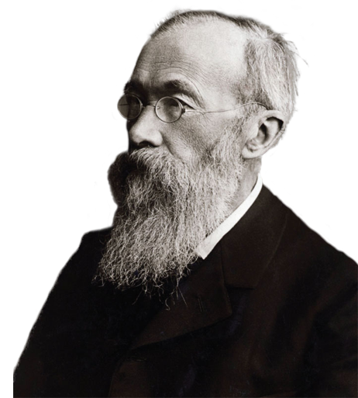
History of Psychology
Structuralism
  Wilhelm Wundt (1832-1920)
  Focused on uncovering the fundamental mental components of consciousness, thinking, and other kinds of mental states and activities
  Introspection: Procedure used to study the structure of the mind in which subjects are asked to describe in detail what they are experiencing when they are exposed to a stimulus

Slide 12
History of Psychology
Criticisms of structuralism
  Introspection was not a scientific technique
  People had difficulty describing some kinds of inner experiences
These drawbacks led to the development of newer approaches

Slide 13
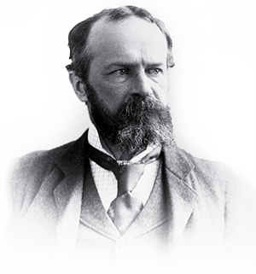
History of Psychology
Functionalism
  William James (1842-1910)
  Concentrated on what the mind does and the role of behavior in allowing people to adapt to their environments

Slide 14
History of Psychology
Gestalt psychology
  Hermann Ebbinghaus, Max Wertheimer, and others
  Focuses on the organization of perception and thinking in a whole sense rather than on the individual elements of perception
  “The whole is different from the sum of its parts”

Slide 15
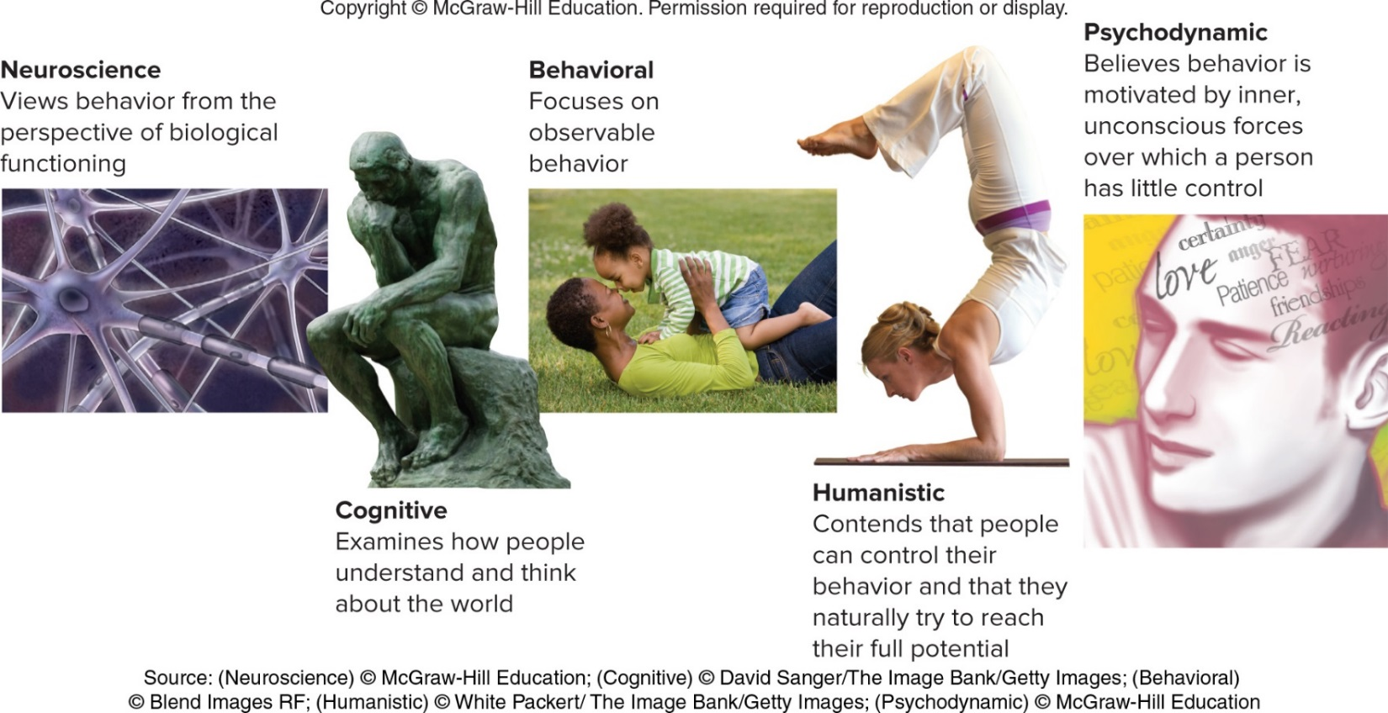
Contemporary Approaches

