Slide 1

D
BI 201/ BA 291 Business Law & Options for starting up a business
by Parichat Jantori

Slide 2
Group activities:
If you're managing the following companies, what are the laws you think specifically apply to your business?

Slide 3


Case: Liebeck v. McDonald's Restaurants (McDonald's coffee case and the hot coffee lawsuit)
a woman who was heavily burned by hot coffee purchased from fast food restaurant McDonald's was rewarded $2.86 million.
Her attorneys argued that McDonald's coffee was "defective," claiming it was too hot and more likely to cause serious injury than coffee served at any other establishment

Slide 4
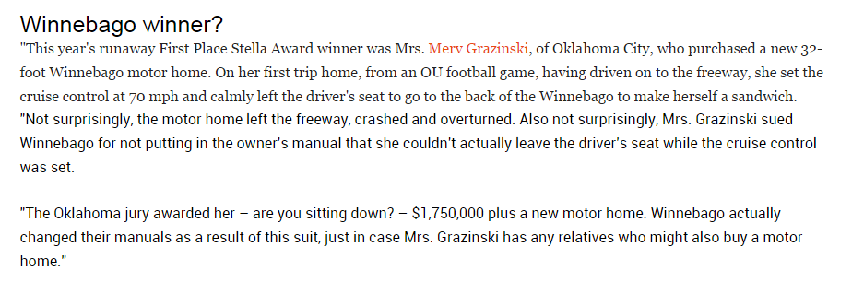
Case:

Slide 5
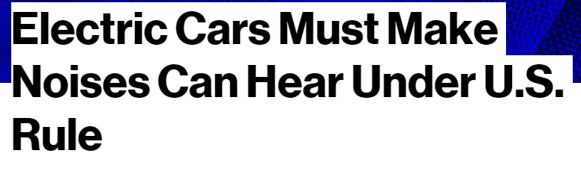
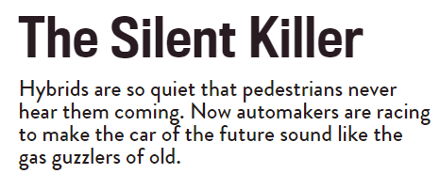

Case:

Slide 6
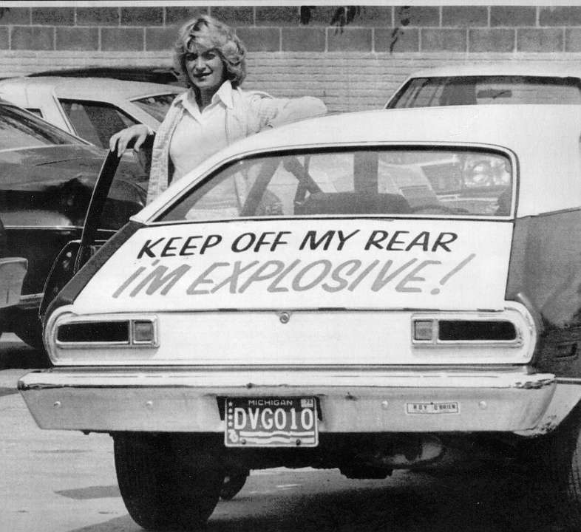
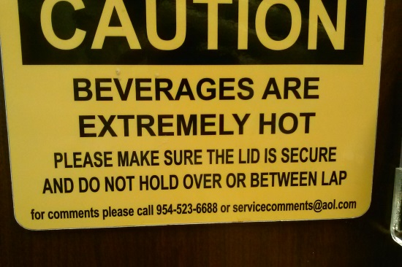
Product liability
Product liability is the area of law in which manufacturers, distributors, suppliers, retailers, and others who make products available to the public are held responsible for the injuries those products cause
manufacturing defect
design defect
a failure to warn
Notes:
The primary difference between a manufacturing defect and a design defect is that a manufacturing defect is a mistake in the process of building a product that would be safe if it were built as designed, while a design defect makes a product inherently unsafe.
Failure-to-warn claims typically involve a product that is dangerous in some way that's not obvious to the user or that requires the user to exercise special precautions or diligence when using it.
Examples of a failure-to-warn claim include:
an electric tea kettle that is packaged without sufficient warning concerning its oddly positioned steam valve
a cough syrup that does not include on its label a warning that it may cause dangerous side effects if taken in combination with another commonly taken drug such as aspirin, or
a corrosive paint-removing chemical that is sold without adequate instructions for safe handling and use.

Slide 7
Question for discussion
How product liability law affects business?
Who carry product liability?
What should company do?
Notes:
https://legalvision.com.au/what-is-product-liability-how-can-you-protect-your-business-from-it/

Slide 8
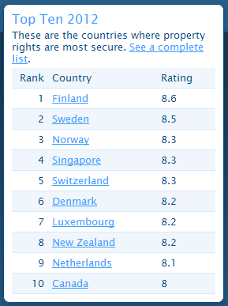
Property rights
International property right index
Legal and Political Environment (LP)
Physical Property Rights (PPR)
Intellectual Property Rights (IPR)
Questions for discussion:
What includes in property right?
Why firm should concern on property right?
How to prevent intellectual property right abroad?
Notes:
http://internationalpropertyrightsindex.org/profile?location=thailand
http://handy-sparen.de/china-faket-nicht-nur-iphones-app-store-ladengeschaeft-kopiert/
http://de.wikipedia.org/wiki/Farbmarke

Slide 9
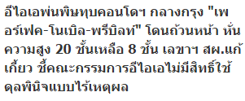

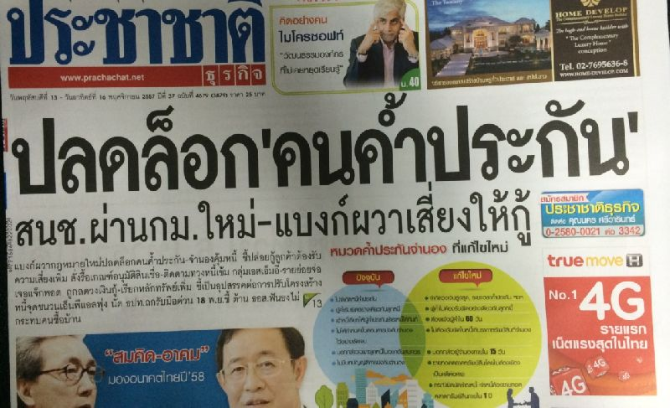
Cases:

Slide 10
Key Takeaway
Law and regulations affect your business in many ways:
Permission to operate
Rights to sue or to be sued, Right to hold asset or land
Business conducts e.g. opening hours, labor regulation, consumer right, product liability, competition, technological requirement, keeping record of business transaction etc.
Cost of business e.g. tax, minimum wage requirement, employee rights and benefits, environmental requirements
Business protection e.g. intellectual property (trademark, patent, copy right)

Slide 11
Key Takeaway
Some laws apply to businesses in general
Business organization
Contract law
Bankruptcy and reorganization
Tax law
Labor law
Intellectual property
Consumer protection
Trade competition law (or anti-monopoly law)
Exchange control
Dispute resolution (Litigation or arbitration)

Slide 12
Group think:
If you look at companies doing a business, some of them define themselves as Partnership, PLC, co. Ltd.?
Why is so?
How does this different form impact your business?
If you have to choose a legal form of business, how would you make your decision?

Slide 13
Key Takeaway
There are different legal form of business in Thailand.
Each form provides some advantages and disadvantages for business.
There is no one size fits all answer, which form is the best.
Depends on type and size of business, preference for liability, management duties, funding options, flexibility, tax duty etc.

Slide 14
Sole proprietorship
Characteristics:
unincorporated business owned by individual, that is not incorporated
no legal distinction between the owner and the business
the owner receives all profits (subject to taxation specific to the business) and has unlimited responsibility for all losses and debts
Sole owner of the business is fully liable for any liabilities of the business (unlimited liability)
pay personal income tax
typically small business with less than 50 employees

Slide 15
Sole proprietorship
A sole proprietor has capacity to conduct any business which does not require a specific form of business organization
If business has a sales volume from 20 baht per day or the total of goods from 500 baht, it must be registered “Commercial registration ”.
More information about Commercial registration http://www.dbd.go.th
Note: Capacity of types of individuals may be limited, e.g. minor, incompetent person, semi-incompetent person, person of unsoundmind.

Slide 16
                minor (under 20 years) - voidable unless prior consent by parent(s)
                incompetent person (unsound mind + court order) - voidable unless prior consent by guardian
                quasi-incompetent person (certain characteristics + court order) - voidable unless prior consent by curator
                unsound mind - void if contract entered into at a time when one party was actually of unsound mind, and the other party had knowledge of such unsoundness.

Slide 17
Sole proprietorship
Advantages of a Sole Proprietorship
Ease and cost of formation
Secrecy
Distribution and use of profits
Flexibility and control of the business
Government regulation
Taxation (pay income tax)
Disadvantages of a Sole Proprietorship
Unlimited liability
Limited sources of funds
Limited skills
Lack of continuity
Lack of qualified employees
Taxation (deduction max. 60,000 Baht)

Slide 18
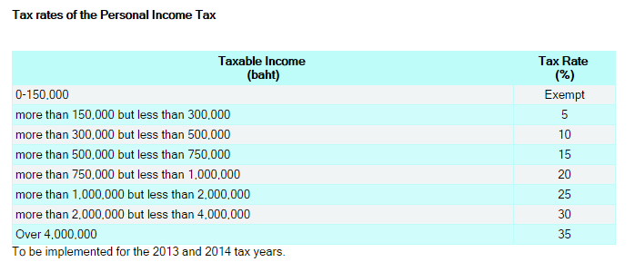
Personal Income Tax
Personal income tax: a tax levied on the total income of individuals (with some deductions/ allowances exemption permitted)
See the form: http://www.rd.go.th/publish/fileadmin/tax_pdf/pit/PIT91_070158.pdf

Slide 19
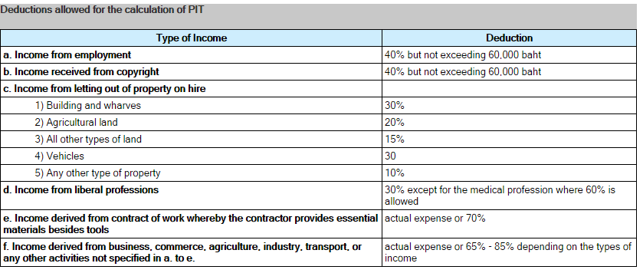
Personal Income Tax

Slide 20
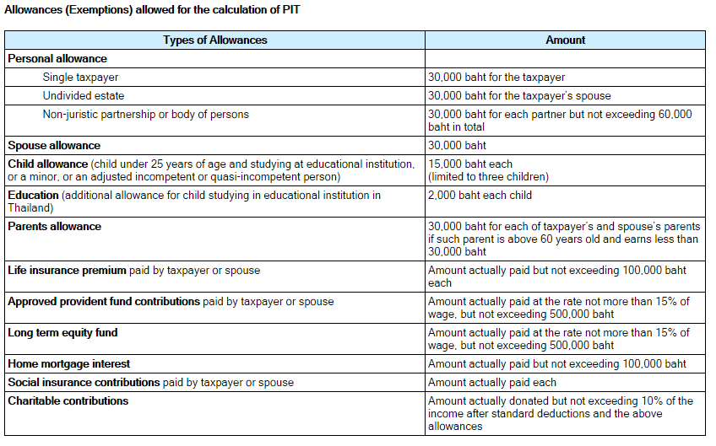
Personal Income Tax

Slide 21
Partnership
A form of business organization defined by the Uniform Partnership Act as “an association of two or more persons who carry on as co-owners of a business for profit”
3 Forms of partnership
Unregistered ordinary partnership (ห้างหุ้นส่วนสามัญไม่จดทะเบียน)
Ordinary partnership (ห้างหุ้นส่วนสามัญ)
Limited partnership (ห้างหุ้นส่วนจำกัด)

Slide 22
Partnership
 | Unregistered Ordinary Partnership | Registered Ordinary Partnership | Limited Partnership
Nature of Organization | No separate entity Partnership has no legal entity | Separate entity from the partners Partnership has legal entity | Separate entity from the partners Partnership has legal entity
Number of owners | 2 or more | 2 or more | 2 or more
Taxation | PIT | CIT | CIT
Liability | All partners are jointly and unlimitedly liable for all the obligations of the partnership. | All partners are jointly and unlimitedly liable for all the obligations of the partnership. A partner may make a claim on behalf of the partnership against third parties. Creditors must exhaust all assets of the partnership before they can pursue claims against the individual partners. | All partners are jointly and unlimitedly liable for all the obligations of the partnership. A partner may make a claim on behalf of the partnership against third parties. Creditors must exhaust all assets of the partnership before they can pursue claims against the individual partners.

Slide 23
 | Unregistered Ordinary | Registered Ordinary | Limited Partnership
Scope of activities | All partners are bound by the acts done by any of them in the ordinary course of the business of the partnership. | A registered ordinary partnership is able to engage in any of the activities within the scope of the objects registered. | A limited partnership is able to engage in any of the activities within the scope of the objects registered.
Procedure of establishment | No establishment is required. Normally, partners enter into a Partnership agreement with each other | Registration with the MOC is required. | Registration with the MOC is required.

Slide 24
Corporate Income Tax
The corporate income tax rate in Thailand is 20 % on net profit. However, the rates vary depending on types of taxpayers.
In calculating CIT, deductible expenses are as follows:
1. Ordinary and necessary expenses. However, the deductible amount of the following expenses is allowed at a special rate:
- 200% deduction of Research and Development expense,
- 200% deduction of job training expense,
- 200% deduction of expenditure on the provision of equipment for the disabled;
2. Interest, except interest on capital reserves or funds of the company;
3. Taxes, except for Corporate Income Tax and Value Added Tax paid to the Thai government;
4. Net losses carried forward from the last five accounting periods;
5. Bad debts;
6. Wear and tear;
7. Donations of up to 2% of net profits;
8. Provident fund contributions;
9. Entertainment expenses up to 0.3% of gross receipt but not exceeding 10 million baht;
10. Further tax deduction for donations made to public education institutions, and also for any expenses used for the maintenance of public parks, public playgrounds, and/or sports grounds;
11. Depreciation

Slide 25
Articles of Partnership
Articles of partnership (หนังสือบริคณสนธิ): Legal documents (required for registration of limited partnership and registered ordinary partnership) that set forth the basic agreement between partners which contains
Name, purpose, location of the partnership
Duration of the agreement
Authority and responsibility of each partner
Character of partners (i.e., general or limited, active or silent)
Amount of contribution from each partner
Division of profits or losses
Salaries of each partner
How much each partner is allowed to withdraw
Death of partner
Sale of partnership interest
Arbitration of disputes
Required and prohibited actions
Absence and disability
Restrictive covenants
Buying and selling agreements

Slide 26
Advantages and Disadvantages of Partnership
Disadvantages
Unlimited liability (for general partner)
Business responsibility – all partners are responsible for business actions of all others
Life of the partnership (= life of the general partnership, 2-persons partnership terminated when partner dies or withdraws)
Distribution of profits – profits are distribute to partners by share or as specified in article of partnership
Limited sources of funds – shares are not sold to public
Taxation of partnerships (income + corporate)
Advantages
Ease of organization- requires articles of partnership
Availability of capital & credit- greater earning power and credit rating
combined knowledge & skills
Decision making
Regulatory controls – few regulations controls affecting its activities
May convert into private limited company

Slide 27
Dissolution of Partnership
Terms of contract of partnership provide for it.
A definite period of time descried in the terms of partnership has expired.
The partnership was formed for a single undertaking, which has been completed.
Any of the partners gives due notice to the others (withdrawal)
Upon death, bankruptcy or incapacity of a partner (general partner)
exception: the partnership can continue to exist if the remaining partners buy the shares of the withdrawing partner.

Slide 28
Private Company Limited
Characteristics:
the most common structure for conduction business in Thailand
established by at least 3 people (Private company), 15 people (Public company)
Separate entity from its shareholders
has legal entity
able to own property and carry on the business under its name
stockholders can buy, sell, give or receive share as gifts or inherit them
Stockholders are entitled to all profits may be distributed (dividends)
liability to the third parties is separate from individual liability of its shareholders
liability of the shareholders is limited to the value of an individual shareholder‘s unpaid share capital
Private companies limited have fewer company management duties than public companies limited.
Can be converted to Public company

Slide 29
Private Company Limited
A private company limited is able to engage in any of the activities within the scope of the objects set forth in its MOA (Memorandum of Association).
Registration with the MOC is required.
Corporate tax, distribution of dividend is subject to 10% withholding tax
Notes:
http://www.set.or.th/th/regulations/tax/tax_p1.html

Slide 30
Public Company Limited
Characteristics:
a minimum of 15 promoters is required registration of a public limited company
separate entity from its shareholders
legal entity
Pay corporate tax, distribution of dividend is subject to 10% withholding tax
The shareholders will not be liable for any liabilities caused by the public company limited (limited liability/ limited to the share)
no restriction on the transfer of shares
can offer its shares to public - the stock of public company can be sold, bought and traded to anyone
at least 50% of the directors must reside in Thailand; and board meetings must be held at least once every three months.

Slide 31
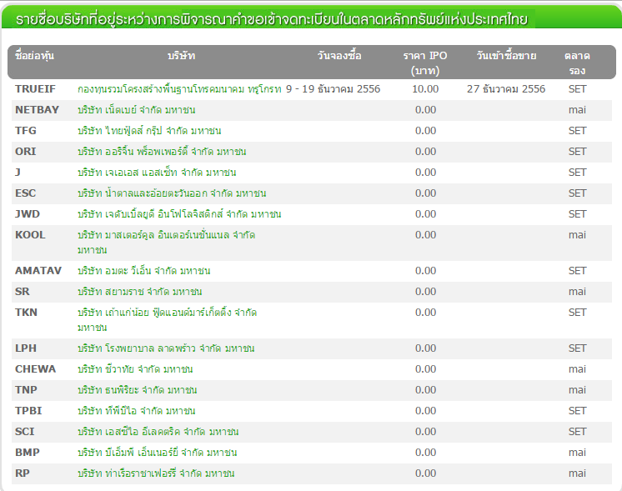
IPO (Initial Public Offering)
The IPO is selling a corporation’s stock on public markets for the first time. Because going public raises cash, and usually a lot of it.

Slide 32
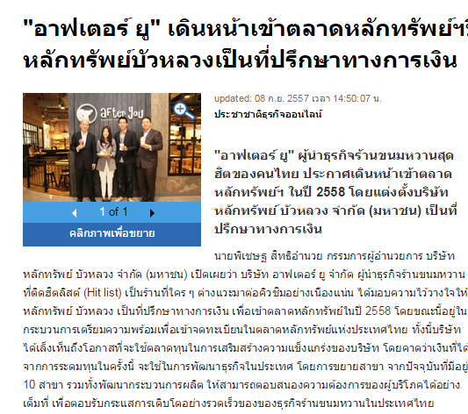
IPO of After you
http://www.prachachat.net/news_detail.php?newsid=1410162700

Slide 33
Difference between SET and mai
SET provides a market for large companies with more than THB 300 million in paid-up capital after IPO to raise long- term funds.
mai, on the other hand, is a source of funding for small and medium-sized enterprises, having over THB 200 million in paid-up capital after IPO.
However, from the viewpoint of firms applying to the Securities Exchange Commission (SEC) for an IPO, there are no regulatory differences.

Slide 34
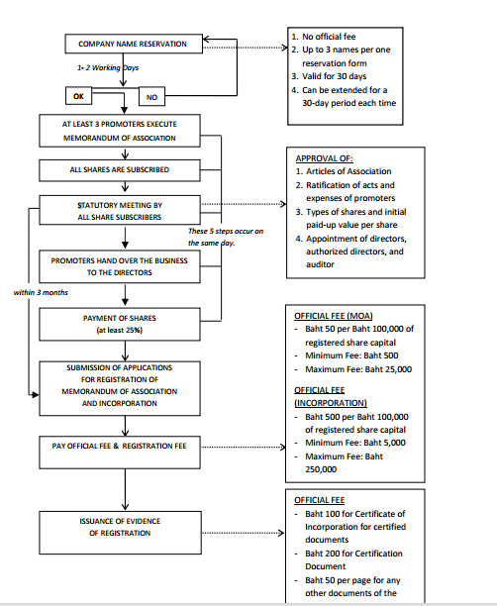
Registration of a Company

Slide 35
Management of Limited Company
The company’s business is to be managed by the directors of the company as appointed at the meeting of the shareholders
Inside Directors – individuals who serve on the board and are employed by the corporation (usually executives of the corporation).
Outside Directors – individuals who serve on the board who are not directly affiliated with the corporation (usually Executives of other corporations).
A supervisory board is a group of individuals chosen by the stockholders of a company to promote their interests through the governance of the company and to hire and supervise the executive directors and CEO (two-tier board system e.g. Germany)

Slide 36
Duties of Limited Company
prepare their financial statement at least once in every 12 months and has at least one auditor and present it to the general meeting of the shareholder for the approval
hold a general meeting within 6 months from the date it is registered as a juristic person and hold this meeting as least once in every 12 month
give its share certificates to the shareholders and arrange shareholder registration book
In case that there is any change in the registered items, the company has to register the new information to the registrar at the partnership/company registration office where the head office is situated

Slide 37
Dissolution of a Company
The company shall be dissolved in any of cases as follows:
(1) when the meeting of shareholders resolved to dissolve the company with votes not less than three-fourths of the total number of votes of the shareholders attending the meeting and having the right to vote;
(2) when the company becomes bankrupt;
(3) when the court orders dissolution of the company under Section 155 and the order is final.

Slide 38
Advantages and Disadvantages of Company
Advantages:
  Limited liability
  Transfer of ownership
  Perpetual life
  External sources of funds
  Expansion potential
Disadvantages:
  Double taxation
  Forming a corporation
  Disclosure of information
  Employee-owner separation

Slide 39
Small business and SMEs
Definition:
Small business is any independently owned and operated business, not dominant in its competitive area, employing less than 500 people.
Definition from EU
An enterprise which employs fewer than 250 persons and has an annual turnover not exceeding EUR 50 million and/or an annual balance sheet total not exceeding EUR 43 million

Slide 40
SME
According to Thai Law, SME is…
Type of business | Number of employees |  | Asset in million baht
 | Small | Middle | Small | medium
Production | Less than 50 | 51-200 | Less than 50 | 51-200
Wholsalers Retailers | Less than 25 Less than 15 | 26-50 16-30 | Less than 50 Less than 30 | 51-100 31-60
Service | Less than 50 | 51-200 | Less than 50 | 51-200

Slide 41
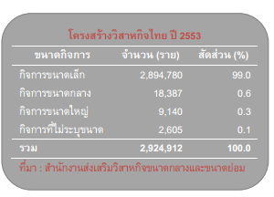
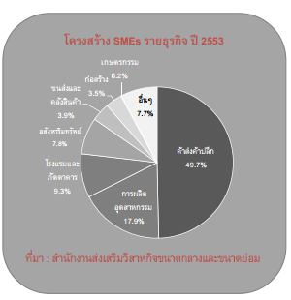
SME in Thailand

Slide 42
Impact of Small Business
80% of all new jobs, annually, created by small business in the last 10 years
boost domestic consume, reduce export
Small businesses responsible for 37% of GDP
Account for 44% of all sales in the country
Initial of potential business
Create value for domestic product and resources
provide wide variety of quality products

Slide 43
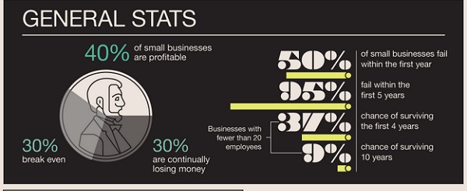
SME in Trouble

Slide 44
Group Discussion: Why SMEs fail?
Provide suggestions on how to reduce failure rate?
Notes:
http://business-easy-easy.blogspot.com/2010/11/blog-post_08.html

Slide 45
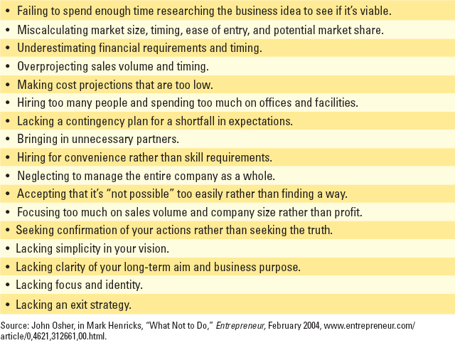
Most Common Mistakes Made by Startup Businesses

Slide 46
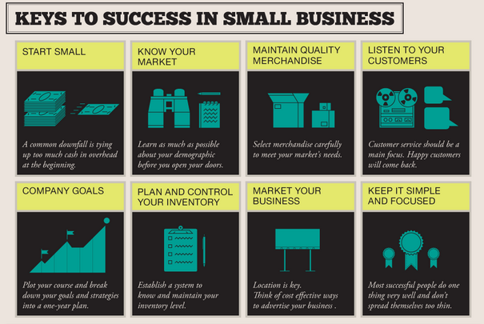
Notes:
http://thumbsup.in.th/2013/03/most-tried-and-failed-sme/

Slide 47
The Success SME – German Mittelstand
More than 99 percent of German companies are SMEs
Even seemingly small companies with 50 to 100 employees often have customers, and receive orders from, all over the world (98% of German exports are from SME)
The principal sales argument for their products and services is not usually one of price, but the quality and the large number of innovations that have found practical implementation. Many German SMEs are technology driven.
German SMEs put high value on Human Resource
Notes:
http://thumbsup.in.th/2013/03/most-tried-and-failed-sme/

Slide 48
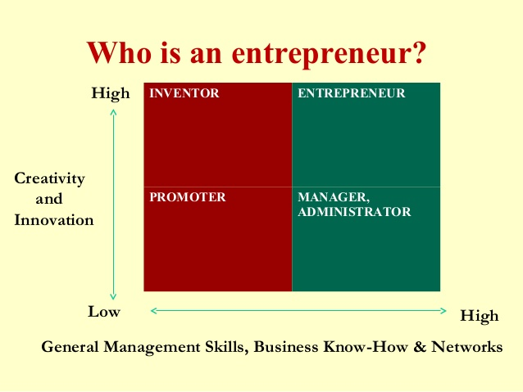
Entrepreneurship
Notes:
http://thumbsup.in.th/2013/03/most-tried-and-failed-sme/

Slide 49
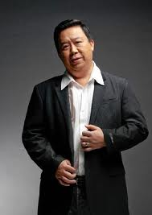
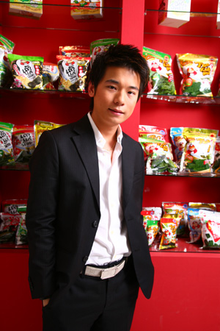
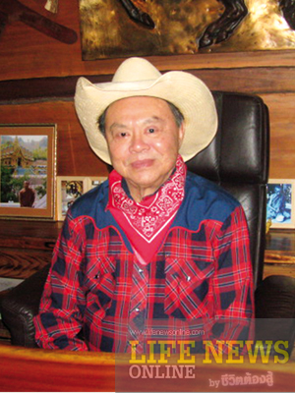
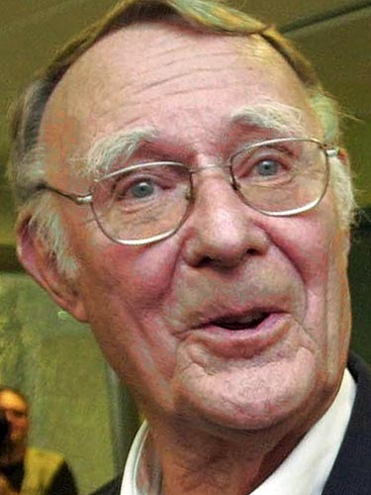
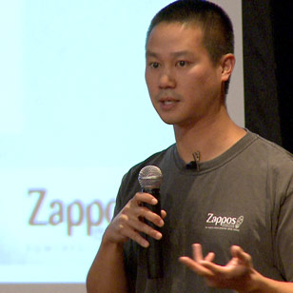
Entrepreneurship
Initiative (Idea+ Opportunity) Risk taking Persisting

Slide 50

Entrepreneurship
Jeff Bezos founded Amazon.com, Inc. in 1994 and the site went online in 1995. The company was originally named Cadabra, Inc., but the name was changed when it was discovered that people sometimes heard the name as "Cadaver". The name Amazon.com was chosen because the Amazon River is one of the largest rivers in the world and so the name suggests large size, and also in part because it starts with "A" and therefore would show up near the beginning of alphabetical lists. Amazon.com started as an online bookstore, but soon diversified, selling almost everything.
Notes:
Internet gold rush, dot-com bubble
The meaning of logo
Since 2000, Amazon's logotype is an arrow leading from A to Z, representing customer satisfaction (as it forms a smile); a goal was to have every product in the alphabet.^{[7]}

Slide 51
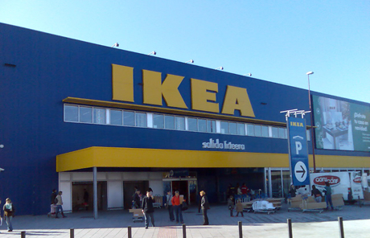
Entrepreneurship
The founder of IKEA, Ingvar Kamprad, was born in Småland, in the south of Sweden. He was raised on a farm, near the small village of Agunnaryd. Even as a young boy his entrepreneurial skills were showing. He started by selling matches to neighbors when he discovered that matches could be purchased inexpensively in bulk and resold at a lower price but still with a profit. From matches, he expanded to selling fish, Christmas tree decorations, seeds and later ball-point pens and pencils.
In 1943, when Ingvar was 17, his father gave him a gift for succeeding in his studies, he used this to establish his own business
which is selling the furniture.
Notes:
Der damals 17-jährige Ingvar Kamprad gründete das Unternehmen 1943 in Schweden. Das Akronym IKEA setzt sich aus den Anfangsbuchstaben von Ingvar Kamprad, des elterlichen Bauernhofs Elmtaryd und des Dorfes Agunnaryd zusammen, in dem der Hof lag.^{[2]}Zunächst verkaufte die Firma diverse Konsumgüter, darunter Kugelschreiber, Brieftaschen, Bilderrahmen, Tischdecken, Uhren, Streichhölzer, Schmuck und Nylonstrümpfe.
1947 begann Kamprad auch Möbel per Versand zu verkaufen, besonders an die Bauern der historischen Provinz Småland. So konnte er die Kosten vom Hersteller bis zum Kunden niedrig halten.
1951 erschien der erste IKEA-Katalog. Das Geschäft konzentrierte sich nun nur noch auf Möbel. In IKEA-Katalogen wurden bald Möbel nicht nur als einzelne Objekte, sondern als Teil eines gesamten, fertig eingerichteten Zimmers abgebildet. Diese Darstellungen waren zur damaligen Zeit ungewöhnlich. Die Kataloge wurden zum Bindeglied zu den Kunden und zum wichtigsten Marketinginstrument des Unternehmens.
Ab 1955 bot Kamprad erstmal eigens für IKEA entworfene Möbel an. Die Möbel wurden um Montage- und Versandkosten zu sparen, ab 1956 als Bausatz verschickt.
IKEA-Möbelhaus in Älmhult
Am 28. Oktober 1958 eröffnete in Älmhult das erste IKEA-Möbelhaus.

Slide 52
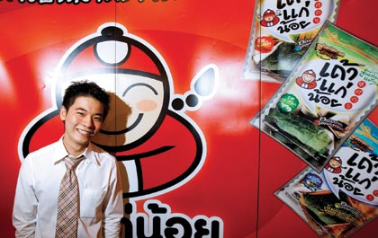
Entrepreneurship
Founded by Ittipan Kulpongvanich
His first business was selling the items on game-online. But as the popularity of the online-game decreased, he started doing something else.
His next idea was operating a franchise for chestnut. He later added others product line into his franchise and one of that is seaweed. But his business didn’t run smooth at first, but he kept trying. Now his products has 70% of the market shares. He is a young millionaire.

Slide 53
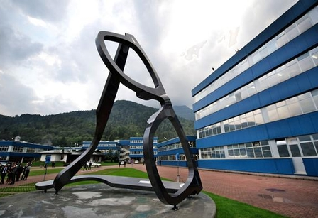
Entrepreneurship
An orphanage who has passionate in glasses. At that time, in Italy, there was a few number of players in market and glasses are lack of design. That was a huge gap, since he believe glasses is not help us to see things better but it’s a thing help improving our personality.
He set up a company called Luxottica. And Luxottica is the producer of Armani glasses and many brands around the world.
Now he is the 2nd riches guy in Italy and 74th richest guy in the world.

Slide 54
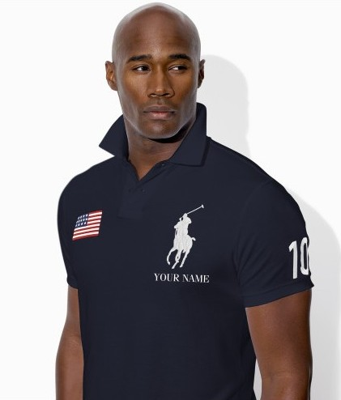
Entrepreneurship
A guy had to stop his study because he had financial problem and started working in a clothe shop. He is poor but has a very good fashion taste. He observed how people dress and followed the fashion trend on magazine.
Starting with new design of necktie, he entered clothe business. His most famous design is a polo shirt with a horse on the left side in 24 colors. He is Ralph Lauren who earns 6000 Million Dollars a year.

Slide 55
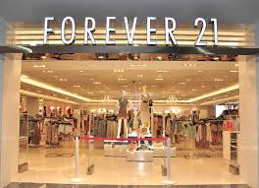
Entrepreneurship
Do Won Chang and Jin Sook, an immigrant pair from Korea who moved to America with nothing, but a big dream. They cannot speak English and that was a barrier to get a job. However, they did what they could. And learnt English by themselves.
Do Won Chang and Jin Sook spotted a problem in America, that clothe and fashion is different from Korea. There is a large number of Asian people living here, so it would be a market. With all the saving they had, they opened a small shop called Fashion 21. Trendy clothes with designed are well-accepted by the market. Fashion 21 turned to be Forever 21 and has more than 500 outlets around the world.

Slide 56
Entrepreneurship
27 years-old Joe Gebbia and Brain Chesky were in trouble finding money to pay rent. They came up with the idea letting people rent their air beds during a big events in town, where all hotels were full-booked. Breakfast was also included in price. They signed up a domain called www.airbedandbreakfast.com A business idea worked quite well, but still lacking of sustained way to generate money.
After getting fund from a venture capital, they improved the website and change business model. They charge commission directly, 3% from home providers and 12% from guest. And change website to airbnb.com

Slide 57
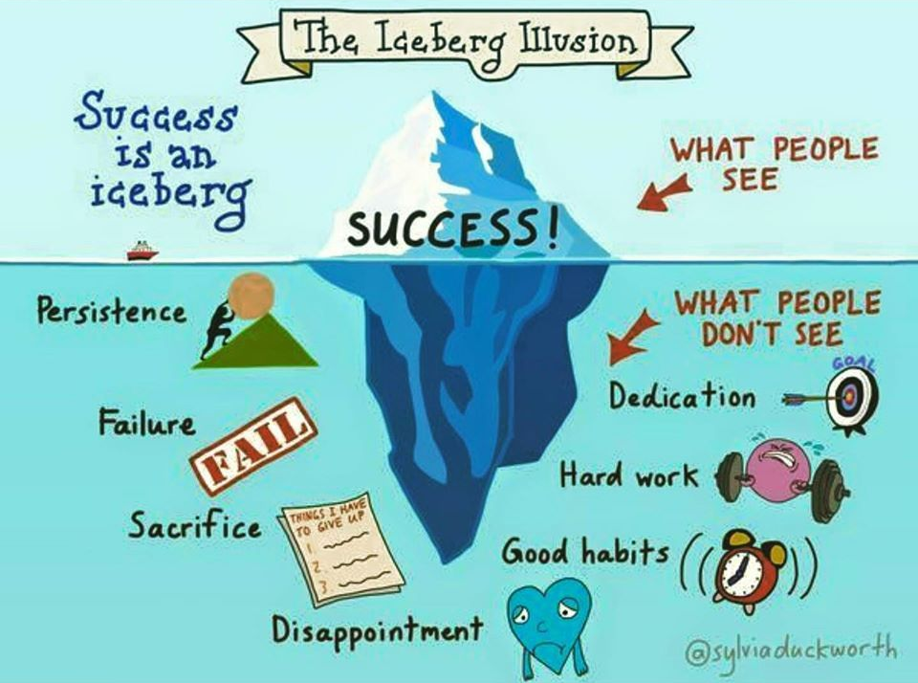

Slide 58


