Slide 1
NOTICE:
This presentation is based upon opinions of the group presenting alone. And have no intention on attacking any companies in particular. It is the audiences to use own judgment in analyzing the information.
We hereby will not stand responsible for any damages in whatever way.

Slide 2
IS FOOD
CONGLOMERATE VICIOUS ?
Chorpaga Udomvanich 5404640194
Gunn Jutiprasert 5404640269
Ekasit Kunadirekwong 5404640251
Jirayu Leangsiriwattanakul 5404640329
Natnicha Srirungroj 5404640541
Peerada Pitaksit 5404641481

Slide 3
What is “Food Conglomerate”

Slide 4
Food Conglomerate
A conglomerate is a combination of two or more corporations engaged in entirely different businesses that fall under one corporate group, usually involving a parent company and many subsidiaries. Often, a conglomerate is a multi-industry company.
Conglomerates are often large and multinational.

Slide 5
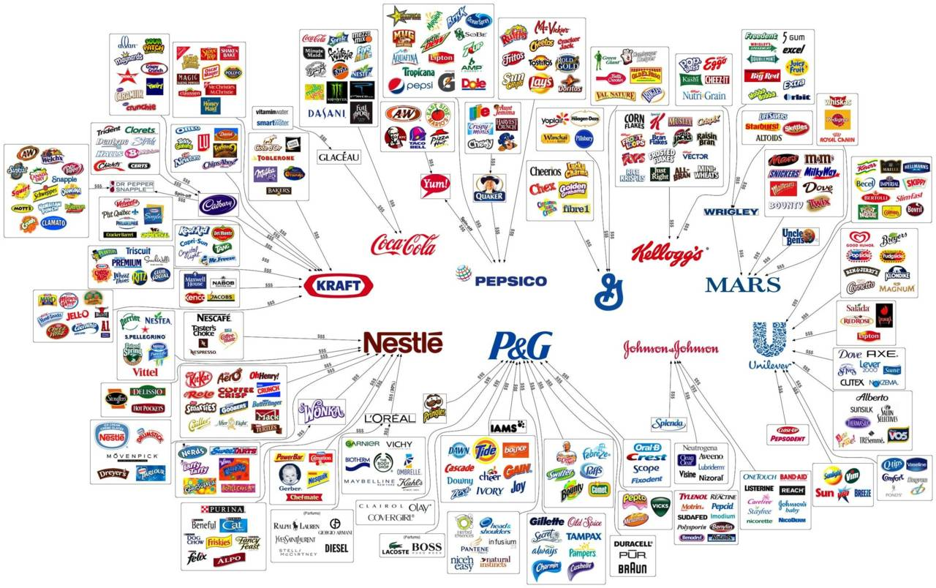

Slide 6
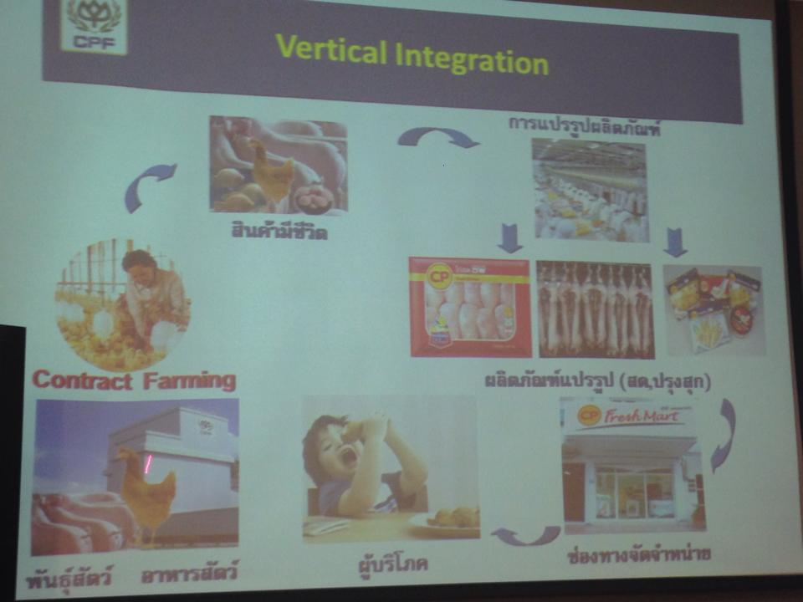

Slide 7
Vicious?

Slide 8
Depends…….

Slide 9
Legally Vicious
OR
Morally Vicious

Slide 10
What Food Conglomerate is doing?
Contract Farming
Support Animal Farming + minimum wages
Guarantee the Price
Guarantee the Market

Slide 11
To be part of Contract Farming
Land
30% Capital
Creditability

Slide 12
Animal feed + Minimum Wages
Breeders
Medicine
Guarantee the Price
Know-how
Guarantee the Market
Know-how
Feed
Vaccine
Know-how
Advice
Technology
Advice
Technology
Advice
Technology

Slide 13
200,000 farmers participated in
Contract Farming Program
More than

Slide 14
Testimonials
Let’s hear from Farmer

Slide 15
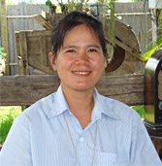
Let’s hear it from Egg’s Farmer
“Many people think that it was a huge investment but I think it worth for investing. If you look in the long run, this technology will reduce the cost. It only takes 6 people from 15 to produce the same amount of eggs. Moreover, the development of the farming system alone is not enough, we have to concern about the environment as well. Our farm adopted the bio-gas system which help eliminate the smell. Furthermore, we can use gas to create electricity which decrease around 70% of electricity expense. Electricity is the main expense of production. Therefore, if we can reduce this cost, we will receive more revenue.”
by Saowaruk Luangraynoo @ Singhaburi
62,000 layer chickens

Slide 16
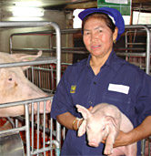
Let’s hear it from Pig’s Farmer
“At first, we known nothing about raising pig but with help of CP. They advised us from beginning, starting from building the animal housing, raising the pig and preventing the disease. They advised us in all aspect including the market so we do not have to worry about where to sell the pig or the price of the pig. CP will buy the qualified piglet from our farm and then sell it out to other pig farmers. We decided to borrow the largest amount of money in our life to invest in this project. In only two years, we were able to expand our farm and have sustainable income of 100,000 baht per month.”
By Sompong Aiummuang @ Subhanburi
220 pigs

Slide 17
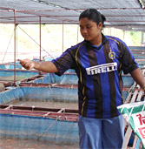
Let’s hear it from Fish’s Farmer
I was working in the factory before. The wage was less than 200 baht per day. If I want anything I have to purchase on installment every time. I have no saving because only me and my husband living expense make it difficult to live on daily basis. I worked in factory until I have my first child in 2005. At that time, CP was supporting fish farming. I took a research and think about the possibility of doing fish farm. I found that the investment is not that high and CP also gave an advice and took care of the market for me. So I decided to take this opportunity, I can say that I was the first comer in this field. I borrowed around 400,000 baht to build the first 20 net cages. It took 4 years to repay all the loan. The income is vary around 40,000 to 70,000 bath per month depends on how many fish we caught to sell.
By Daoreung Srikrajae @ Pitsanulok
60 Net cages

Slide 18
Let’s hear it from CP

Slide 19

Mr. Narong Jiamjaibunjong
Vice Senior President of Charoen Pokphand Food Plc.

Slide 20
Untold truth from Farmer
Pay short term debt
Don’t take this business seriously
Cheats on contract
Sell Company’s animals
Don’t have 30% Capital Investment
Share animal’s feed with their own animals

Slide 21
Is it also not morally wrong?

Slide 22
Let’s find out

Slide 23
Contract farming
Is it Controversial?

Slide 24
Untold truth from Food Conglomerate
All risk & damages → farmer
All debts & obligations → farmer
Standards → Company Equipment will needed to change periodically
All foods, medicines & livestock prices → Company

Slide 26
Why don’t the farmers revoked the contract?

Slide 27
Farmer’s Debt
Initial Investment 2,000,000 to 3,000,000
Case of 0% death rate of livestocks (Chicken)
Expected Return in 40 days : 100,000
Expected total costs in 40 days : 80,000 (exclude owner cost of living)
Profit : 20,000
Annual expected return : 12 x 20,000 = 240,000

Slide 28
Case of single owner (No family)
Cost of living per 40 days : 50% of total profit
20,000 x 50% = 10,000 leftover profit
Annual 120,000 or 240,000 left over profit per year
Total debt 2,000,000 < 120,000
12.66 years in order to breakeven in normal case
(Case of 2% death rate, excluding epidemic bird flu and flood)

Slide 29
Vicious Cycle
Debt
More Debt
More & More Debt

Slide 30
Successful Case from CP

Slide 31
Farmer Selection

Slide 32

Consumer who agree with food conglomeration
Assure Quality
Standard and control in each process
Specialization and lower cost
Low price

Slide 33
Consumers who disagree with food conglomeration
Take advantage over farmer
Monopoly pricing
Asymmetric information

Slide 34
Conclusion of the two sides from food conglomeration
ONE SIDE BENEFIT
EFFICIENTCY
BRIBE
SECRETS
LOW PRICE
FAIRNESS
UNFAIRNESS
SPECIALIZATION
POLLUTION
LOW COST
ASYMETRICINFORMATION
HIGH QUALITY
MONOPOLY PRICING
HIGH SATISFACTION

Slide 35
Thailand
VS
International

Slide 36

Producer
Standardization lead to contract farming
Farmer
Not reading the contract carefully sometime leads to failure of the contract
Consumer
Receive high and standard quality products
Control quality by providing firm standard input
To prevent animal disease that can widespread to consumer by strictly control the production chains
To maximize firms’ profits
Successful contract leads to positive effect on both sides if the contract is fair
Limited alternatives of brands
One of the biggest food conglomeration firm in the world
They focus on domesticate crops
Similarly to food conglomeration of CP in Thailand

Slide 37
THANK YOU
Q & A

