Slide 1

BI 201/ BA 291 – Accounting and financial statement
By Aj. Parichat Jantori

Slide 2
Money and Business
Materials, office supplies, equipment, a website and business cards all cost money
A business owner needs to draw a salary to survive. If the business has employees, they must be paid.
A new location, product and marketing research, new services and additional staff if needed can be financed with business funding.
In case of accident, although insurance will cover most catastrophic events, premiums and deductibles have to be paid and there needs to be money in the coffers to pay salaries while the business is repaired.

Slide 3
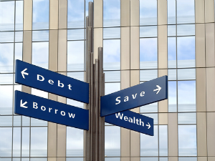
Major financial decisions
Financing decision (how to finance the company, where to find money)
Investment decision (how to spend money for the best benefits)
Dividend decision (whether to distribute the surplus fund to shareholder)

Slide 4

Financing decision
The company can choose to use its own money (owner’s fund) or finance externally.
What are the differences between debt and equity financing?
What are the pro and con of each approach?

Slide 5
Debt vs. Equity
 | Debt | Equity
Maturity date
Claim on asset
Claim on income
Right to a voice in management
Tax benefits

Slide 6
Other funding sources
Grant
Venture capitalist
Crowdfunding

Slide 7
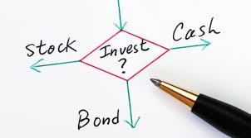
Investment decision
Basis criteria:
Investment must maximize the value of the firm after considering the amount of risk the company feel comfortable with.
It must finance appropriately
If there is no investment opportunity fall under 1,2, the case must be return to shareholder in order to maximize shareholder value.

Slide 8
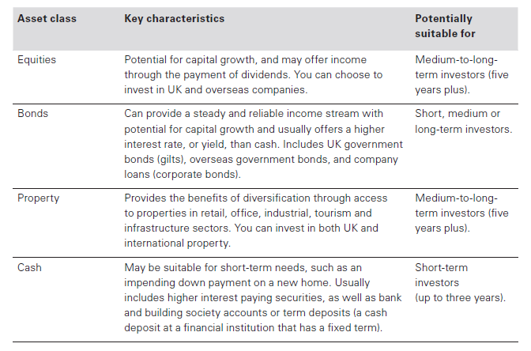
Where to invest

Slide 9
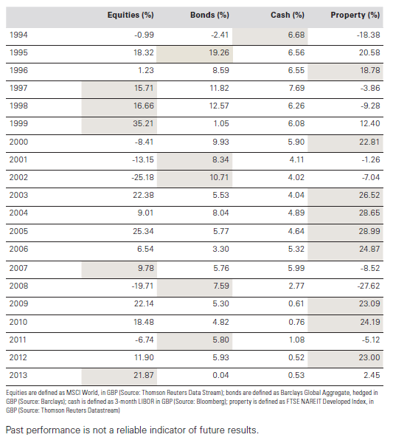
Where to invest

Slide 10
Activity:
Compare the balance sheets from different companies. Discuss following questions in group.
- What are the things they have in common?
What are shown in the balance sheet? How are they listed?
Describe the basic characteristic of the balance sheet.
What could a balance sheet tell you?

Slide 11
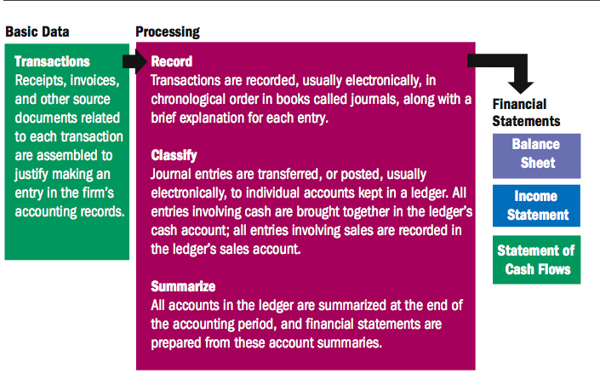
Accounting cycle

Slide 12
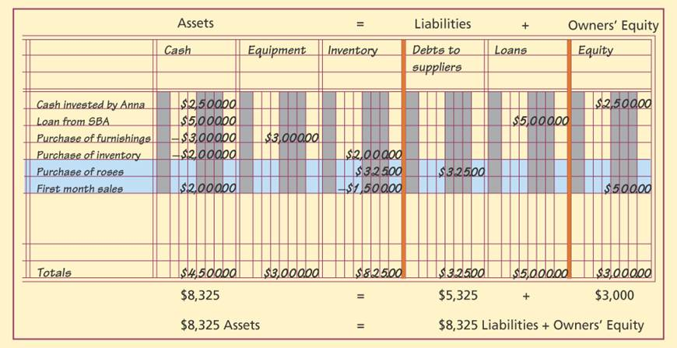
Double-entry bookkeeping
Notes:
Find example: Buchungssätze

Slide 13
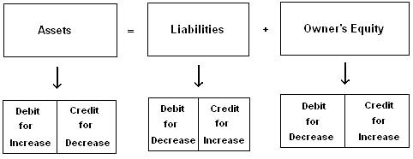
General Ledger
A general ledger account is an account or record used to sort and store balance sheet and income statement transactions.
Examples of general ledger accounts include the asset accounts such as Cash, Accounts Receivable, Inventory, Investments, Land, and Equipment.
Examples of the general ledger liability accounts include Notes Payable, Accounts Payable, Accrued Expenses Payable, and Customer Deposits. Examples of income statement include Sales and Expense etc.

Slide 14
Accounting information
Accounting information
- helps managers to plan and control daily and long-range operations.
shows how well managers are operating the organizations.
are used by union officials in contract negotiating.
helps employee to understand how their work affects the bottom line.
helps potential investor (external user) to evaluate investment opportunities, whether to invest or buy firm’s securities.
helps bankers and creditors to evaluate a potential borrowers’ financial soundness.
Notes:
Open book management Sharing sensitive financial information with employees and teaching them how to understand and use financial statements.
• Viewing financial information may help them better understand how their work contributes to the company’s success.

Slide 15
Financial statement
Financial statements provide managers with essential information needed to evaluate liquidity position of an organization – its ability to meet current obligations and needs by converting assets into cash, the firm’s profitability and its overall financial health.
Important financial statements are:
The balance sheet
Income statement
Statement of cash flow

Slide 16
Financial statement
Who has to provide the financial statement according to Thai law?
Type of business | Balance sheet | Income statement | Statement of changes in shareholders | Statement of cash flows | Financial statement notes
Registered partnership | X | X |  |  | X
Limited liablity company | X | X | X |  | X
Public company | X | X | X | X | X
Legal entity based on foreign law | X | X | X |  | X
Joint venture | X | X | X | X | X

Slide 17
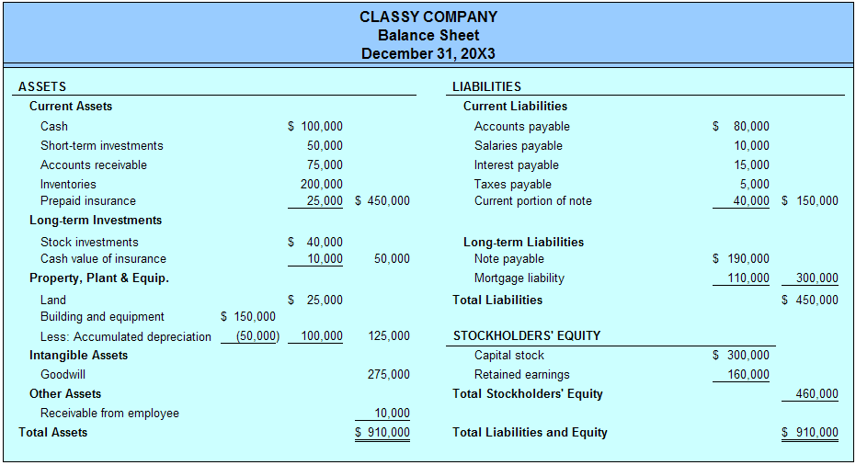
The balance sheet
A “snapshot” of an organization’s financial position
The balance sheet indicate what the organization owns or controls and the various source of funds used to pay for these assets.
The balance sheet takes its name from its reliance on the accounting equation.

Slide 18
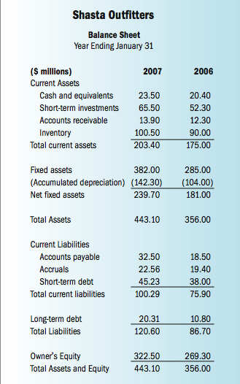

Slide 19
The balance sheet
Assets: The major category for all physical, monetary or intangible goods that have some value
Current assets: Assets that are either cash or are expected to be turned into cash within the next 12 months.
Cash and cash equivalent: cash or checking account
Marketable securities: Short-term investment in securities that can be converted into cash quickly (liquid asset)
Accounts receivable: Cash due from customers in payment for goods received. (sales on credit)
Inventory: Finished goods ready for sale, goods in process, or raw materials
Prepaid expense: A future expense item that has already been paid.

Slide 20
The balance sheet
Non-current assets (fix assets): Assets that are long term in nature or have a minimum life expectancy that exceeds one year
Long-term investment: assets held as investment in bonds or small ownership in other companies
Gross property, plant and equipment: Land, buildings and other fix assets listed at original cost
Intangible assets: non-monetary assets that cannot be seen, touched or physically measured (trade secret, copyright, patents, trademarks, knowhow, goodwill)
Other assets: any other asset that is long term and does not fit into above categories

Slide 21
The balance sheet
Liabilities and stockholders’ equity
Liabilities refer to all indebtedness and loans of both long-term and short-term nature. Stockholders’ equity is all money that has been contributed to the company over the life of the firm by the owners
Current liabilities
Accounts payable: money owned to suppliers for goods ordered. Firms usually have between 30-90 days to pay this account.
Wages payable: money owned to employees for hours worked or salary.
Note payable: short-term loans from banks or other lenders.
Unearned revenue for services paid for by customers but not yet provided
Accrued expense: all unpaid financial obligations incurred by the organization
Other current liabilities: other short-term debts that do not fit above categories

Slide 22
The balance sheet
Long-term liabilities: All long-term debt that will not be paid in the next 12 months
Long term debt: loans of more than one year from banks, pension funds, insurance companies or other lenders (debenture, loan, mortgage)
Stockholders’ equity: owners’ initial amount of investment in the company
Common stock: The tangible evidence of ownership is a security called common stock. The par value is sated value and does not indicate the company’s worth.
Capital in excess of par
Retain earnings: reinvestment of earnings into company assets

Slide 23
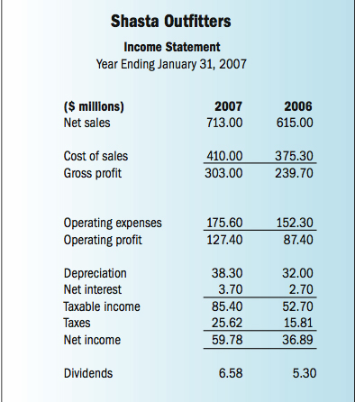
The income statement
The income statement is a financial record of a company’s revenues, expenses, and profits over a period of time (month, quarter, year)

Slide 24
The income statement
Revenues (sales): Total amount of products and service sold over a specific period of time
Cost of goods sold: the cost of producing the goods and services, including the cost of labor and raw material and other expenses associated with production
Operating expense: the cost of promoting, advertising and selling products as well as the overhead cost of managing the company.
Interest expense: A cost of borrowing money
Taxes: The tax rate is specified in the tax law
Depreciation: The process of spreading the costs of long-lived assets over the total number of accounting periods
Net income: Sales minus total expenses, profit after tax

Slide 25

The statement of cash flows
Statement of cash flow provides the information about firm’s cash receipts and cash payments for its operations, investments and financing activities during an accounting period.
Many investors and other users of financial statements want more information about the cash flowing into and out of the firm in order to better understand the company’s financial health.
Notes:
Where the cash is used and where it‘s from

Slide 26

The statement of cash flows
Cash from operating activities:
This section shows how much cash comes from sales of the company's goods and services. Operating cash flows include:
Receipts from the sale of goods or services
Receipts for the sale of loans, debt or equity instruments in a trading portfolio
Interest received on loans
Payments to suppliers for goods and services.
Payments to employees or on behalf of employees
Interest payments
Buying Merchandise

Slide 27
The statement of cash flows
Cash from investing activities
This section largely reflects the amount of cash the company has spent on capital expenditures to keep the business going.
Examples of Investing activities are
Purchase or Sale of an asset (assets can be land, building, equipment, marketable securities, etc.)
Loans made to suppliers or received from customers
Payments related to mergers and acquisitions
Dividends Received

Slide 28
The statement of cash flows
Cash from financing activities
This section describes the goings-on of cash associated with outside financing activities. Typical sources of cash inflow and outflow in financial activities are:
Proceeds from issuing short-term or long-term debt
Payments of dividends
Payments for repurchase of company shares
Repayment of debt principal, including capital leases

Slide 29
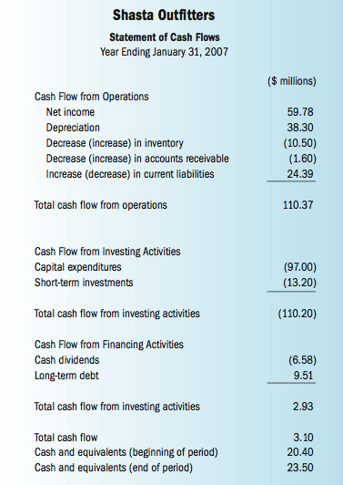
The statement of cash flows

Slide 30
Example
Which company would you like to invest?
 | Company A | CompanyB | Company C
Cash from operating activities | 500000 | 0 | 0
Cash from investing activities | 0 | 500000 | 0
Cash from financing activities | 0 | 0 | 500000
Total cash-flow | 500000 | 500000 | 500000

Slide 31

Financial analysis
The process of evaluating businesses, projects, budgets and other finance-related entities to determine their suitability for investment. Financial analysis is used to analyse whether an entity is stable, solvent, liquid, or profitable enough to be invested in. It indicates the past performance of an organization, the ability to gain profits and ability to manage organizational assets. It helps investors to predict the risks within an organization.

Slide 32
Financial analysis
Trend analysis (Horizontal analysis)
analysis that tries to predict the future movement of a stock based on past data
Common- size analysis (Vertical analysis)
a proportional analysis of financial statements. Each line item listed in the financial statement is listed as the percentage of another line item.

Slide 33
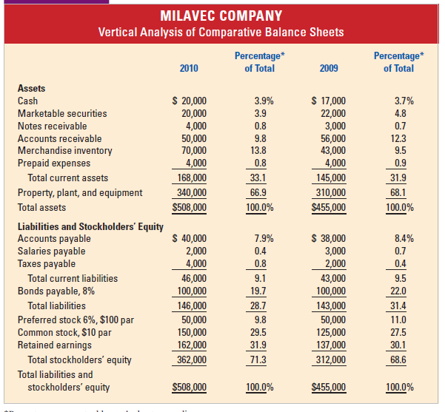
Financial analysis

Slide 34
Financial analysis
Ratio analysis: studying various relationship between different items reported a set of financial statements.
Liquidity ratio: company’s ability to pay back short term debt
Debt ratio (Leverage ratio): company’s long term debt paying ability
Profitability ratio: company’s ability to generate earning
Activity ratio: efficiency in utilization of the asset

Slide 35
Ratios
Base on the financial statement you have. Please calculate the ratios:
Ratio | Formula | Northeast | Average Business Ratio | Direction for improvement
Current Ratio Quick Ratio Cash Ratio Working capital
Debt to total assets Debt to equity
Return on sales (Net margin) Return on owner’s equity Return on Investment
Account receivable turnover Inventory turnover

Slide 36
Example
How would you interpret the ratio in this table?
Ratio | 2000 | 2001 | 2002 | 2003
Current ratio | 2.61 | 2.94 | 1.69 | 2.3
Quick ratio | 0.13 | 0.11 | 0.07 | 0.08

Slide 37
Budget
Planning and control tool that reflects a firm’s expected sales revenues, operating expenses, and cash receipts and outlays.
Management estimates of expected sales, cash inflows and outflows, and costs.
Budgets are a financial blueprint that serves as a financial plan.

Slide 38
Budget
Sales volume
Production volume
Material cost
Labour cost (directly associated with production)
Production cost
Inventory
Sales and overhead cost
Cost of good sold
Approximated income statement
Cash budget
Approx. Statement of cashflow
Approx. Balance sheet

