Slide 1
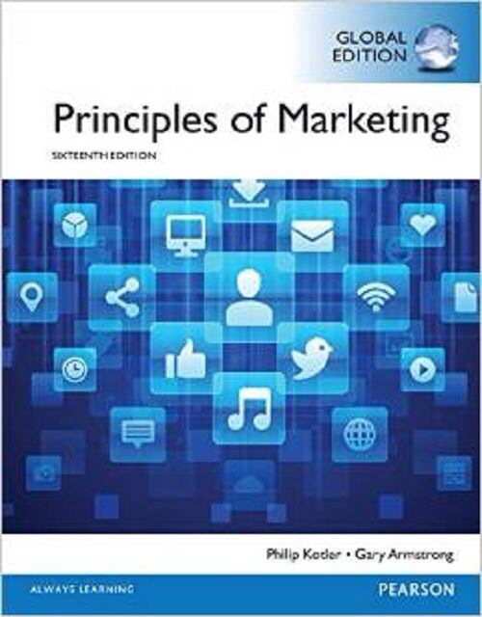
Products & Service Strategy II
Chapter 9
MK 202 Fundamentals of Marketing
By Aj.Suwalya K.

Slide 3
Objective Outline
Objective 1: Explain how companies find and develop new product ideas.
Objective 2: List and define the steps in the new product development process and the major considerations in managing this process.
Objective 3: Describe the stages of the product life cycle and how marketing strategies change during a product’s life cycle.
Objective 4: Discuss two additional product issues: socially responsible product decisions and international product and services marketing.

Slide 4


Google
Google’s famously chaotic innovation process has unleashed a seemingly unending flurry of diverse new products. But at Google, innovation is more than a process. It’s part of the company’s DNA. “Where does innovation happen at Google? It happens everywhere.”

Slide 5

Google innovation machine is renowned for producing new product "moonshots" such as Google Glass, the wearable smart-devices that have everyone buzzing.

Slide 6
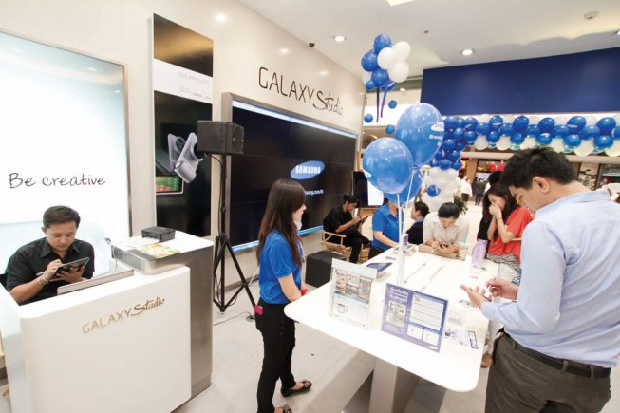
Samsung
Beyond cutting-edge technology and stylish design, Samsung puts the customer at the core of its innovation movement. It’s new products “bring genuine change to people’s lives.”

Slide 7
Objective 1:Explain how companies find and develop new product ideas.

Slide 8
New Product Development Strategy
Obtained in 2 ways
  Acquisitions – by buying a whole company, patent, or license to product someone’s else’s product
  The firm’s new-product development efforts
  New-product development: The development of original product improvements, product modifications and new brands through the firm’s own product development efforts.

Slide 9

Objective 2: List and define the steps in the new product development process and the major considerations in managing this process.

Slide 10
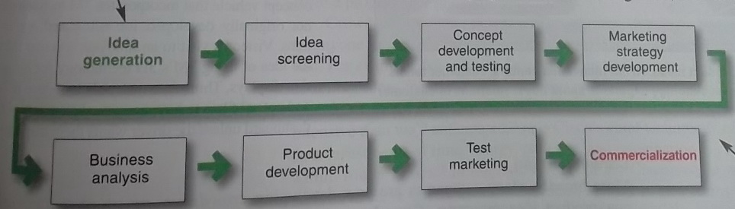
The New-Product Development Process
Figure 9.1 Major Stages in New Product Development
New-product development starts with good new-product ideas-lots of them. For example, Cisco’s I-Prize crowdsourcing challenge attracted 824 ideas from 2,900 innovators representing more than 156 countries.
The remaining steps reduce the number of ideas and develop only the best ones into profitable products. Of the 824 ideas from Cisco’s I-Prize challenge, only a handful are being developed

Slide 11

1. Idea Generation
Idea Generation: The systematic search for new- product ideas
  Internal Idea Sources
Internal product ideas: Twitter hosts and annual “Hack Week: Let’s Hack Together” event, which actively promotes internal innovation through experimentation around the company.

Slide 12

1. Idea Generation
  External Idea Sources
Customer-driven new product ideas: At 3M innovation centers, customer teams meet with 3M marketing and technology experts to spark novel solutions to customer problems.

Slide 13
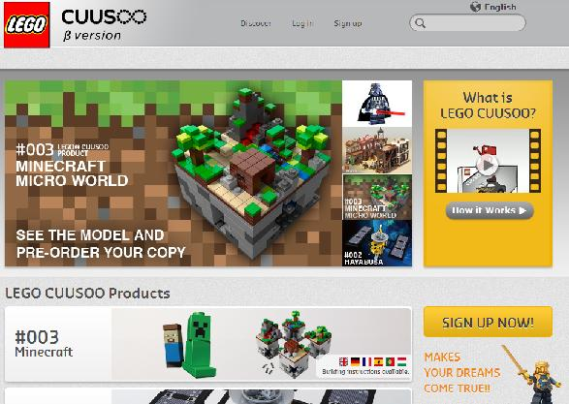
New-product ideas from customers: LEGO’s CUUSOO Web site invites users to submit and vote on product ideas. LEGO Minecraft Micro World racked up the required 10,000 votes in less than 48 hours.

Slide 14
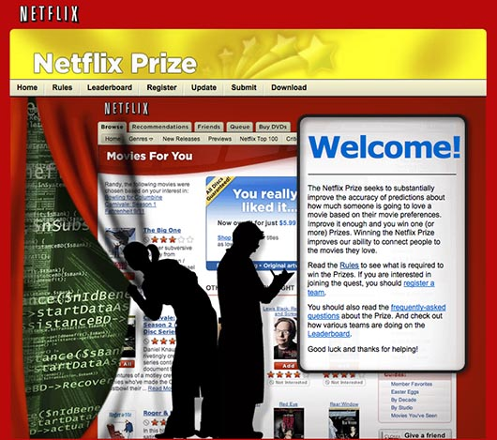
1. Idea Generation
Crowdsourcing: Inviting broad communities of people-customers, employees, independent scientists and researchers, and even the public at large-into the new-product innovation process.
Crowdsourcing: When Netflix wanted ideas for improving the accuracy of its Cinematch online recommendation system, it decided to “open it up to the world,” promising a $1million prize for best solution

Slide 15
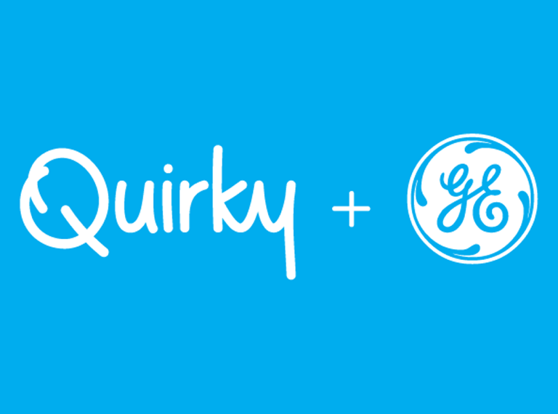

Real Marketing 9.1
Crowdsourcing: Throwing the Innovation Doors wide open
Products invented by real people like Jake
Crowdsourcing: New product start-up Quirky best illustrates the raw power of crowdsourcing in its purest form. "Nobody is innovating at the pace that Quirky is"

Slide 16
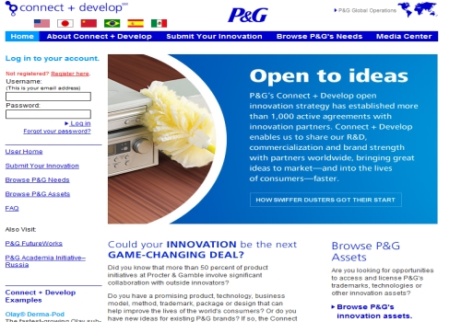
Crowdsourcing: P&G’s Connect and Develop
P&G’s highly successful Connect & Develop crowdsourcing program invites outside innovation partners to help develop new technologies and products that will delight customers.

Slide 17

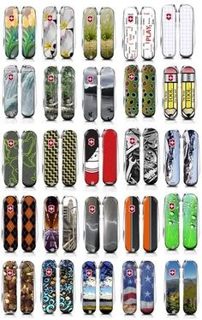
Victorinox used third-party crowdsourcing network jovoto to capture creative designs for limited fashion editions of its venerable Swiss Army Knife. The crowdsourced designed models had 20 percent better sales success than any previous internally created limited editions.

Slide 18
2. Idea Screening
Idea Screening: Screening new-product ideas to spot good ideas and drop poor ones as soon as possible.
R-W-W
  Is it real?
  Can we win?
  Is it worth doing?

Slide 19
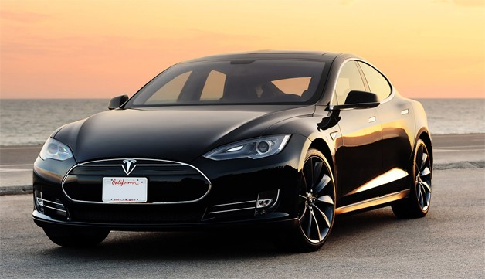
3. Concept Development and Testing
This is Tesla’s initial all-electric roadster. Later, more affordable mass-market models will travel more than 300 miles on a single charge, recharge in 45 minutes from a normal 120 –volt electrical outlet, and cost about one penny per mile to power.

Slide 20
3. Concept Development and Testing
Concept Development
Product Concept: A detail version of the new-product idea stated in meaningful consumer terms.
Develop to find the most attractive one:
Concept 1: An affordably priced midsize car designed as a second family car to be used around town for running errands and visiting friends.
Concept 2: A mid-priced sporty compact appealing to young singles and couples.
Concept 3: A “green “car appealing to environmentally conscious people who want practical, low-polluting transportation.
Concept 4: A high-end midsize utility vehicle appealing to those who love the space SUV’s provide but lament the poor gas mileage.

Slide 21

3. Concept Development and Testing
Concept Development
Concept Testing: Testing new-product concepts with a group of target consumers to find out if the concepts have strong consumer appeal.

Slide 22
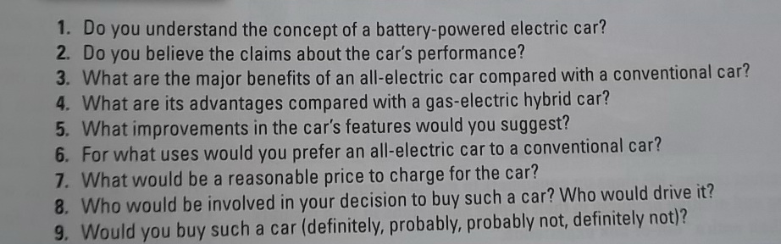
3. Concept Development and Testing
Concept Testing
Table 9.1 Questions for the All-Electric Car Concept Test

Slide 23
3. Concept Development and Testing
Concept Development
Winning :Concept 3
An efficient, fun-to-drive, battery-powered compact car that seats four. This 100 percent electric wonder provides practical and reliable transportation with no pollution. It goes 300 miles on a single charge and costs pennies per mile to operate. It is a sensible, responsible alternative to today’s pollution-producing gas-guzzlers. Its fully equipped price is $25,000.

Slide 24
4. Market Strategy Development
Marketing strategy development: Designing an initial marketing strategy for a new product based on the product concept
The marketing strategy statement consists of three parts
The first part describes:
  Target market
  Planned value proposition
  Sales, market share and profit goals for the first few years

Slide 25
4. Market Strategy Development
The first part:
  Describes the target market
The target market is younger, well-educated, moderate-to-high-income individuals, couples, or small families seeking practical, environmentally responsible transportation. The car will be positioned as more fun to drive and less polluting than today’s internal combustion engine or hybrid cars. The company will aim to sell 50,000 cars in the first year at a loss of not more than $15 million. In the second year, the company will aim for sales of 90,000 cars and a profit of $25 million.

Slide 26
4. Market Strategy Development
The second part:
  Outlines the product’s planned price, distribution, and marketing budget for the first year:
The battery-powered electric car will be offered in three colors-red, white, blue-and will have a full set of accessories as standard features. It will sell at a retail price of $25,000, with 15 percent off the list price to dealers. Dealers who sell more than 10 cars per month will get an additional discount of 5 percent on each car sold that month. A marketing budget of $50 million will be split 50-50 between a national media campaign and local event marketing. Advertising and the Web site will emphasize the car’s fun spirit and low emissions. During the first year, $100,000 will be spent on marketing research to find out who is buying the car and what their satisfaction levels are.

Slide 27
4. Market Strategy Development
The third part:
  Describes the planned long-run sales, profit goals and marketing mix strategy:
We intend to capture a 3 percent long-run share of the total auto market and realize an after-tax return on investment of 15 percent. To achieve this, product quality will start high and be improved over time. Price will be raised in the second and third years if competition and the economy permit. The total marketing budget will be raised each year by about 10 percent. Marketing research will be reduced to $60,000 per year after the first year.

Slide 28
5. Business Analysis
Business Analysis: A review of sales, costs and profit projections for a new product to find out whether these factors satisfy the company’s objectives.
Do objectives meet?
1. Sales forecast – estimate sales..then..
2. Estimate expected costs and profits for the product, including marketing, R&D, operations, accounting, and financial costs.

Slide 29
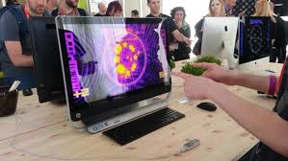
6. Product Development
Product Development: Developing the product concept into a physical product to ensure that the product idea can be turned into a workable market offering.
Product Testing:
HP signs up consumers to evaluate prototype imaging and printing products in their homes and offices to gain insights about their entire “out-of-box experience.”

Slide 30


Product testing: New Balance’s “Weartest Program engages consumers to field test new designs under real world conditions.

Slide 31

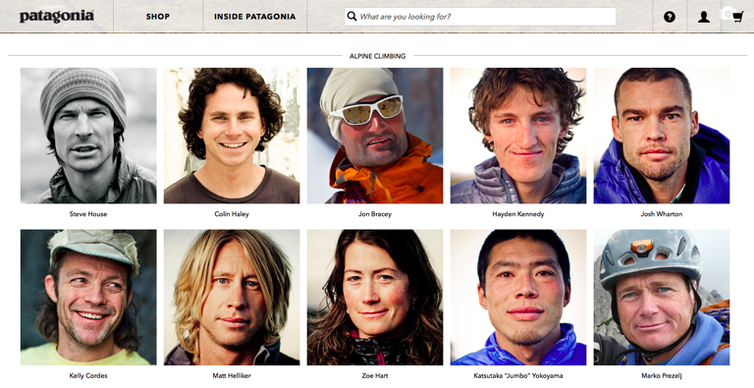
Product testing: Patagonia uses tried-and-true customers-its Patagonia Ambassadors-to help field test its products under harsh conditions and help designers refine them.

Slide 32
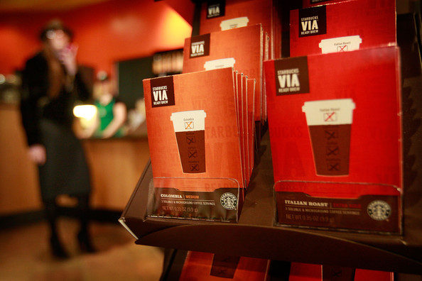
7. Test Marketing
Test Marketing: The stage of new-product development in which the product and its proposed marketing program are tested in realistic market settings.
Starbucks tested its VIA instant coffee extensively before launching new-product nationally. “We knew it could undermine the company if we didn’t do it right”

Slide 33

8. Commercialization
Commercialization: Introducing a new product into the market

Slide 34
Managing New-Product Development
Customer-centered new product development
New-product development that focused on finding new ways to solve customer problems and create more customer-satisfying experiences.
Team-based new product development
An approach to developing new products in which various company departments work closely together, overlapping the steps in the product development process to save time and increase effectiveness.
Systematic new-product development
A company can install an innovation management system to collect, review, evaluate and manage new product ideas.

Slide 35
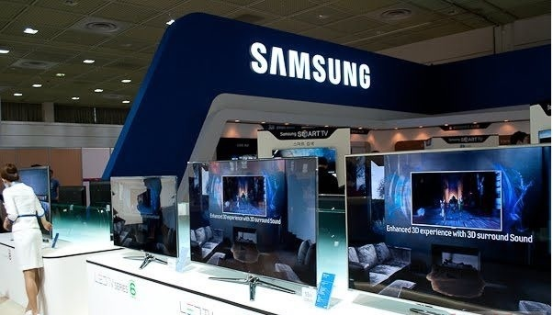
Samsung's entire culture encourages and supports innovation. Every product has to pass the customer "Wow!" Test or it goes straight back to development.

Slide 36
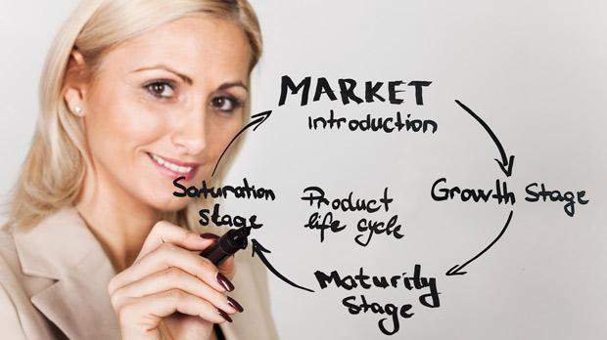
Objective 3:Decribe the stages of the product life cycle and how marketing strategies change during a product’s life cycle.

Slide 37
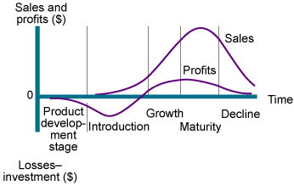
Product Life Cycle Strategies
Product Life Cycle (PLC): The course of a product’s sales and profits over its lifetime.
Figure 9.2 Sales and profits over the Product’s Life from Inception to Decline

Slide 38
Product Life Cycle Strategies
Product Development: begins when the company finds and develops a new product idea. During product development, sales are zero, and the company’s investment costs mount.
Introduction: is a period of slow sales growth as the product is introduced in the market. Profits are nonexistent in this stage because of the heavy expenses of product introduction.
Growth: is a period of rapid market acceptance and increasing profits.
Maturity: is a period of slowdown in sales growth because the product has achieved acceptance by most potential buyers. Profits level off or decline because of increased marketing outlays to defend the product against competition.
Decline: is the period when sales fall off and profits drop.

Slide 39
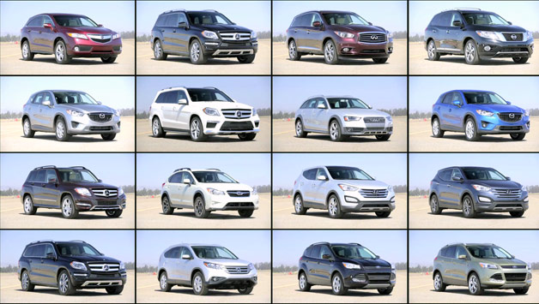
Product Life Cycle Strategies
The PLC can describe:
1. Product class: gasoline –powered automobiles
2. Product form: SUV’s
3. Brand: Ford Escape

Slide 40
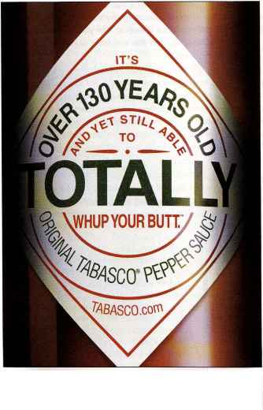
Product Life Cycle: Some products die quickly; others stay in the mature stage for a long, long time. TABASCO sauce is over “140 years old and yet still able to totally whup your butt!”
Some products die quickly, others stay in the mature stage for a long time. For example, TABASCO sauce has been around for more than 140 years. Even then to keep the product young, the company has added a full line of flavors (such as Sweet & Spicy and Chipotle) and a kitchen cabinet full of new TABASCO products(such as spicy beans, a chill mix and jalapena nacho slices)

Slide 41
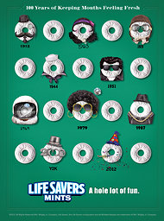
Product life cycle: Some products die quickly; others stay in the mature stage for a long time. Life Savers mints recently celebrated “ 100 years of keeping your mouth fresh.”

Slide 42

Inspiring more usage: The Post-it Brand from 3M's "Go ahead" campaign portrays Post-it Notes as good for much more than just scribbling temporary notes and reminders.Instead, they are a means of self-expression.

Slide 43
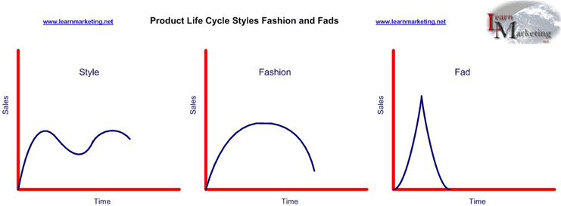
Product Life Cycle Strategies
PLC Concept
PLC concept could be applied to :
Figure 9.3 Styles, Fashion,Fad

Slide 44
Product Life Cycle Strategies
PLC Concept
Style: A basic and distinctive mode of expression
(once invented may last for generations)
  Homes: colonial, ranch, transitional
  Clothing: formal, casual
  Art: realist, surrealist, abstract
Fashion: A currently accepted or popular style in a given field.
(tends to grow slowly for a while and decline slowly)
  1980’-1990’s -> Business Attire
  2000’s -> Business Casual
Fad: A temporary period of unusually high sales driven by consumer enthusiasm and immediate product or brand popularity.
  Pet Rock
  Low Carb Diets

Slide 45
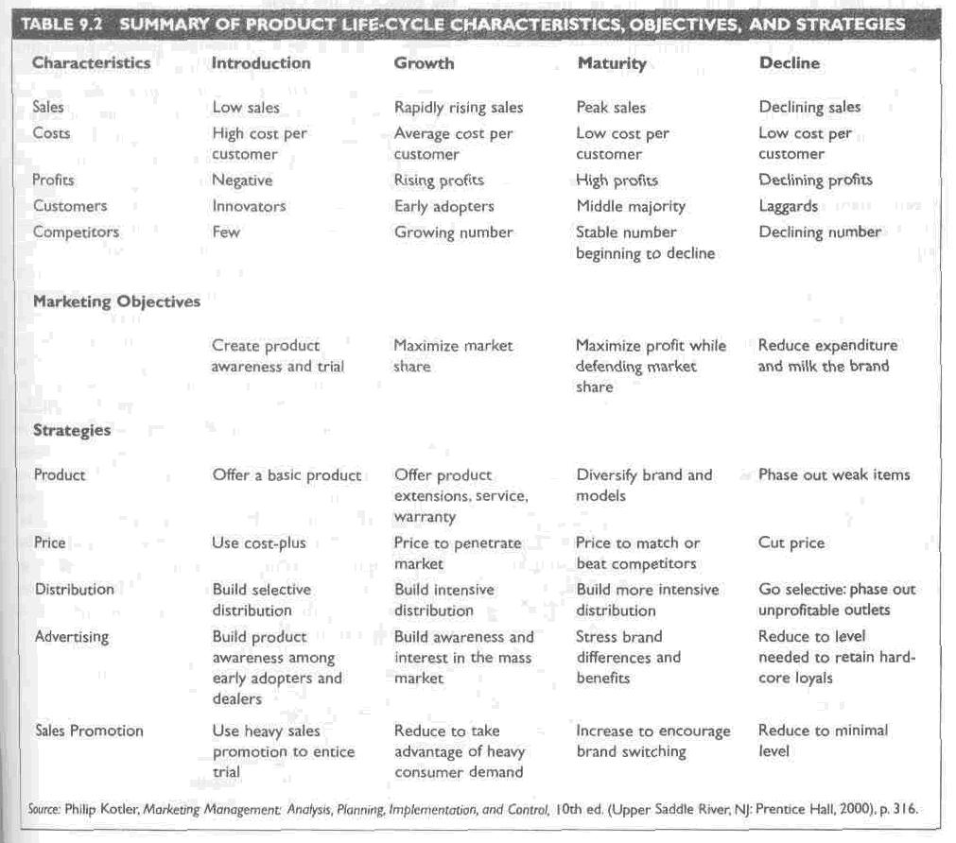

Slide 46
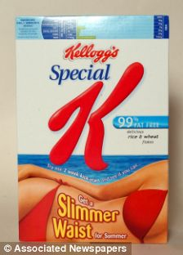
Reinvigorating the mature brand: Kellogg’s kept its 55-year old Special K brand growing by turning it into a healthful, slimming lifestyle brand.

Slide 47
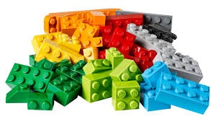
Real Marketing 9.2
LEGO: An Old Brand Story with a New Beginning
LEGO resurrects itself with a new story, building on its foundation of delivering high quality bricks despite a tumultuous history, as it sets new benchmarks in manufacturing and quality control with dynamic, consumer- sustaining business plans.

Slide 48
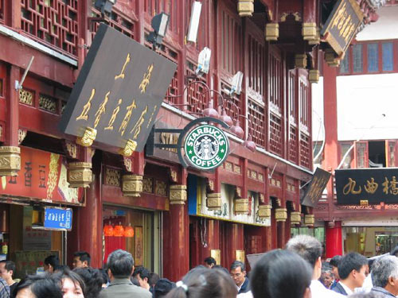
Objective 4: Discuss two additional product issues: socially responsible product decisions and international product and services marketing.

Slide 49


Product Decisions and Social Responsibility
The Federal Food Drug and Cosmetic Act
The Consumer Product Safety Act of 1972 (USA)
  Consumer protection on product safety
  WHAT ABOUT THAILAND?

Slide 50
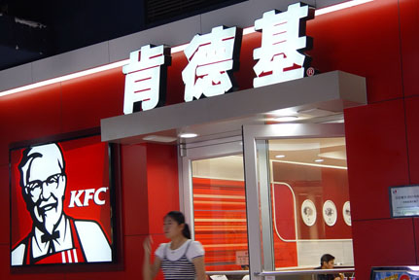
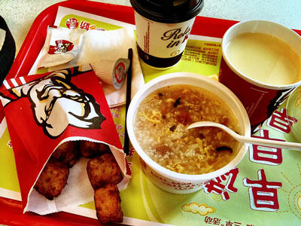
International Product and Services Marketing
Global product adaptation: By adapting to local tastes and eating styles KFC has achieved finger-linkin’ good success in China("dragon twister, chicken with Sichuan spicy sauce and rice and egg soups have become popular)

Slide 51
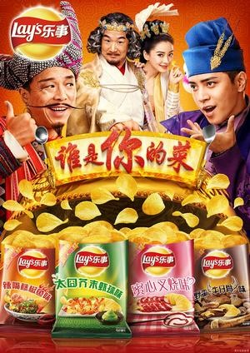
Global product adaptation:Lay's famously funky Chinese chip flavors include cucumber (a best seller), iced lemon tea, "Numb & Spicy Hot Pot," and ShaLa Cui," a concoction that tastes like a baked salad

Slide 52

Individual Homework
Product Life Cycle (PLC)
  Identify a product, service or brand at each stage and explain why they belong to that stage.
  Then give suggestions as a marketer what strategies you will use to handle them?
  Due next week: no more than one page.

Slide 53
Group Homework
Applying the new-product development process you’ve studied, develop an idea for an innovative new consumer product never launched in the market in the category you have chosen. Then you are to develop a brief plan for launching (introducing) it to the market. You do not need to put all steps in the presentation, but the impact is how you could "Wow" consumers with your new product. Please feel free to use charts, graphs, visuals in your presentation. Loosen up and have fun with this.
Due next week:
- 10 power point slides maximum
7 minutes presentation for each group
(everyone in the group to present).

