Slide 1
Chapter 17: Bond Fundamentals
Analysis of Investments &
Management of Portfolios
10TH EDITION
Reilly & Brown

Slide 2
Basic Features of a Bond
Bonds as fixed income securities
  Pay a fixed amount of interest periodically to the holder of record
  Repay a fixed amount of principal at the date of maturity
Bond market is divided by maturity
  Money Market: Short-term issues that mature within one year
  Notes: Intermediate-term issues that mature between one and ten years
  Bonds: Long-term obligations with maturity greater than ten years

Slide 3
Bond Characteristics
Intrinsic Features
  Coupon: Determine the periodic interest income
  Term to maturity: Term bond or a serial bond
  Principal value: Different from market value and the common principal or par value is $1,000
  Type of ownership: Bearer vs. registered bonds
Types of Issues
  Secured (senior) bonds
  Unsecured bonds (debentures)
  Subordinated (junior) debentures

Slide 4
Bond Characteristics
Indenture provisions
  The indenture is the contract between the issuer and the bondholder specifying the issuer’s legal requirements
Features affecting a bond’s maturity
  Callable (call premium)
  Noncallable
  Deferred call
  Nonrefunding provision
  Sinking fund

Slide 5
Rates of Return on Bonds
The Computations of Bond Return
  Holding period return
where:
HPR_{i,t} = the holding period return for bond i during period t
P_{i,t+1} = the market price of bond i at the end of period t
P_{i,t} = the market price of bond i at the beginning of period t
Int_{i,t} = the interest payments on bond i during period t
  The holding period yield (HPY) is
  HPY = HPR - 1

Slide 6
The Global Bond Market Structure
The market for fixed-income securities is substantially larger than the listed equity exchanges (NYSE, TSE, LSE) because corporations tend to issue bonds rather than common stock
For United States during 2010, less than 10 percent of all new security issues were equity, including preferred as well as common stock
Exhibit 17.1 shows the size of the global bond market and the distribution among countries

Slide 7
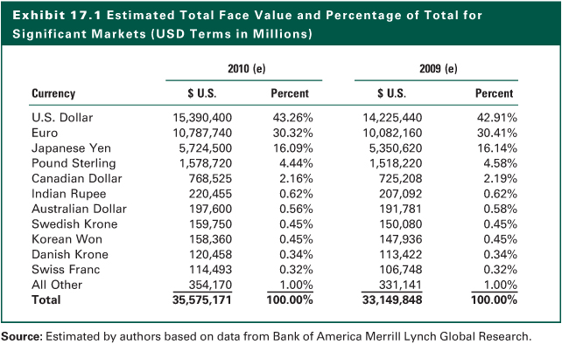
Exhibit 17.1

Slide 8
The Global Bond Market Structure
Participating Issuers
  Sovereign bonds (e.g., the U.S. Treasury)
  Quasi and foreign governments (including agency bonds)
  Securitized and collateralized bonds from governments or corporations
  Directly issued corporate bonds
  High-yield and/or emerging market bonds
  See Exhibit 17.2

Slide 9
The Global Bond Market Structure
Participating Investors
  Individual investors
  Institutional investors
    Life Insurance Companies
    Commercial Banks
    Property and Liability Insurance Companies
    Pension Funds
    Mutual Funds
  Two factors influencing institutions
    The tax code applicable to the institution
    The nature of the institution’s liability structure

Slide 10
The Global Bond Market Structure
Bond Ratings
  Most corporate and municipal bonds are rated by one or more of the rating agencies
  The exceptions are very small issues and bonds from certain industries, such as bank issues. These are known as non-rated bonds
  The three major rating agencies (Exhibit 17.3)
    Moody’s
    Standard and Poor’s
    Fitch Investors Service

Slide 11
Alternative Bond Issues
Domestic Government Bonds
  United States
    T-bills, notes, bonds
    TIPS
  Japan
    Medium term, long term, super long term
  United Kingdom
    Short gilts, medium gilts, long gilts
  Eurozone
    Government bonds

Slide 12
Alternative Bond Issues
Government Agency Issues
  United States
    Not direct issues, but backed by “full faith and credit” of the U.S. government
    GNMA pass-through certificates
  Japan
    Account for about 7 percent of the total Japanese yen bond market
  United Kingdom
    about 13 percent of the pound sterling market is agency and foreign government debt
  Eurozone
    Agency bonds and foreign government bonds are less than 8 percent of the Euro bonds outstanding

Slide 13
Alternative Bond Issues
Municipal Bonds
  General obligation (GO) bonds
  Revenue bonds
  Interest payments are exempt from federal income tax
  Convert the tax-free yield of a municipal bond selling close to par to an equivalent taxable yield (ETY)
    where: i = coupon rate of the municipal obligations
    T = marginal tax rate of the investor

Slide 14
Alternative Bond Issues
Municipal Bond Insurance
  Bond insured against default risk
    Insurance is irrevocable for the life of the issue
  Four private bond insurance carriers
    Municipal Bond Investors Assurance (MBIA)
    American Municipal Bond Assurance Corporation (AMBAC)
    Financial Security Assurance
    Financial Guaranty Insurance Company (FGIC)
  Insured bonds obtain AAA (Aaa) ratings
  Issues with private guarantees have more active secondary market, and lower required yield

Slide 15
Corporate Bonds
U.S. Corporate Bond Market
  Mortgage bonds
  Collateral trust bonds
  Equipment trust certificates
  Mortgage pass-through securities
  Collateralized mortgage obligations (CMOs)
  Asset-backed securities (ABS)
  Certificates for automobile receivables (CARs)
  Credit card receivables
  Variable rate notes
  Collateralized debt obligations (CDOs)
  Zero coupon and deep discount bonds

Slide 16
Corporate Bonds
High-Yield Bonds
  Also known as speculative bonds and junk bonds
  Based on a specification that bonds rated below BBB make up the high-yield market, that is, non-investment grade bonds
  The high-yield bond market exploded in size and activity beginning in the early 1980s (Exhibit 17.6)
  Exhibit 17.7 contains the distribution of ratings for all the bonds contained in the Bank of America Merrill Lynch High-Yield Bond Index
  Major owners of high-yield bonds have been mutual funds, insurance companies, and pension funds

Slide 17
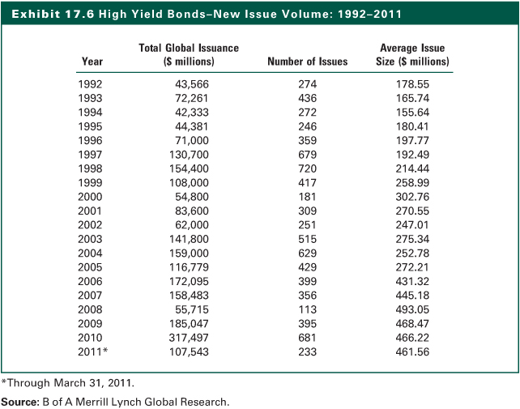
Exhibit 17.6

Slide 18
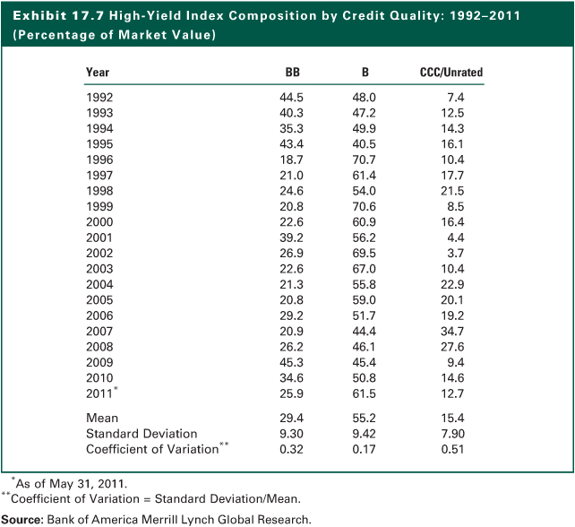
Exhibit 17.7

Slide 19
International Bonds
Foreign bonds are sold in one country and currency by a borrower of a different nationality
  Yankee bonds are U.S. dollar denominated bonds sold in the U.S. but issued by a foreign firm
Eurobonds are underwritten by international bond syndicates and sold in several national markets

Slide 20
International Bonds
United States
  Yankee bonds register with SEC
  Eurodollar bond market affected by changes in value of U.S. dollar
Japan
  Samuri bonds: Yen denominated issued by non-Japanese firms in Japan
  Euroyen bonds: Yen denominated, sold outside Japan

Slide 21
International Bonds
United Kingdom
  Bulldog bonds are sterling-denominated bonds issued by non-English firms and sold in London
  Eurosterling bonds are sold in markets outside London by international syndicates
Eurozone
  Market popular among foreign issuers including issuers domiciled in the U.S.
  Impressive growth in Eurobonds issued by non-residents

Slide 22
Obtaining Information on Bonds
Less emphasis on fundamental analysis
Most bond investors rely on rating agencies for credit analysis
Market and economic conditions
Intrinsic bond features
Popular publications available
  Wall Street Journal
  Barron’s,
  Business Week
  Fortune & Forbes
  Federal Reserve Bulletin
  Survey of Current Business

Slide 23
Obtaining Information on Bonds
Bond Publications
  Treasury Bulletin
  Standard & Poor’s Bond Guide
  Moody’s Bond Record
  Moody’s Bond Survey
  Fitch Rating Register
  Fitch Corporate Credit Analysis
  Fitch Municipal Credit Analysis
  Investment Dealers Digest
  Credit Markets
  Duff & Phelps Credit Decisions
  The Bond Player

Slide 24
Obtaining Information on Bonds
Interpreting Bond Quotes
  Treasury Bulletin
  Standard & Poor’s Bond Guide
  Moody’s Bond Record
  Moody’s Bond Survey
  Fitch Rating Register
  Fitch Corporate Credit Analysis
  Fitch Municipal Credit Analysis
  Investment Dealers Digest
  Credit Markets
  Duff & Phelps Credit Decisions
  The Bond Player

Slide 25
Interpreting Bond Quotes
Corporate Bond Quotes
Last Last EST EST $ VOL
Company (Ticker) Coupon Maturity Price Yield Spread UST (000’s)
Ford (F) 7.45 July 16, 2031 80.625 9.461 503 30 213,645
  Explanations
    Issued by Ford Motor Company with a coupon of 7.45%
    Maturity is July 16, 2031
    The last transaction price was 80.625 percent of par or $806.25, implying an yield to maturity (YTM) of 9.461%
    The computed yield spread for the Ford bond is 503 basis points (5.03%), in comparison with the prevailing yield for a U.S. treasury issue with a maturity of 30 years

Slide 26
Interpreting Bond Quotes
Treasury and Agency Bond Quotes
  Notations
    “n” = treasury note
    “i” = inflation-indexed issue
    “p” = treasury note on which nonresident aliens are exempt from withholding taxes on interest
  Quotes resemble those used for OTC securities because they contain both bid and ask prices

Slide 27
Interpreting Bond Quotes
  The Quotation
Fri. Ask
Rate Mo/Yr Bid Asked Chg. Yld.
5 May 37 112:06 112:08 +62 4.22
  Explanations
    This is a 5 percent Treasury note due in May 2037
    The bid quote is 112:06, implying a bid price equal to 112+6/32. That is 112.1875% of par value. The same applies to ask quote
    If one buys at the asked price, the yield to maturity would be 4.22%

Slide 28
Interpreting Bond Quotes
U.S. Treasury Strips
  “ci” = the coupon interest portion stripped from the note
  “np” = the principal payment for the treasury note
Treasury Bills
  Pure discount instrument: There is no coupon and they pay par at maturity
  The bid-ask quotes are not the prices but rather discount rates from the par

Slide 29
Interpreting Bond Quotes
Municipal Bond Quotes
No. of Bonds Special Price/
Offered Municipal Issuer Characteristics Coupon Maturity YTM Broker
150 INDIANA ST TOLL RD M/S/F 11 9.000 01/01/15EST 6.30 DRIZOS
COMMN TOLL
  Explanations
    $150,000 Indiana State Toll Road bonds with 9% coupon
    M/S/F: Mandatory sinking fund, effective in 2011
    The maturity is 2015
    EST: Sinking fund is put into escrow until maturity
    The yield to maturity is given as 6.3%

Slide 30
The Internet Investments Online
http://www.bondheads.com
http://www.investinginbonds.com
http://www.fitch.com
http://www.moodys.com
http://www.standardandpoors.com/ratings
http://www.bradynet.com
http://www.publicdebt.treas.gov

