Slide 1
Macroeconomics:
An Introduction (1)
Thorn Pitidol
Faculty of Economics, Thammasat University
EE212, Semester 2/2017

Slide 2
Week 1: Economic activity in context
1.1 What is macroeconomics?
1.2 What are the goals of macroeconomics?
1.3 The brief history of macroeconomics?

Slide 3
The distinction b/w micro and macroeconomics
Microeconomics: the study of the economic activities and interactions of individuals, households, businesses, and other groups at the sub-national level
Macroeconomics: the study of how economic activities at all levels create a national (and global) economic environment
Links between macro and micro: economic conditions at the aggregate level, such as rates of unemployment and inflation, create the environment in which individual economic actors make their decisions.

Slide 4
Some more definitions
Macroeconomy: an economic system whose boundaries are normally understood to be the boundaries of a nation
Global-economy: the system of economic rules, norms, and interactions by which economic actors and actions in different parts of the world are connected to one another

Slide 5
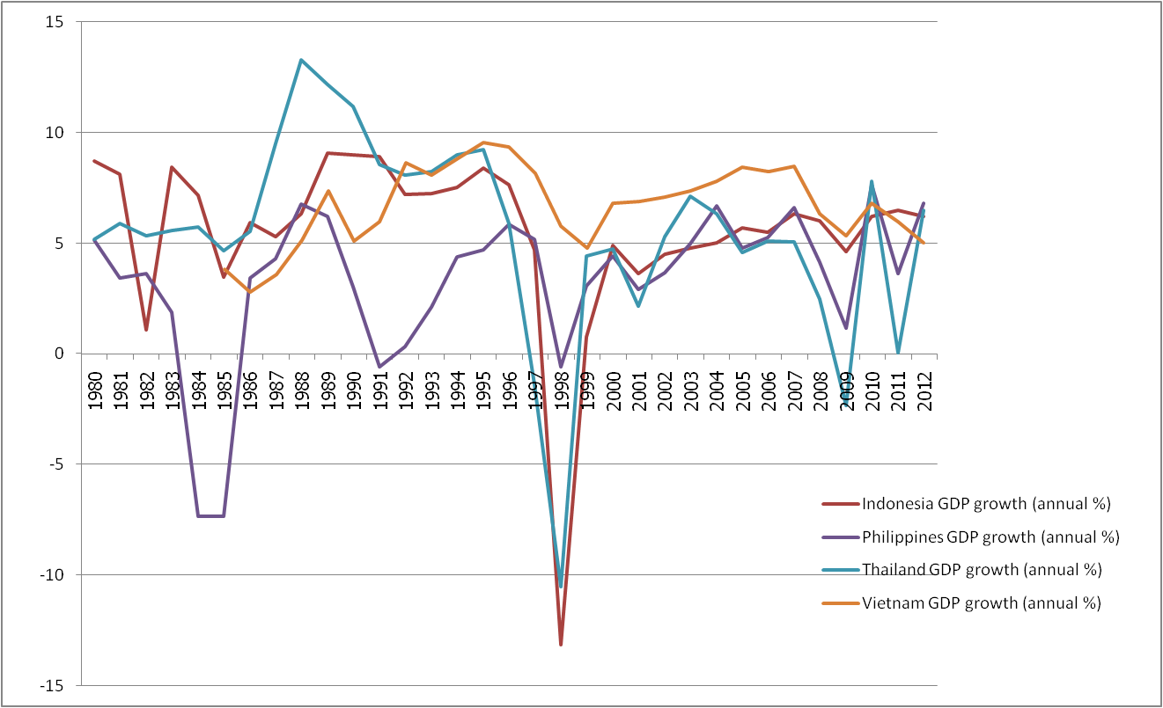
GDP growth, selected countries, 1980-2012
Source: World Bank

Slide 6
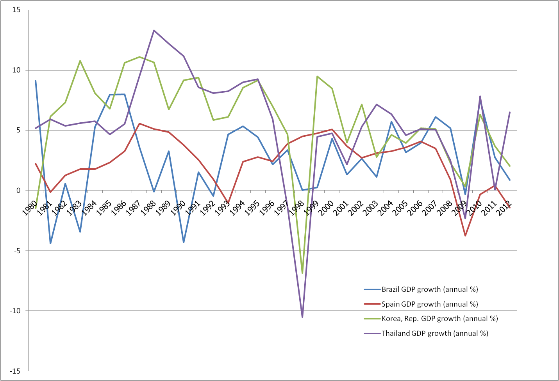
GDP growth, selected countries, 1980-2012
Source: World Bank

Slide 7
Questions
What do you want in life, and how do you think macroeconomic matters to what you want?

Slide 8
Macroeconomic Goals
General goals
  Giving good life
Three major macroeconomic goals
  Raising living standards
  Creating stability
  Ensuring sustainability

Slide 9
Macroeconomic Goals
Raising living standards
  Improving what are important to life
    Consumptions, housing, health, education, entertainment, etc.
  The crucial means to achieve this objective is “economic growth” (i.e. growth in GDP per capita).
  But in the context of developing countries, concerns are also with “economic development” issues such as poverty and inequality

Slide 10
Macroeconomic Goals
Creating stability
  Yet, the unpredictability of economic conditions can be very harmful to your life.
  Another major macroeconomic goal, therefore, is to deal with economic fluctuations
  Stability enables individuals and families to enjoy economic security and to be able to make reasonable predictions about their future.

Slide 11
Macroeconomic Goals
Ensuring sustainability
  How about the future generations?
  Economic sustainability can be made in the following ways
    Financial sustainability
    Ecological sustainability
    Socially sustainable
Do you think there are other goals?

Slide 12
Positive VS Normative
The discussion of “economic goals” are “normative”.
  A statement can be said to be “normative” when it involves the suggestion of “what should be done?”
    A normative statement makes value judgment on what is desirable or undesirable.
While the depiction of “how the economy works” is “positive”
  A positive statement limits what it says to the depiction of reality (past, present, future).
    It is a statement about “facts” which can be tested.

Slide 13
Positive VS Normative
Which one of the following is “positive” or “normative”?
  The world will be a better place without cheese.
  Blue swans do not exist.
  Arsenal plays the most beautiful football in the EPL.
  If it rains tomorrow morning, 10% of BE students will be missing classes.
  Because lowering unemployment will lead to higher inflation, macroeconomist should not attempt to lower unemployment.

Slide 14
The history of macroeconomics
Different historical periods brought about different concerns that underpinned development in macroeconomic ideas
From classical to Keynesian (through Marx)
And from Keynesian to monetarism, and finally to neo-classical economics

Slide 15
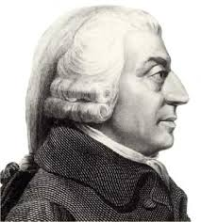
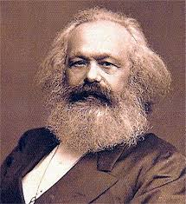
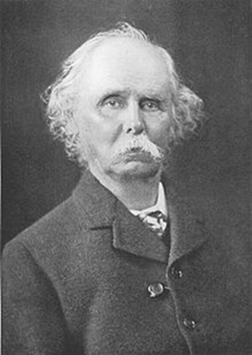
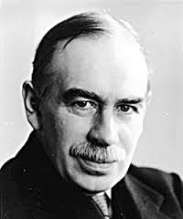
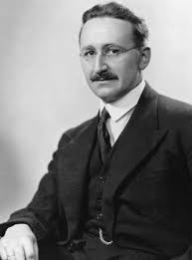
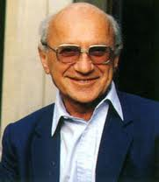
The history of macroeconomics
1723-1790
1818-1883
1842-1924
1883-1946
1899–1992
1912-2006

Slide 16
The history of macroeconomics
Classical period
  Adam Smith and "An Inquiry into the Nature and Causes of the Wealth of Nations“
  In the context of the beginning of industrialisation
    Division of labour (specialisation) is crucial to raising production
    Market can help coordinate self-interested actions of individuals so that they would ultimately serve the social good.
  Through the market system, “the invisible hand” bring the benefits to everyone.
    Have to remember that Smith was a reaction to the prior “mercentilism” (controlled economy).

Slide 17
The history of macroeconomics
  Marxist Economics
    In contrast to the pro-market view, Karl Marx raised a crucial observation on the (unfair) distributions of benefits from industrialisation
  The concern for Marx on the exploitation that occurred from “capitalism”
  And the way Marx sees the world is not just bounded to the working of the markets. He sees the whole society as proceeding through the systematic plot of history.

Slide 18

The history of macroeconomics
  Marxist Economics
  History is the history of “class struggle”, i.e. conflicts between ownership class that controls means of production, and labour.
  In the modern context, this conflict arises between the capitalists and the working class.

Slide 19
The history of macroeconomics
Neo-classical economists
  The revived belief in “markets”
    Market as the most efficient, and also self-regulating
  Alfred Marshall
    The “father” of modern economics
    Founded theories explaining “demand”, which underpins the modern microeconomic understanding of “markets”
    More importantly, Marshall also introduced the concept of “homo-economicus”, posing the understanding of economic agents as individuals seeking to fulfill “self-interests”.

Slide 20
Markets: the core of neo-classical economics
Neo-classical economists tend to see the market system as the most efficient in allocating resources.
  Even most economists accept the advantages of the market, there are still different views on the degree of regulations needed for markets to work,
  In addition, we may also place different values to other economics-related objectives
    Growth, stability, and even inequality.

Slide 21
The history of macroeconomics
Keynesian economics
  In the context of “the great depression”
  Recognise that classical economics, which sees the market as self-regulating, is not adequate in dealing with economic fluctuations
  Keynes offer solutions: boosting aggregate demand
    Through encouraging domestic consumptions, raising government spendings, and lowering interest rates
    Particularly through government investment

Slide 22
The history of macroeconomics
F.A. Hayek
  Contemporary to Keynes
  But saw economic recession more as the result from government attempts to promote economic boom.
    Expansion of market supply leads to artificially low interest rates, prompting misallocation of investments, subsequently causing recession
  Argues that it is better to leave the market to function to deal with economic cycles
    The way to avoid the busts is to avoid the booms that cause them.

Slide 23
The history of macroeconomics
The monetarists
  Led by Milton Friedman
    Put the emphasis on the roles of bad monetary policies as the major factor behind economic crisis
    Suggest that the gov’t should leave the goods market alone, acting rather through controlling the money supply
Neo-liberalism (following Hayek and Friedman)
  Keeping the trend of the “neo-classics”
  Arguing for reducing the government roles and privatising public services
  Pro “free-trade”

Slide 24
The history of macroeconomics
Classical and Keynesian perspectives
  Classical view: economics will naturally settle at full-employment, as wages and price manage to adjust to changes in money supply or unemployment
  Keynesian view: unemployment arises from failure of the labour market to adjust fast enough, leaving room for fiscal and monetary policies to be effective means in coping with fluctuations
  Classical is often seen as “long-run” perspective, while Keynesian is seen as the “short run”.

Slide 25
The history of macroeconomics
Debates remain:
  Classical and neo-classical macroeconomists tend to emphasize market efficiency and argue for the small role of the government.
  While Keynesian macroeconomists emphasise persistent effects of unemployment, and argue for a more active role of the gov't.
    Famous Keynes’s quote: “in the LR we are all dead.”

Slide 26


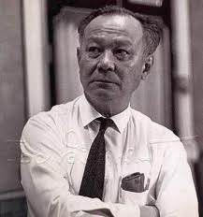
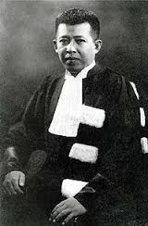
Thai economists in history

