Slide 1

Introducing a ground-breaking approach to help successfully grow your brands
Understanding Consumers’ Needs and Segments

Slide 2

1
Today’s Challenges
2
Brand Growth
3
Motivations
4
Impacting Sales
Notes:
Here is what I will cover

Slide 3

1
Today’s Challenges
2
Brand Growth
3
Motivations
4
Impacting Sales
Notes:
Here is what I will cover

Slide 4


We've been voted the best marketer of the 20th century ... but that's because we were the biggest shouters. In the 21st century, we want to be the best listeners.
AG Lafley, ex-CEO and Chairman, P&G
Notes:
A bold proclamation by the much quoted AG Lafley at the end of the 20th Century.
We are now 12+ years into the 21st Century – and I don’t know about you, but if anyone on the line saw the Olympics P&G - Thank You Mom Commercial “the hardest job in the world is the best Job in the world” will see that Proctor and Gamble certainly started listening and putting people at the heart of their decision making.
And with some success continued with 3% organic growth globally.

Slide 5

“Ikea is a modern, young brand, innovative, bold, unconventional and inspiring. A brand that works ‘with you’ and plays with your imagination, instead of doing things ‘for you’” – USA
“””Amazon is my favourite, clever, up to date and well priced. It's savvy and it makes me feel savvy” - UK
Notes:
Sue : How does this sound when the consumer says it. One of the benefits of being part of a global organisation is that you can pick up the phone and get insights from colleagues across the world. Here, from the US and Brazil
Ikea .. Appreciated for working WITH ME not FOR ME – no longer parent child but very much adult adult
Natura, a skincare brand in Brazil – does not stereotype me … the desire to be addressed as an individual not just a number

Slide 6
There is no doubt that selling things has become more complex. We have moved from a marketing world of the push salience model to a pull engagement model. As a result, our relationships with consumers have rightly become more demanding and so we need to become more meaningful. We are moving from creating simple awareness to advocacy and
involvement.
Jackie Hughes, former Consumer Insight Director, Kelloggs Europe, 2011
Notes:
Sue to paraphrase this
So 1. listening 2 is becoming more meaninful

Slide 7
1
Today’s Challenges
2
Brand Growth
3
Motivations
4
Impacting Sales
Notes:
How does this relate to brand growth and researching brands today?

Slide 8


Products are made in the factory, but brands are created in the mind.”
Walter Landor

Slide 9


There are 2 levers for creating brand growth
BRAND
GROWTH
Creating desire
in the mind
Activating/enabling
people to “buy”
Notes:
This webinar is about growing brands. At Ipsos we believe there are 2 key levers for creating brand growth: 1) creating desire in the mind. and 2) activating/enabling people to effectively ‘buy’ the brand. Indeed, it is not enough to create desire in the mind, we also must transform this desire in an actual purchase. The latter is important because at a given moment consumers transform into shoppers. When shoppers are on a path to purchase there are things which can favor sales of one brand versus another.
And of course, there is overlap between these drivers of growth. The way the brand sits in the mind has an important impact on how people shop a category.

Slide 10
In this session, we will focus on the first part of the equation: Creating desire in the mind.
BRAND
GROWTH
Creating desire
in the mind
Activating/enabling
people to “buy”
Notes:
The focus of this webinar is on the first part of the equation, i.e. creating strong brands in the mind.

Slide 11

Growing brands by connecting with deeper human motivations
Notes:
How do you create desire in the mind
We believe you do this by connecting with deeper human motivations.

Slide 12

Our starting point is simple:
It’s not about brands,
it’s about people
Notes:
The starting point is simple, it’s not about brands it is about people

Slide 13
DEEPER
HUMAN
MOTIVATIONS
People are on a personal journey
to satisfy deeper human motivations
Notes:
People do not get up in the morning saying ‘I must buy more stuff’ .. Well, that might be what they ‘SAY’ but what they mean is I want to buy more stuff because ‘I want to be a better mother, more successful golfer, a better driver, to have my friends think me cool – or whatever. People are on a personal journey to satisfy their own personal deeper human motivations

Slide 14

DEEPER
HUMAN
MOTIVATIONS
Along the way, they make choices based upon the degree to which the options available to them resonate with them.
In order to be successful, a brand must resonate with people’s deeper human motivations.
Notes:
Along the way, they make choices based upon the degree to which the options available to them resonate. In order to be successful, brands must resonate with deeper human motivations.

Slide 15

DEEPER
HUMAN
MOTIVATIONS
Brand resonance is achieved when
people become familiar
with unique brand associations which
are relevant to their individual journey
Notes:
Brand resonance is achieved when people become familiar with unique brand associations that are relevant to their individual journey. So it’s all about creating “differentiated relevance”.
Now over to Hans who will share with you how most brand research today is done

Slide 16

1
Today’s Challenges
2
Brand Growth
3
Motivations
4
Impacting Sales
Notes:
In the next section we will share with you what we have developed.

Slide 17
DEEPER
HUMAN
MOTIVATIONS
People are on a personal journey to meet deeper human motivations.
In order to be successful, a brand must resonate with these deeper human motivations.
Notes:
Let’s go back at what was shown earlier. A people centric vision implies that we start from the paradigm that in order to be successful, a brand must resonate with people’s deeper human motivations.

Slide 18










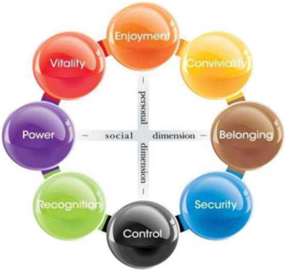
CENSYDIAM
Provides clients with a compass on how they can connect their brands with these deeper human motivations
NEEDS
&
ASPIRATIONS
Notes:
So if it is all about connecting with deeper human motivations, there is a need for a framework. Motivations can be complex and in order to compare brands and categories we need to have a measurement system.
At Ipsos we use the Censydiam framework for this. I don’t know to what extent you are familiar with this but Censydiam provides clients with a compass on how they can connect brands with these deeper human motivations.

Slide 19
A first key facet of Censydiam: it identifies 4 layers of motivations
Category motivations ?
What am I
looking for?
Functional Characteristics
How will it help optimize life?
Emotional
Benefits
What should it
stand for?
Personality
How should it
reflect upon me?
Social Identity
Notes:
There are 2 important facets to the Censydiam framework
The first aspect within Censydiam we deconstruct human motivations in 4 layers.
Functional Characteristics – physically what someone is looking for in a product.
Social identity – how the solution should reflect upon someone
Emotional Benefits. How a solution will help to emphasize my life
Finally, we look symbolically at what the brand should stand for. We know brands, products, solutions have to have short cuts in order for people to quickly understand what they represent – and this is why we ask what an ideal solution should stand for. We call this personality.

Slide 20
These four facets explain 85 – 95% of brand choice across categories and countries
Importance of different facets of
a brand’s identity in driving choice
Personality
Functional Characteristics
Relative Importance in driving Brand Choice
Emotional Benefits
Social Identity
NOTE: Data Based on Ipsos R&D surveys across categories and countries
Notes:
We know these 4 facets of motivations explain 85-95% of brand choice across categories and countries. Through our R&D and various studies we have done we know that across categories and cultures these 4 facets explain 85 to 95% of brand choice. Of course this the relative importance of the different facets is different for different categories.

Slide 21

A second key facet of Censydiam: human motivations can be framed according to 2 simple universal dimensions
The desire to let go
The desire to assert oneself, stand out and dominate
The desire for companionship, bonding and fit with others
― SOCIAL DIMENSION ―
― PERSONAL DIMENSION ―
The strive for control,
be rational and
suppress your feelings
Notes:
A second important aspect of Censydiam is that we can frame the motivations into a relatively simple framework. This framework is based on two dimensions which underlie all human behaviour.
The horizontal dimension is the social dimension. The right of the horizontal axis is about the need for xxx. The opposite of this on the left hand side is about xxx.
We can relate this to products and brands – some brands give us a feeling of being part of things, others help us stand apart from the crowd and be individuals
The vertical axis is the personal dimension. On the top is the desire to let go, ...on the bottom the need for control, be rational and suppress your feelings.
This framework provides a disciplined way to look at motivations
It also gives you a common language to talk about motivations– and that language works across countries and across categories.

Slide 22
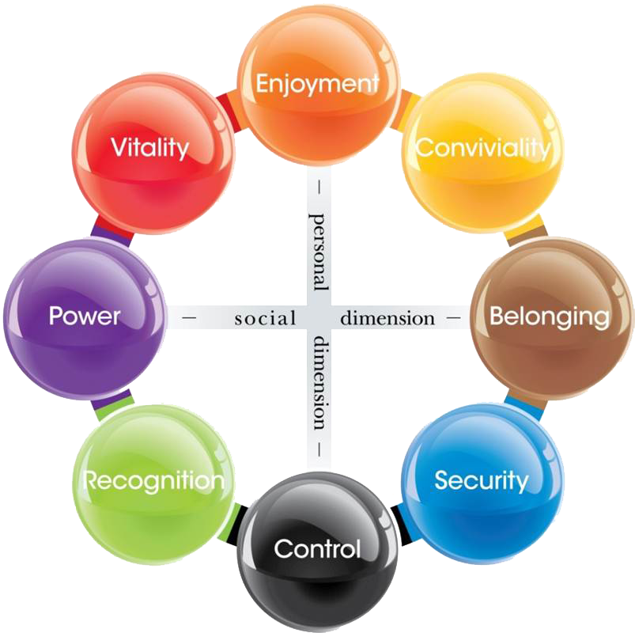
These 2 dimensions lead to 8 core motivations

Slide 23













Based on the relative performance of brands, we can map the brands in the Censydiam framework
US beer market example
LIBERATION
EMPOWERMENT
TOGETHERNESS
BE NOTICED
INTEGRATION
CONNOISSEURSHIP
TIME OUT
ROUTINE
Fictitious Data
Notes:
Based on the relative performance of brands we can map the brands in the Censydiam framework. When we developed the new suite of tools we have done several Research on Research projects. This slide shows the brand landscape in the US beer market. The brands at the outskirts have the most outspoken position and the map makes it intuitively clear what key differentiators are.

Slide 24

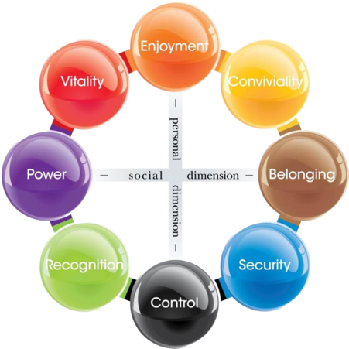







Example of the Censydiam Model in the Automotive Industry
Notes:
Based on the relative performance of brands we can map the brands in the Censydiam framework. When we developed the new suite of tools we have done several Research on Research projects. This slide shows the brand landscape in the US beer market. The brands at the outskirts have the most outspoken position and the map makes it intuitively clear what key differentiators are.

Slide 25








Example of the Censydiam Model in the Social Media Applications
Notes:
Based on the relative performance of brands we can map the brands in the Censydiam framework. When we developed the new suite of tools we have done several Research on Research projects. This slide shows the brand landscape in the US beer market. The brands at the outskirts have the most outspoken position and the map makes it intuitively clear what key differentiators are.

Slide 26






Example of the Censydiam Model in the Milk Products
Fictitious Data
Expression
Prestige
Bonding
Basic
Notes:
Based on the relative performance of brands we can map the brands in the Censydiam framework. When we developed the new suite of tools we have done several Research on Research projects. This slide shows the brand landscape in the US beer market. The brands at the outskirts have the most outspoken position and the map makes it intuitively clear what key differentiators are.

Slide 27
1
Today’s Challenges
2
Brand Growth and Research Today
3
Motivations
4
Impacting Sales
Notes:
So far for what concerns our methological approach, I will now pass the word again to Sue who will share a case study on how a client could grow its brand by connecting with human motivations and based on this type of research.

Slide 28


ASICS

Slide 29

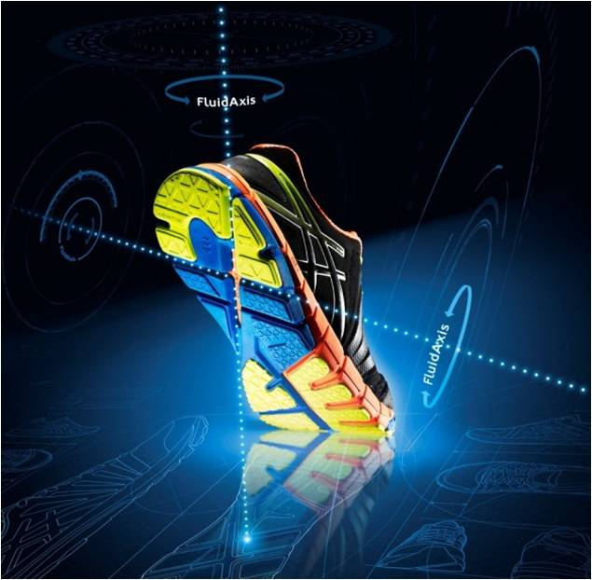
ASICS stands for…
Leading technology
First brand in running

Slide 30







… in a very competitive sports market
#5

Slide 31

With high ambition
2010
2012
2015
+100%

Slide 32


NEEDS
& ASPIRATIONS
brands growas they resonate
with strong motivations

Slide 33

“It is important to me that I can make the perfect corner. I am constantly trying to improve my technique and figure out how we improve our team tactics”.
“I do everything I can to make sure we can end as high as possible. The ultimate goal is of course to be the champion.”
“Of course I find it important that we play well as a team, but I mainly play a team sport because I enjoy being together with friends.”

Slide 34
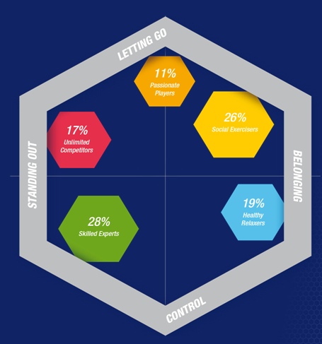
Why do people play sport?
completely let go and really enjoy the moment, preferably with others
enjoy a fun way to have a great time with others
stretch my limits and to achieve my goals
it’s good for my body and mind and helps me to relax
develop new skills and to be an expert

Slide 35

Involvement with sport ….

Slide 36

Involvement with running ….

Slide 37
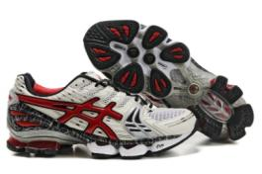

Focus on Performance –
“Unlimited Competitors”

Slide 38
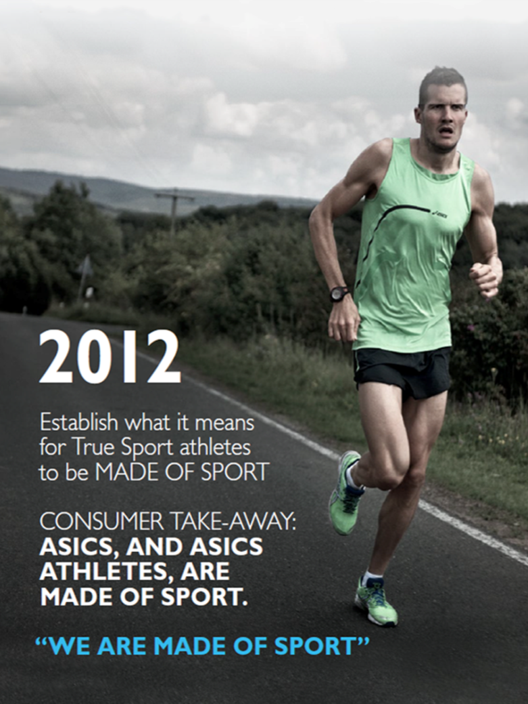

Slide 39
High impact on the ASICS brand worldwide
2010
2012
2015
Market Share
+42%
+100%

Slide 40


