Slide 1
Dynamics of Global Agricultural Development (II):
Success in Agricultural Transformation

Slide 2
What is Agricultural Transformation?
Isabelle Tsakok (2011)
  Two polar views against agriculture
  “Pro-agriculture” view
  “Anti-agriculture “view

Slide 3
What is Agricultural Transformation?
  “Anti-agriculture” view
  Economies can bypass this process of agricultural development
  Instead, the ‘industrial base’ should better be focused and invested → esp. , “Import substitution industrialization” (ISI)
  Investing in agri.sector => ‘Bad development strategies’!! → ‘squeeze agriculture’ development strategy (around the 1950s)
    “…resources devoted to slow growing agriculture as wasted…”

Slide 4
What is Agricultural Transformation?
  “Anti-agriculture” view
  Trade perspective:
    Declines in world cereals prices (USD 300 per metric ton in 1960 to USD 150 per metric ton in 2005)
    Agricultural price subsidies in the OECD member countries (around USD 360 billion per year)

Slide 5
What is Agricultural Transformation?
  “Pro-agriculture” view
  Agricultural development is “necessary” for the overall economic transformation
    5 potential contributions: Food, fiber, raw materials, labor, and financial surplus (foreign exchange)
  Agriculture is the “passive” sector with weak link to non-agriculture (Lewis model)

Slide 6
What is Agricultural Transformation?
  Common view
  Agriculture can generate the surplus needed by industry in its early stages
  Disagreement
  Importance of agricultural investments to generate such surplus

Slide 7
What is Agricultural Transformation?
  The Meaning of “Success in Agricultural Transformation”
  Increase in productivity
    Output per unit of input, sustained over 2-3 decades at least
  Sustained increases in income for the majority of farm/ rural households

Slide 8
What is Agricultural Transformation?
  The process of agricultural transformation; is characterized by
  A declining share of agriculture to gross domestic product (GDP)
  A declining share of agricultural employment to a total employment
  Positive growth in productivity sustained over several decades
  **Steady income increases over several decades for at least 50 percent of rural households

Slide 9
What is Agricultural Transformation?
  Amartya Sen (2000): “Development as Freedom”
  - Goal of development:
  - the expansion of human capabilities, enabling the enrichment of human lives
  - people have greater freedom to choose the lives they want to live
- Agricultural transformation = transforms human lives

Slide 10
The Industrialized World: England
  - The 18th and 19th centuries: the first known case of successful agricultural transformation
  Agricultural revolution → Increases in productivity instead of area expansion
    Narrow concept
    Broader concept

Slide 11
The Industrialized World: England
  - Narrow concept: Changes in farming techniques
  (a) the introduction of nutritious fodder crops in particular turnip & clover + the adoption of a four-course rotation systems of wheat-turnips-barley/ or oats-clover/ rye-grasses
  (b) the reduction of bare fallows due to the four-course rotation system
  (c) the use of mechanical seed drills , threshers/ reapers
  (d) the improvement of livestock breeds

Slide 12
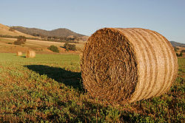
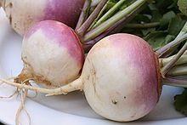
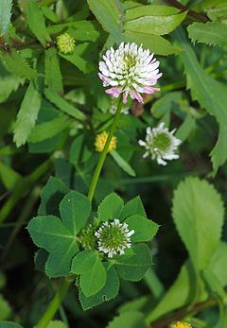
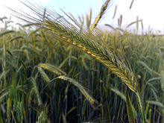
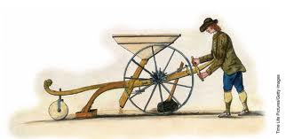
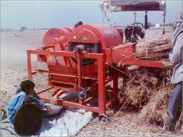
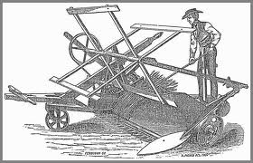
  fodder crops
  turnip
  clover
  Rye
  seed drills
  Threshers
  reapers

Slide 13
The Industrialized World: England
  - Broader concept: Institutional changes
  (a) “Enclosure policy”: the removal of common property rights → more private property & consolidation of small farms into large farms
  (b) Improvement in transportation & market information (the daily mail) & commercial regulation to favor competition→ the geographical expansion of markets
  (c) the tripartite landlord-tenant farmer-laborer structure
  (d) a fluidity between country and town people

Slide 14
The Industrialized World: England
  Results:
    Agricultural production and productivity increases
    Impact on the structure of economy
    Price of wheat increased: → rise of population
    But, real agricultural wages declines at the earlier years and for decades until the mid-19th century
    Expansion of large farm: medium to large farms: 35% of farmers but owning around 78% of total land

Slide 15
The Industrialized World: England
  Results:
    Industrial expansion → rising demands for labor → reduced surplus agricultural labor
    Only the Midlands, the north, and around London
    But low linkage in the south
    Greater disparity in distribution → lag in improvement for the laboring class
    Until 1850, the gap narrowed as intensified migration, expanded employment in the railways and drainage works, and the growth of manufacturing

Slide 16
The Industrialized World: Japan
  From Meiji Restoration (1868-1912) to the 1960s:
    Japan: the first non-Western nation to successfully industrialize
    Feudal : Traditionally low productivity economy → Westernization in the Meiji reforms
    Some two hundred peasant uprisings & four samurai revolts

Slide 17
The Industrialized World: Japan
  Technical changes:
    Government promoted yield-increasing agricultural innovations: Western advice (e.g. from a German scientist) on plant nutrition
    Introduction of high-yielding, fertilizer-responsive crop varieties → a “fertilizer-responsive rice culture”
    The use of chemical fertilizers began to spread
    “Silk revolution”: development of hybrids between Chinese and Japanese silkworms → 17 times increase in the output of raw silk

Slide 18
The Industrialized World: Japan
  Institutional changes:
    Reform of land tax:
      Predictable tax rates were levied on individual parcels of land instead of on villages as entities
      promoted incentives to increase farm investment and productivity and to commercialize agriculture
    Government heavily invested in transportation, irrigation, and communication
      Spreading techniques developed by small farmers throughout Japan
      Later, agriculture was dominated by small-scale farmers
    Local institutions: direct relationship between the researchers at the experimental stations to the farmers’ associations
    Promotion of the technical education

Slide 19
The Industrialized World: Japan
  Results:
    In the 1950s, annual farm output growth averaged 4.4 percent per year → mainly in grains and sericulture
    The share of agri., fishery, and forestry in the GDP fell from 45 percent in 1888 to 18 percent in 1938
    During the initial stage until 1900, Japan exploited traditional agriculture to generate exports and revenues for the government
    Industrialization: light (labor-intensive) industries, many small non-farm companies located in rural area were a major source of employment
    Rises in tenancy rates and more unequal income distribution

Slide 20
The Industrialized World: Japan
  Stagnation (1929-1940) and recovery:
    Excess supply of rice extracted from its colonies (Korea, Taiwan, China) → collapse in rice prices
    Tight monetary policies → slowed down the growth of light industries → overvalued Japan’s exchange rates → lowering the growth of agricultural output and productivity
    Farm labors were pulled away by the non-primary sector → cotton textiles production
    Increasing labor shortage in Japanese agriculture, non-substitutability between labors and other farm inputs despite high investments in farm technology → “Paradox of agricultural stagnation”

Slide 21
The Industrialized World: Japan
  Stagnation (1929-1940) and recovery:
    After WWII (1939-1945)
      Successful land reform (1946-47) → landlord who did not live in the countryside could not own land, Those who lived in the countryside could rent out a maximum of one chobu (around a hectare), and retain a maximum of four chobu.
    Former tenants → owners
    Per capita GDP growth 3% per year (1965-1985)
    Rapid industrialization → Heavy industries → High farm-urban labor migration
    Share of agri.GDP 14% (1960) → 3% (1985) → 1% (2001)
    widening income differences

Slide 22
The Industrialized World: Japan
  Stagnation (1929-1940) and recovery:
    Agri.Policy (1961)→ Income support instead of production-promoting policies → high cost of protection
    Agri. → sustained agricultural output & productivity growth → no longer an important productive sector supporting the rise of a major power
    “pro-agriculture view”

Slide 23
The Industrialized World: USA
  Formerly, USA → “CARL” (a Country with Abundant Rural Labor)
  Until 1830, more than 90% of population lived on farms
  Poor husbandry, low-yield, subsistence agriculture
  Two revolutions
    1) The rapid adoption of horsepower in late 19th century
    2) Application of mechanical power, fertilizers, pesticides, herbicides, and hybrid seeds in the early 20th century → Agricultural transformation

Slide 24
The Industrialized World: USA
  Technical changes:
    Mechanical innovations: the cotton gin, the steel-moldboard plow, the reaper, and barbed wire
    Chemical innovations: chemical fertilizers, pesticides, herbicides, hybrid seeds
    The research programs in the Department of Agriculture, Agricultural colleges, experimental stations

Slide 25
The Industrialized World: USA
  Institutional changes:
    The Homestead Act 1862
      Distribution of uncultivated lands → giving 160 acres of Great Plains prairie to individuals who promise to cultivate the land
        ‘Geographical expansion of US economy’
    Large-scale investment:
      Opening of the Erie Canal in the 1830s, railroads, transcontinental railway, communication technology (telegraph) → market expansion

Slide 26
The Industrialized World: USA
  Results:
    The sustained accelerated growth of total factor productivity from 1940-1980
    Farm population shrank from 30 million in 1900 to 4.5 million by 1990 and 2.5 million by 2000
    Most farms are still family-owned
    More roles of corporate-held farming
    Off-farm source of income remains economically viable. (around 85% in 1997)
    Increasing land concentration dominated by large farms
    Falling poverty among farm household

Slide 27
The Industrialized World: USA
  Results:
    Do support neither pro- or anti-agriculture view
    Agri. Is not really an engine of growth, but it is not overlooked by substantial investment in infrastructure

Slide 28
The Developing World: India
  The economy was primarily agricultural wit large inequalities in resource endowments and income distribution among and within resource and states
  Green revolution (the 1960s) → benefiting irrigated rice and wheat + improving technologies increases in productivity→ accelerating growth in the 1980s
  “Food grains self-sufficiency” by the 1990s → helped the poor

Slide 29
The Developing World: India
  Intervention policy → agricultural subsidies
    Benefits: political stability + poverty reduction + adoption of improved technologies
    Costs: private trade is restricted to control pricing and distribution, only small-scaled units are allowed to cooperate
  Low efficiencies, costly, crowd out other public investments, benefit primarily the large farmers and the better-off group in rural society
  Rejected the anti-agri. view

Slide 30
The Developing World: Indonesia
  Agri-sector is dominated by smallholders who cultivate food crops, mainly rice, and export crops
  Intervention policy for ensuring rice self-sufficiency → subsidies the adoption of the Green Revolution technology in HYV (e.g. irrigation, fertilizers, pesticides, improved seeds)
  Guaranteed the floor price to producers while ceiling price for consumers --> Pro-agriculture

Slide 31
Conditions of Success?
  Necessary conditions: Tech. & Government’s role
    Subsidy/ Investment
  Sufficient conditions
  A. A stable framework of macroeconomic and political stability. Central & local gov. → enforcing peaces and orders
  B. An effective tech-transfer system: research & extension
  C. Access to market
  D. An ownership system that rewards individuals from farm investing
  E.Employment-creating non-agri. sectors

