Slide 1
MK 322 Final Presentation on May 4th
Everyone in the team needs to present by dividing the time equally and should sound and look passionate in presenting.
Your team will be pitching your new business to me, as I will be your foreign investor and have to decide if your retail business will be profitable or not. You will be competing against other retailers for the investment capital.
You will be judged on your strategy, purchase intent, creativity and team work.
You will have 30 minutes to present with 10 minutes Q & A.
You should have cover slide plus appendices to back up your findings.
Always source your findings to build credibility.
You are to present new facts ( example- merchandising/ store plan) could make original already presented details more concise.
Make sure you align your ppt slides to feel like you are on the same page in terms of structure and design.

Slide 2
MK 322 Final Presentation details
Background for launch, Corporate vision/mission/ Market and Competitive situation, trends, challenges, etc. You are encouraged to use graphs, charts and diagrams to communicate your data.
Retail Strategy
Financials - Estimations are sufficient – Inventory/sales/GMROI/Profit model, etc.
In-depth interview results/insights/recommendations- appendix
Final Retail Mix and STP
Perceptual Map
Final Location and details
CRM Programs- Building Customer Loyalty
Merchandising Planogram
Store Layout, Design and Visual Merchandising, Window Display
Store Management, employee detail organization and structure
IMC Plan/ with Gantt Chart
Website, App, online connection with customers
Advertising- online –SMILE Criteria
One in-store technological innovation to enhance customer experience(refer to The Future of Retailing)
Key Learning from this project as individual and team ( not textbook words, Ajarn want you to share from your own words ka)
AOB -Anything else you will like to share is welcomed ☺

Slide 3

How to evaluate good advertising?
The “SMILE” APPROACH
S = simple, easy to understand
M= memorable, stick to consumer’s mind,
measures by a day after recall
I = interesting, employ new story, has new information to tell
L= linked to the brand, cannot be mistaken to other brands/products
E = emotionally involving

Slide 4
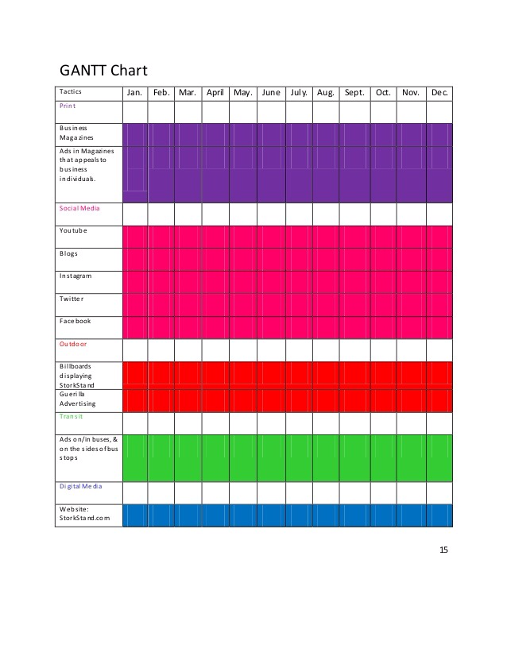

Slide 5
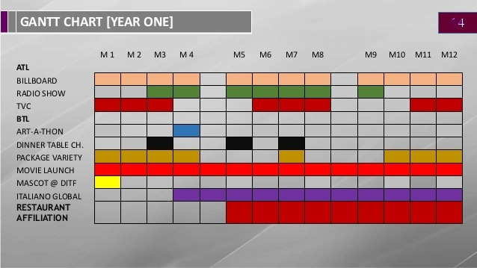

Slide 6
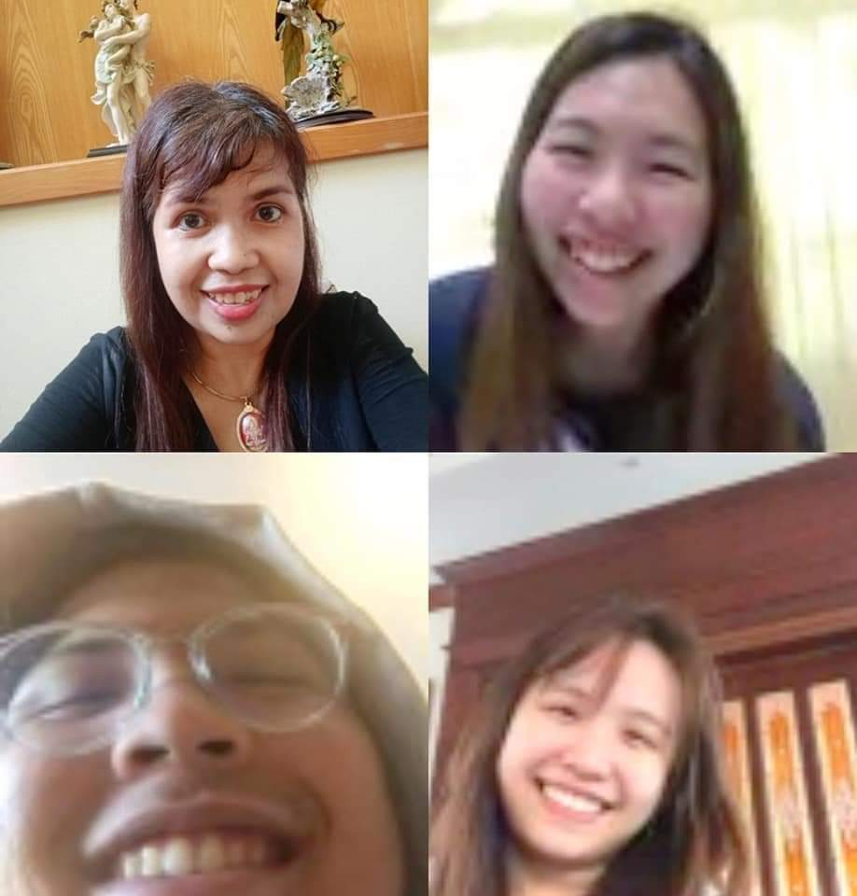
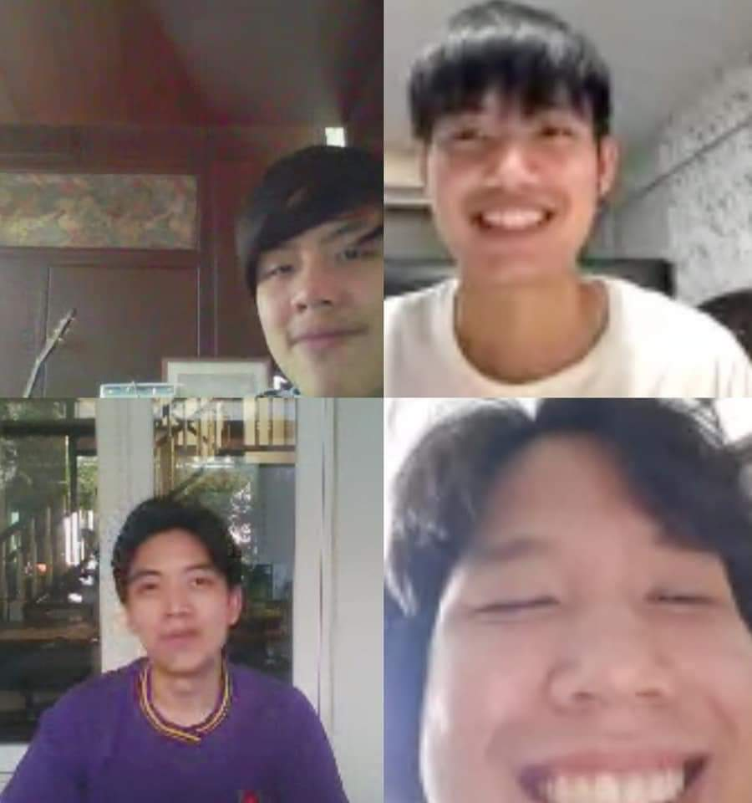
Good Luck… see …See you May 4th

