Slide 1




Marketing Planning 312
Chapter 4
Leveraging Competitive Advantage
By Ajarn Suwalya K.

Slide 2

Figure 1.1: The stages of building a
marketing plan

Slide 3

RBV vs. MOV
The Resource Based View (RBV) is an inside-out perspective
The Market Orientation View (MOV) is an outside-in perspective as illustrated below

Slide 4
Chapter 4
Developing Competitive Advantage and Strategic Focus

Slide 5
Potential Issues to Consider in a SWOT Analysis
Potential internal strengths | Potential external opportunities
Abundant financial resources | Rapid market growth
Well-known brand name | Mishap of a rival firm
Economies of scale | Government deregulation
Proprietary technology | New technology
Better marketing skills | Demographic shifts
Potential internal weaknesses | Potential external threats
Lack of strategic direction | Entry of foreign competitors
Limited financial resources | Product life cycle in decline
Weak spending on R&D | Changing customer needs/tastes
Very narrow product line | Economic boom/downturn
Internal political problems | New technology

Slide 6
The SWOT Matrix
Four-cell array used to visually evaluate elements of SWOT analysis
Should be based on customer perceptions, not perceptions of the manager
Elements with the highest total ratings should have the greatest influence in developing the strategy
Focus on competitive advantages by matching strengths with opportunities

Slide 7
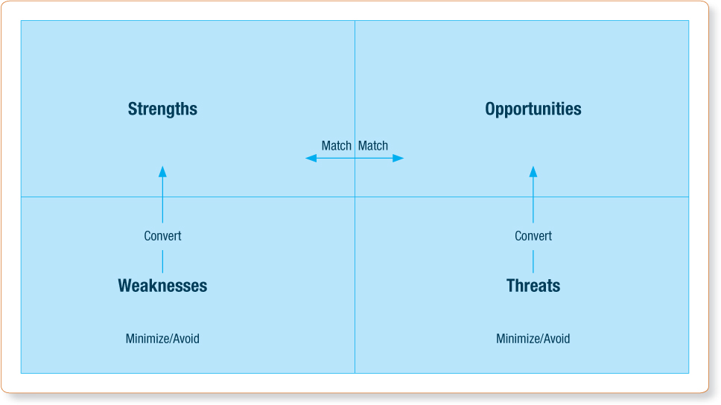
Exhibit 4.5 - The SWOT Matrix
Source: Adapted from Nigel Piercy, Market-Led Strategic Change (Oxford, UK: Butterworth-Heineman, 2002).

Slide 8
Developing and Leveraging Competitive Advantages
Competitive advantages
  Can arise from many internal and external sources
  Refer to real differences between competing firms
  Can be based on perception rather than reality
  Should possess a specific benefit for customers to be of value to firms

Slide 9
Developing and Leveraging Competitive Advantages (Continued)
Based on one of the following strategies:
  Operational excellence
  Product leadership
  Customer intimacy

Slide 10
Sources of Competitive Advantage
Relational advantages
Legal advantages
Organizational advantages
Human resource advantages
Product advantages
Pricing advantages
Promotion advantages
Distribution advantages

Slide 11
Core Competencies Necessary for Competitive Advantage Strategies
Operational excellence - Walmart and Dell
  Core competencies
    Low cost operations and totally dependable product supply
  Common attributes
    Target a broad, heterogeneous market of price-sensitive buyers
    Maintain a system to avoid waste and highly reward efficiency improvement

Slide 12
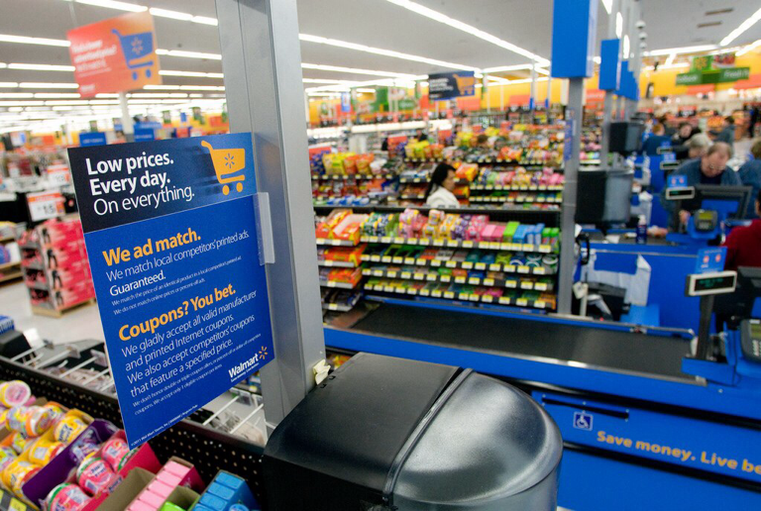


Slide 13
Core Competencies Necessary for Competitive Advantage Strategies (Continued 1)
Product leadership - 3M and Pfizer
  Core competencies
    Basic research or rapid research interpretation
    Excellent marketing skills
  Common attributes
    Target narrow, homogeneous market segments
    Maintain organizational cultures characterized by decentralization, adaptability, entrepreneurship, creativity, and the expectation of learning from failure

Slide 14

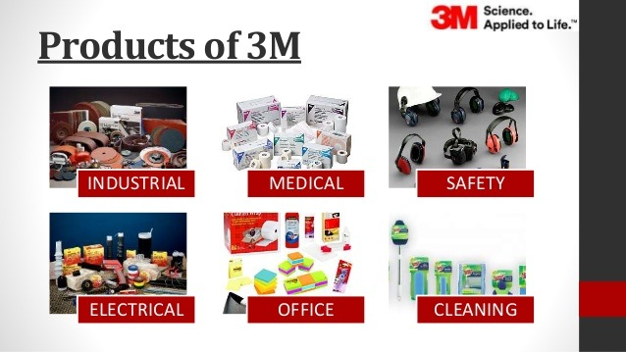

Slide 15
Core Competencies Necessary for Competitive Advantage Strategies (Continued 2)
Customer intimacy - Nordstrom and Amazon
  Core competencies
    Exceptional skills in discovering customer needs
    Problem solving proficiency
  Common attributes
    Decentralize most decision-making authority to the customer-contact level
    Assess all relationships with customers or alliance partners

Slide 16


Slide 17
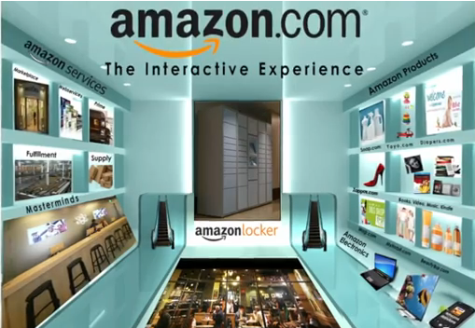


Slide 18


