Slide 1




Comparative Approaches to
Estimating Demand for Payment for Environmental Services Payment
Monthien Satimanon,
March 24th ,2014

Slide 2
Introduction
Policy interest in Payment for Environmental Services (PES).
Estimation of willingness to pay for and of choices to join programs are often estimated by Probit models.
Results can be inconsistent if there is conditional heterogeneity or if the underlying distribution is misspecified.

Slide 3
Objective and Methodology
Objective
  Compare several parametric and semiparametric methods for estimating willingness to pay.
Methods
  Parametric
    Probit (P)
    Heteroskedasticity Probit (HP)
  Semiparametric
    Sieve Estimator (S)
    Wananabe (2010)
    An (2000)
    Turnbull (T)

Slide 4
Review Literature
Semiparametric and binary choice model
→ Robust
  Gallant and Nychka(1987), Horowitz(1992)
  Klein and Spady(1993) Ichimura(1993)
  Li (1998)
  Li and Racine(2008)
Semiparametric Estimation of Willingness to Pay Flexible Functional Form of Distribution or WTP
  Chen and Randall (1997), Creel and Loomis (1997), An (2000), Cooper (2002), Beluzzo (2004), Huang et.al (2009), and Watanabe (2010)
Notes:
Theoretically, the semiparametric models have been compared with parametric binary choice model by simulation. Horowitz (1992) found that semiparametric models will be more robust when the estimated model contains heteroskedasticity.
Empirically, semipametric results are robust and can be used as a complementary procedure along with the parametric estimation.

Slide 5
Methods : Probit and Hetprob
Dichotomous Choice Contingent Valuation Method
Probit (P) and Hetroskedasticity Probit (HP)

Slide 6

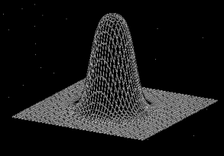

Sieve
Sieve Estimator
  One class of semiparametric estimation that solves the problem of infinite dimensional parameter space.
  The sieve method employs the optimization routine that tries to optimize the criterion function over finite approximated parameter spaces (sieves).
  Geman and Hwang (1982), Xue et.al. (2004), Chen (2007), Khan (2012), Blevins and Khan (2011), Ackeberg et.al. (2012).
  The estimator is a key in doing statistical inference for two-step estimation.
Notes:
Second bullet, during the presentation, when you mention this second bullet, let the audience know that you will provide more detail later (since they won’t really know what the criterion function of the sieves are).
1. Similar to how we choose the bandwidth and numbers in plotting the histogram.
2.One of the solution is to allow either flexible functional form of distribution or conditional variance.
Proposed estimation is computationally less time consuming than allowing fully flexible functional form.

Slide 7
Methods : Sieve
Sieve estimator, Probit model with distribution-free heteroskedasticity (S)
Goal Estimate
Two-step estimation
  Estimate conditional variance by sieve estimation

Slide 8
Methods : Sieve
Two-step estimation (cont.)
  Plug the estimated conditional variance on the probit criterion function.
  Apply the results from Ackerberg et.al.(2012) in order to estimate the asymptotic variance of estimated parameter and WTP.
Notes:
By using parametric approximation since it requires less computation power to get the variance of the estimate of and willingness to pay.

Slide 9
Methods : Turnbull Estimator

Slide 10
Methods : Turnbull Estimator

Slide 11
Methods : Turnbull Estimator

Slide 12
Methods : An(2000)
Discrete choice proportional hazard model with shared frailty

Slide 13
Methods : Watanabe(2010)
Survival function is defined as
Then he assume the distribution of the the bid follows

Slide 14
Methods : Watanabe(2010)

Slide 15
Monte Carlo Result 1

Slide 16
Monte Carlo Result 1
True Model mean willingness to pay = 47.746
 | Turnbull | Watanabe | An | Probit | Hetprob | Sieve
Mean willingness to pay | 28.920 | 19.990 | 23.970 | 48.008 | 37.292 | 36.048
Bias | 18.556 | 27.486 | 23.506 | -0.532 | 10.184 | 11.428
Variance | 10.910 | 11.029 | 8.209 | 60.203 | 40.590 | 40.918
Root mean squared errors(RMSE) | 18.848 | 27.686 | 23.680 | 7.777 | 12.013 | 13.096
Maximum WTP | 41.400 | 32.000 | 44.085 | 77.511 | 164.072 | 57.258
Minimum WTP | 19.800 | 10.400 | 19.812 | 18.569 | 12.557 | 12.870
Frequency of rejection |  |  |  |  | 58

Slide 17
Monte Carlo Result 2

Slide 18
Monte Carlo Result 2
True Model mean willingness to pay = 37.773
 | Turnbull | Watanabe | An | Probit | Hetprob | Hetprob1 | Sieve1
Mean willingness to pay | 38.395 | 30.178 | 27.682 | 52.035 | 39.223 | 42.193 | 53.327
Bias | 0.622 | -7.595 | -10.091 | 14.262 | 1.450 | 4.420 | 15.554
Variance | 23.394 | 18.050 | 11.958 | 98.292 | 57.737 | 82.785 | 403.976
Root mean squared errors(RMSE) | 4.877 | 8.702 | 10.667 | 17.369 | 7.736 | 10.115 | 25.415
Maximum WTP | 55.927 | 46.400 | 48.711 | 89.358 | 66.803 | 80.388 | 221.391
Minimum WTP | 19.800 | 18.400 | 21.107 | 22.335 | 12.557 | 14.122 | 12.896
Frequency of rejection |  |  |  |  | 125 | 213

Slide 19
Monte Carlo Result 3

Slide 20
Monte Carlo Result 3
True Model mean willingness to pay = 44.986
 | Turnbull | Watanabe | An | Probit | Hetprob | Hetprob1 | Hetprob2 | Sieve1 | Sieve2
Mean willingness to pay | 37.552 | 29.390 | 26.541 | 52.253 | 39.138 | 41.885 | 42.1929 | 43.341 | 51.120
Bias | -7.434 | -15.596 | -18.445 | 7.267 | -5.848 | -3.101 | -2.793 | -1.645 | 6.134
Variance | 20.129 | 17.015 | 11.853 | 92.106 | 53.508 | 69.425 | 82.785 | 111.529 | 342.966
Root mean squared errors(RMSE) | 8.683 | 16.133 | 18.764 | 12.038 | 9.365 | 8.891 | 9.518 | 10.688 | 19.509
Maximum WTP | 53.787 | 44.800 | 54.703 | 90.071 | 66.606 | 87.964 | 80.388 | 131.567 | 149.185
Minimum WTP | 24.051 | 18.400 | 20.391 | 15.155 | 14.495 | 17.343 | 14.122 | 20.212 | 12.896
Frequency of rejection |  |  |  |  | 124 | 177 | 135

Slide 21

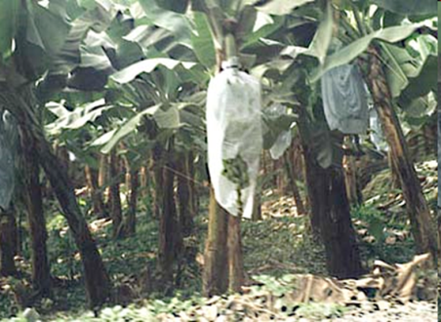
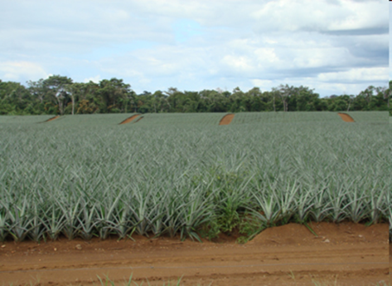
Application: PES in a Costa Rican Watershed
Estimate WTP of community water user’s to protect water supply via PES.
Good is clearly defined:
  Payment from downstream water users to upstream farmers to protect water source (quality and quantity).
Program & payment is realistic.
  River water is polluted, so communities financed their own projects to build aqueduct to get upstream water; they pay monthly for water; and they vote on aqueduct management.

Slide 22
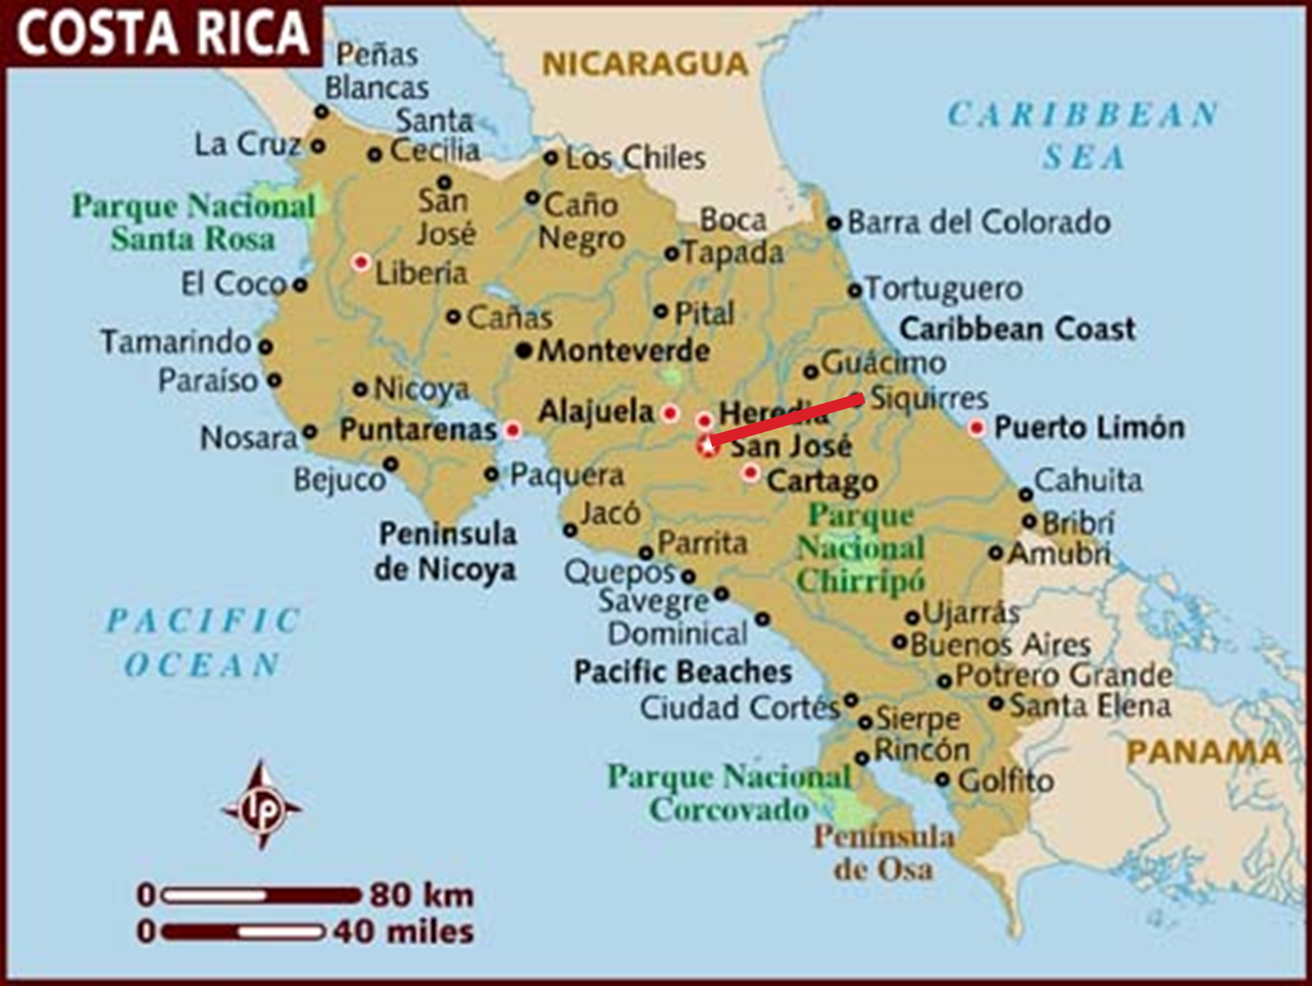
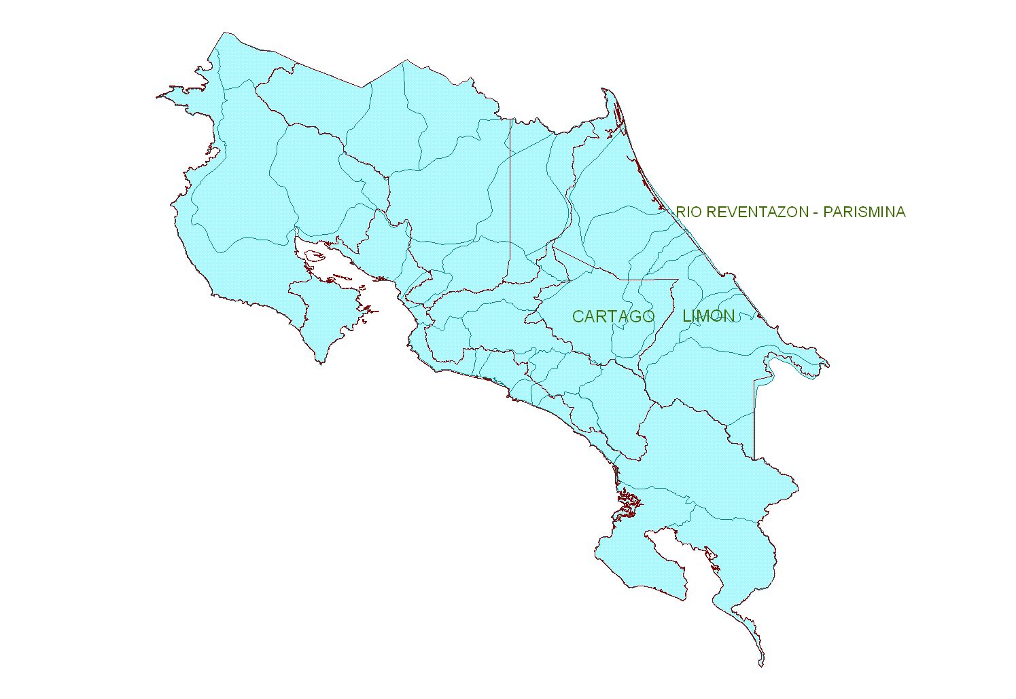
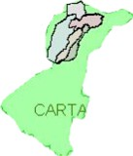

Slide 23
Data
1141 Observations
Survey Data from 6 communities in the Costa Rica
  Herediana
  Cariro-Francia
  Florida
  Alegria
  Milano
  Iberia
Thanks to Michael Kaplowitz, Daniel Ortega-Pacheco, Oscar Arreola and Earth University for the data.

Slide 24
Data description and descriptive statistics (N=1141)
Description | Measurement | Mean | Std. Dev. | Min |  | Max
Response to " Would you vote for or against the program if you would have to pay [cost] Colones more on your water bill (yes or for = 1, no or against = 0) | 1 Or 0 | 0.659 | 0.474 | 0 | 1
Monthly cost of program (on top of current water bill) from the vote question. Defined in the preamble to the vote question and varied across respondents | Colones | 1243.087 | 758.098 | 400 | 2400
A dummy for sex of the respondent (female = 1 male = 0) | 1 Or 0 | 0.725 | 0.447 | 0 | 1
Age of respondents |  | 43.176 | 15.113 | 18 | 93
Number of household member under age 18 |  | 1.515 | 1.418 | 0 | 9
A dummy for schooling (high school or more = 1 otherwise = 0) | 1 Or 0 | 0.120 | 0.326 | 0 | 1
Monthly household income | Colones | 142364.4 | 141374.8 | 7000 | 2000000

Slide 25
Model Specification
Dependent Variable
    Response to " Would you vote for or against the program if you would have to pay [cost] colones more on your water bill? ” (yes or for = 1, no or against = 0)
Independent Variables
  Monthly cost of the programs (-)
  Female dummy (?)
  Age (-)
  Numbers of Household member with age<18 (?)
  High school dummy (+)
  Household Income (+)
Notes:
1) 130 KMs East of San Jose, Capital city.

Slide 26
Empirical Results
Dependent variable =1 if respondent vote "Yes", 0 if the vote is "No". | Probit | HP | Sieve | Watanabe | Turnbull | An
Monthly Cost | -0.0004*** | -0.0007*** | -0.0003*** | -0.3552***
 | (-8.29) | (-3.10) | (-2.36) | (-8.42)
Female | -0.2420*** | -0.2250 | -0.1298 | -198.4140***
 | (-2.53) | (-1.41) | (-0.56) | (-2.82)
Age | -0.0150*** | -0.0203*** | -0.2490*** | -13.3100***
 | (-4.85) | (-3.19) | (-2.63) | (-5.73)
Household members | -0.0608** | -0.0363 | -0.0860*** | -45.5040**
 | (-1.95) | (-0.33) | (-2.53) | (-1.81)
Education | 0.0955 | 0.7335 |  | 121.4693
 | (0.65) | (0.94) |  | (-1.22)
Income | 2.56E-06*** | 6.60E-06*** | 4.31E-06*** | 0.0011***
 | (4.95) | (2.10) | (3.37) | (4.53)
Intercept | 1.5679*** | 1.9731*** | 1.3856** | 2643.5690***
 | (7.02) | (3.58) | (1.82) | (17.58)
Mean Willingness to Pay | 2340.69 | 2492.7 | 2426.02 | 1592.29 | 1630.99 | 1407.28

Slide 27
Conclusion
Neglecting conditional variance can lead to biased WTP
Using survival models tend to provide the lower bound for WTP.
Empirical results are not different from previous study
There is still no specification test telling which model is the best given that the first three models are parametric model and the last three are nonparametric.

Slide 28
Thank you
Question & Comment

