Slide 1
Dollarization
Jordyn Vandeleur

Slide 2
Definition
Dollarization is when a country (officially or unofficially) uses another countries currency for conducting transactions
  Full/Official dollarization: A foreign currency is used to replace domestic currency for all functions (transactions, store of value, unit of account)
  Partial/Unofficial dollarization: Individuals substitute the use of domestic currency for a foreign currency

Slide 3
Terminology
Currency Substitution
Asset Substitution
Individuals use foreign currency to make transactions
Occurs in inflationary periods as domestic currency becomes too costly to hold
Invest in portfolios which are denominated in foreign currency
Insures against macroeconomic risks (price inflation, prolonged depressions)

Slide 4
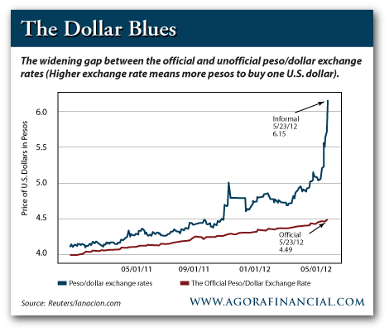
Argentina’s “Blue” Dollar

Slide 5
Benefits
Drawbacks
Eliminate risk of sudden shocks in valuation of a country’s currency
  Reduce risk premium attached to international borrowing
Lower transaction costs in global market
Increase economic stability
Seigniorage costs
  Earnings a country receives from printing additional currency
  Have to buy back all current domestic currency
Give up control of monetary and exchange rate policy
Sense of national pride

Slide 6
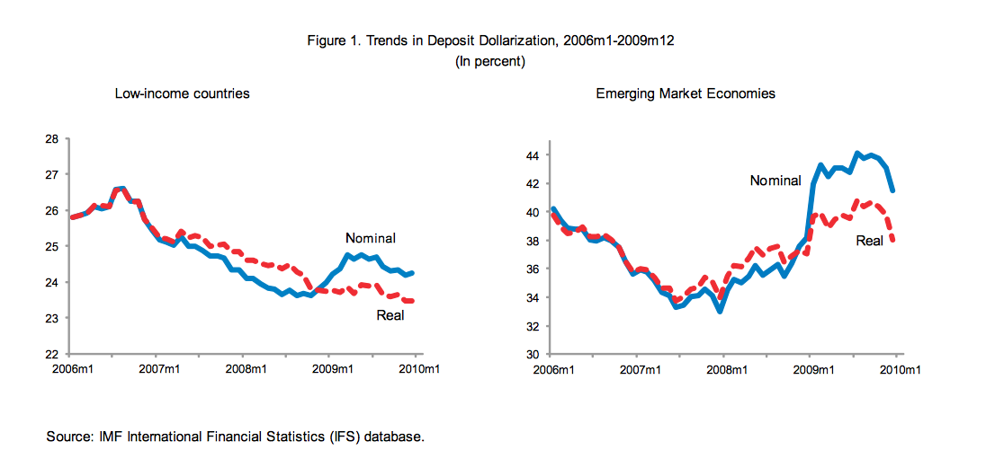

Slide 7
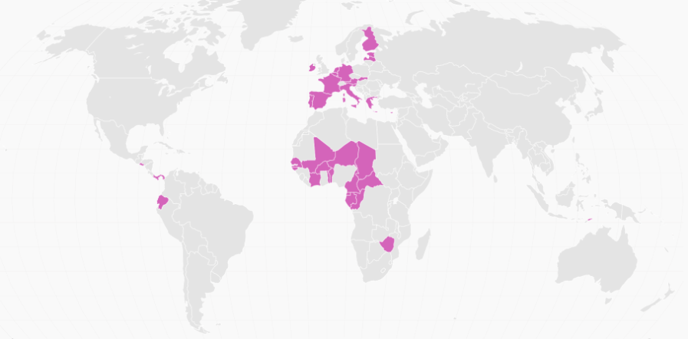
Countries With No National Currency
Using foreign currency: Ecuador, East Timor, El Salvador, Marshall Islands, Micronesia, Palau, Turks and Caicos, British Virgin Islands, Zimbabwe

Slide 8
USD and another Currency
Bahamas
Barbados
Belize
Bermuda
Uruguay
Iraq
Cambodia
Costa Rica
Haiti
Lebanon
Liberia
North Korea
Somalia
Zimbabwe

Slide 9

Questions?

Slide 10
Sources
https://www.imf.org/external/pubs/ft/issues/issues24/
https://www.frbatlanta.org/~/media/Documents/americascenter/ac_research/quispedollarizationrevised.ashx
http://qz.com/260980/meet-the-countries-that-dont-use-their-own-currency/
https://www.imf.org/external/pubs/ft/wp/2015/wp1512.pdf

