Slide 1
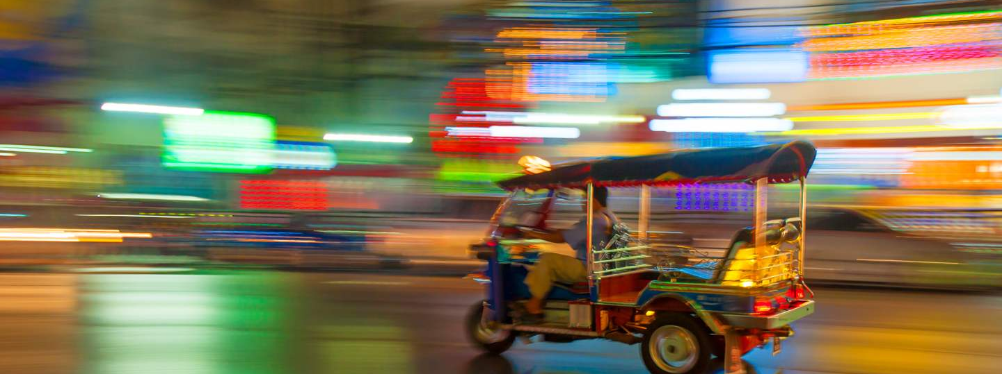
EE460 Thai Economy
Lecture 1: Prelude to the Thai Economy
Kiatanantha Lounkaew
Email: klounkaew@econ.tu.ac.th
Line: k_lounkaew
ที่มาของรูป https://www.worldtravelguide.net/guides/asia/thailand/

Slide 2
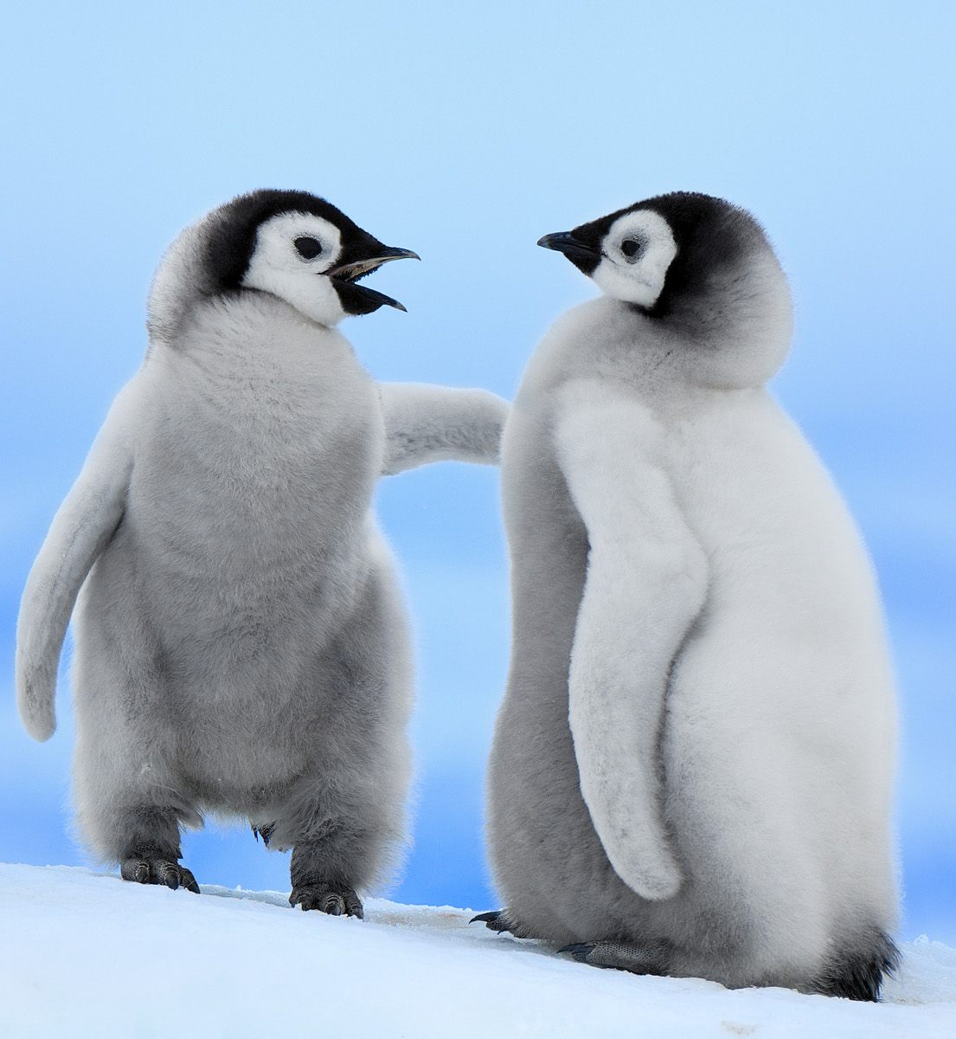

Care for a talk?
Let’s get familiar.

Slide 3


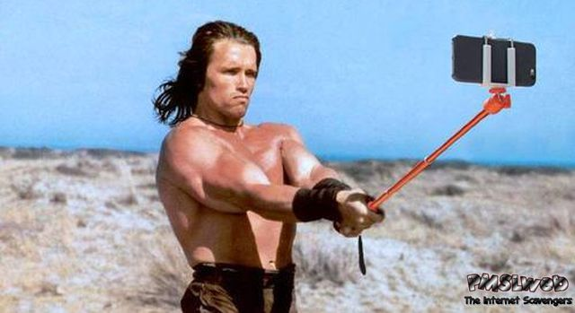

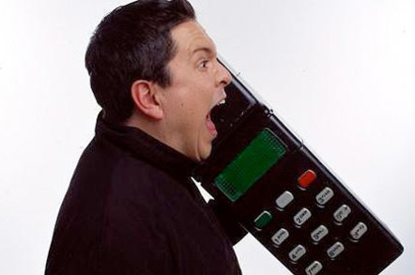
First things first
Midterm: 30%
Final: 40%
Quizes: 20%
Group works: 10%
Enrollment key: 2814
Selfie is OK
Phone is OK
Chat is OK

Slide 4
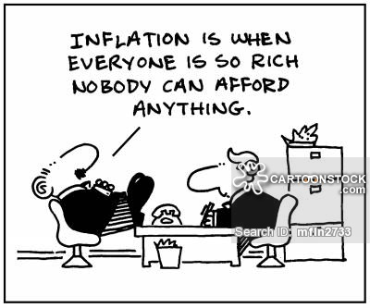
Why?

Slide 5
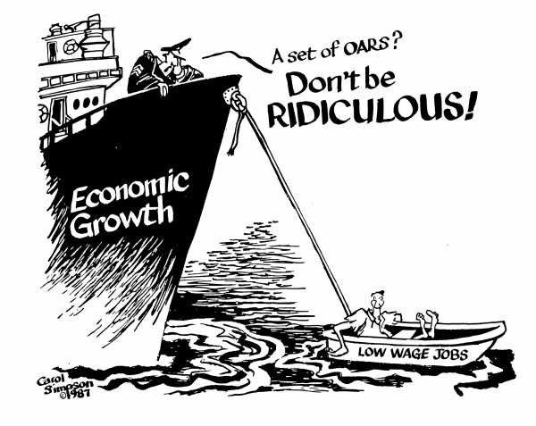
What does the captain mean?

Slide 6
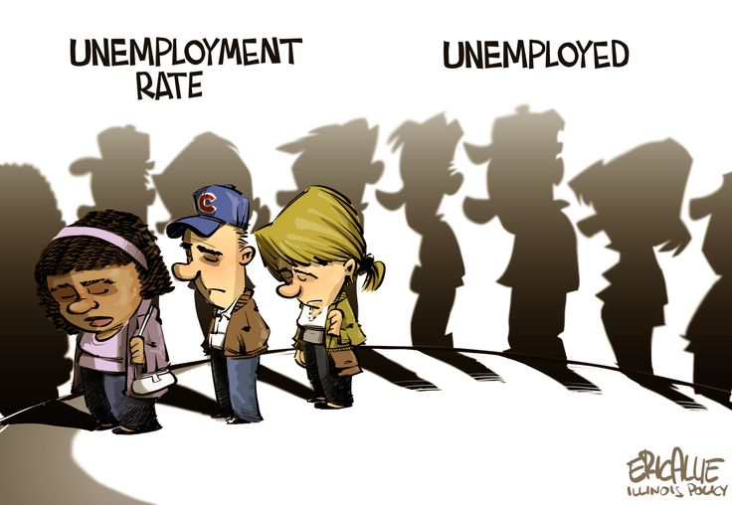
Any words on this?

Slide 7
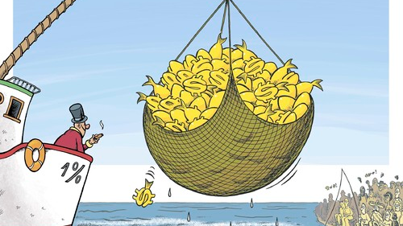
What does this picture says?

Slide 8
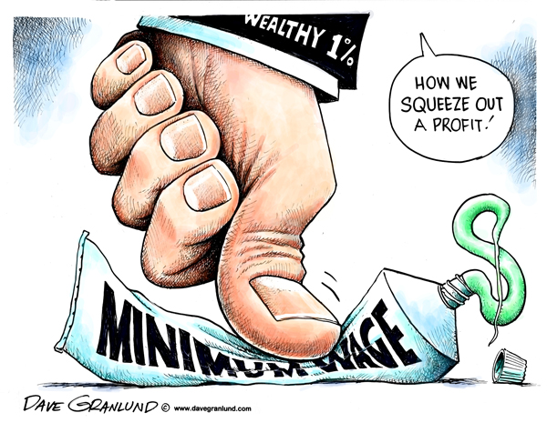
What is the implication of this?

Slide 9
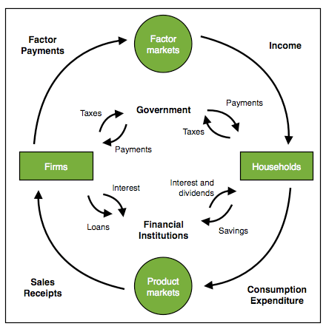

Slide 10
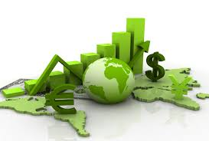
Choose three pictures to best capture what you think are the key features of the Thai Economy

