Slide 1
Dynamics of Thai Agricultural Development

Slide 2
The Engines of Growth (the 1960-70s)
Agriculture facilitated industrialization
  Supplying cheap food and labor, generating tax revenues, foreign exchange, and providing market for industrial outputs

Slide 3
The Engines of Growth (the 1960-70s)
Major source of agri. growth
  Surplus land → “Expansion of cultivated land” (at the expense of forested areas)
  More forest concessions were granted in the early 1970s than in any other period, allowing forested lands to be rapidly cleared, and occupied by farmers
  enabled farmers to produce new commodities in new lands and increase exports in large quantities
  Increasing growth → ‘Commodities boom’
    Yield improvement, capital investment, and a shift from low value to high value crops

Slide 4
The Engines of Growth (the 1960-70s)
Agricultural policies
  “Traditional government market intervention
  Comparative advantage
  “Policy bias” in agriculture for the major export commodities
    Rice and rubber → Taxes
    Maize and cassava → Export control
    *Sugar → Subsidy

Slide 5
Sunset (the 1980-90s)
“Natural decline hypothesis”
Rise of industrial growth and, then, being self-sustained
End of land frontiers → decreased in agri.price
Declining share of Agri. in total GDP and total export
Declining comparative advantages
“Industrial boom” but “Agri.Commodity bust”

Slide 6
Sunset (the 1980-90s)
“Inter-sectoral inequality”?
  Theoretically, “Kuznets Curve”:
    first increasing and then decreasing level of inter-sectoral inequality
    Narrowing gap between industrial and agricultural productivity

Slide 7
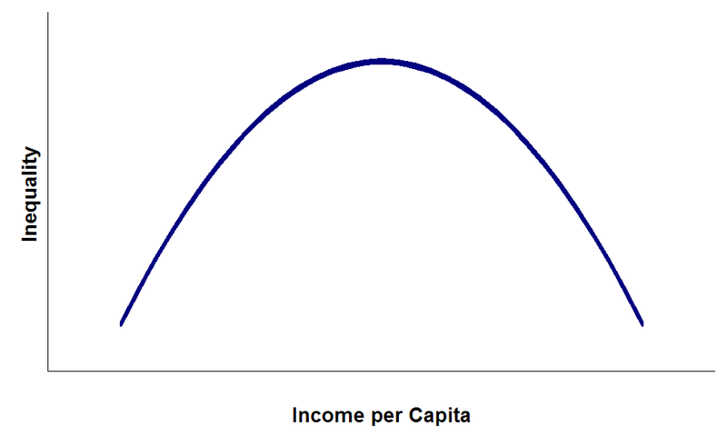
Sunset (the 1980-90s)
  “Kuznets Curve”:

Slide 8
Sunset (the 1980-90s)
“Inter-sectoral inequality”?
  But Thailand:
    Continuously widening gap between agricultural and industrial labor productivity and wage level
    the ratio of industrial over agricultural nominal wages increased from 6.34 in 1977 to 8.72 in 1990 → sectoral migration
    The value of Gini-index climbing from 36.77 in 1975 to 46.96 in 1992
    Trickle-down effects have reduced the country’s poverty incidence (as measured using a poverty line) from 42 percent in 1975 to 16 percent in 1992
    Poverty is increasingly concentrated in rural areas

Slide 9
Sunset (the 1980-90s)
    II. Dutch disease hypothesis
a massive boom in a large tradable sector, then the other tradable sectors would bear the cost of adjustments in the economy
E.g. via “real exchange rate”, “competition in resource use”

Slide 10
Sunset (the 1980-90s)
“Cost-price squeeze”
the export-oriented industrial boom
primary factors of production become more expensive (wage for agriculture) → Costs go up,
the (relative) prices come down as the real exchange rate appreciates + the effects from the severe worldwide agricultural depression of the 1980s

Slide 11
Sunset (the 1980-90s)
Impacts on the rural economy
Changes in cropping patterns
the growth of the tradable crops, both exportables and import-competing, would be less than for the nontradable subsector
the bulk of the growth has been in the fruit subsector, which grew at 9.9 percent per annum during the 1980s
the growth in the protection of some important crops within that category, for example, the oil crops

Slide 12
Sunset (the 1980-90s)
Impacts on the rural economy
2. Labor markets
Thai agriculture depends relatively more on hired labor than on family labor
The share of expenses on hired labor (both cash and food provided during the operations) in total cash farm expenditures has increased from 33.6 percent in 1978/79 to 57.4 percent in 1991/92
part of the is due to the increase in wage rates

Slide 13
Sunset (the 1980-90s)
Impacts on the rural economy
2. Labor markets
Farmers are increasingly separating themselves into two categories
1) “casual farmers”
older, using traditional methods, not particularly innovative
their income and interests lie elsewhere than in farming, or else they are too old to introduce large changes in their patterns of living
Expected to dwindle into insignificance within a generation

Slide 14
Sunset (the 1980-90s)
2) “professional farmers”
acquiring new kinds of farming skills and technology to cope with changing output markets, but more importantly, to cope with the shortage and high cost of labor

Slide 15
Sunset (the 1980-90s)
Four major obstacles
  A scarcity of water
  A shortage of labor
  An inefficient utilization of pesticides
  Increasing competition in the world market

Slide 16
Sunset (the 1980-90s)
Scarcity of water
  Crop sector (e.g. rice) is the most water-intensive production
  Water is a free good (costless) but not adequate to the increasing demands for it → Water scarcity
    A long-term declines in annual rainfall
    changes in patterns of highland use, and upland cropping on the fringes of the basin → deforestation → reduced the sideflow into the Chao Phraya basin’s tributaries and irrigation canals
    rapid development in the North has tripled its water use of capita
    the sectoral allocation of water has changed in favor of urban and industrial areas
      the Bangkok Metropolitan region
      Eastern Seaboard Industrial Area

Slide 17
Sunset (the 1980-90s)
Scarcity of water
  raising overall demand for water in agriculture → accumulated irrigated area has grown from 10,223,140 rai in 1960, to 18,685,480 rai in 1994
  water distribution is so inefficient and poorly maintained that an increasing portion of water is lost
  Free good → inefficient utilization

Slide 18
Sunset (the 1980-90s)
Scarcity of water
  Impacts:
  water shortages always hurt rural farmers more than urban workers and industrialists
  lower yields and smaller crops
  switching to the cultivation of less water intensive crops

Slide 19
Sunset (the 1980-90s)
Labor shortage
  Rapid economic expansion → increased aggregate demands for agriculture
  Declining population growth rates, declining share of the labor force in total population
  Increasing competition for labor among sectors
  The number of employed persons in agriculture dropped from 20.5 million in 1989 to 16.9 million in 1995

Slide 20
Sunset (the 1980-90s)
Labor shortage
  Reasons
  many agricultural workers took up employment in non-agricultural sectors
  real wages in industry rose from 108.18 baht/day in 1977 to 206.42 baht/day in 1995, while real wages in agriculture stagnated at 63.99 baht/day until 1993
  the school enrollment of 15-24 years old increased by 1.51 million, accounting for 51 percent of the reduction of their agricultural employment

Slide 21
Sunset (the 1980-90s)
Inefficient uses of pesticides
  Thailand’s most pesticide-intensive crops, vegetables and fruits, are also its highest value added crops
  Increasing shares of pesticide costs in total production costs
  with 96 registered producers in 1996, Thailand’s pesticide market is highly competitive
  the great gap between registered trade-names and generic names → increased farmers’ uncertainty regarding the effectiveness of pesticides

Slide 22
Sunset (the 1980-90s)
Inefficient uses of pesticides
  a number of public policies have encouraged pesticide use
    government’s reduction of the import duty on formulated pesticides from 5 percent to 0 in 1992
    tax differentials among agricultural inputs → the total effective tax on pesticides is 7 percent, while that on agricultural machinery and active ingredients for fertilizers is 8.05 percent and 17.7 percent, respectively.
    DOAE provides farmers with free pesticides in case of a pest outbreak → MC = almost 0, Alternative methods: Integrated Pest Management (IPM) (biological control methods) are paid less attention

Slide 23
Sunset (the 1980-90s)
Inefficient uses of pesticides
  Thai farmers generally spray highly concentrated pesticides with little intervals between spraying rounds, chemical residues in food are generally high
  farmers often mix pesticides, creating a “cocktail” of several chemicals, without considering their combination possibilities
  farmers frequently increase the concentration of pesticides, in the belief that increased intensities lead to greater protection
  farmers tend to have a strong preference for pesticides which wipe out pests rapidly, thus using the most hazardous chemicals

Slide 24
Sunset (the 1980-90s)
Inefficient uses of pesticides
  adverse externalities on consumers and the environment, whose costs are not borne by farmers and thus not included in the market price
    the annual social costs in 1990 → 5.5 billion baht
    implying that for every baht spent on pesticides society incurs costs of about one baht
  pesticide application harm farmers’ health and are technologically inefficient, i.e., they do not maximize farmers’ expected profits

Slide 25
Sunset (the 1980-90s)
Agricultural Policies
  three-year plan on “Restructuring Agricultural Production Systems” (RAPS) in the late 1993
  reduce and replace the production of rice, cassava, coffee, and pepper, with the production of higher value products, such as vegetables, flowers, fruit trees, bamboo (for human consumption), fast-growing trees, cattle, and milk cows
  Policy instrument: subsidized credits and inputs

Slide 26
Sunset (the 1980-90s)
Inefficiencies
  1. the government’s attempt to successfully pick winners and losers crucially depends on its knowledge and ability to forecast markets and prices better than farmers.
  However, the government’s record in forecasting prices has been poor

Slide 27
Sunset (the 1980-90s)
Inefficiencies
  2. the promotion of the production of “new” high value added products requires the government to provide farmers with adequate technology
  3. planted area reduction of four main crops was incapable of maintaining their prices, the domestic prices of all major crops are determined by prices on the world market (except rice)
  4. farmers who participated in the program were those who had already made plans to restructure their production

Slide 28
Sunset (the 1980-90s)
the world markets for most agricultural markets were (and still are) depressed by massive subsidies and protectionism, mostly from developed countries (but including some East Asian countries as well)
The first response to the fall in world prices, particularly in the early to mid-1980s, was to try and "support" domestic prices, with public purchases at above market price

Slide 29
Sunset (the 1980-90s)
Inefficiency
  short-term influence
  The purchases were too small to exercise any influence on prices
  never put into a coherent well-thought out program
  discredited as vehicles for patronage and corruption

Slide 30
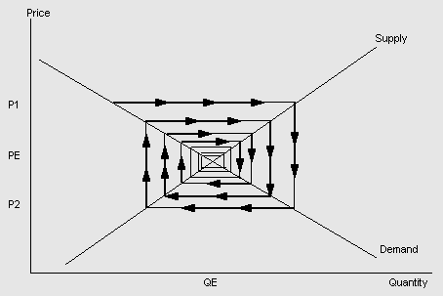
Sunset (the 1980-90s)
Price volatility: Cobweb theory

Slide 31
Policy reform?
Institutional restructuring of the agricultural system
  a mechanism to forecast demand for various commodities, and then manage the supply to match with the forecasted demand
  Introduction of the “marketing boards”/ national agricultural council
  Practice of “contract farming” whereby an agri-business firm would contract with farmers to produce a commodity, whose purchase and sometimes the price the firm would guarantee.

Slide 32
Policy reform?
“Supply management policy”
Instead of trying to control supplies directly, the government began to provide incentives to draw farmers away from growing crops that it deemed to be in excess supply
Instrument: credit policy
  BAAC → has an organ which had close (if not always friendly) relations with individual farmers

Slide 33
Policy reform?
Livelihood development policy
Natural resource & environmental policy

