Slide 1

Introduction to Marketing
BE case club

Slide 2



Agenda
About me
Important marketing concepts
Needs and wants, market segmentation and target market, competitor analysis
4Ps
Q&A
If you have any question, just ask!
Product, Price, Place, Promotion

Slide 3
Important marketing concepts
Marketing concepts: achieving organizational goals depends on determining the needs and wants of target markets and delivering desired satisfactions more effectively and efficiently than competitors.

Slide 4
Important marketing concepts
Marketing concepts: achieving organizational goals depends on determining the needs and wants of target markets and delivering desired satisfactions more effectively and efficiently than competitors.

Slide 5
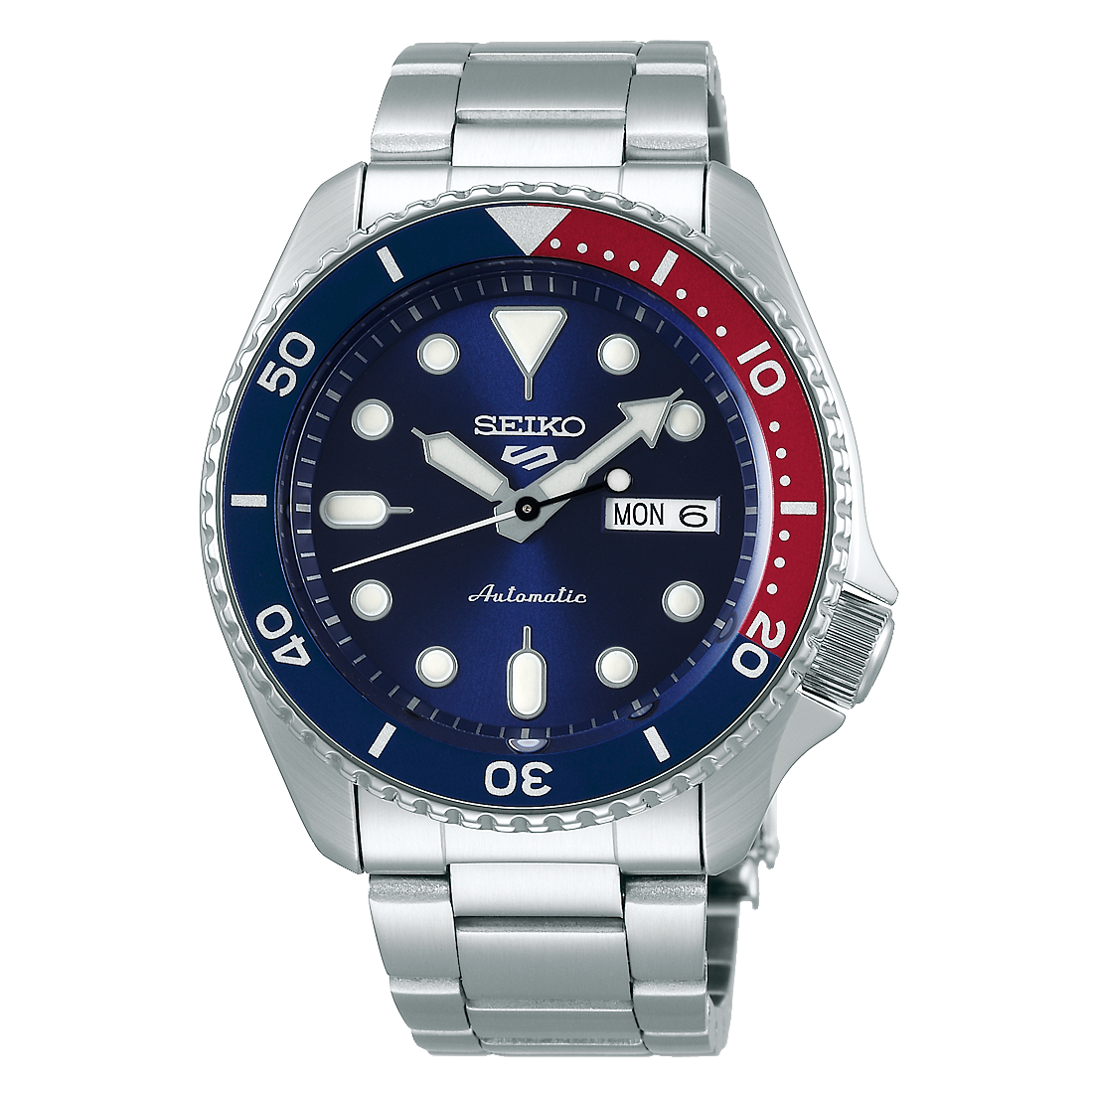

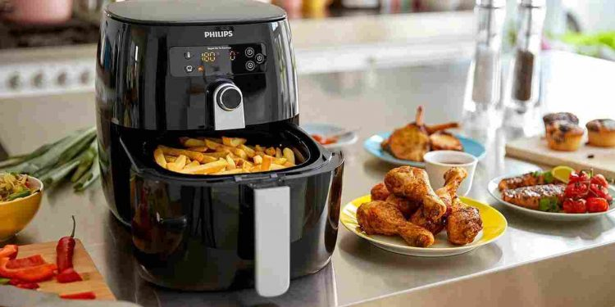
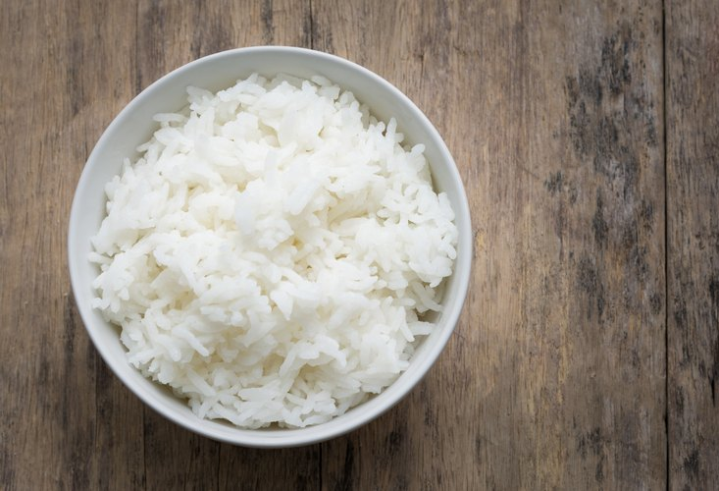
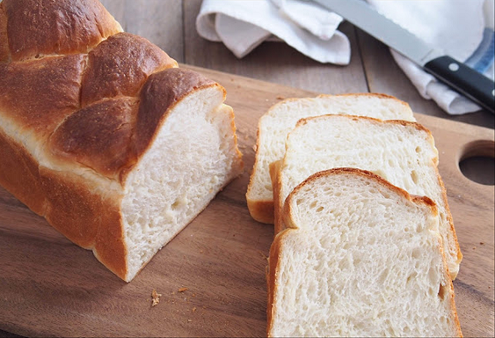
Understand needs and deliver value
Consumers’ needs and wants
Value creation and satisfaction
Needs
Basic requirements
Value
the sum of the tangible and
intangible benefits and costs
Wants
Shaped by culture and individual personality
High price ≠ high value
Low price ≠ low value
Satisfaction
a person’s judgment of a product’s perceived performance in relationship to expectations
Unmet need is an opportunity

Slide 6
We may not want to serve everyone
Undifferentiated (mass) marketing
Differentiated (segmented) marketing
Micromarketing (local or individual marketing)
Concentrated (niche) marketing
Market segmentation
Target market
Geographic segmentation (countries, regions, cities, urban/rural, postcode)
Demographic segmentation (age, gender, family size, income, occupation)
Psychographic segmentation (social class, lifestyle, personality)
Behavioural segmentation (consumer knowledge, attitudes, product usage)
Targeting
broadly
Targeting
narrowly

Slide 7
Are we growing fast enough?
 | Year 2019 | Year 2020
Total Market sales | 100 | 120
Brand A’s sales | 40 | 50
Brand B’s sales | 60 | 70
Brand share = (Brand sales / Market sales)
(40/100) = 40%
Brand manager of brand B: Did we perform well in year 2020?
Marketing analyst: Yes, because we expanded our sales at 16.7%. We did great job.
Market share
Brand A’s share in 2019 =
Brand B ’s share in 2019 =
(60/100) = 60%
(50/120) = 41.7%
Brand A’s share in 2020 =
Brand B ’s share in 2020 =
(70/120) = 58.3%
Market / brand growth
Market growth = (120/100) – 1 = 20%
Brand A growth = (50/40) – 1 = 25%
Brand B growth = (70/60) -1 = 16.7%
Only looking at growth only can be misleading

Slide 8
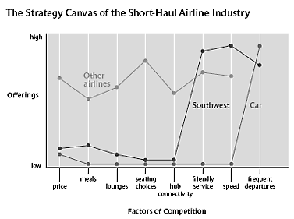
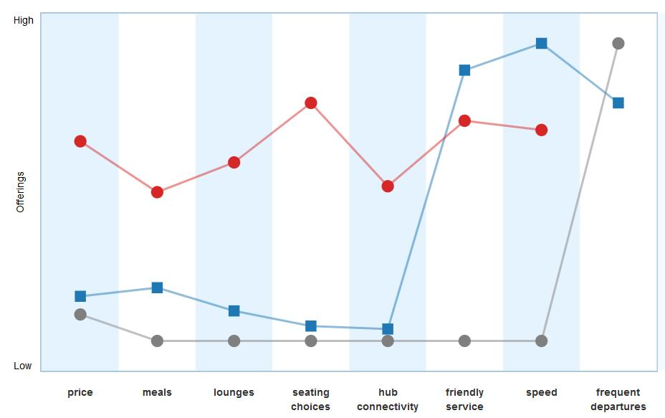










We are not alone in the market
Strategic Canvas
Perceptual map
International
Other airlines
Car
Popular
Exclusive
Southwest
National
How do we come up with this chart?

Slide 9
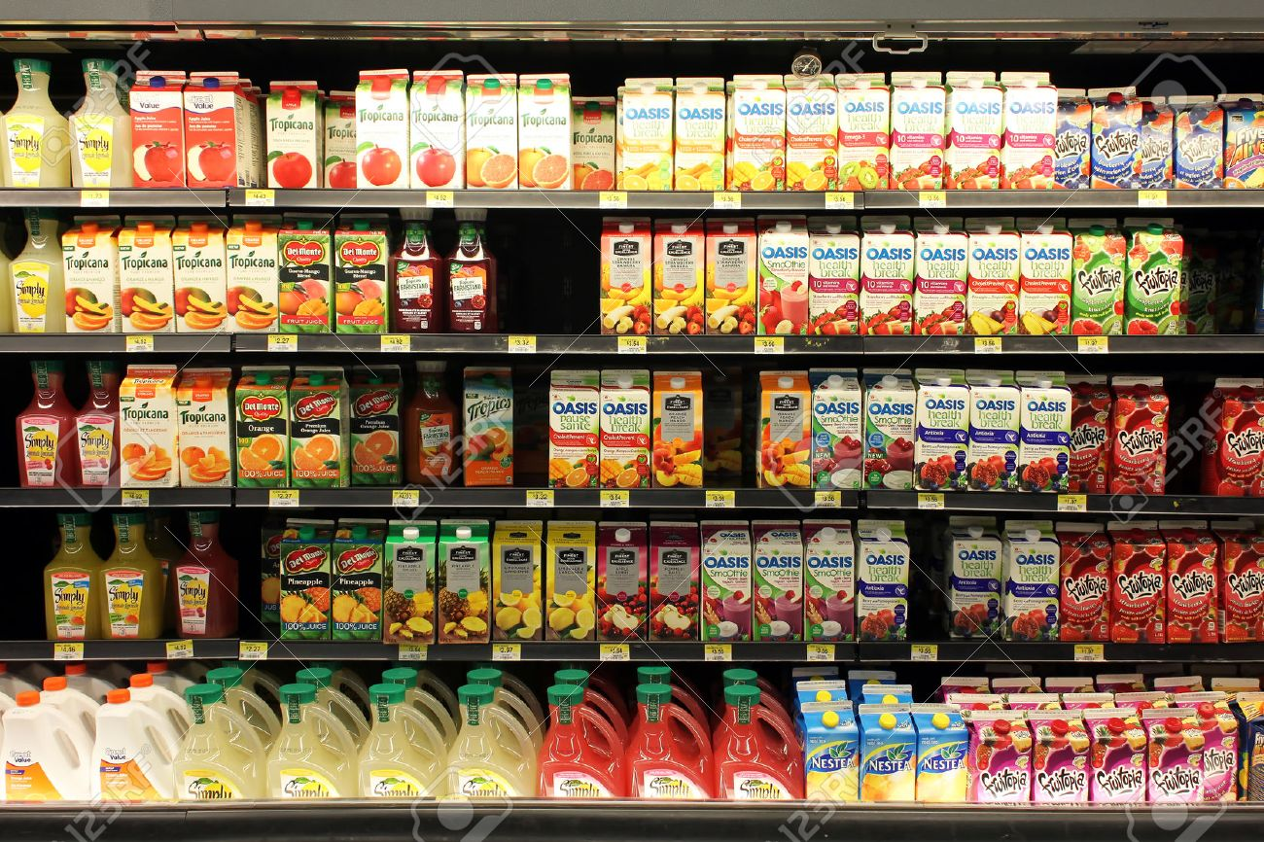
Market research is crucial to answer marketers’ questions
Who will be main target group for fruit juice product?
Which shelf level/position that consumers will see fist?
How frequent they will buy?
Will our new product be noticed? Is our packaging attractive enough?
Which sizing consumer will buy? At which price range?
Are they willing to try new product?

Slide 10
Key task is to take customers to the end of funnel
Fruit Juice
Buying clothes online
Awareness
Interest
Consideration
Intent
Evaluation
Purchase
See new product
See the product in friend’s Instagram
Want to look closer
Want to look in detail
Look for product information & price, Compare with other brands
Read the product information and reviews
Thinking of buying it, go to Shopee and put it in the cart
Thinking of buying it
Make sure again if it’s right decision
Think again whether to buy it for sure or to wait for 9.9
Buy it!
Let’s buy it
How your marketing activities stimulate customers in each stage?

Slide 11
Marketing mix - 4 Ps
“If the marketer does a good job of identifying consumer needs, developing appropriate products, pricing, distributing, and promoting them effectively, these goods will sell very easily.” - Philip Kotler

Slide 12
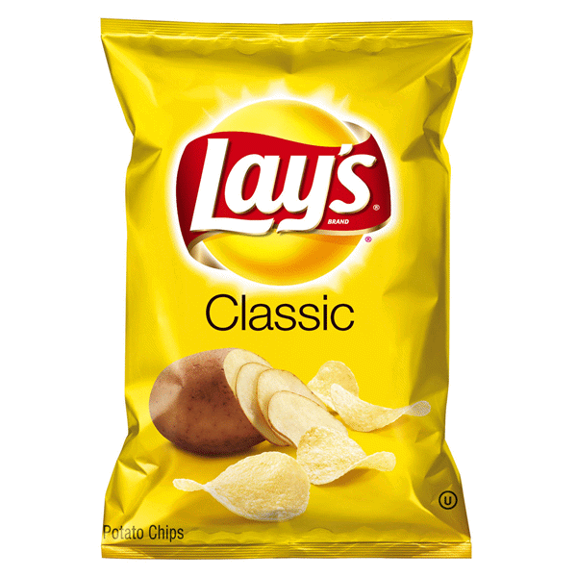
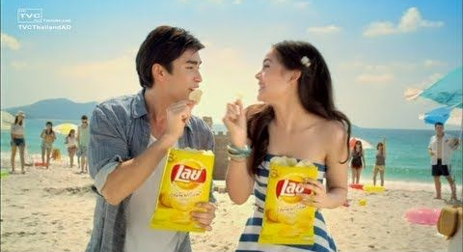
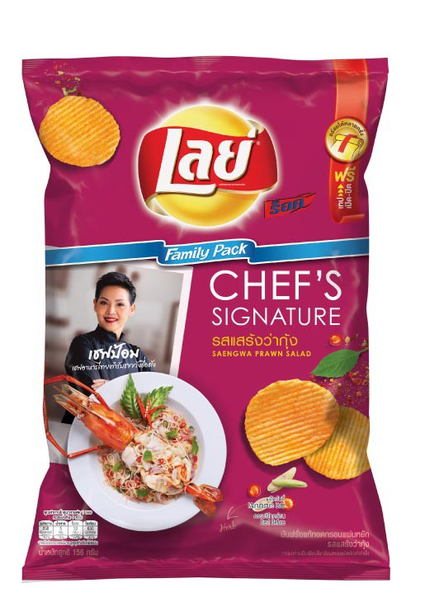
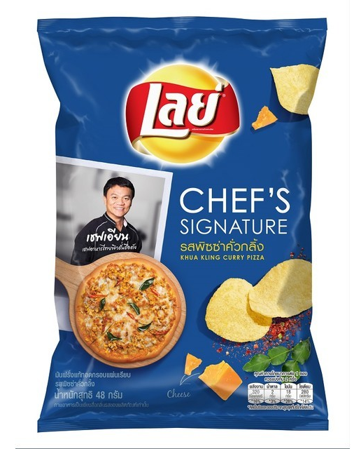

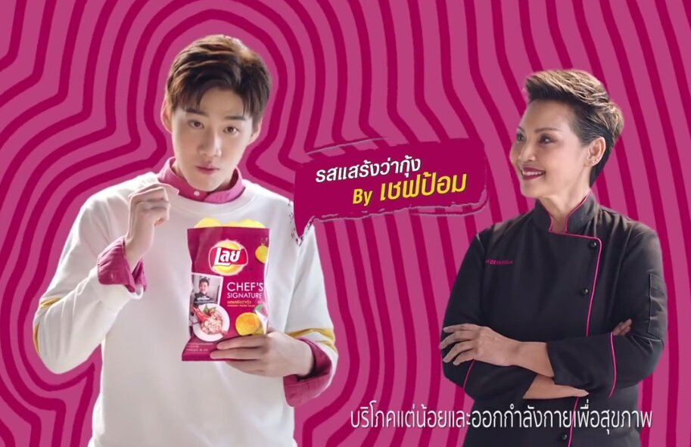
Product
New Product Development (NPD) can help growing the brand

Slide 13
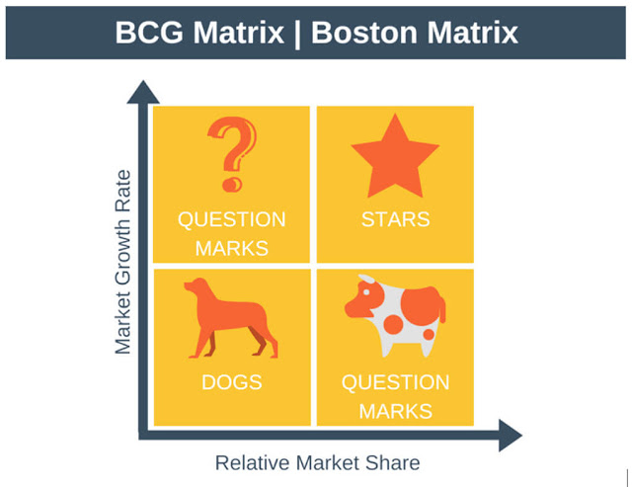
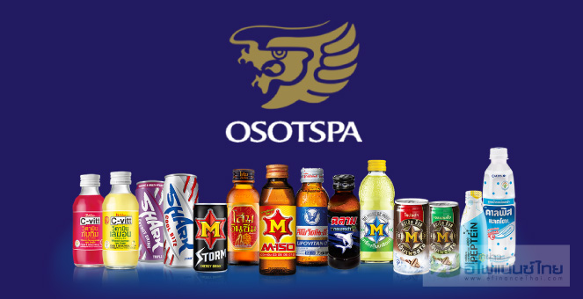
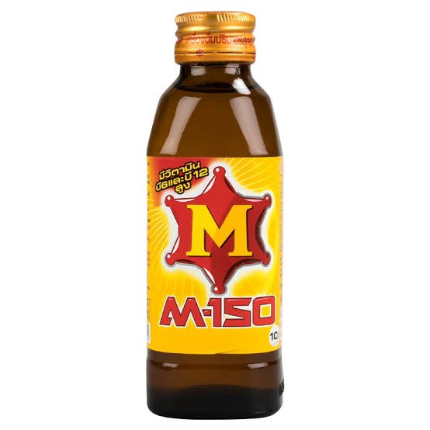
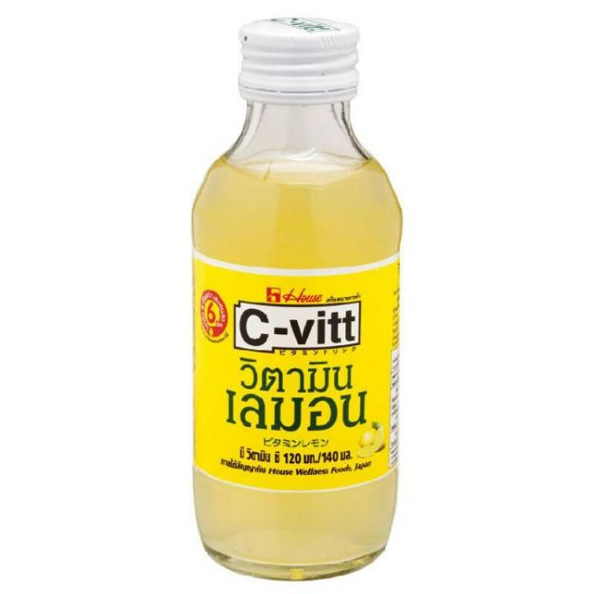

Product
Firms may need to manage not only one product, but a portfolio
Beverage portfolio of Osotspa
Question Marks
Stars
Dogs
Cash Cows
Herbal energy drinks

Slide 14
Price
Consider appropriate pricing strategy for the product
Skimming pricing
Goal: High revenue by achieving large market shares and economies of scale
When to use:
Extensive local competition
High price sensitivity
Ability to achieve significant cost benefits through economies of scale
Cost leader
When to avoid:
Fear of price wars
Ability of competitors to adjust cost/price structures
Low selling price hurts brand image
Marketing pricing
Goal: High revenue through targeting price inelastic market segment
When to use:
Unique product
Patented product
High tech product
When to avoid:
Inability to justify price premium
Low disposable income
Penetration pricing
Goal: Revenue by stealing existing players’ market shares using competitive prices
When to use:
Extensive competition
Long product life cycle
Lack of ability to justify premium
Price sensitive consumers
When to avoid:
The price of the competition is to low to break-even
Demand-cost conditions do not allow for adaptations
Need for price image consistency across countries

Slide 15

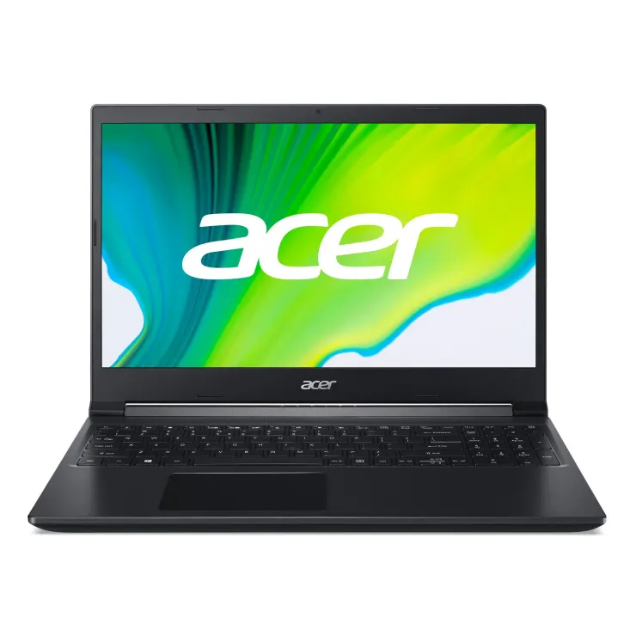

Place
Choose your distribution strategy that fit with your product
Model of Distribution
Intensive Distribution
- Maximum number of outlets
- Maximum availability
- Convenience products
- High number of potential purchases
- High purchase frequency
- Low level of planning for purchases
- Low price
Selective Distribution
- Number of outlets varies
- Specialist retailer knowledge
- Shopping products
- Medium number of potential purchases
- Occasional purchase frequency
- Medium level of planning for purchases
- Medium price
Exclusive Distribution
- Few outlets
- Close retailer/consumer relationship
- Specialty products
- Low number of potential purchases
- Low purchase frequency
- High level of planning for purchases
- High price

Slide 16
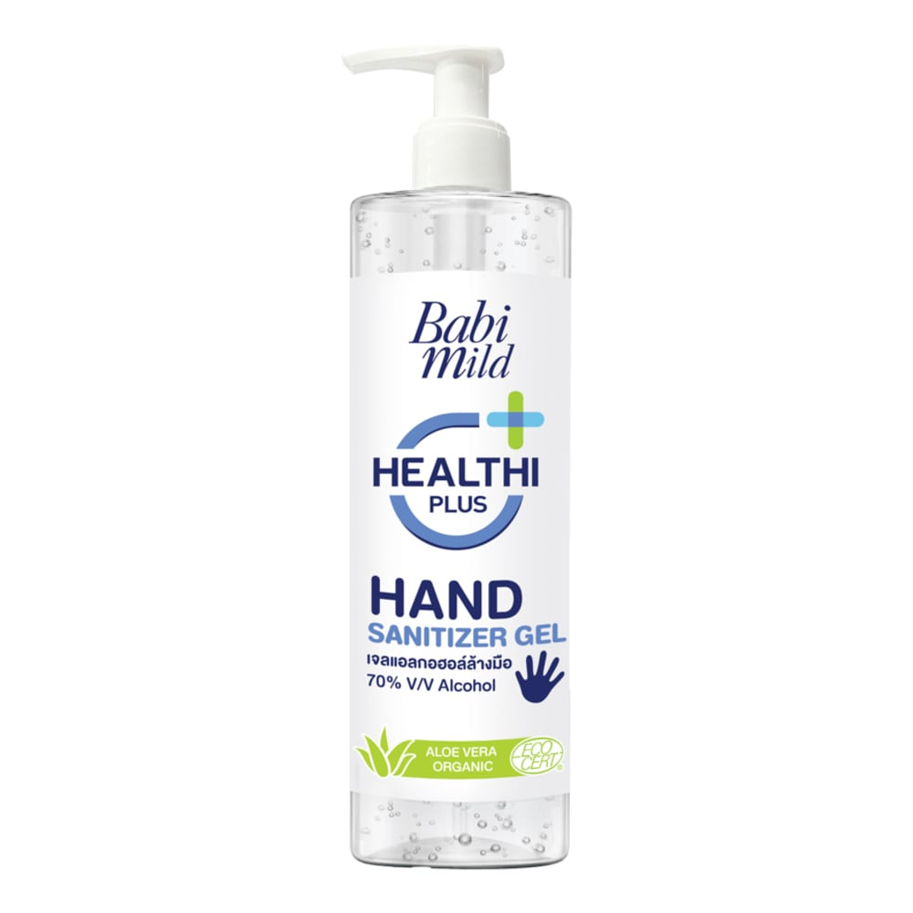


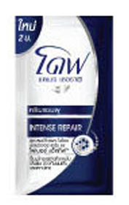

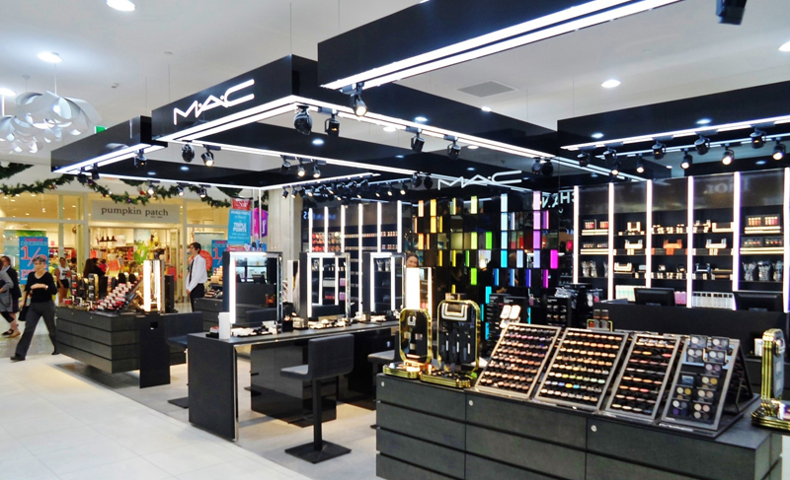
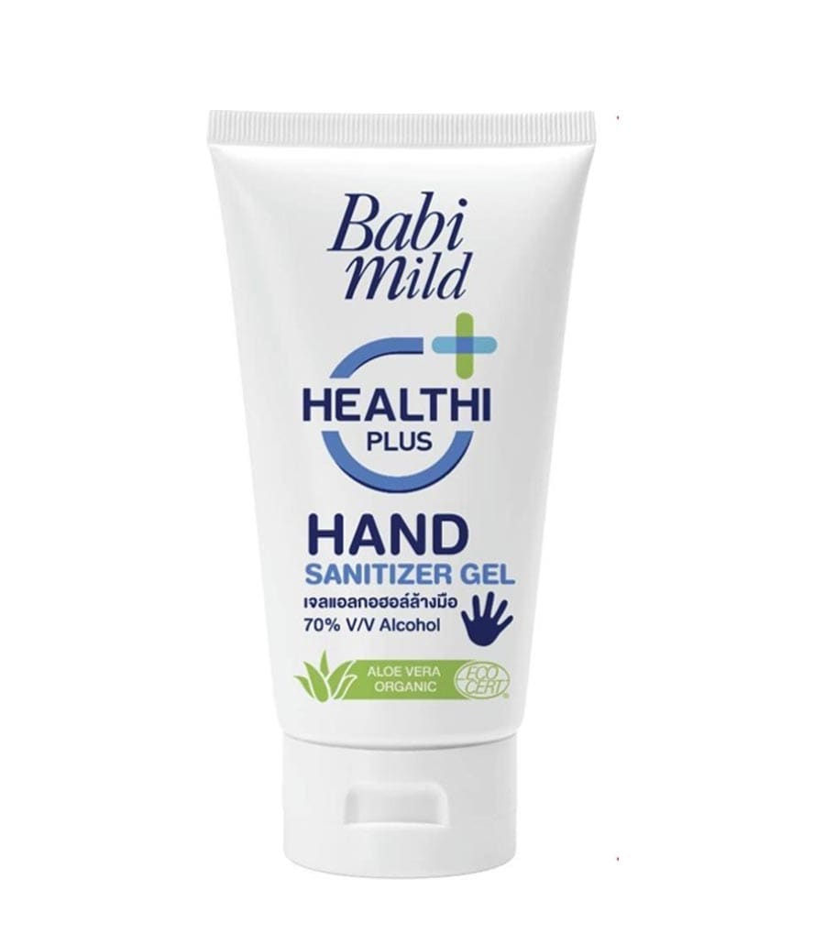
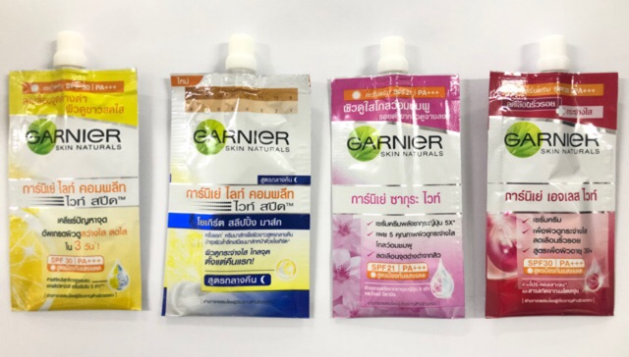
Place
Distribution in practice
The success of sachet format
Multi-Channel
Intensive distribution
Omni-Channel

Slide 17
Promotion
Promotion is not all about discount or advertising
Advertising
Sales promotion
Public relations
Direct marketing
Personal selling
Product placement
Event & Sponsorship
Brand websites
Social media
Mobile marketing
Packaging
Word of month
Target Audience
Target Audience
Viral
Point of sale

Slide 18
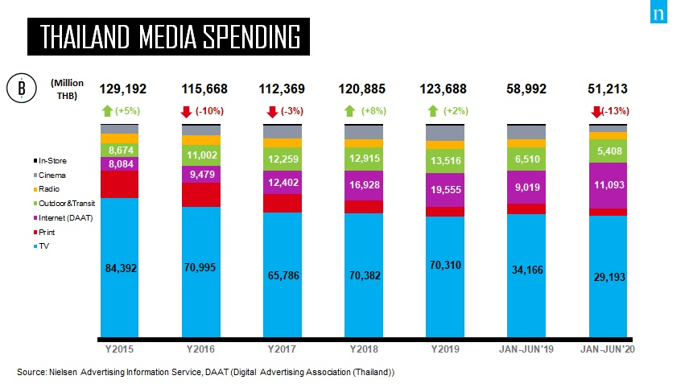
Promotion
TV Ads and Printed declined as Internet and OOH rose

Slide 19
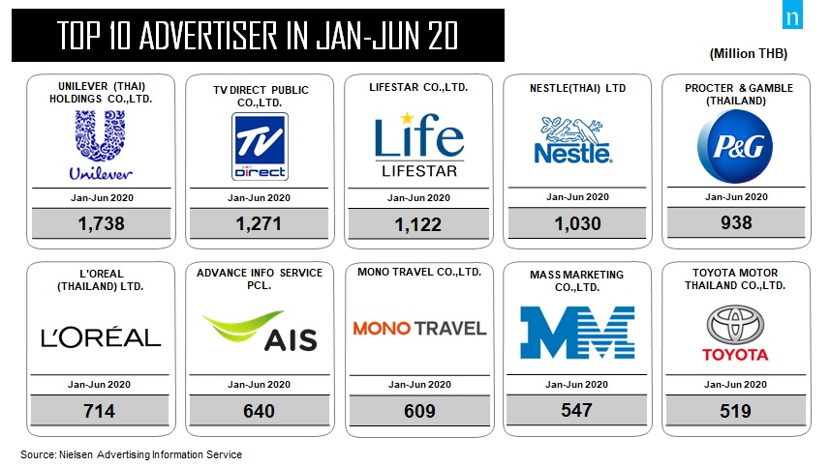
Promotion
Key FMCG firms are leaders for ads spenders

Slide 20
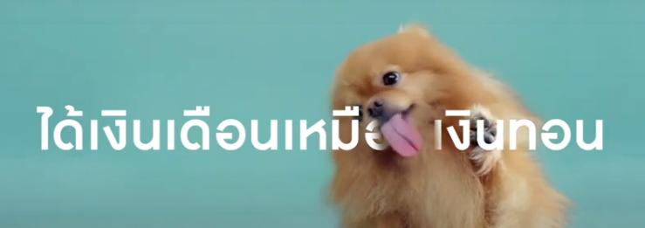
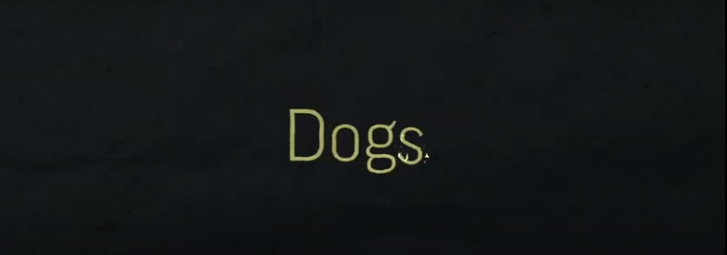
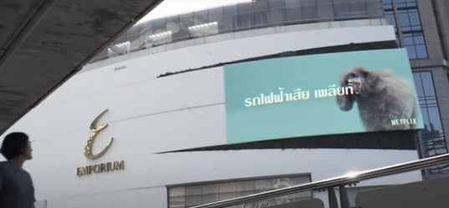
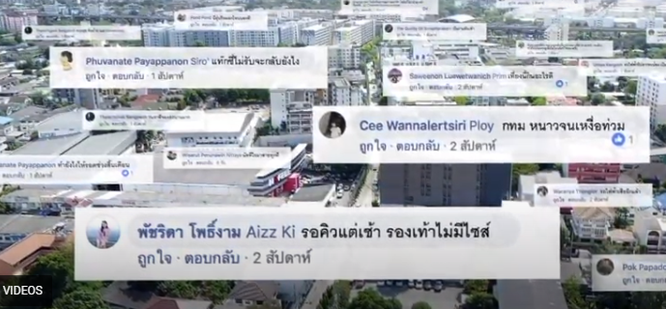
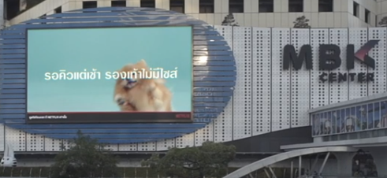
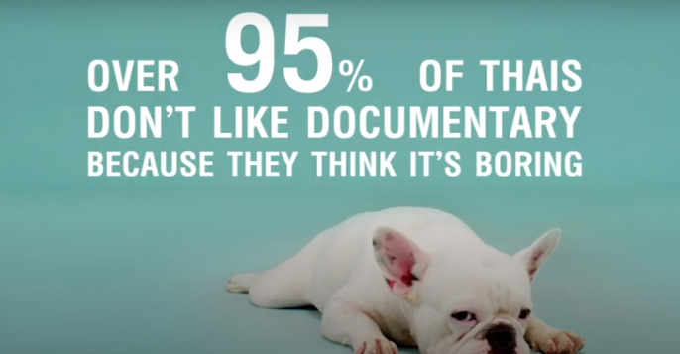
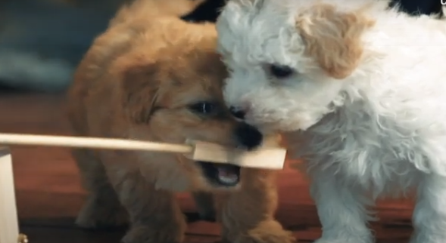
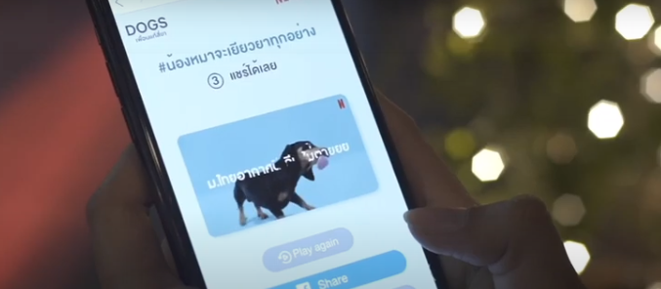
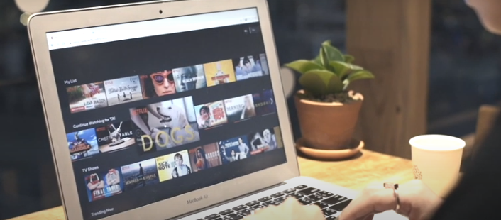
Promotion
Viral marketing is not about the budget. It’s all about idea!
Netflix: Lick Away Bad Day
Idea
Background
http://wolfbkk.com/Project/View/28
Key challenge for all promotion campaigns = how to reliably measure the effectiveness!

Slide 21
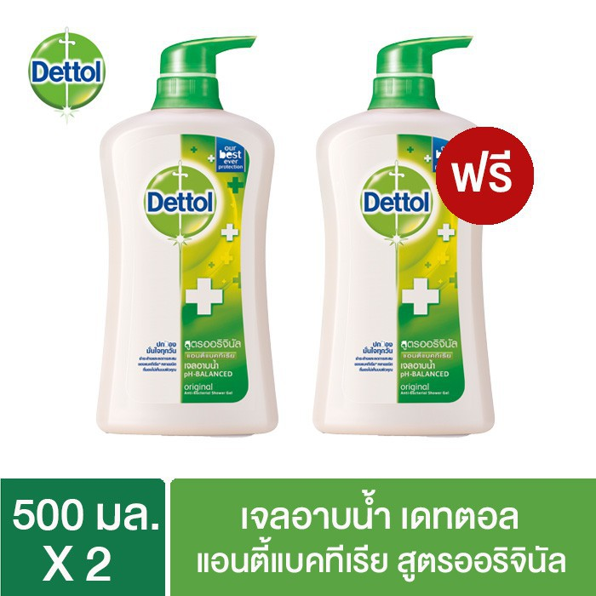
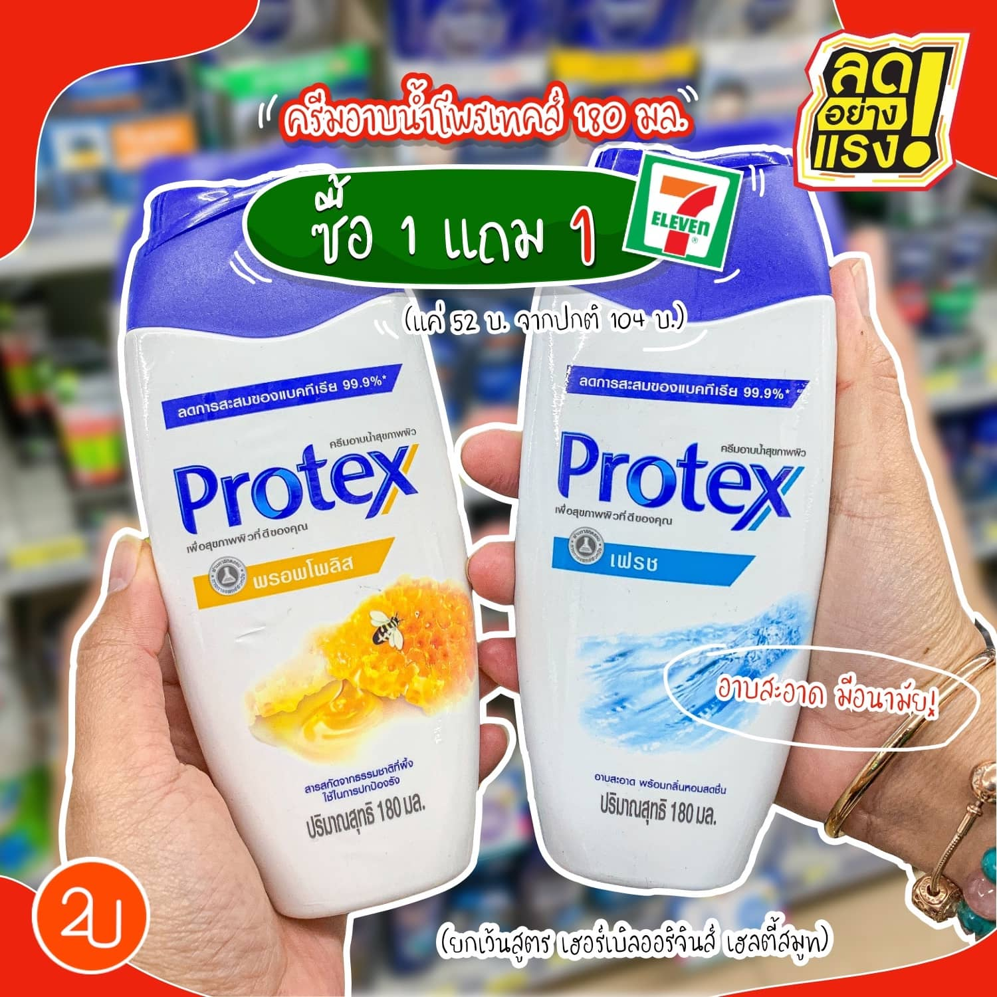

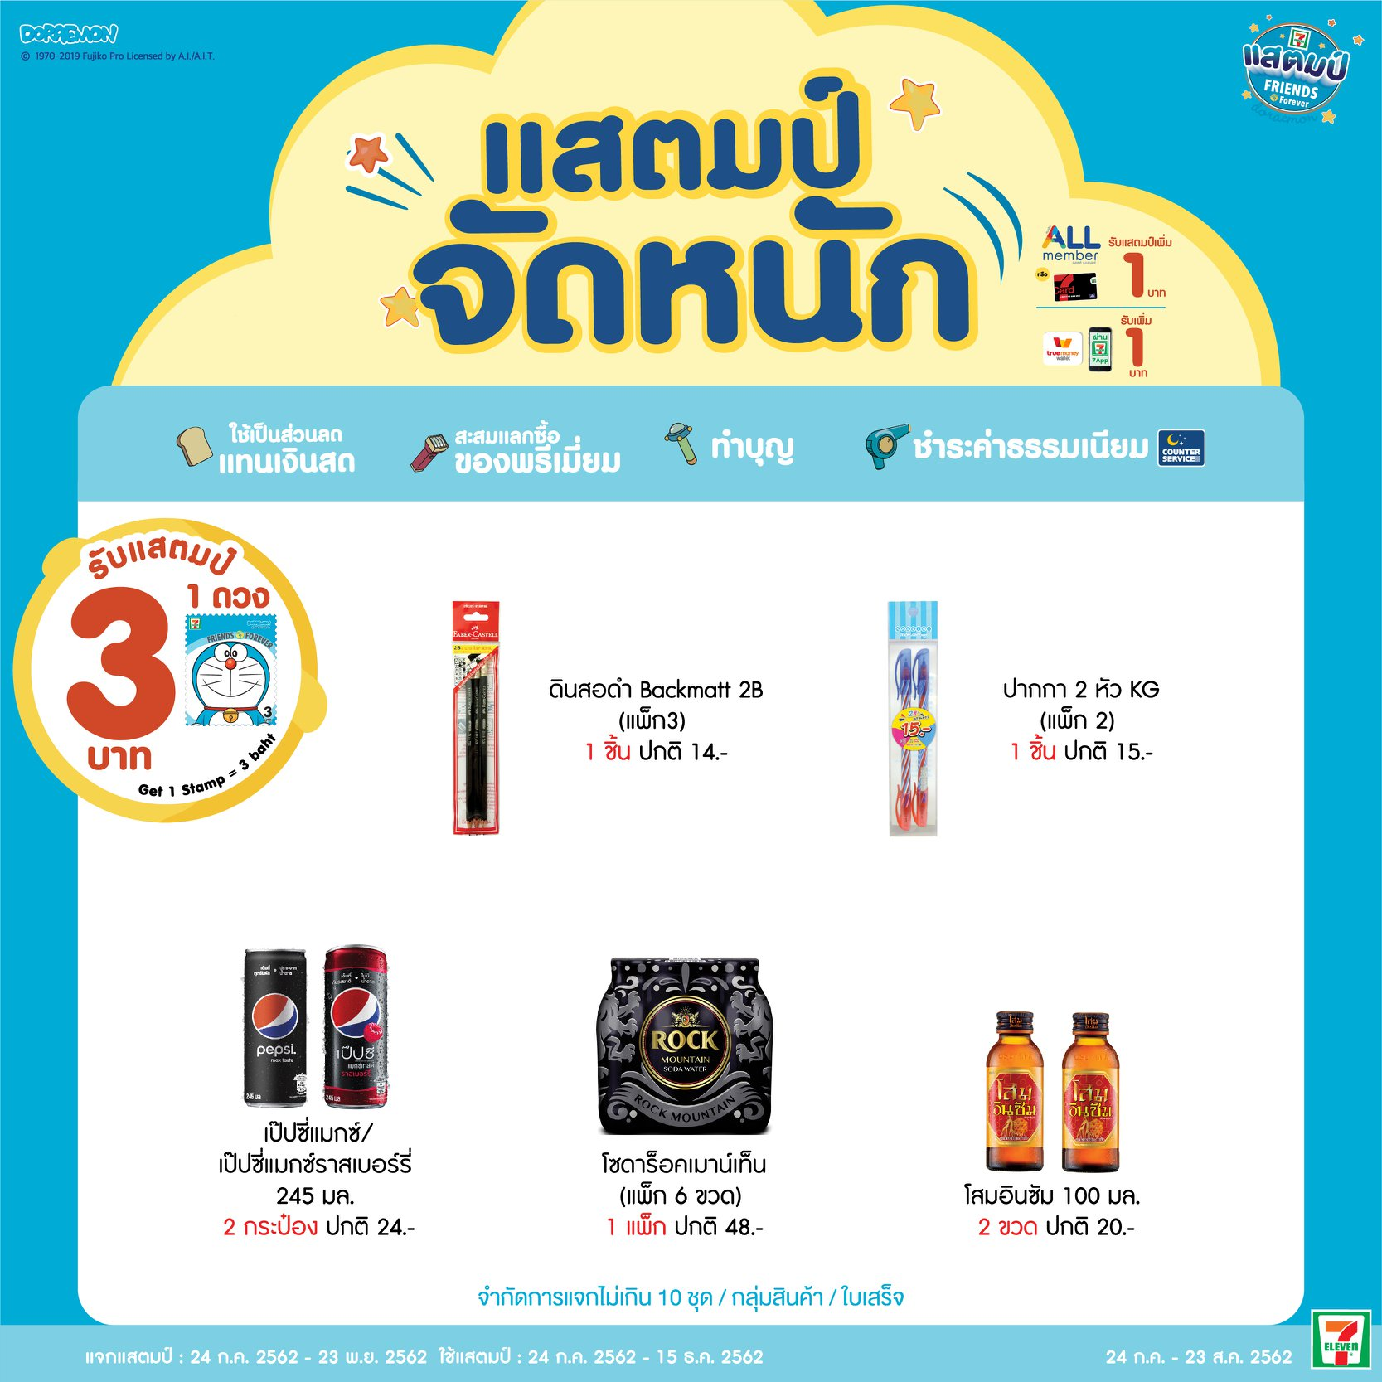
Promotion
Promotion in practice
Share of voice
Sales promotion
Traditionally, share of voice is share of advertising, compared to all of your competitors.
Liquid soap Buy1 Get1 (BOGO)
Share of Mind
When consumers are asked about “Top of mind brand”
7-Eleven stamp campaign

Slide 22
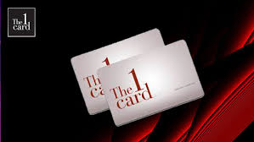
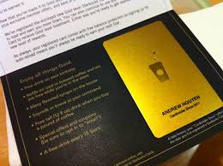
Promotion
Engage new customers and maintain relationship with old customers
Consumer engagement
Customer Relationship Management (CRM)
Unawareness
Awareness
Knowledge
Liking
Preference
Trial
Loyalty
Develop brand loyalty
Retain customer base
Prevent brand switching

Slide 23
Q&A

