Slide 1
2952352 MATHEMATICS FOR ECONOMISTS II
Matrix Algebra

Slide 2
Topics
Linear Equations and System of Linear Equations
Matrix operations
Solving a linear system using row operations
Echelon form and Reduced Echelon form
Rectangular (coefficient) matrices
Matrix inverses
Determinants and Cramer’s rules

Slide 3
Linear equations and Linear Systems

Slide 4
Economics models typically consist of a number of equations that
represent identities, behavioral relationships and conditions that
contribute an equilibrium. These equations include both variables,
which are economics quantities that can assume different values
and parameters, which are unvarying constants for example
parameters
variables

Slide 5
Systems of linear equations
A collection of one or more linear equations involving the same set of variables.
A system of linear equations with 2 variables:
E.g.
A system of linear equations with 3 variables:

Slide 6
A system of linear equations with n variables:
Set variables:

Slide 7
Examples of a system of linear equations
A charity wishes to endow a fund that will provide $50000 per year for
cancer research. The charity has $480000 and , to reduce risk, wants to
invest in two banks paying 10% and 11 % respectively.
How much should be invested in each bank?
x + y = 480000
0.1 x + 0.11 y = 50000
10x+10y=4800000
10x+11y=5000000
y = 200000
x = 280000

Slide 8
Examples of a system of linear equations
Tax benefits of charitable contribution
A company earns before-tax profits of $100000. It has agreed to contribute
10% of its after-tax profits to Red Cross Relief Fund. It must pay a state tax
of 5 % of its profits (after the Red Cross donation) and a federal tax of
40 % of its profit (after the donation and state taxes are paid). How much does
the company pay in state taxes, federal taxes and Red Cross donation?
C + 0.1S + 0.1F = 10000
0.05C+ S = 5000
0.4C+ 0.4S+ F = 40000
C = 5956, S = 4,702, F = 35,737

Slide 9
Examples of a system of linear equations
Suppose that you are at a bench-press contest and have just witnessed the
Lightweight Champion press a bar weighted with 2 large disks and 1 small disk on
each side and the weight is announced as 275 pounds. Then the eventual
middleweight champion pressed a bar with 3 large disk and 1 small disk on each
side, the weight is announce 365 pounds. The heavyweight champion lifts a bar
weighted with 4 large disks and 1 small disk, but you cannot hear announced
weight. Assuming the bar weighted 45 pounds,how much did the heavyweight lift?
Ans:X=45 and y=25
A foolish dieter, following the instructions of his nutritionist to the letter,
is insistent that fat constitute exactly 10% of his diet. On a certain day, he must
Select from a menu consisting strictly of 92% fat-free turkey bologna and hog
Lard, which is virtually 100% fat. How much of each should he consume if he
wishes to eat 10 pounds of food.
Ans: X=9.8, y=0.2
A manufacturer produces three products: A,B, and C. The profits for each unit of A ,B and C sold are $1,$2 and $3 respectively. Fixed costs are $17000 per year, and the costs of producing each unit of A,B and C are $4,$5, $7, respectively. Next year, a total of 11,000 units of all three products is to be produced and sold, and the total profit of $25,000 is to be realised. If the total cost is to be $80,000, how many units of each of the products should be produced next year?
A=2000,B=4000,C=5000
Notes:
Econ applications

Slide 10
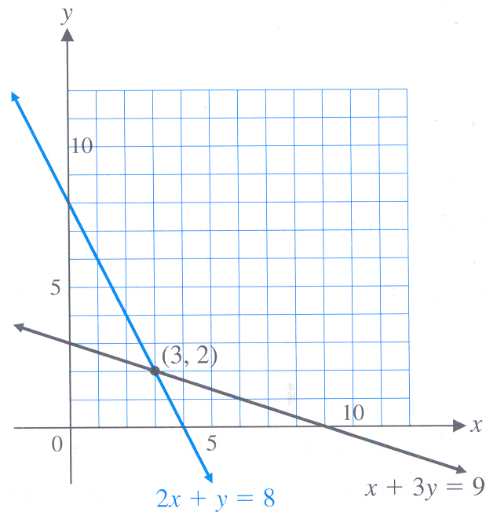
(1)
(2)
To obtain solutions to this system of linear equations we can either use, for examples
Graph method
Substitution method
Elimination of unknowns method
Elementary row operations
Inverse of a matrix
Cramer’s rule
1. Graph method
2. Substitution method

Slide 11
3. Elimination of unknowns
Methods 4-6 require the use of matrix algebra.

Slide 12
Matrix Algebra
A powerful set of tools for handling systems of linear equations is
provided by matrix algebra (Linear Algebra).
Matrix algebra is a method suitable for a large system of simultaneous equations.
Matrix algebra provides a compact way of writing an equation system even an extremely large one.
Matrix algebra leads to a way of testing the existence of a solution.
It gives a method of finding that solution (if it exists).
Applicable only to linear equation systems.

Slide 13
What is a matrix?
A Matrix is a rectangular (or square) array of numbers,
variables or parameters with one or more rows and
one or more columns.
Column 1
C 2
C 3
C 4
Size of matrix is 3x4
Row 1
Row 2
Row3
entries/elements

Slide 14
A 3x3 square matrix
A matrix with one row ➔
A row matrix or a row vector
A matrix with one column ➔
A column matrix or a column vector

Slide 15
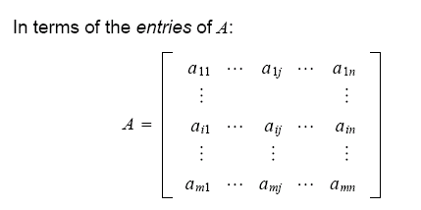

Matrix notation
Two way to denote m×n matrix A:
Scalar entry in the ith row
and jth column of A is
denoted by a_{ij}
The columns of A are vectors in R^{m}

Slide 16
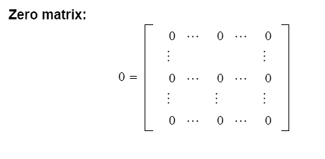
Matrix notation
A diagonal matrix is a square matrix whose nondiagonal entries are zero
Identity matrix

Slide 17
Matrix addition and scalar multiplication
Two matrices are equal if they have the same size and if their
corresponding entries are equal.
Matrix addition
Matrices must have the same size
The resulting matrix is also of the same size
Each entry in A+B is the sum of the corresponding entries
in A and B.
Scalar multiplication
The scalar multiple rA is the matrix whose columns are r times
the corresponding columns in A

Slide 19
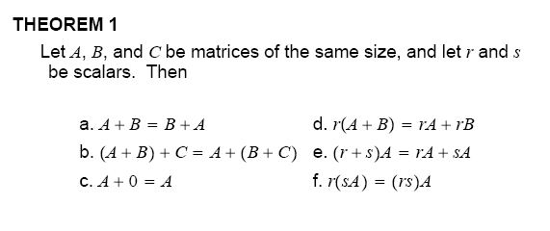
Properties of Sums and Scalar Multiples
Commutative law
Distributive laws
Associative law
of addition
Each equality is verified by showing that
LHS matrix have the same size as RHS matrix
corresponding columns are equal

Slide 20

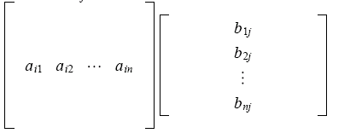
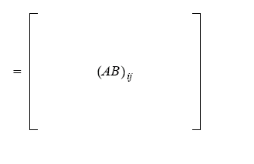
Matrix multiplication
Three different ways with the same answer:
Method 1: Each entry of AB is the product of a row and a column.
(AB)ij=row i of A times column j of B
This single entry is the inner product of the two vectors.

Slide 21
Example

Slide 22
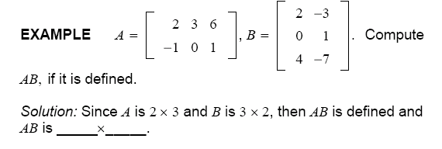
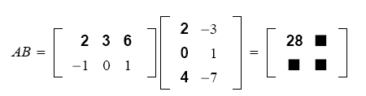

Slide 23



Method 2: Each column of AB is the product of a matrix and a column
Column j of AB = A times column j of B
The number of columns in A has to equal the number of rows in B .

Slide 24
Example
Example

Slide 25
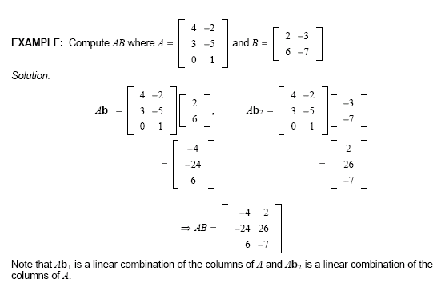

Slide 26
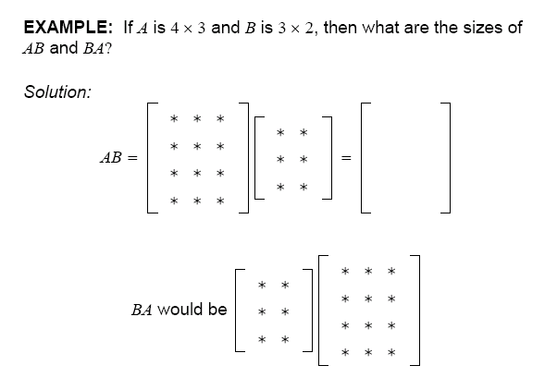
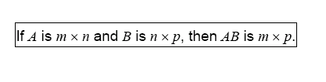
Which is _____________

Slide 27
Method 3: Each row of AB is the product of a row and a matrix
row i of AB = row i of A times B

Slide 28
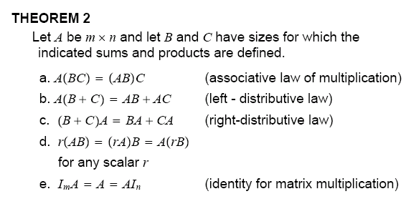
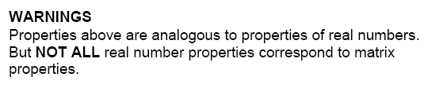
Properties of matrix multiplication

Slide 29
1.
2.
3.

Slide 30
Examples
Inventory:
A grocer sold 125 cans of tomato soup, 275 cans of beans and
400 cans of tuna. Write a row vector that gives the number of each item sold.
If the items sell for $0.95, $1.03 abd $1.25 each, respectively, write this information
as a column vector.
Raw material and cost:
Suppose that a building contractor has accepted orders for 5 ranch-style houses,
7 cape cod-style houses and 12 colonial-style houses. Then his orders can be
represented by the row vector:Q=?

Slide 31
Furthermore, suppose that the “raw materials” that go into each type of house are steel, wood, glass,paint, and labour. The entries in the following matrix R give number of units of each raw material going into each type of house ( the entries are not necessarily realistic, but chosen for convenience)
Suppose now the contractor wishes to compute the amount of each raw material needed to fulfill his orders. Then such information is given by ___________

Slide 32
The contractor is also interested in the costs he will have to pay for these materials.
Suppose steel costs $2500 per unit, wood cost $1200 per unit, and glass, paint and
labour cost $800, $150, and 1500$ per unit, respectively. These data can be written
as the column cost vector C = ?
Then the cost of each type of house is given by the matrix RC
The total cost of raw materials for all the houses is give by Q(RC)

Slide 33
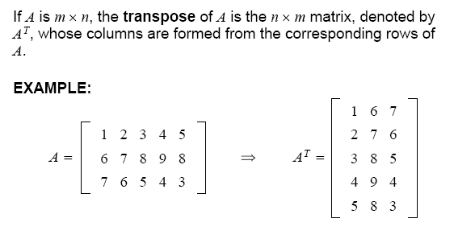
Matrix transposition

Slide 34
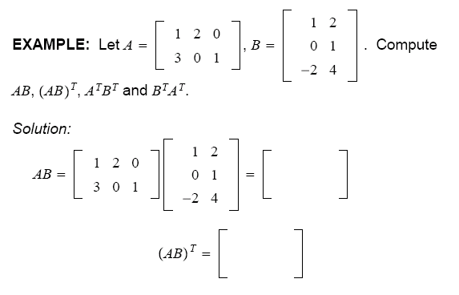
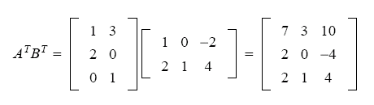
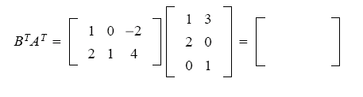

Slide 35
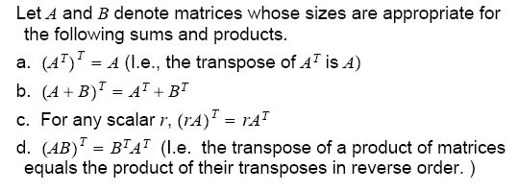
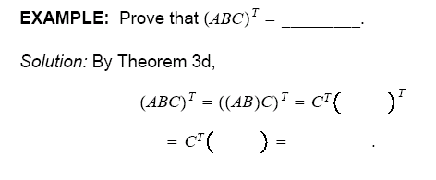
Properties of Matrix Transposition

Slide 36
Using a Matrix and Vectors to Depict a system of Linear Equations

Slide 37
Coefficient matrix A
Constant vector b
An augmented matrix
A system of linear equations can be written in a matrix equation form

Slide 38
The whole idea of linear algebra is to solve
A system of linear equations can be written in matrix form
or
Augmented matrix

Slide 39
A solution of the system of algebraic equations
A list of numbers that makes each equation true
Possible solutions of a system of linear equations
A system of linear equations has either

Slide 40
Consistent system ➔ one solution or infinitely many solutions
Inconsistent system ➔ no solution

Slide 41
A solution of a linear system:
A list of numbers that makes each
equation in the system true when the values
are substituted for
respectively
The solution set:
The set of all possible solutions of a linear system.
Equivalent systems:
Two linear systems with the same solution set.

Slide 42
Strategy for solving a linear system
Replace one system with an equivalent system (one with the same solution set) that is easier to solve.
example
a)
b)
c)

Slide 43
Equivalent systems
c)
a)
b)
c)

Slide 44
Solving a linear system
Note:

Slide 45
Example

Slide 48
We can stop the row operation process at step 4 and perform
Back substitution to obtain the solution set. This method
is known as “Gauss Elimination” method.

Slide 49
Gauss Elimination method

Slide 50


Example of system of linear equations with 3 variables
An augmented matrix

Slide 51



Slide 53
Example

Slide 56
Important terms
Pivot position: a position of a leading entry in an echelon form of the matrix.
Pivot: a nonzero number that either is used in a pivot position to create 0’s or
is changed into a leading 1, which in turn is used to create 0’s
Pivot column: a column that contains a pivot position.
Pivot row: a row that contains a pivot position.
Number of pivots = Rank of a matrix
Example : 3 equations 3 unknowns
(coefficient matrix)

Slide 57
The first pivot
Pivot row
Pivot column
Replacement
Replacement
U
By definition, pivots cannot be zero.

Slide 58

Example
Row reduce to echelon form and locate the pivot columns.
~
~
~
Note: There is no more than one pivot in any row.
There is no more than one pivot in any column.

Slide 59


Slide 60
Echelon form
Reduced echelon form

Slide 61
Example
How many pivots?

Slide 62
Under what circumstances could the elimination stop?
If the algorithm produces n pivots (there are pivots in every column
i.e. a full set of pivots),
then there is only one solution to the equations (a unique solution)
If a zero appears in a pivot position, elimination has to stop!
Stop temporarily➔ there is possibility to exchange with
a lower row for a proper pivot.
Stop permanently➔ there is no exchange of row that
can avoid zero.
example
Ax=b
examples
Ax=b
Ax=b
However, we do not know whether a zero will appear until we try.

Slide 63
If a solution exists either a unique solution or infinitely many solutions
, the system is said to be consistent. Otherwise the system is inconsistent.
How an echelon form (or rref) of a matrix (obtained by performing
row operations on a matrix ) tell us about the nature of the solution
(e.g. Unique solution, infinitely many solutions or no solution)?

Slide 64
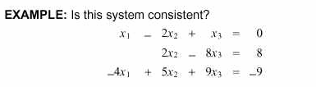

Perform row operation to obtain echelon form

Slide 67
Homogeneous linear systems
Ax=0
E.g.
~
or
E.g.
~
or

Slide 68
Homogeneous linear systems
Suppose an economy consists of the Coal, Electric (power), and steel sectors
And the output of each sector is distributed among the various sectors, where
the entries in a column represent the factorial parts of a sector’s total output

Slide 69
Nonhomogeneous linear systems
Ax=b
e.g.
(a)
~
(b)
No solution
~
(c)
Infinitely many solutions
~
or
Notes:
Eg tax questions

Slide 70
Example
~ ….
General solutions

Slide 71
As a vector the general solutions of Ax=b has the form
;
x∈ℜ
x3 can be any real number.
x∈ℜ
;

Slide 72
Rectangular (coefficient) matrices
This matrix equation is equivalent to a system of linear equations of
m equations n unknowns.
The solution of m equations n unknowns

Slide 73
Rectangular (coefficient) matrices
3 equations 4 unknowns➔ Ax=0
Perform
row operation
Candidate for the 2nd pivot has become zero and
The entry below is also zero. “ go onto the next column”
U ( Echelon form)
Ux = 0
Row of zero
occurs because
of row 3 was
a combination
of row 1 and 2
Number of pivots = 2 (rank of the matrix)
Solution is not unique

Slide 74
Solution to Ux=0 is the same as solution to Ax=0
Number of pivot variables (any variables that corresponds to a pivot column) = r
Number of free variables = n-r
Assign any numbers to X₂ and X₄
Solve for X₁ and X₃
Parametric description
of general solutions

Slide 75
General solutions as a vector

Slide 76
4 equations 2 unknowns➔ Ax=0

Slide 77
Rectangular (coefficient) matrices
m<n → No unique solution exists. There may be
      infinitely many solutions
      no solution
      (if the system in echelon form contains equations of
the form 0=b with b nonzero.)
e.g.
~
~

Slide 78
m>n →There may be
      A unique solution could exist provided that
      number of rank equal number of unknowns
      and m-n row are zero rows (within echelon form).
      infinitely many solutions
      no solutions
Example
Unique solutions
a)
~
~
m-n=2
These 2 rows are linear
combination of other rows
(b)
~
~
~
No solutions
(c)
~
Many solutions

Slide 79
Pivot columns:
Pivot variables: Free variables:
The system is consistent and has infinite many solutions

Slide 80
Perform sequences of row operation
What is general solutions in a vector form?

Slide 82
Example
&
RREF
r=n <m
(full column rank)
∼
∼

Slide 83
Summary
r = m = n ➔ one solution exists (full rank)
r = n < m ➔ 0 or 1 solution (full column rank)
r = m < n ➔ infinitely many solutions
(no zero row) (full row rank)
r < m and r < n ➔ no solution
or infinite many solutions

Slide 84

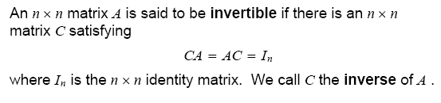
Matrix Inverses
example
;
AC=
CA=

Slide 85
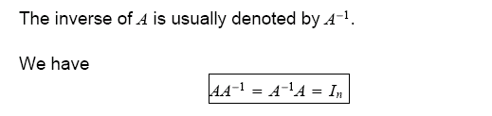


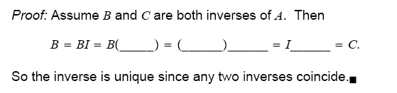
Fact 1
Fact 2
The inverse of A⁻¹ is A itself.

Slide 86
Matrix inversion algorithm
➔Take a column at a time, that equation determines the columns of A⁻¹
A times column j of A⁻¹ = column j of I
;
Carry out elimination on
all systems simultaneously.

Slide 87
The Gauss-Jordan method
Perform row operations

Slide 88
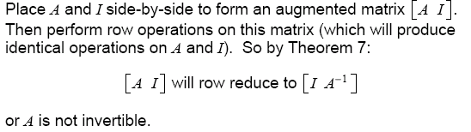

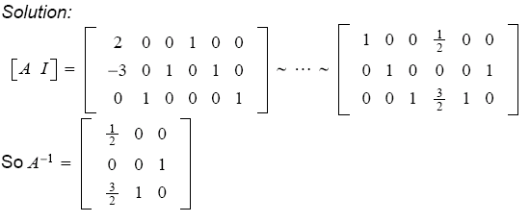
Matrix inversion algorithm

Slide 89
Find the inverse of the matrix
, if it exists

Slide 90
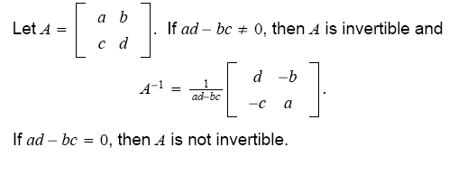
Fact 3
~….

Slide 91

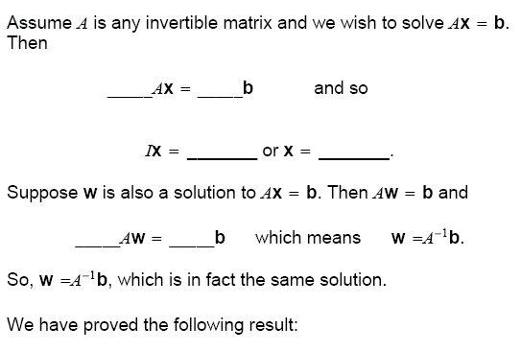
Fact 4

Slide 92
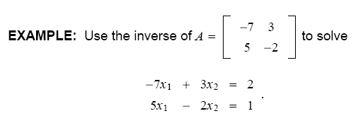
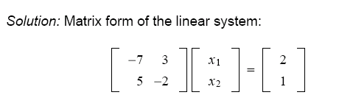
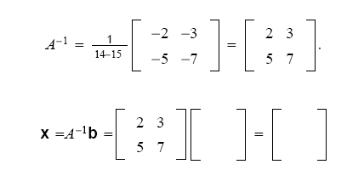

Slide 93
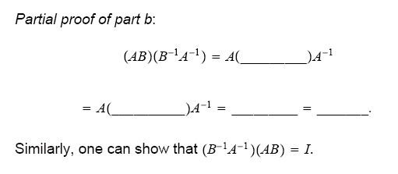
Properties of Inverses
Suppose A and B are invertible. Then the following results hold:
Proof part c

Slide 94
Determinants
Formulas for the determinants
Properties of Determinant
Applications of determinants
Determinant➔ a number that associates with every square matrix
Determinant of A ➔
Determinant gives a test for invertibility. .
detA =

Slide 95
For any square matrix A, let Aij denote the submatrix formed by deleting the ith row and jth column of A.
The determinant of a 3x3 matrix is defined by determinants of the 2x2 submatrices Aij.
The determinant of an nxn matrix is defined by determinants of
(n-1)x(n-1) submatrices.

Slide 96
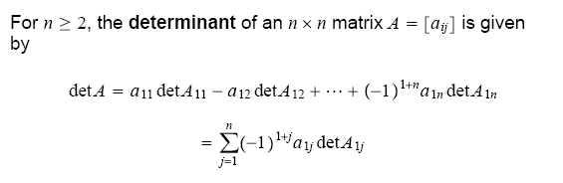
A recursive definition of a determinant
The determinant of an nxn matrix A is the sum of n term of the form
det A_{ij} with plus and minus sign alternating where entries a₁₁, a₁₂, ….a_{1n}
from the first row of A

Slide 97
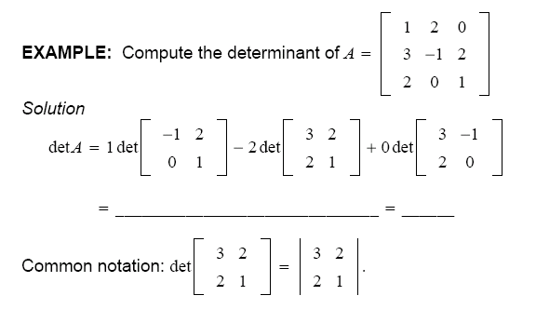
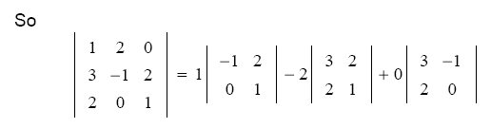

Slide 98
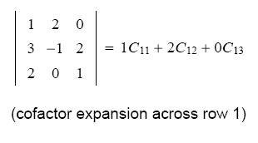
A cofactor expansion across the first row of A

Slide 99
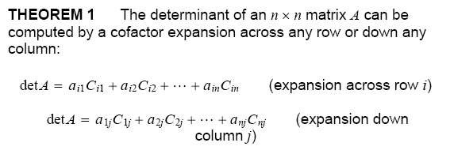
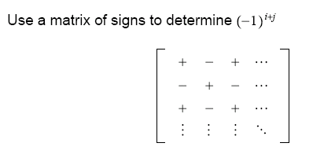
Cofactor expansion theorem

Slide 100
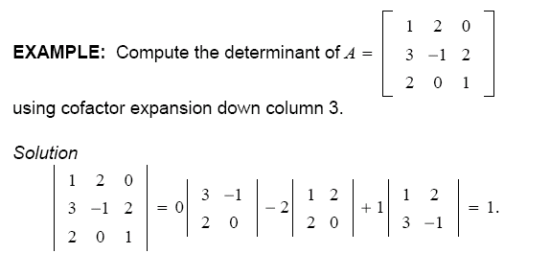
Example
detA=?

Slide 101
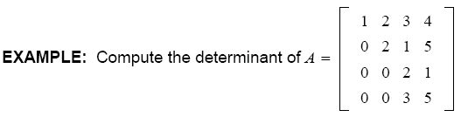
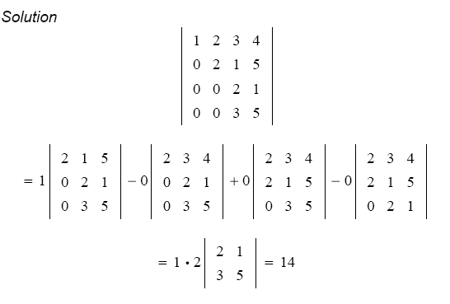

Slide 102
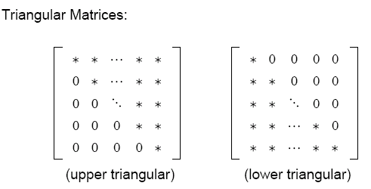
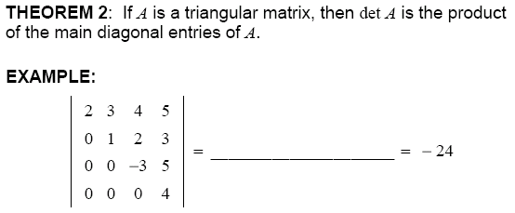

Slide 103
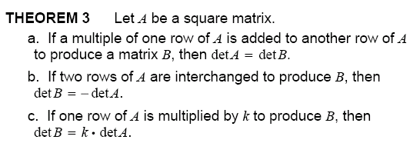
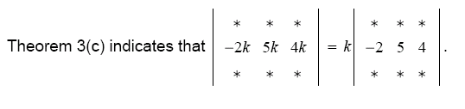
Properties of Determinants

Slide 104
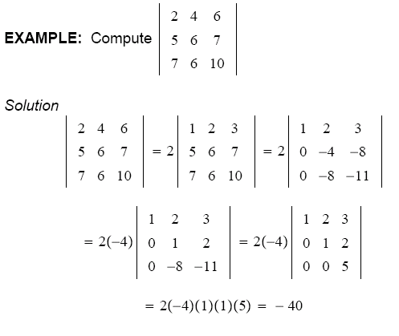


Slide 105
Find

Slide 106
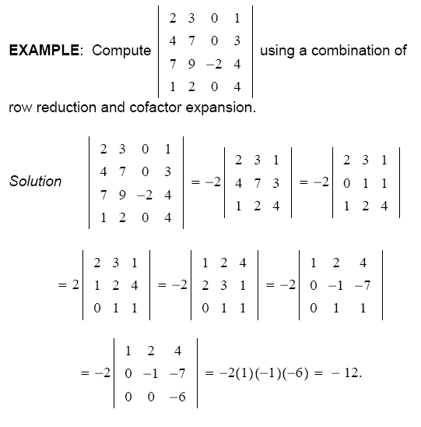

Slide 108
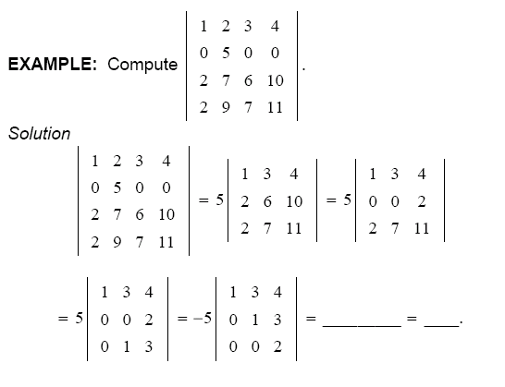

Slide 109
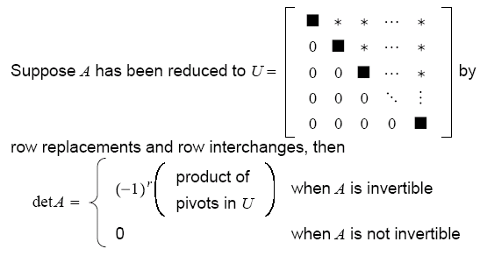

k
; k= row interchange

Slide 110


∼
∼

Slide 111
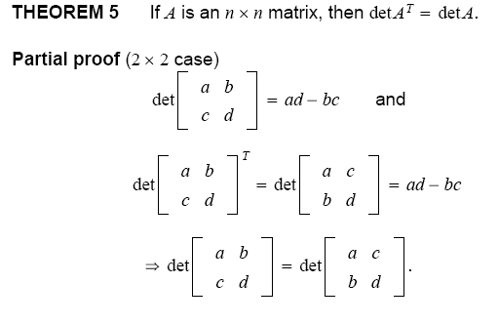

Slide 112
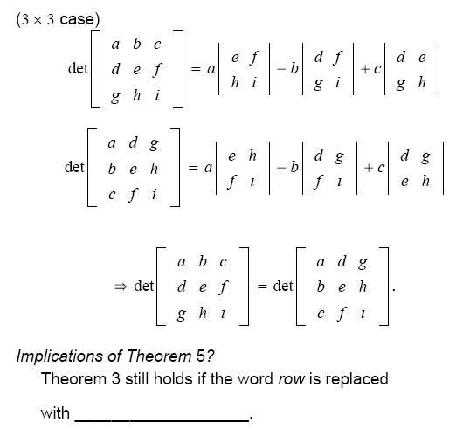

Slide 113



Slide 114
Applications of determinants
Cramer’s Rule
Cramer’s rule can be used to study how the solution of Ax=b
affected by the changes in the entries of b.
Col i

Slide 115
Example

Slide 116
The computation of A⁻¹
The adjoint of A_{nxn} is defined to be the transpose
of the matrix of cofactors:

Slide 117
Example
Theorem

Slide 118
Example

Slide 119
det A=14

