Slide 1
Canals, Landlords, and Peasants
Post-Bowring Transformation of Thai Peasants
EE/EC301
Thai Economic History
Thorn Pitidol

Slide 2
Topics
Canals and landlords
Peasant colonization
The decline of force labour
The two regimes structure

Slide 3
Post-Bowring: Changing Context
Changes in trade
  China decline & rise of European
Encouraging participation of European trade
  Bowring Treaty in 1855
  Initially, it was thought the main trading commodity would be “sugar”.
  Rice became the main exporting product.

Slide 4
Post-Bowring: Changing Context
Boom in rice export started from mid 1870s.
  Over the next 60 years, rice export increased 15 times from 100,000 tons to 1.5 millioms.
Crucial changes.
  Expansion of land use to produce rice.
  New agrarian society of individual peasant proprietor.

Slide 5
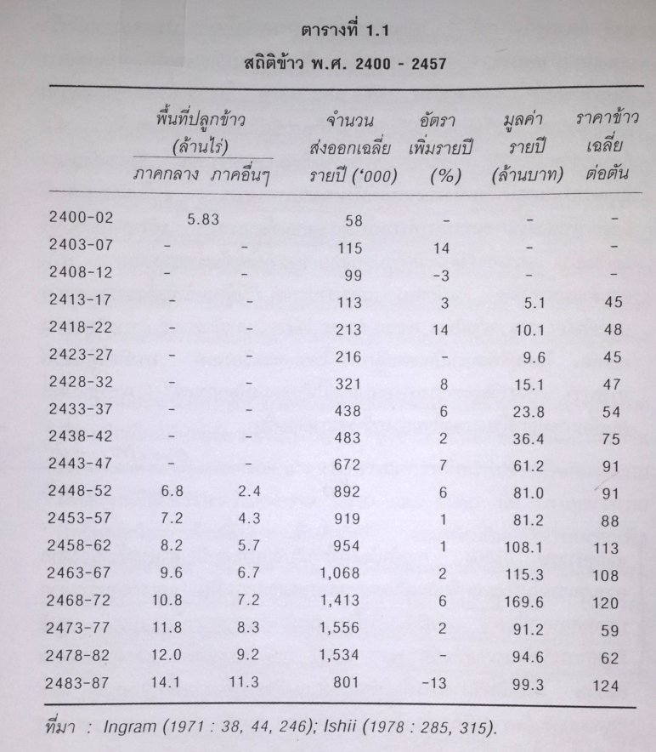
Source: Pasuk and Baker

Slide 6
Canals and landlords
Rise in rice production made “land” much more valuable.
  Contest for gaining controlling over land started
But land still required work for draining away excess water.
  The key for transforming the area for rice production → canal building

Slide 7
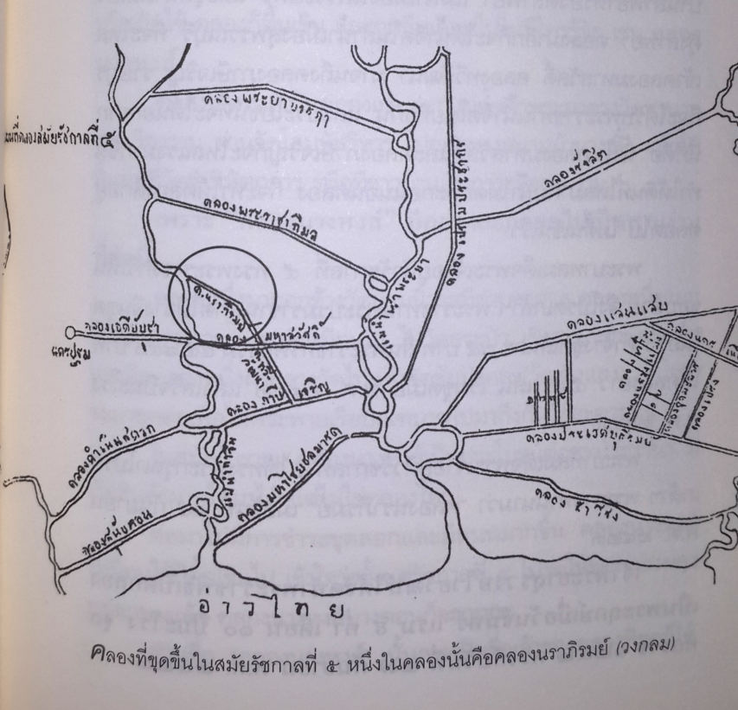
Source: ส.พลายน้อย (2555)

Slide 8
Canals and landlords
Canals’ shifting purpose
  Before 1850s, canals were highways with some benefits for cultivation.
  But after 1850s, canals became projects to own property rights over land.
    Exampele: Klong Mahasawat, Klong Damnern Saduak, Klong Premprachakorn were digged and land rights were distributed to Kings and nobles.

Slide 9
Canals and landlords
Rising rice export accelerated
  the process of cultivating new land
  prospective tenants of the new canals tracts.
    Sansaeb, for example, became populated between 1878-1885.
With plentiful supply of tenants, the nobles petitioned for rights to build canal and own lands.

Slide 10
Canals and landlords
A beginning of legal framework for land ownership
  Receipts of land tax were used as proof of land ownership
  Sale of land was enabled. Land along Klong Prawet in 1877, for example, cost 1-1.5 baht per rai.
It seemed a system of landlords and tenants was going to be created…But

Slide 11
Canals and landlords
Siam’s creation of the system of landlords and tenants faced opposition from 1) peasants; and 2) king
  1) The peasants settlers were not easy to control, especially with the nobles also lacking skills
  Disorder and disputes were so widespread.
  2) The King also resisted competition from nobles

Slide 12
Canals and landlords
Competition between the King and nobles
  Longer history
  From mid 1870s, competition turned toward land ownership.
King also turned to support peasant colonization
  Land in Royal scheme were distributed directly to peasants’
  The King and his closer circles still expanded their control, but deny other nobles from doing the same.

Slide 13
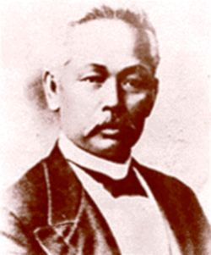
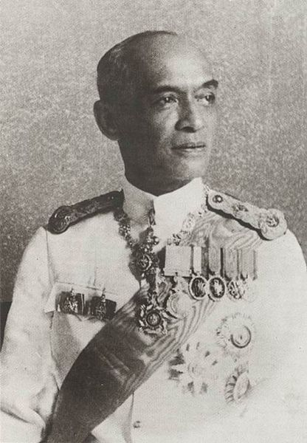
Rangsit canal project
  Siam Land, Canals, and Irrigation Company, built a gigantic Rangsit project
  Joint venture between Sanitwong family, Rama V, and other aristrocrats.
  No comparable project would be built afterward.
  The project eventually faced problems over control and production. As much as 1/3 of tenants moved out.

Slide 14
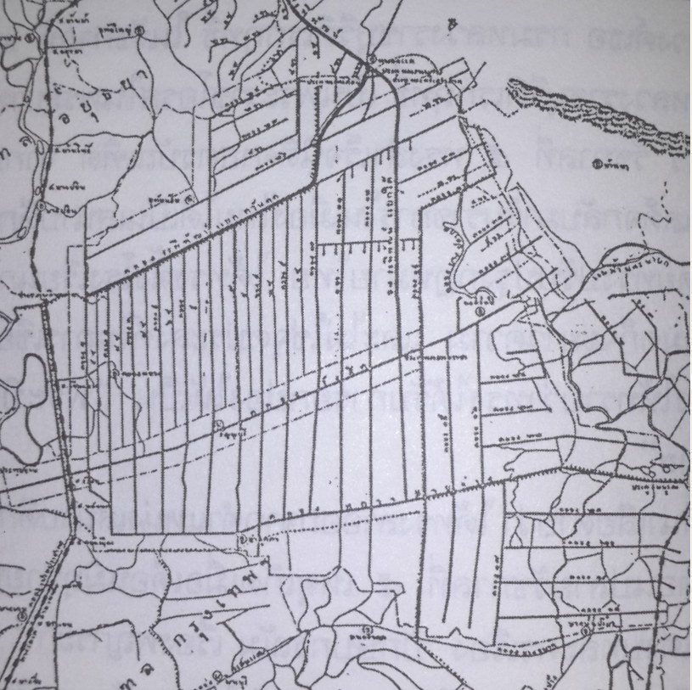
Rangsit canals
1.5 million rai.
Source: ส.พลายน้อย (2555)

Slide 15
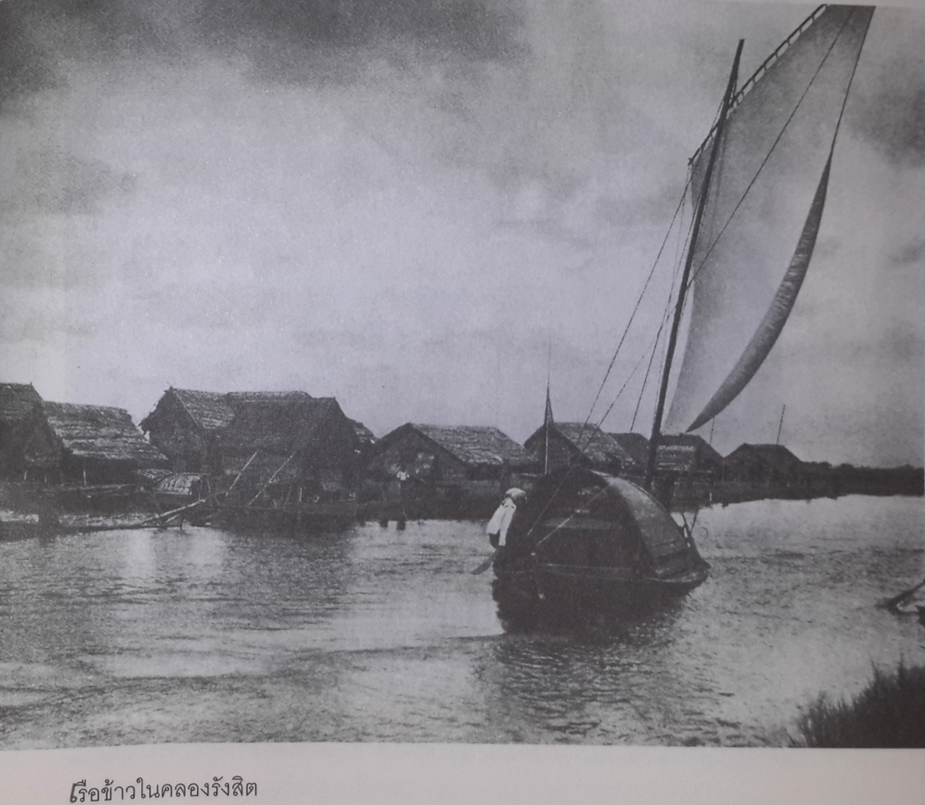
Rangsit canals
Source: ส.พลายน้อย (2555)

Slide 16
Canals and landlords
Taking control, the King and close associates accumulated land and pushed for a new legal framework to facilitate their ownership.
  Rejected the use of tax payment
  Land registry and certificates developed, but applied mostly to land claimed by King and nobles.
  Rights over land ownership remained unclear for land further away.

Slide 17
Peasant colonization
Investments in canal-building ceased in 1900s. But the frontier of land cultivation expanded.
  For the land beyond ownership by King and nobles
    Certificates of tax payment remained in use, supported customary rights to jab-jong
    The legal framework favoured individual peasant settler.

Slide 18
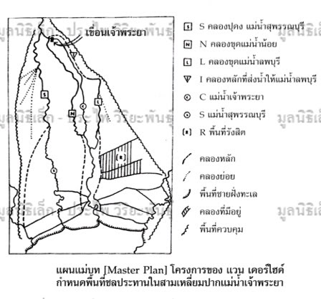
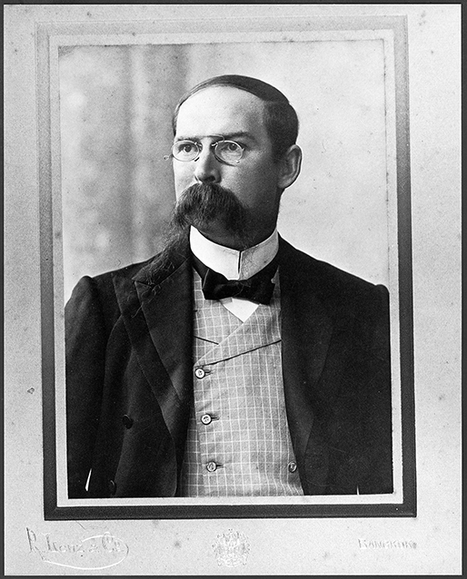
Homan von de Heide
Creation of irrigation department
With the government undertaking irrigation roles, the roles of landlords declined. Colonizing peasants moved to use the areas.

Slide 19
Peasant colonization
Peasant colonizing land even beyond irrigation.
  Swamp and jungle were cleared and turned into paddy land. Settlers travelled along river to find new sites.
Frontier society of peasants was highly mobile.
  Peasants always moved for new opportunities; abandoned places with difficulties. Several moves in a single lifetime were normal.

Slide 20
Peasant colonization
In 1900, 98% of rice export came from the central plain. It was only after WWI that process extended to other regions
The northern valley
  With difficulty in transportation
  But this eventually changed with the train. As land became more valuable, the northern rulers were allowed to “grab” lands with little restraint from Bangkok.
The Northeast
  The railway link to Korat opened up some paddy cultivation, making Korat the center for rice trade.
  But area further away were beyond reach, and developed as suppliers of lifestock.

Slide 21
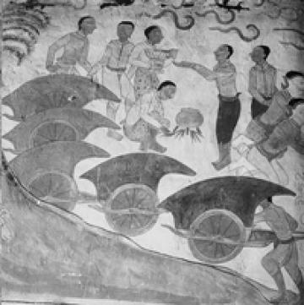
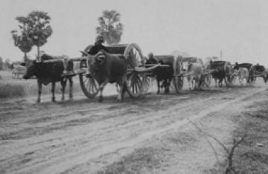
Nai Hoi (นายฮ้อย)
Nai hoi also brought along troops of wage labourers
Source of pictures :http://www.khaosod.co.th/view_news.php?newsid=TUROb1lYQXdOREkyTVRJMU13PT0=

Slide 22
Peasant colonization
Transformation of Chaophraya Delta helped rapid increase of population
    Clearing land contributed by falling death rates and mass immigration.
    Captives from military campaigns, and voluntary migrants moved for new opportunities.
    Northeasterners who moved to take labour jobs also settled.
  Terwiel estimation: In 1830s, population of central plain was 375000. By the 1920s, the number was 3.3 millions.

Slide 23
The decline of force labour
All the changes turned people further away from the corvee system
  Phrai were always resentful of corvee. Tightened of control never work.
  The eventual reduction of the corvee period still failed. By 1870s, as much as 80 percent evaded.
From 1870s, in the broader attempt to control nobles’ power the King started ending the corvee system
  The system was gradually replaced by cash payment
  In a similar fashion, the King announced the end to the That system.

Slide 24
The two regimes structure
In the late 19th century, with Rama V establishing absolutism, two regimes of peasant’s production and society co-existed.
  1) a society of landlords and tenants developed in early canal projects and northern valley
  2) A new peasantry of independent cultivators, growing beyond the canal areas.

Slide 25
The two regimes structure
Landlords and tenants
  Landlords held over 90% of land. Three families held 1/3 of total area under tenancy in 4 provinces around Bangkok.
  Use of land deeds.
  Connected to export.
  Conflicts with tenants were frequent.
  Insecurity over various issues
Independent cultivators
  Beyond canal tracts such
  They avoided holding a large piece of land to avoid paying land taxes.
  Allocated land through the family system. Landless farmers were rare.
  Production mainly for self-consumption first
  Older system of using tax-payment certificate

Slide 26
Co-existence of the two regimes
Insecurity of tenants in the landlords system
  Unsecured tenure and occupancy rights.
  No protection system
    Use of Nak-leng for self-protection
    Frequent riots
  Drought and the fluctuation in international price
Thus, they were prepared to leave during bad times and become independent cultivators

Slide 27
Co-existence of the two regimes
Landlords controlled more valuable land that produced most exports. But independent cultivators occupied more land.
The two regime connected through migration
  Peasants settled as tenants in years of high prices.
  But fled faced with failures from price and weather.
  Taxes eventually forced them to come back to produce for market.

Slide 28
The poor but not disintegrated peasants
The regimes structure limited impact from the market expansion on peasants
  With low yields, they were mostly poor
  But with the state lack of support for expansion of smaller landlords and rice merchants, peasant society still do not face destruction from markets.
  They remained small amount of landless farmers, and the internal division of peasants remain limited.

