Slide 1

MK 322 Retail Management
Chapter 5: Retail Market Strategy Part II
By Ajarn Suwalya K.

Slide 2
Multiple Source Advantage
To build SCA for long periods of time, cannot rely on single approach, but multiple approach instead
McDonald's long term success is based on providing consumers with – good value that meets their expectations, having efficient customer service, possessing a strong brand name, and offering convenient locations.
Notes:
1

Slide 3
Multiple Source Advantage
IKEA has a large group of loyal customers due to its strong brand image and the stimulating shopping experience it provides to its customers
Walmart complements its size advantage with strong vendor relationships with its clear positioning of retailer that offers superior products
Starbucks combines its location advantage with unique products, committed employees, a strong brand name, and strong relationships with coffee growers to build overall advantage difficult for competitors to erode
Notes:
1

Slide 4
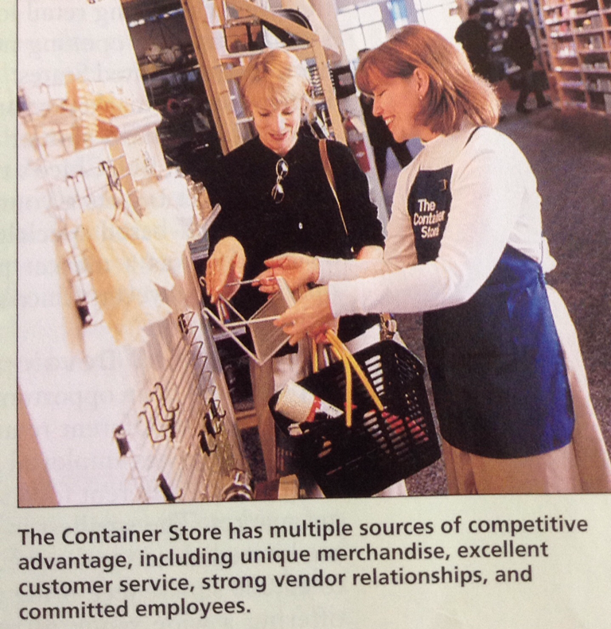
Multiple Source Advantage
Notes:
1

Slide 5

Growth Strategies

Slide 6
Market Penetration
Market Penetration growth opportunity is a growth opportunity directed toward existing customers using the retailer's present retailing format
Involves attracting new customers from retailer's current target market
Example opening more stores in the target market, and/or keeping existing stores open for longer hours, displaying merchandise to increase impulse purchase,training sales employees to cross-sell
Notes:
1

Slide 7
Market Penetration
Cross-selling means that sales associates in one department attempt to sell complementary merchandise from other departments to their customers
Notes:
1

Slide 8
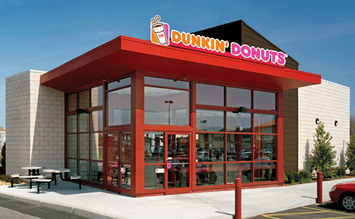
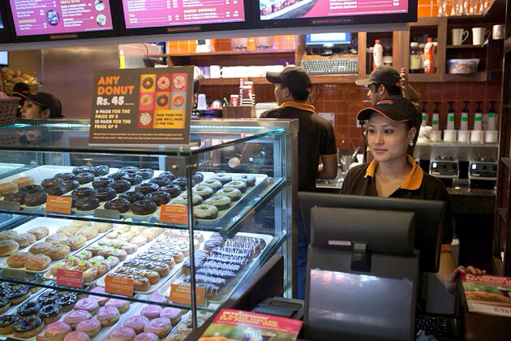
Market Expansion
Market Expansion growth opportunity involves using the retailer's existing format in new market segments.
For example Dunkin' Donuts has been operating new stores outside its traditional target market
Notes:
1

Slide 9
Retail Format Development
A retail format development growth opportunity is an opportunity in which a retailer develops a new retail format – a format with a different retail mix- for the same target markets.
For example, Tesco operating different formats including Tesco Express which is 15,000 sq.feet,
Tesco Superstore 50,000 sq.feet, and Tesco Extra 60.000 sq.feet
Notes:
1

Slide 10
Diversification
A diversification growth opportunity is one in which a retailer introduces a new retail format directed toward a market segment that is not currently served by retailer
Related vs Unrelated Diversification
Vertical Integration describes diversification by retailing into wholesaling or manufacturing
Examples – CP?
Notes:
1

Slide 11
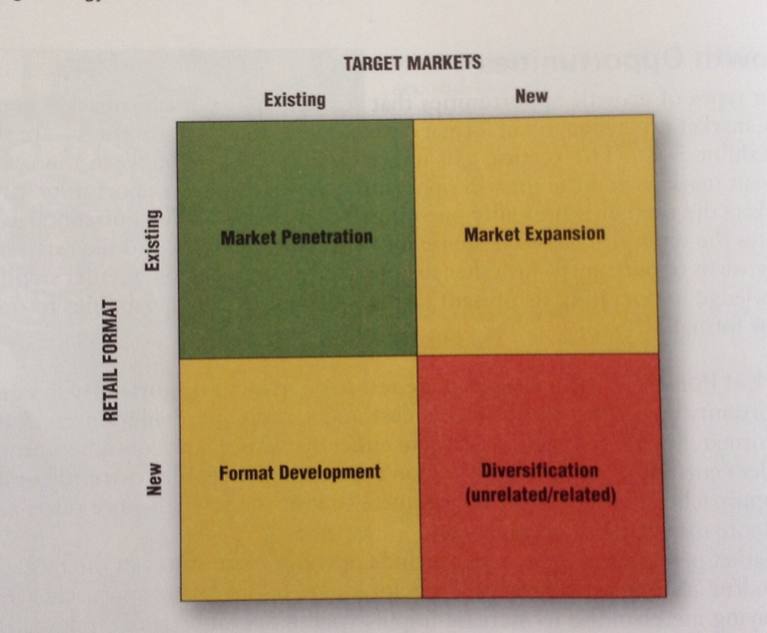
Diversification
Notes:
1

Slide 12

The Strategic Retail Planning Process

Slide 13
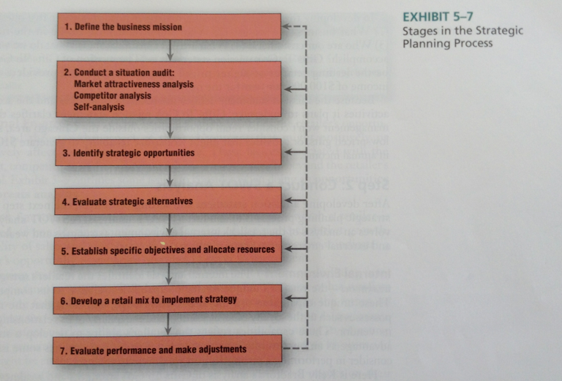
Notes:
1

Slide 14


