Slide 1
MK 202 Group Homework for Section 1 and 2
Assigned on Oct 25/27
5 mins presentation for 2 slides due next week
1 power point slide on the positioning statement of your new product
1 power point slide on team name and logo

Slide 2
Positioning Statement:
We are (name of brand).
We produce (type of offering) for (target consumer)
This market offering provides benefits that satisfy(consumer needs)
Our offering uniquely attracts our target consumer
Because (source of competitive uniqueness).
Our benefits differ from competitors’ benefits in the following
Way(s): (points of differentiation).

Slide 3
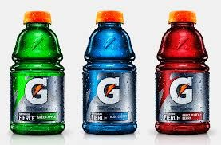
Gatorade
We are Gatorade. We produce sports drinks for physical
activity enthusiasts who consider themselves to be
accomplished, but not necessarily competitive, athletes.
This market offering provides benefits that satisfy our
Consumer’s need to quench thirst in a healthy and fun
(but not frivolous)way. Our offering uniquely attracts
Our target consumer because it is absorbed in the body
12 times faster than water and because it is heavily promoted
Using imagery of everyday athletes working up a sweat.
Our benefits differ from competitors’ benefits in the following
ways: fun, scientifically-backed quenching.

Slide 4

Team Name and Logo Contest
You are to design the team logo that that represents your team name
Your logo should be creative and meaningful
Winning team will get a special prize

