Slide 1

MK 322 Retail Management
Chapter 12: Managing the Merchandise Planning Process Part I
By Ajarn Suwalya K.

Slide 2

Merchandise Management Overview

Slide 3
The Buying Organization
The highest classification level is the merchandise group.
The organization chart has four merchandise groups
Women's apparel
Men's, children's and intimate apparel
Cosmetics,shoes,jewelry,and accessories
Home and kitchen
Notes:
1

Slide 4
The Buying Organization
Department is the second level in merchandise Classification and managed by division managers
The classification is the third level and merchandising management activities
Notes:
1

Slide 5
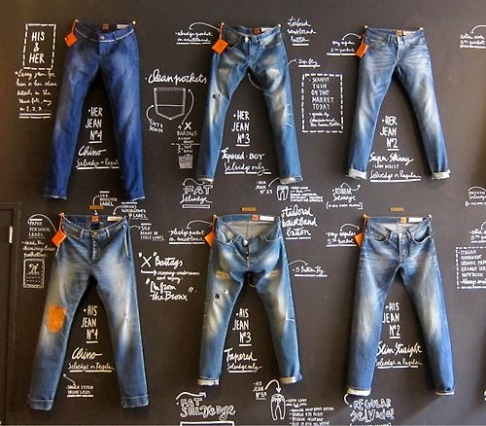
The Buying Organization
A stock-keeping unit (SKU) is the smallest unit available for inventory control.
In soft goods, SKU means a particular brand,size,color, style – for example a pair of size 5, rinsed wash, blue,straight-legged Levi jeans is a SKU
Notes:
1

Slide 6
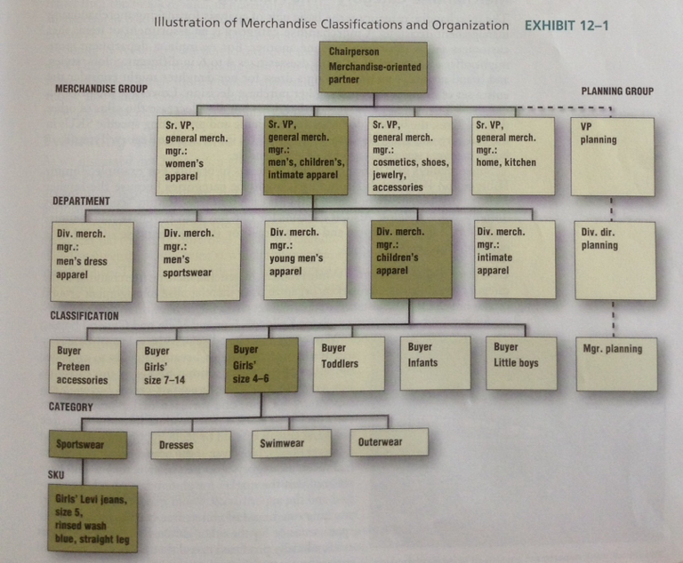
The Buying Organization
Notes:
1

Slide 7
Merchandise Category –Planning Unit
The merchandise category is the basic unit of analysis for making merchandise management decisions
A merchandise category is an assortment of items that customers see as substitutes for one another
Notes:
1

Slide 8
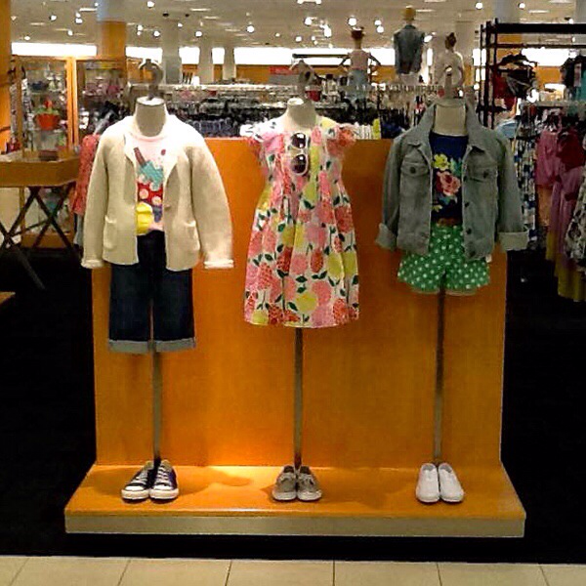
Merchandise Category –Planning Unit
For example, a department store might offer a variety of girl's dresses size 4 to 6 in different colors, styles and brand names
Notes:
1

Slide 9
Merchandise Category –Planning Unit
For example, a department store might offer a variety of girl's dresses size 4 to 6 in different colors, styles and brand names
A mother buying a dress for her daughter might consider the entire set of dresses when making her purchase decision
Lowering the price on one dress may increase the sales of that dress, but also decrease the sales on other dresses
Thus the buyers' decisions about pricing and promoting specific SKUs in the category will affect the sales of other SKUs in the same category
Typically a buyer manages several categories of merchandise
Notes:
1

Slide 10
Merchandise Category –Planning Unit
Category Management approach to managing merchandise assigns one buyer category to oversee all merchandising activities for the entire category
Category Captain works with the retailer to develop a better understanding of consumer shopping behaviors, create assortments that satisfy the needs, and improve profitability of the merchandise category
Notes:
1

Slide 11
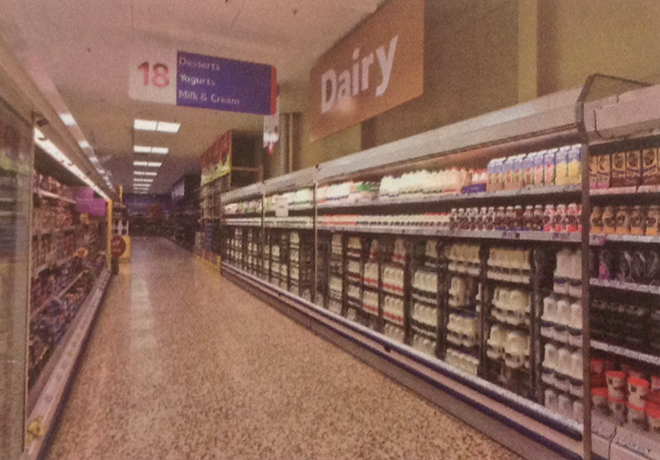
Merchandise Category –Planning Unit
The chilled drink department consists of several categories.
Notes:
1

Slide 12
Evaluating Merchandise Management Performance
GMROI- A financial ratio that assesses a buyer's contribution to ROA is gross margin return on inventory investment
It measures how many gross margin dollars are earned on every dollar of inventory investment made by the buyer
GMROI combines gross margin percentage and sales-to-stock ratio, which is related to inventory turnover
Notes:
1

Slide 13
Evaluating Merchandise Management Performance
The reason sales-to-stock is used to calculate GMROI (instead of inventory) is the GMROI which is a type of return on investment measure, so the investment in inventory is expressed at cost
Inventory turnover and sales-to-stock ratios are very similar in concept, but they are calculated slightly differently
Notes:
1

Slide 14
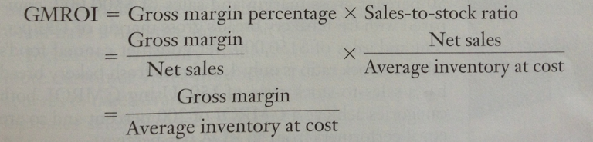
Evaluating Merchandise Management Performance
Notes:
1

Slide 15
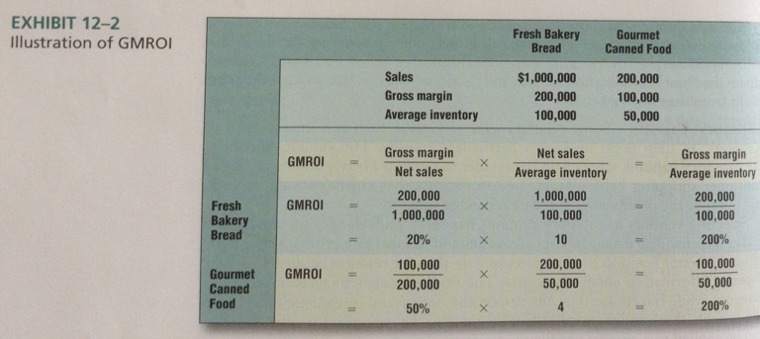
Evaluating Merchandise Management Performance
Notes:
1

Slide 16
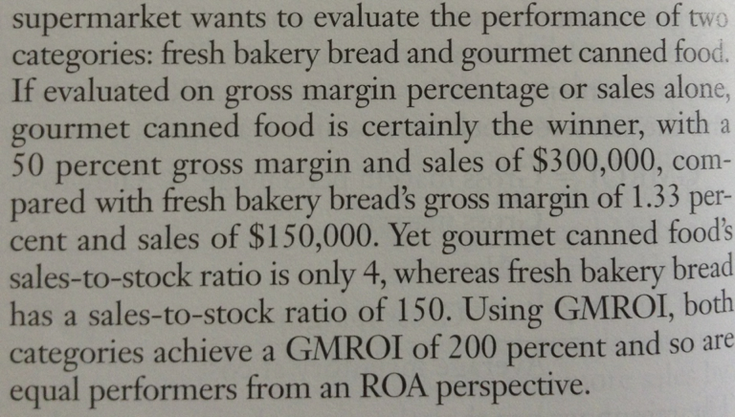
Evaluating Merchandise Management Performance
Notes:
1

Slide 17
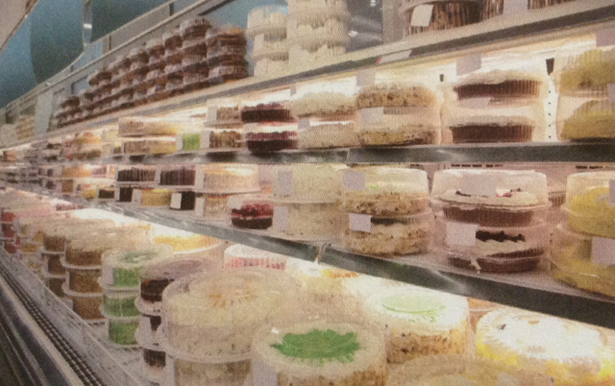

Evaluating Merchandise Management Performance
Notes:
1

Slide 18
Improving GMROI
Two paths that buyers can take to increase GMROI is
Improve inventory turnover (sales-to-stock ratio)
Increase gross margin
Notes:
1

Slide 19
Improving GMROI
How to improve inventory turnover (sales-to-stock ratio)?
Reduce number of SKU within a category
Keep the same number of SKU but reduce the backup stock for each SKU
Buy merchandise more often, but in smaller quantities
Increase sales but not increase inventory proportionally ie. Increase sales by reducing prices
Notes:
1

Slide 20

Improving GMROI
Increasing inventory turnover can have positive impact on sales by attracting more customer visits, improving sales associate morale, and providing more resources to take advantage of new buying opportunities
Notes:
1

Slide 21

Improving GMROI
How to increase gross margin?
Increasing prices
Reducing cost of goods sold
Reducing customer discounts
Notes:
1

Slide 22

Merchandise Planning Process

Slide 23
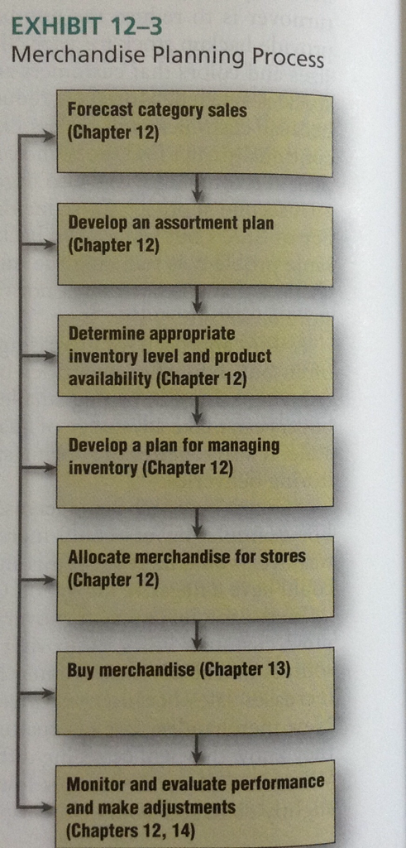
Merchandise Planning Process
Notes:
1

Slide 24
Types of Merchandise Management Planning Systems
Different merchandise planning systems for these categories
Staple – called basic merchandise that are in continuous demand ie. Most categories sold in supermarkets, white paint, copy paper, basic casual apparel such as T-shirts and men's underwear
- Demand for staple merchandise is very predictable, merchandise planning systems involve continuous replenishment
Notes:
1

Slide 25
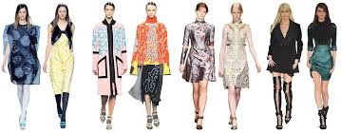
Types of Merchandise Management Planning Systems
2. Fashion merchandise- are in for a short period of time ie. Athletic shoes, tablets, smartphones, women's apparel
- Forecasting sales is more challenging
Notes:
1

Slide 26
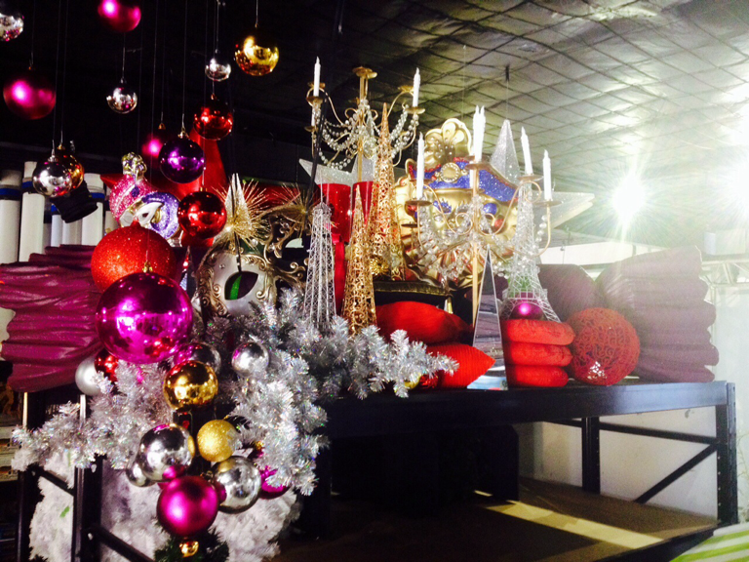
Types of Merchandise Management Planning Systems
3. Seasonal merchandise category consists of items whose sales fluctuate dramatically depending on the time of year ie.Halloween candy, Christmas ornaments, swimwear
- Retailers buy seasonal merchandise in the same manner as fashion merchandise
Notes:
1

Slide 27


