Slide 1


Chapter 1
Chapter 4
SWOT ANALYSIS
MK 312 Marketing Management
By
Aj.Suwalya K.

Slide 2
Ch. 4 - Learning objectives
After studying this chapter you should be able to:
■ explain how a SWOT analysis can capitalize on a company’s internal and external issues
■ understand the reasons for matching strengths and opportunities, and converting weaknesses and threats
■ discuss the importance of doing some research as the basis for SWOT analysis
■ discuss the barriers to and benefits of conducting SWOT analyses
■ explain the reasons for preparing multilevel SWOT analyses.

Slide 3
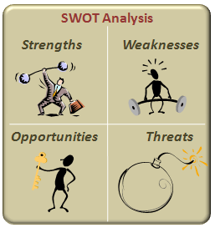
SWOT analysis
Successful SWOT analysis is fundamentally a process of finding the optimum fit between the firm’s controllable strengths and weaknesses and the uncontrollable opportunities and threats posed by the environment in which the firm operates.

Slide 4

SWOT analysis
A good SWOT profile facilitates the development of a strategy that capitalizes on a company’s strengths, minimizes any weaknesses, exploits emerging opportunities and avoids, as far as possible, any threats.

Slide 5

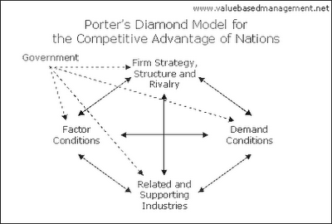
SWOT analysis
The SWOT framework became popular during the 1970s because of its assumption that managers can plan the alignment of a firm’s resources with its environment. Subsequently, during the 1980s, Porter’s (1980) introduction of the industrial organization paradigm, with his five forces/diamond models, gave primacy to a firm’s external environment, overshadowing the popularity of SWOT analysis. In the 1990s, Barney reinvented SWOT as the foundation framework linking the firm’s resources to sustained competitive advantage (Barney, 1991)

Slide 6

The development of a SWOT-analysis – The structure of Chapters 2, 3 and 4:

Slide 7
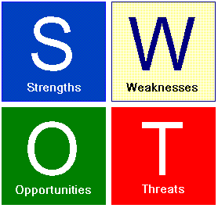
Elements of the SWOT analysis
Strengths
  Determine your organization’s strong points, from an internal perspective as well as from the perspective of external customers. Do not be humble, be a pragmatic as possible
Weaknesses
  Determine your organization’s weaknesses not only from internal point of view, but also from customers.
Opportunities
  Another major factor is to determine how your organization can continue to grow within the marketplace. After all, opportunities are everywhere, such as changes in technology, government policies, social patterns, etc.
Threats
  It is vital to be prepared and face up to threats

Slide 8
SWOT analysis
The following are the strategic options suggested by the SWOT-matrix:
1 Make a match between strengths and opportunities
2 Convert weaknesses to strengths
3 Convert threats to opportunities
4 Minimize, if not avoid, weaknesses and threats.

Slide 9
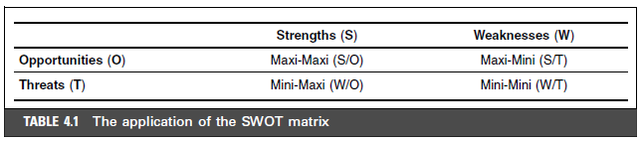
Application of the SWOT matrix

Slide 10
Application of the SWOT matrix
The four combinations that could result from SWOT analysis are called:
Maxi-Maxi (strengths/opportunities): In essence, an organization should strive to maximize its strengths to capitalize on new opportunities
Maxi-Mini (strengths/threats): In essence, an organization should strive to use its strengths to parry or minimize threats.

Slide 11
Application of the SWOT matrix
The four combinations that could result from SWOT analysis are called (cont.):
Mini-Maxi (weaknesses/opportunities): It encourages the organization to conquer its weaknesses by making the most of any new opportunities
Mini-Mini (weaknesses / threats): This is most definitely a defensive strategy: to minimize an organization’s internal weaknesses and avoid external threats.

Slide 12

Internal analysis
An internal (company) analysis involves a comprehensive appraisal of company strengths and weaknesses.
Every aspect of the business should be assessed.
For example, coverage should include financial capabilities, technical abilities, location, plant and equipment, personnel, distributor relationships, customer relationships, and so on.
In particular, the firm should try to identify its core competencies compared to its competitors

Slide 13

Analyzing competitors
The main questions to ask about competitors are as follows.
■ What is their (marketing mix) offer?
■ What is their competitive advantage?
■ How well are they performing?
■ What does their SWOT profile look like?
■ How are they likely to compete in future?

Slide 14

Benefits of and barriers to conducting a SWOT Analysis
The reasons why so many organizations take the ‘ask the manager’ approach and not a more analytical path in form of a SWOT analysis are numerous.
They include the following(Jenster and Hussey, 2001; Hussey 2002)

Slide 15
Benefits of and barriers to conducting a SWOT Analysis
Lack of guidance on how to do it: There are very few books that attempt to explain how to undertake and integrated company analysis
Better management information systems: Managers today have access to better more comprehensive and more up-to-date management information systems than was the case in the past.
Pressure on managers: It is certainly much quicker to ask them to define corporate strengths and weaknesses than to spend precious time on special analysis.
The complexity of many companies: Many companies are very large and complex which can make the task of carrying out a comprehensive appraisal seem rather daunting, and with the decline of large strategic staff departments the task of organizing such a study is devoted to busy line managers.

Slide 16

Exhibit 4.1 SWOT Analysis of Honda Motor Company corporate level

Slide 17
Exhibit 4.1 SWOT Analysis of Honda Motor Company corporate level

Slide 18


Multilevel SWOT Analysis
SWOT analysis may be undertaken on different organizational levels.
  Product 1 and Market 1
  Product 1 and Market 2
  Product 2 and Market 1
  Product 2 and Market 2

Slide 19
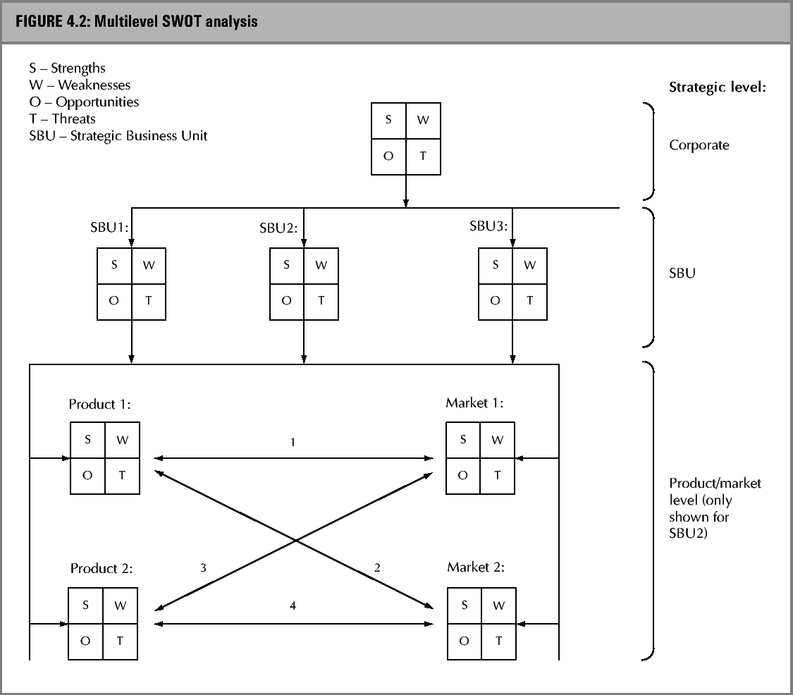

Slide 20
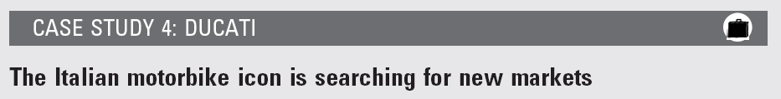
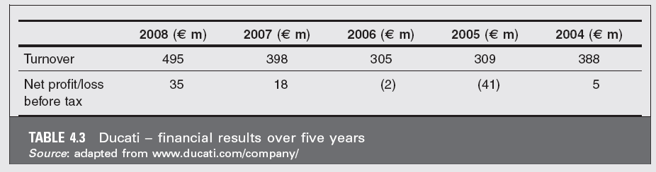
Individual Homework

Slide 21
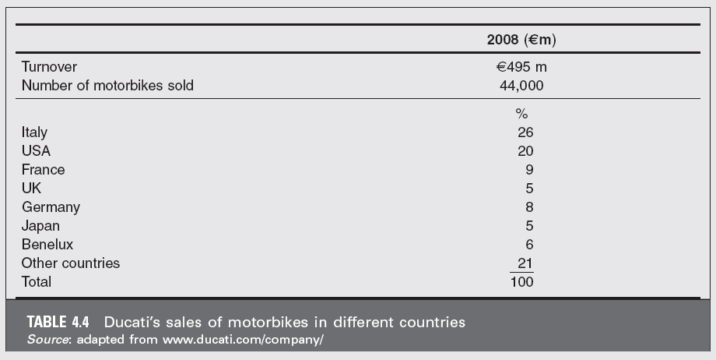

Slide 22
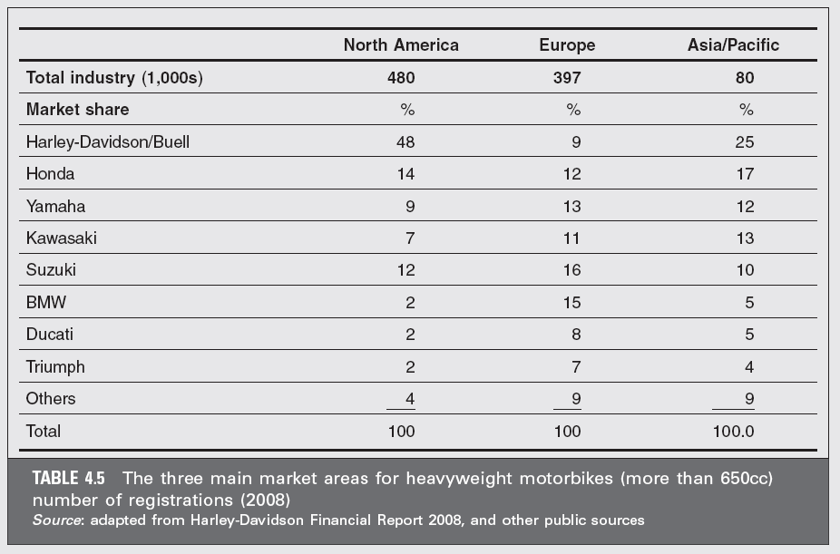

Slide 23
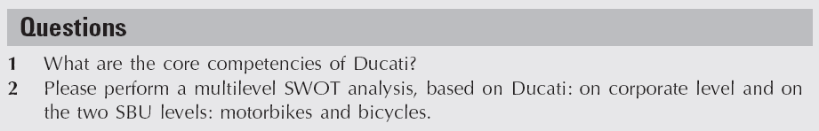

Slide 24
Group Homework
Conduct a Swot Analysis for your focal company and main competitor
Then only pick one combination for your focal company and one for your competitor that will be best choice to build your business.
7-10 mins powerpoint presentation due next week

