Slide 1

Problems of Education among CLMV

Slide 2
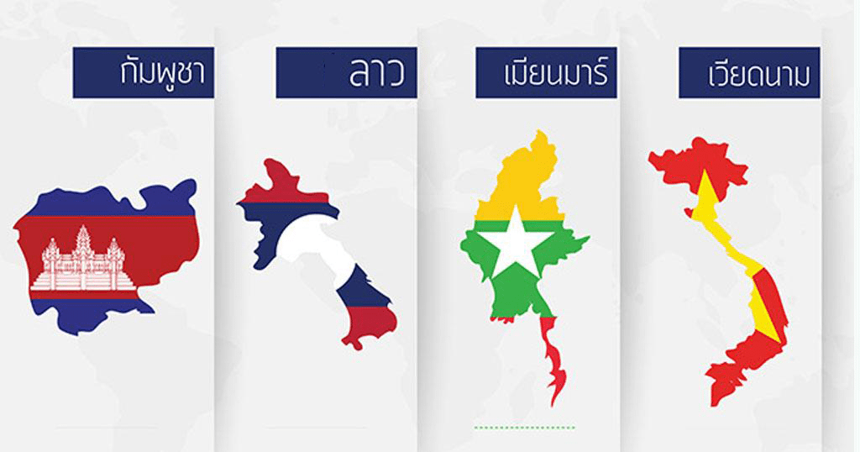

Agenda
CLMV Overview
Compare indicators of education among CLMV
Problems of education among CLMV
Policies for solving problems of education in CLMV countries

Slide 3
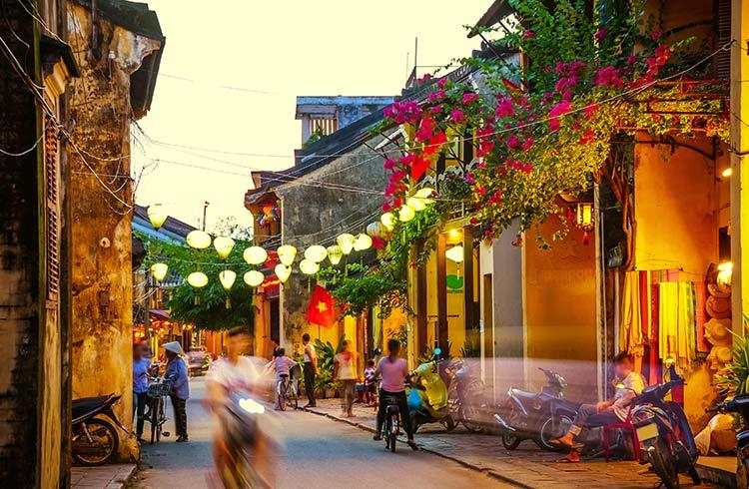
CLMV
Overview

Slide 4


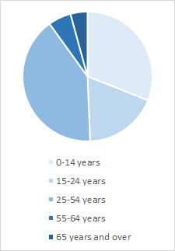
Cambodia
Age structure
4%
Number of population : 15.76 million (2016)
GDP per capita : $1,384.4
Percent of population living below poverty line : 24%
6%
31%
41%
18%
A five-year Education Strategic Plan (2009-2013)
“ Seeks to ensure equitable access to basic education without discrimination, to improve the quality and efficiency of education system and to institute capacity development for educational staffs for decentralization”
Source : CIA World Factbook, 2017
World bank data, 2017
Overview
Indicators
Problems
Policies

Slide 5

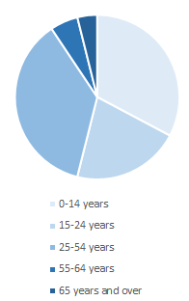
Lao PDR
Age structure
Number of population : 6.758 million (2016)
GDP per capita : $2,457.4
Percent of population living below poverty line : 29%
4%
5%
33%
37%
The Constitution of 1991 designates education, culture and scientific activities as being “The means to raise the level of knowledge, patriotism, love of the people’s democracy, the spirit of solidarity between ethnic groups and the spirit of independence”
An Education Law of 2000
21%
Source : CIA World Factbook, 2017
World bank data, 2017
Overview
Indicators
Problems
Policies

Slide 6

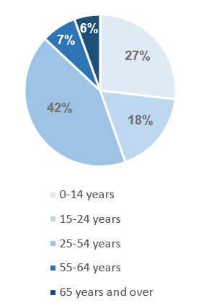
Myanmar
Age Structure
Number of population : 52.89 million (2016)
GDP per capita : $1298.9
Percent of population living below poverty line : 32.1%
A Thirty-year long-term development plan of 2000
“To create an education system that will generate a learning society capable of facing the challenges of the Knowledge Age”
Source : CIA World Factbook, 2017
World bank data, 2017
Overview
Indicators
Problems
Policies

Slide 7

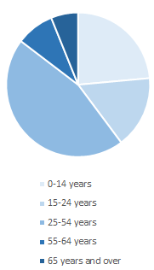
Vietnam
Age structure
Number of population : 96.49 million (2018)
GDP per capita : $2,343.1
Percent of population living below poverty line : 17%
6%
9%
24%
16%
46%
The 2011-2020 education development strategy aims to thoroughly grasp and concretize the guidelines and orientations for education and training renewal, contributing to successfully implementing the XIth National Party Congress’s resolution and the 2011-2020 national socio-economic development strategy.
Source : CIA World Factbook, 2017
World bank data, 2017
Overview
Indicators
Problems
Policies

Slide 8
 | Primary | Lower Secondary | Upper Secondary
Cambodia | From aged 6 to 11 years Compulsory (Free) Enrollment rate is 97% | From aged 12 to 14 years Compulsory (Free) Participation rate is >60% | From aged 15 to 18 years Voluntary (Not Free) Participation rate is 28%
Lao PDR | From age 6 to 10 years Compulsory (Free) Enrollment rate is 96.8% | From age 11 to 14 years Voluntary (Free) Enrollment rate is 69% | From age 15 to 17 years Voluntary (Not Free) Enrollment rate is 37%
Myanmar | From aged 6 to 10 years Compulsory (Free) Enrollment rate is 84.6% | From age 11 to 14 years Voluntary (Not Free) Enrollment rate is 43.77% | From age 15 to 16 years Voluntary (Not Free) Enrollment rate is 43.77%
Vietnam | From aged 6 to 11 years Compulsory (Free) Enrollment rate is 99% | From aged 12 to 14 years Compulsory (Free) Participation rate is 87% | From age 15 to 17 years Voluntary (Not Free) Enrollment rate is 87.24%
Overview
Indicators
Problems
Policies

Slide 9

Comparison indicators on education among CLMV

Slide 10




Government Expenditure on Education
( % of government expenditure )
17.8%
8.0%
7.7%
5.4%
Source : World bank data, 2011
Overview
Indicators
Problems
Policies

Slide 11
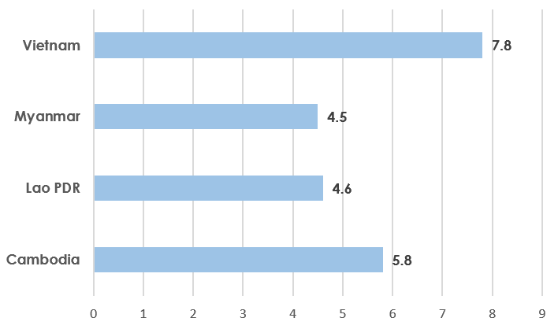
Mean years of education
( Number of years,2012)
Source: Human Development Report, 2013
Overview
Indicators
Problems
Policies

Slide 12
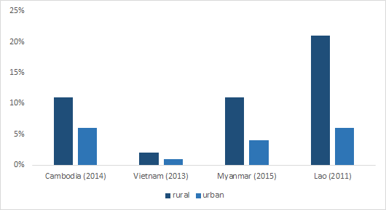
Never been to school
Source: Global Education Monitoring Report
Overview
Indicators
Problems
Policies

Slide 13
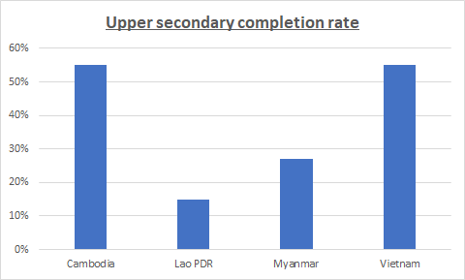
Upper secondary completion rate
( % of total population)
2014
2013
2015
2011
Source : Global Education monitoring Report, UNESCO
Overview
Indicators
Problems
Policies

Slide 14
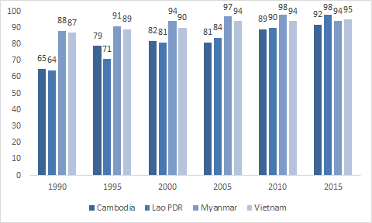
Literacy rate of 15-24 years-old in CLMV
( % of total population in the group)
Source : ASEAN statistical report on MDGs 2017
Overview
Indicators
Problems
Policies

Slide 15

Problems on education among CLMV

Slide 16


Cambodia
Poverty
A teacher’s average salary is only US$30 per month
Education equipments
never adequate for students
Weak Regulation
Teacher can disobey the law openly and easily
Corruption
A country with full corruption also being a culture trend for Khmer people
Unaffordable facilities
lack of government support
Overview
Indicators
Problems
Policies
Notes:
>>>10% of urban poor young people complete lower secondary education, whereas, 69% of urban rich young people complete lower secondary education. The availability of supplementary tuition contributes considerably to the gap in educational opportunities between rich and poor. Richer family can access to more supplementary tuition
>>>In all public schools, there aren’t any science laboratories or places for students to put their knowledge into practice

Slide 17


Lao PDR
The ethnically diversity
The country is composed with 49 ethnic groups.
Language problems since lao was colonized by French, it adopted the french educational system.
Gender Inequality
Government spending on education
Insufficient teachers Inefficiencies in deploying teachers due to budget cut in 2013 Financial crisis
Demographic Structure
Imply higher unit cost of education in the rural area.
Overview
Indicators
Problems
Policies
Notes:
http://unesdoc.unesco.org/images/0023/002314/231489e.pdf
http://www.borgenmagazine.com/evolution-education-laos/

Slide 18




Myanmar
Gap between rich and poor Inequality gap in education between the rich and the poor
Infrastructure electricity and public transportation are still poor
Military government
violently suppressed dissent and closed universities for many decades
Government spending on education spending more on military than education
The inefficient of teachers & High supplementary costs
Corruption & Priorities good exam results can be acquired with money and influence of military elites.
Overview
Indicators
Problems
Policies
Notes:
Infrastructure: electricity and public transportation are still poor for the whole country. Therefore, it leads to inequality in access to education between urban and rural.
Military government: violently suppressed dissent and closed universities for many decades
High supplementary costs: accounting for US$100 per years
Gap between rich and poor : whereas over 85.5% of children aged 10 to 15 years from the richest quintile of households were enrolled in school, the comparable figure for children in the same age group from the poorest quintile of households was only 28.2%.
Military government
Historically, Burma, officially called Myanmar, has not supported and has even been hostile to education. In response to student protests against the 1962 military coup, Burma’s government violently suppressed dissent and closed universities until they adopted the current government-sponsored curricula. Other than working to shut schools down and to regulate what is taught in them, Burma has not spent much on its educational systems. The lack of government support for schools makes it difficult for low- and even middle-income families to pay for education.
High supplementary costs
Higher portion of low- and middle income relative to high income families
Lack of government support for schools makes it difficult for them to pay for education since parents must pay for transportation to schools and additional fees to help the schools buy textbooks and desks. Although primary education in Burma is meant to be free, the supplementary costs can add up to $100 annually, which is more than what many low- and middle- Burmese income families can earn.

Slide 19


Vietnam
Low educational standard in the country
Lack of strategic planning
at the individual institution and school level.
Low wages
low-wages staff and lack of adequately trained teaching
Socialist orientation
The desired by the government retaining to control higher education.
Corruption problems
Overview
Indicators
Problems
Policies
Notes:
War and poverty problems
Low educational standard in the country, low-wages staff and lack of adequately trained teaching and management of staff.
Corruption problems, happened in the system at every level.
The desired by the government to retain control of the socialist orientation of higher education and centralised control obstructs the educational sector to function as effectively as they can.
Lack of strategic planning at the individual institution and school level.
https://www.eduhk.hk/apclc/roundtable2010/paper/paper%20(my%20phuong%20thanh%20Ho%20&%20Dennis%20Berg)education%20leadership%20challenges%20for%20Vietnam%20-%20paper%20and%20abstract.pdf
http://www.compareyourcountry.org/pisa/country/THA?lg=en

Slide 20
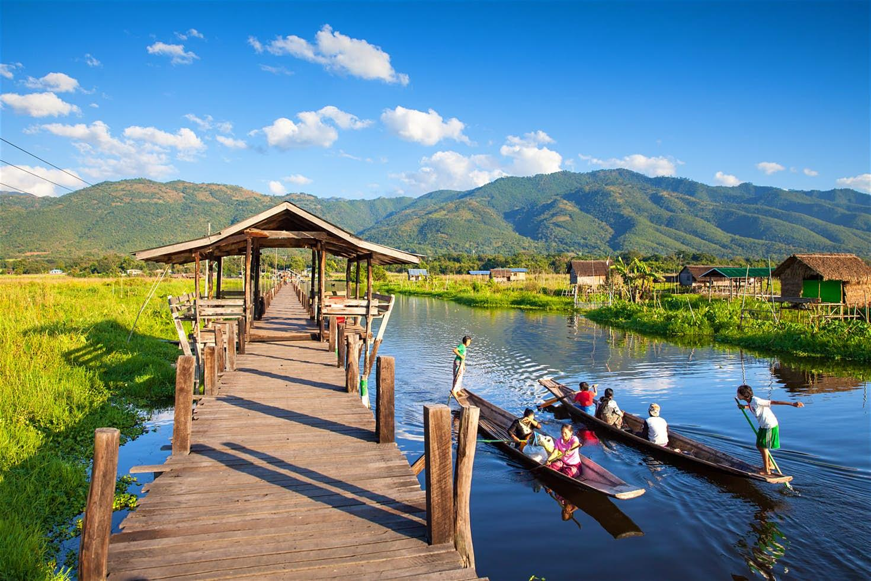
Policies for solving problems of education in CLMV countries

Slide 21
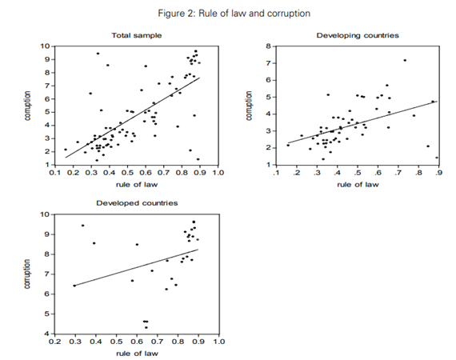
Corruption
Cambodia
Leff (1964) and Huntington (1968): Weak rule of law implies a high level of corruption
World Bank: The strongness the rule of law is one important factor of governance in the control of corruption
Strong rule of law ensure that no one is above the law and thus the corruption may decrease
“A higher level of rule of law is associated with a lower level of corruption”
Overview
Indicators
Problems
Policies

Slide 22
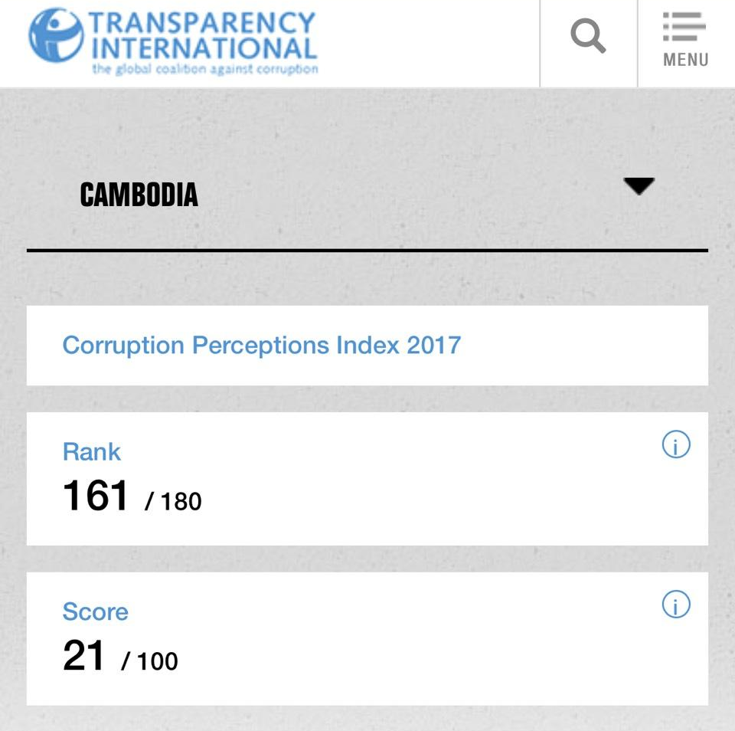
Corruption
Cambodia
Policy: Strengthen laws and regulations
Publish severe punishments
Enacted the law with implementation
Increase awareness of people to the law
Probability of corruption decrease
Mitigate other education problems
Source : https://www.transparency.org/country/KHM
Overview
Indicators
Problems
Policies

Slide 23
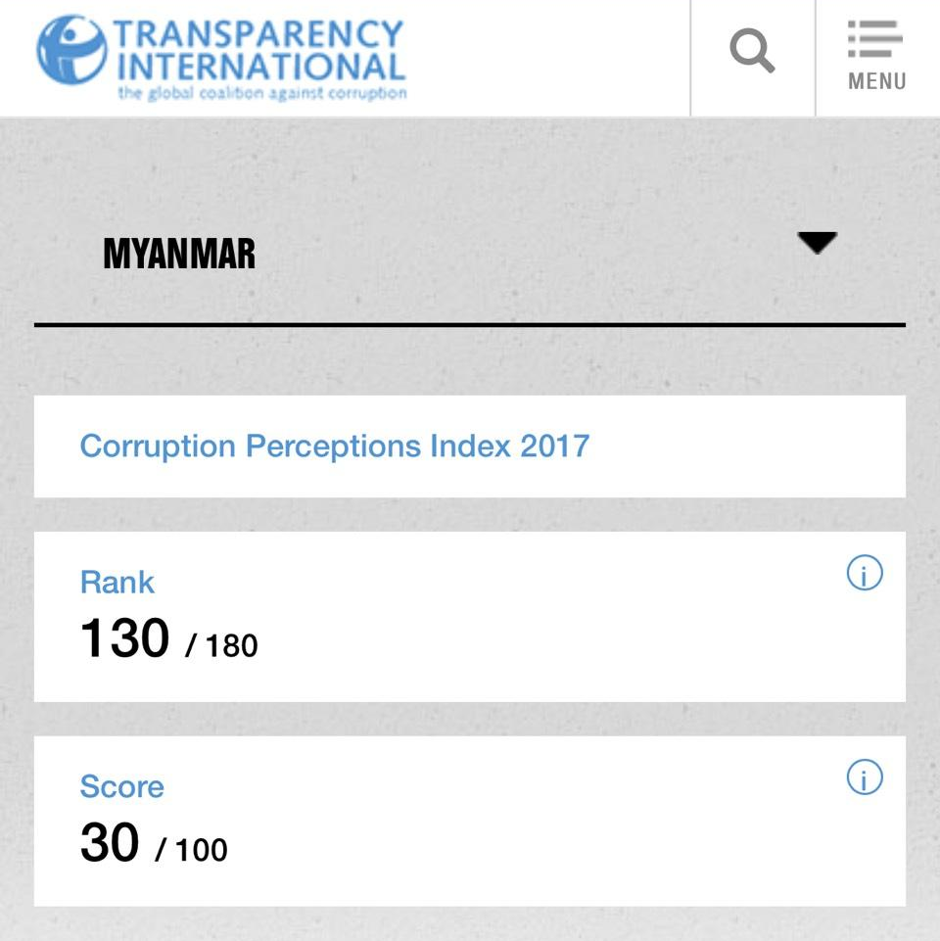
Corruption
Myanmar
Although the law and regulation are very strong, there are still some priorities for the military elites.
Policies:
Balance power between citizen and the military elites
Setting some institution for tackling corruption problems.
Strengthen the law and regulation, especially to the military elites.
Overview
Indicators
Problems
Policies

Slide 24
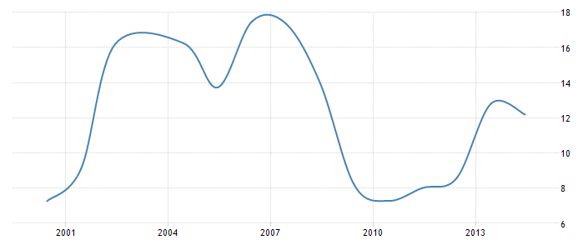
Government Budget
>>> Unqualified teacher
>>> High supplementary cost
Myanmar
Although the new government has increased budgets for the education sector year by year, its spending is still lower than other countries.
Policies :
Promote education as important factor for economic growth
Distribute more budget to education sector
Re-allocate budget to rural area education system
Lao PDR
The government expenditure is unstable due to the economic situation in that time.
Policies:
sustaining stable government expenditure to be stable
Reallocate the budget to the rural area.
Overview
Indicators
Problems
Policies
Notes:
https://borgenproject.org/education-laos/
http://www.borgenmagazine.com/evolution-education-laos/

Slide 25
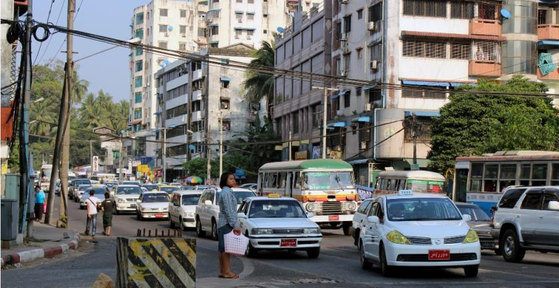
Infrastructure
Myanmar
Rural area is difficult to access to electricity and convenient transportation.
Policies :
Promote more Research and Development on improving basic infrastructure. (road, bus and electricity)
Allocate more government’s budget on improving infrastructure.
Overview
Indicators
Problems
Policies

Slide 26
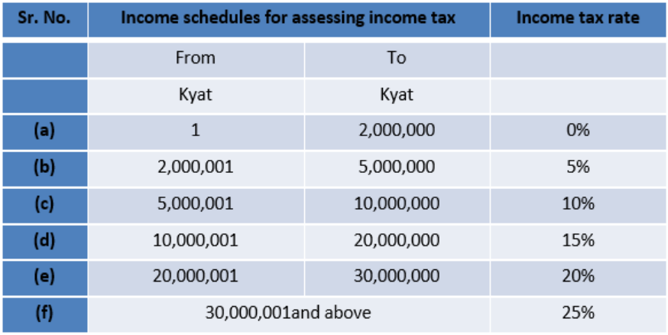
Income distribution
Myanmar
Although Individual income is taxed at the progressive rates ranging from 0% - 25% in Myanmar, people in rural area are still poor and starving.
Policies :
Increase property tax and commercial tax & Distribute more income to rural area and poor people
Create more jobs for rural area and poor people
Improve infrastructure to rural area
Overview
Indicators
Problems
Policies

Slide 27
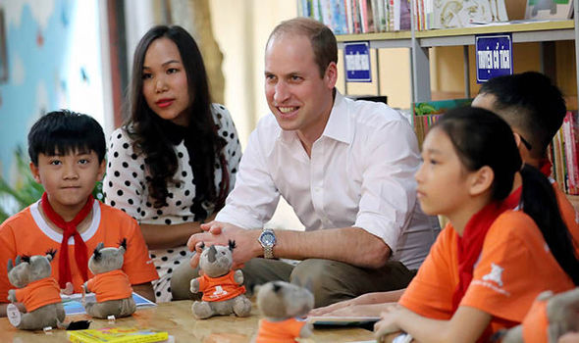
Standard of education
Vietnam
Policies:
Rearrange the curriculum to be in standard of the world
Change the way of teaching to be more practical and support more vocational education for responsive to the labor market.
Purpose the intensive course for the executive team and teacher to boost their ability base on the new regulation.
Rearrangement the financial system for education
Overview
Indicators
Problems
Policies

Slide 28
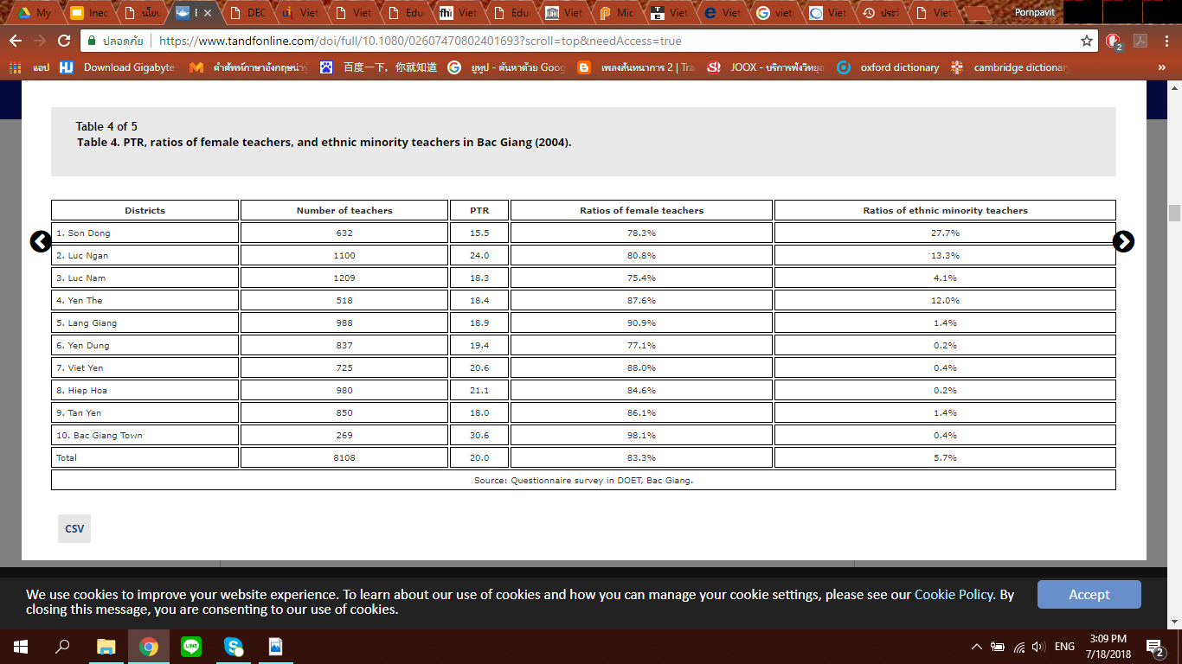
Standard of education
Source: Educational reform and teacher education in Vietnam
Overview
Indicators
Problems
Policies

Slide 29
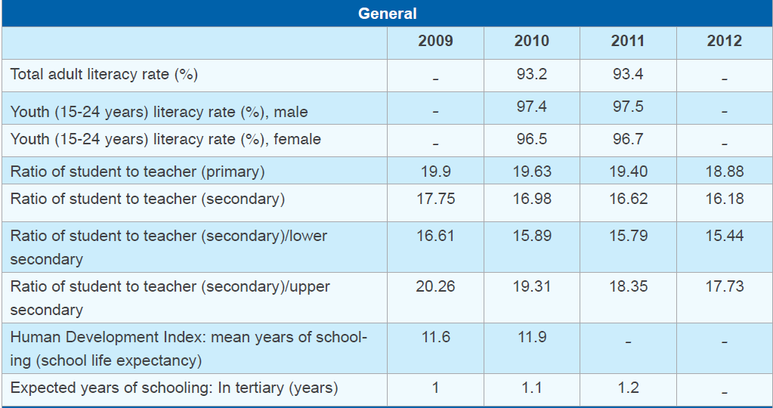
Standard of education
Source: ASEAN STATE OF EDUCATION REPORT 2013
Overview
Indicators
Problems
Policies

Slide 30
THANK YOU
Q&A

