Slide 1
International capital flows
EE463 Globalization and international development
Faculty of economics
Thammasat university

Slide 2
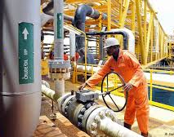
overview
International capital flows take many forms
Private foreign investments through companies/firms; this comprises foreign direct investments by large multinational corporations such as Exxon, Toyota, Hyundai, Coca Cola and foreign portfolio investments in the form of stocks, bonds in developing countries’ credit and equity markets

Slide 3

overview
Remittances of earnings by international migrants or foreign workers to their home country
Official development assistance provided by bilateral or multilateral sources to recipient governments/non profit organizations or academic institutions for development purposes
Military aid through government-to government arrangements for defense and military purposes

Slide 4

Foreign direct investment
Multinational corporation (MNC): corporation that conducts and controls productive activities in more than one country
Most MNCs are based in North America, Europe and Japan; and more recently, PR China, South Korea, Taiwan and Brazil
MNCs and resources they bring provide development opportunities but may also pose serious problems for developing countries in which they operate

Slide 5

Foreign direct investment
Historically MNCs focused on extractive and primary industries, mainly petroleum, nonfuel minerals, and agribusiness
Thereafter MNCs became more involved in export-oriented agriculture and local food processing
More recently, MNCs operate in manufacturing operations, finance and services
Production now geared for export to MNCs home country and other developed markets rather than for the host country

Slide 6
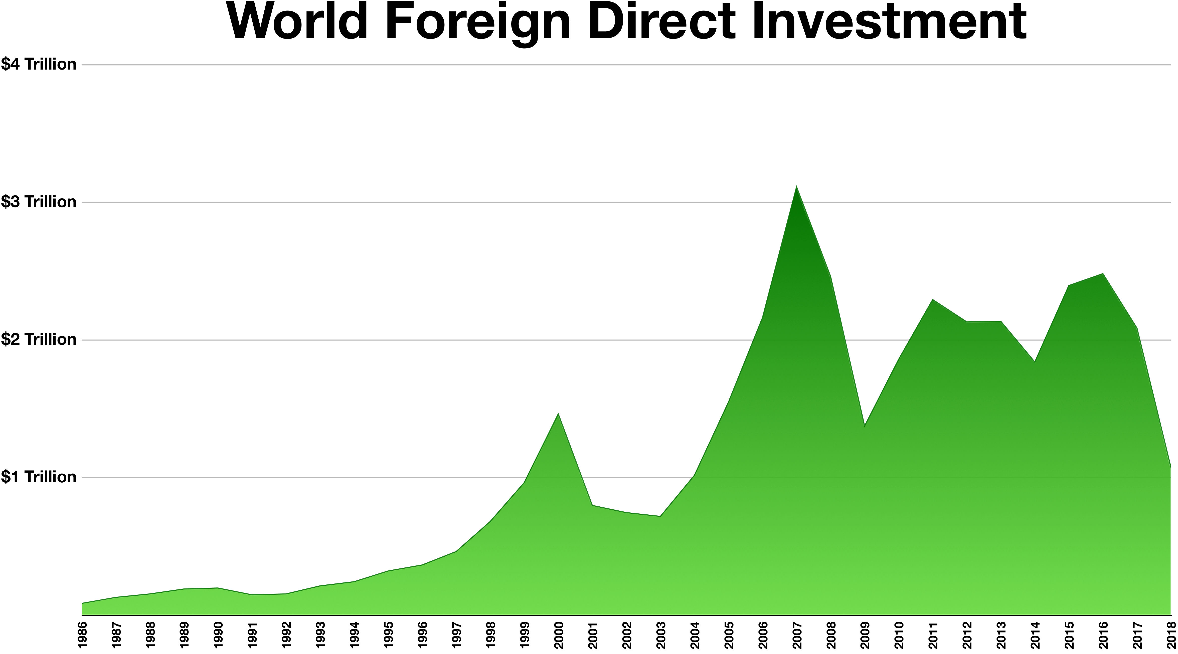
Foreign direct investment trends
Foreign direct investment trends worldwide,1986-2018:
gradual rise from 1986-2000
decline thereafter, up to 2004 followed by increase up to 2008
rebound in 2009
Slight dip in 2014 but rebound thereafter

Slide 7
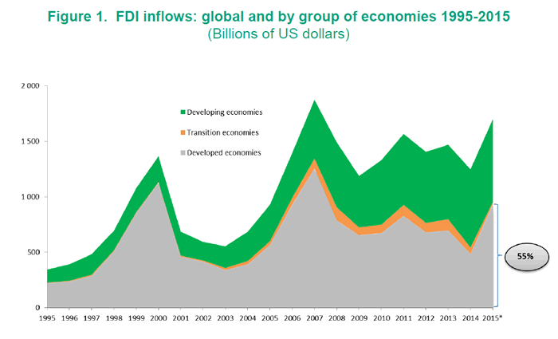
Foreign direct investment trends
FDI flows: global and by groups of economies 1995-2015, in billion of dollars
FDI flows to developing countries constitute only a small percentage of total GDP

Slide 8
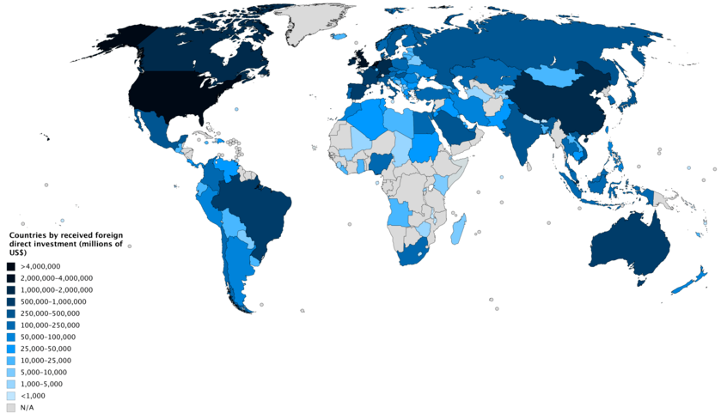
Main recipients of fdi
Developed countries are recipients of a major share of FDI
According to UNCTAD, two thirds of profits from FDI are repatriated back to the home country

Slide 9
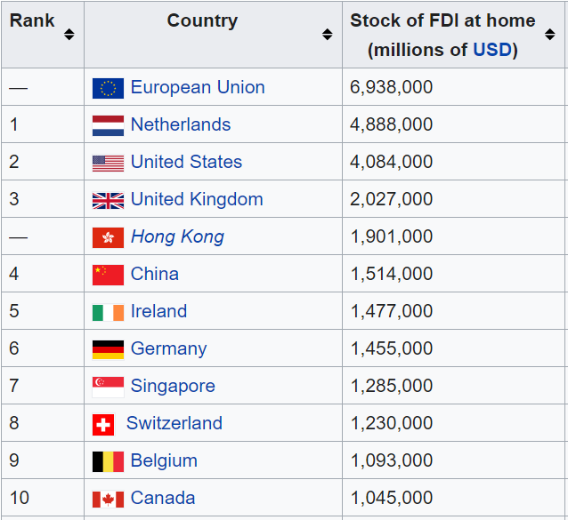
Ten top recipients of fdi

Slide 10

Impacts of foreign direct investment
MNCs fill the resource gap in terms of available supply of domestic savings, foreign currency, government revenues and human capital skills and the desired level of need for these resources to achieve development targets
MNCs also fill the gap between: targeted foreign exchange requirements and those derived from net export earnings plus net foreign aid; targeted tax revenues and locally-raised taxes; needed and available management, technology and skills

Slide 11
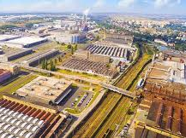
Impacts of foreign direct investment
MNCs crowd out private businesses Although MNCs provide capital, they may lower domestic savings and investment rates substituting private savings, stifling competition through special arrangements, failing to re-invest their profits, and raising local capital
Reduced foreign exchange earnings in the long run although the initial impact of MNC investment is to improve foreign exchange position of the recipient country

Slide 12

Impacts of foreign direct investment
Less-than-expected contribution to public revenues although MNCs contribute to public revenue through corporate taxes in reality the contribution is considerably less because of tax holidays, subsidies, and transfer pricing
Little impact on developing local resources MNCs’ management, entrepreneurial skills, technology may have little impact on developing local sources

Slide 13
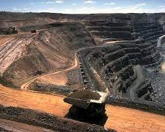
Impacts of foreign direct investment
Impact of MNCs on development is uneven; in some cases MNCs reinforce dualistic economic structures and exacerbate inequalities by promoting the interests of local factory managers above workers
MNCs use their economic power to influence government policies in directions that are unfavorable to development

Slide 14


Slide 15

Foreign Portfolio investments
Private portfolio investments comprise foreign purchases of stocks, bonds, and certificates of deposit and other commercial paper
Private portfolio investments currently account for a large and rising share of overall net resource flows to developing countries
Follows liberalization of domestic financial markets and opening up of these markets to foreign investors

Slide 16

Foreign Portfolio investments
Favored destination of private portfolio investments: middle income countries where risks and returns are higher
Perspective of recipient country: portfolio investments enables the country to raise capital and for domestic investors to diversify their assets
Perspective of foreign investors: investing in stock markets of developing countries or emerging economies permits them to increase returns while diversify risks

Slide 17

remittances
Workers from less developed countries look for jobs overseas because of wage differentials; workers in advanced countries earn 5 times more than in less-developed countries
This provides incentives for workers to migrate/work temporarily overseas
Remittance: overseas worker send back a portion of wages earned to the home country

Slide 18
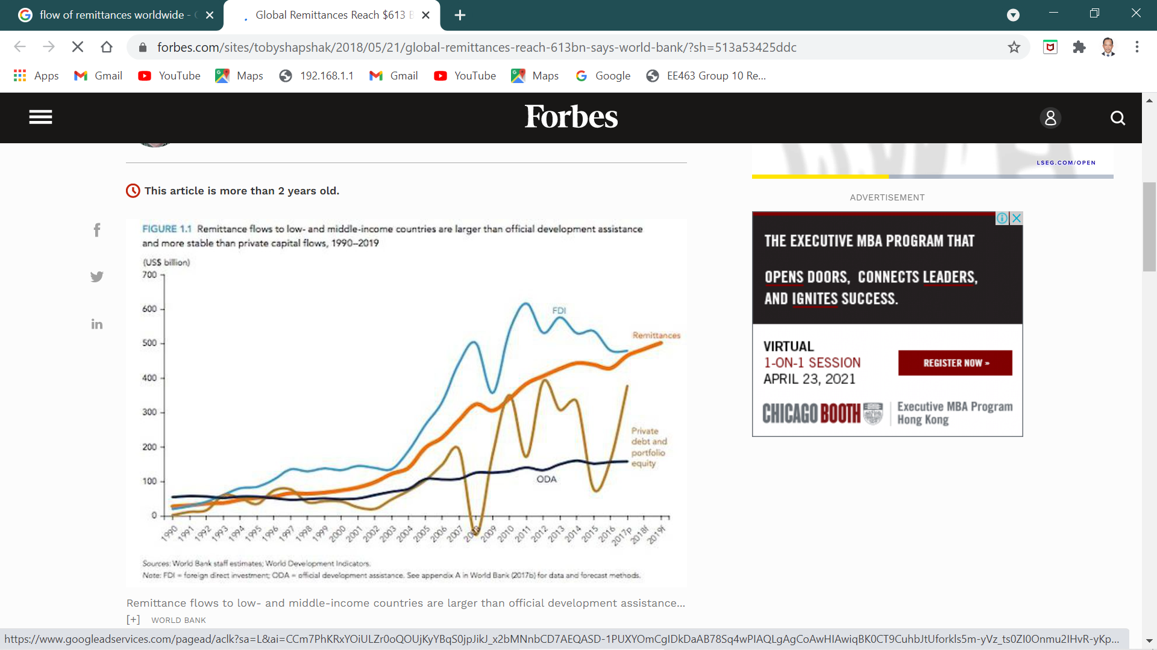
remittances
Since 1995, remittances have overtaken ODA and portfolio investment flows as a source of capital resource flows to developing countries
Since 2017 it has overtaken foreign direct investment as a source of capital flow to recipient countries
Global remittances have grown to a record level of $613 billion in 2017, a 7% increase from $573billion in 2016

Slide 19

summary
International capital flows take many forms; these include, among others, foreign direct investment, portfolio investments, official development assistance, remittances and non-development aid (military, religious)
Foreign direct investment is mainly channeled through multinational corporations; historically MNCs were engaged in extractive/primary commodities, but currently more on manufacturing, finance and services

Slide 20
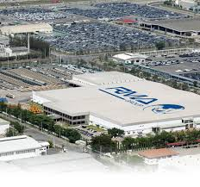
summary
MNCs bring advantages as well as disadvantages to the recipient country; although MNCs bring capital, technology and skills, the can also use their economic power to influence government policies in directions that are unfavorable to development
To capitalize on the benefits, government should be capable of negotiating the terms and conditions of investments
Most flows of FDI occur among high income countries

Slide 21

summary
Portfolio investments provide an opportunity for domestic investors to diversify their assets and for the foreign investor to generate high returns; it naturally follows liberalization of domestic financial markets and opening up of these markets to foreign investors
Remittances are an important source of capital for developing countries; the figures indicate that remittances are the main source of revenues for the recipient country, exceeding FDI and ODA

