Slide 1
Credit and Debit card
Team member :
1. Arsal Khanani 5704930030
2. Jonathan Green 5704930121
3. Vorachart Tangkijngamwong 5404641440
4. Nutt Mongkol 5404640640
5. Tanthai Sermsirimanont 5404641275
6. Surapat Klovuttisatien 5404641200

Slide 2
Did you know?
Today, Americans have an astounding 609.8 million credit cards in their wallets. If all those cards were stacked up, they would create a tower 288 miles high. (equivalent to over 1,000 Empire State buildings!)
Notes:
Today, Americans have an astounding 609.8 million credit cards in their wallets. If all those cards were stacked up, they would create a tower 288 miles high
(the equivalent of 1152 Empire State buildings!).

Slide 3
Agenda
Basic definition of Debit Card and Credit Card
Differences between them
Real life example in Thailand and the US
The future of Debit Card and Credit Card

Slide 4
Basic Definition of Credit & Debit Card

Slide 5
Debit Card
“An electronic card issued by a bank for customer to access their account to purchased good and services’’ investopedia
Notes:
When we used this card. It will withdraw a money out of our bank account. This would reduced a transaction cost by, instead of actually going to the bank to withdraw a money every time we needed. We could just find an atm machine from it [ usually small fees will be charged from using a vender of other banks but, trading-off with convenient issue, its still a good bargain ]. The are 2 types of Debit card, which is pin base and signature base. In thailand, the usage of this card still limited and people still need some cash on hand but, in some places like Denmark and the nordic countries, the function of this card is so extensive that it can be used with anything, so much that people actually hold no cash on hand at all. Which is safer and more convenient.

Slide 6
Credit Card
“A card issued by a financial company giving the holder an option to borrow funds, usually at point of sale.” investopedia
Notes:
reducing a transaction cost and inconvenience of holding a cash are the functions that both of them have. There are many differences between them which will be discuss later on but, the most fundamental one is that, using this card is actually borrowing money. This create an advantage of enable you to spend more than what you have, with no cost if you are able to pay it all back in a limited amount of time. But mind you, if you are not, this card become a subject to more fees, in the form of interest rate charged which is ridiculously high.

Slide 7
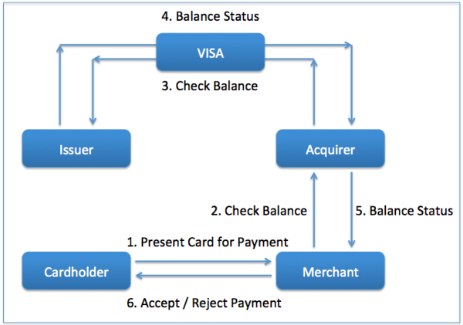
How it works ...

Slide 8
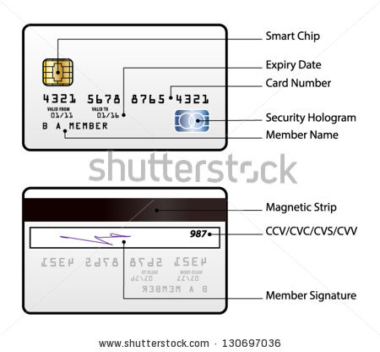

Slide 9
Differences Between
Both Cards

Slide 10
Differences Between Credit Card and Debit Card...
Debit Card
- Money comes from banking account
- Money is transacted instantaneously
-Overdraft fees (varies by bank)
Credit Card
- Charges a line of credit
- 30 grace period of payment
- Credit Card Trap (high interest rates)
Notes:
Credit Card Trap when only paying minimum payments (interest rates 13-16% depending on credit card type)

Slide 11
Differences Continued...
Debit Card
- basically no barriers to acquire card
-only spend as much as you have
-no influence on credit score
Credit Card
-barriers depending on credit and other factors
-spending limit
-influences the credit score

Slide 12
When to use Debit or Credit...
Debit Card
-if you are on a tight budget
- if have trouble managing your money effectively
Credit Card
-Online shopping
-Traveling
-When purchasing electronics (additional warranties offered)
-Rewards
Notes:
American Express will extend the warranty an additional year

Slide 13
Real-Life Examples:
Elitist Cards
Thailand

Slide 14
Elitist Cards: Gold, Platinum, Black
Common Traits:
  Membership fee
  Exclusivity over regular members
  Only for preferred group
Benefits:
  Special rewards.
  Heightened warranty protection.
  Exclusive access to events and restaurants.
Notes:
Common Traits:
An annual membership fee, often costing hundreds of dollars or more.
Programs and services not available to holders of "regular" credit cards.
Available only to a select group of preferred customers.
Benefits:
Dedicated concierge and travel agent, complimentary companion airline tickets on selected airlines, personal shoppers, access to airport clubs, first-class flight upgrades, exclusive tickets to sports and performing arts events, heightened warrantee protection, hard-to-get reservations in trendy restaurants.
Credit Card targeted towards a more affluent customer segment.

Slide 15

Real-Life Example: American Express Centurion Card (Black Card)
Notes:
Invitation Only and AE does not specify the requirements needed to attain a black card except for the fact that they have substantial net worth and are former platinum card holders. (Average black card holder has $16.3 million in assets and $1.3 million in annual income). Initiation fee is $7500 and annual fee is $2500
No limit on how much money can be put on the card.
People usually use this card for extravagant purchases like buying exotci cars and fueling their private jets.
Largest purchase ever made was a rare porcelain chicken cup for $36 million

Slide 16
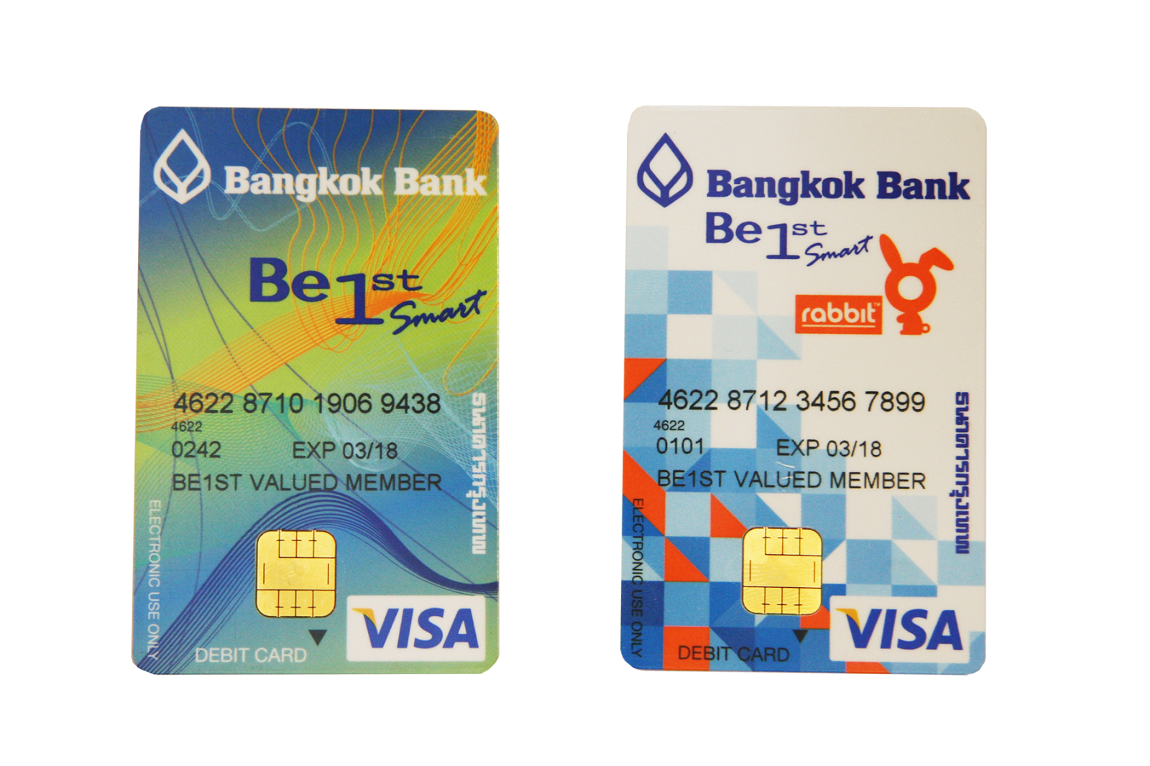
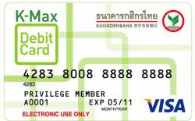
Notes:
In Thailand, Banks and

Slide 17
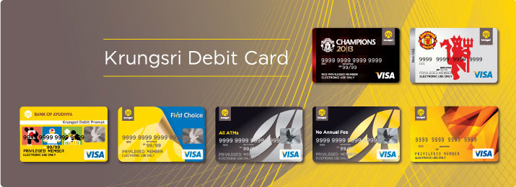

Slide 18
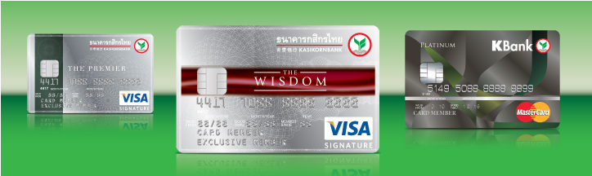

Slide 19
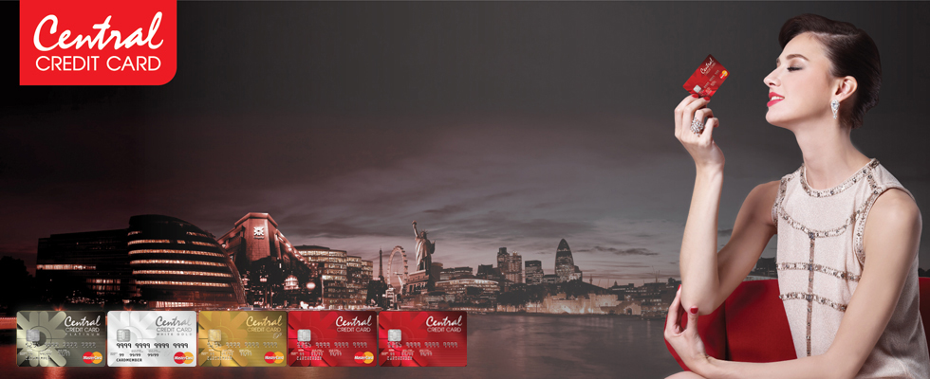
Notes:
Additionally, since

Slide 20
The future of debit card and credit card

Slide 21
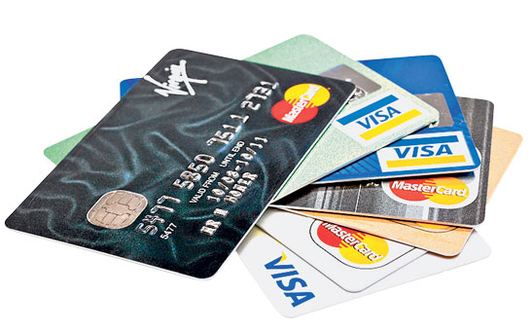
Notes:
Nowadays some people have to carry a lot of debit and credit card with them.

Slide 22
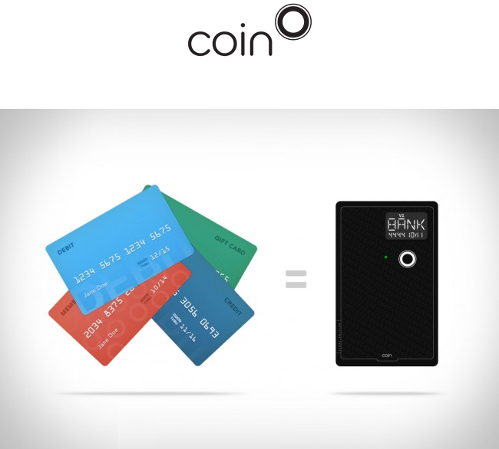
Notes:
A Company named coin come up with a card that can electronically store all of your credit cards in it. The button on the coin card can be used to switch between all the card you have stored inside. So you can select each card for different type of payment you want, then you can just use this coin card to swipe and make payment just like any other credit card This mean, all you have to carry with you is this only one coin card and you have all of your cards along with you all the time. This is a lot more convenient

Slide 23
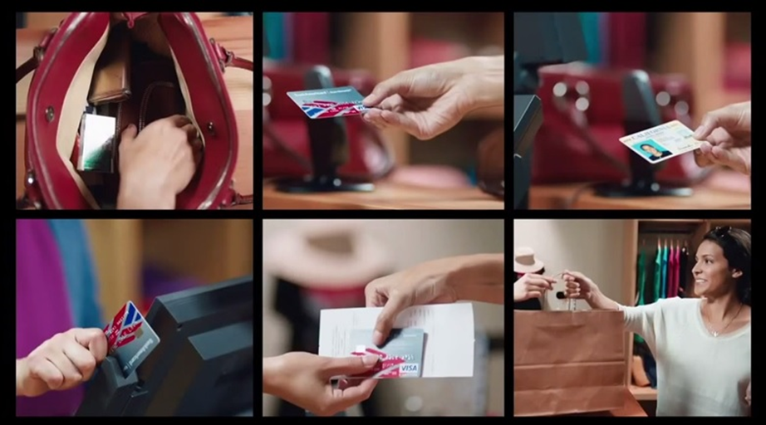

Slide 24

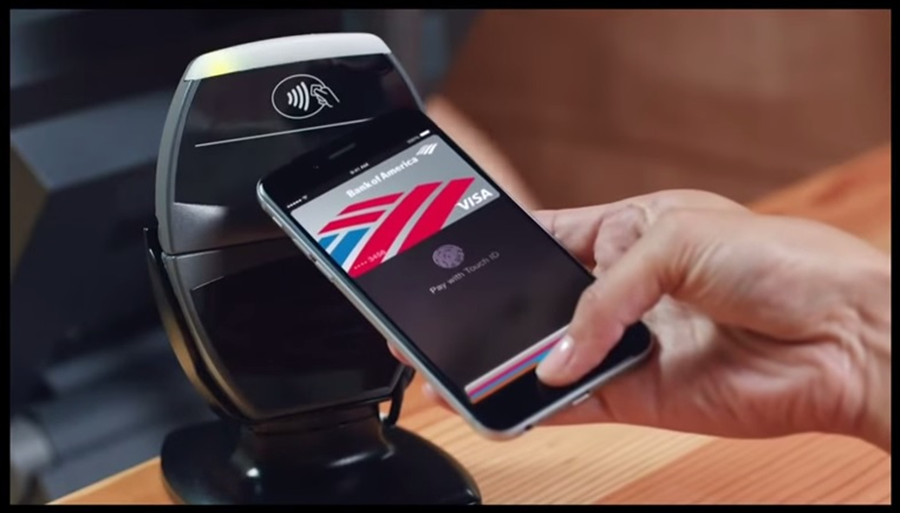
Notes:
Apple also use the same idea as we’ve seen from Coin card, but take it to another level. In this case, you can store all types of card you have into your iPhone and use it to pay directly. As you can see in the picture there’s no number, name, or expiration date on the card. This is part of the security that Apple use, for example if the phone is lost, the credit card is not lost with the phone, as there’s no information about it. Apple claim that these information are stored in a separate encrypted chip inside the iPhone. Not only that fingerprint is also another security that Apple use. In order to pay the owner of the credit card must have their fingerprint verified as well.

Slide 25
Thank You

