Slide 1
Agriculture development: policies and institutions
EE463 Globalization and international development
Faculty of economics
Thammasat university

Slide 2
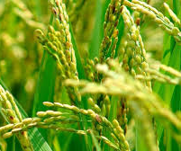
The green revolution
Before the 1950s, agriculture relied on traditional technologies and crop varieties. Although suited to local contexts, productivity was low
With rapid population growth providing sufficient food relied on expansion of areas under cultivation
By the 1960s, new technologies enabled new crop varieties, better quality seeds and improved agricultural inputs which led to substantial increases in agricultural productivity

Slide 3
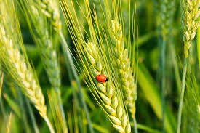
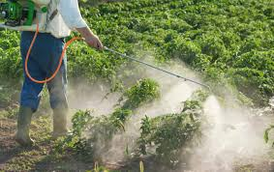
Outputs of the green revolution
Disease resistant wheat varieties (mostly staple crops such as rice, wheat and maize) which can withstand pests diseases, parasites and weeds
High-yielding crop varieties, with substantial increases in crop yield per hectare
Several methods: application of chemical fertilizers, innovative crop breeding, and improved farm practices

Slide 4
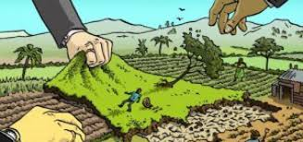
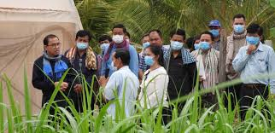
Constraints on agricultural development
Government policies relating to food prices. If prices are set too low, no incentive for farmers to produce; low prices cause long term disincentives to invest in agriculture. If too high, then problems of hunger and malnutrition arise
Inadequate institutional support for agriculture. Example: land rights; microfinance credits; extension services; social protection

Slide 5
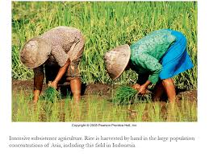
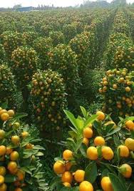
Traditional agriculture
Subsistence. Small scale, under 3 hectares; farmers consume most of production. Farmers are either land owners or are laborers
Dependency. The livelihood, health and productivity of farmers depend on the efficiency with which they allocate their scarce resources
Seasonality. Additional labor may be needed during planting and harvesting seasons
Technology. Limited use of farm inputs

Slide 6
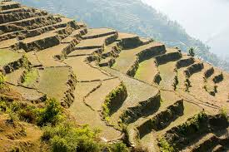
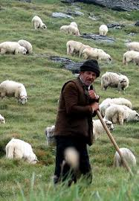
Agriculture systems
Shifting cultivation. Producers cultivate an area until its fertility is exhausted. Opening up new areas sometimes involves slash and burn
Pastoral nomadism. Producers travel more or less continuously in search of better pastures; usually based on livestock
Settled agriculture. Farmers engage in intensive annual cropping, mixed farming (crops and livestock), perennial crops, and livestock

Slide 7
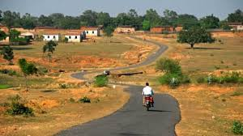
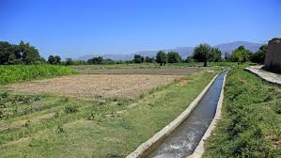
Constraints to agriculture development
Economic
Inefficient farm markets
Poor quality infrastructure (roads, canals)
Low prices for agricultural produce
Uncertainty of land tenure
Technical
Low quality/absence of agriculture inputs (seed variety, quality of seeds, fertilizers)
Poor land/soil quality
Lack of technology and know how

Slide 8
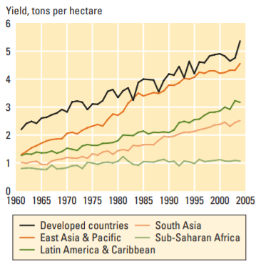
Trends in agricultural productivity
World agricultural production is going up, particularly since the 1960s green revolution
However, growth rates are declining, particularly since the 1980s, with cuts in agricultural research and development expenditures
There are marked differences across regions, in yield (tons per hectare). Sub Saharan Africa has not progressed much; East Asia and Pacific countries have substantially increased their crop yields and are almost on par with developed countries

Slide 9
Land reform
Land reform
Changes in laws, regulations or customs regarding land ownership.
Involves re-distribution of land from wealthy landowners to individuals/families who work the land

Slide 10
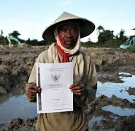
Land reform
Land reform takes a variety of forms:
Reform of rent contracts: increases security of tenure
Rent reduction: places a ceiling on rent
Land to the tiller with compensation
Land to the tiller without compensation
Implementation of land reform is not easy and sometimes controversial, particularly in cases where land is given to the tiller without compensation

Slide 11
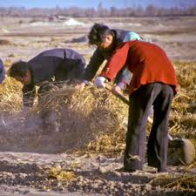
Land reform: South Korea and Taiwan
Case of successful land reform: South Korea and Taiwan after World War II
Korea and Taiwan were under Japan occupation before the war
Following Japanese defeat, land holdings were re-distributed
Farmers were given the rights of ownership/lease
Agricultural production and productivity increased

Slide 12
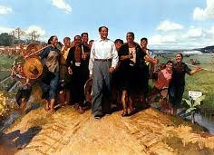
Land reform – Soviet Union and China
Land reform preceded by foreign invasions that destroyed the agrarian order followed by revolutions
Reforms made in context of socialism; land confiscated from rich landlords and distributed to peasants
Similar cases experienced by Cuba, Ethiopia, Nicaragua and Viet Nam

Slide 13
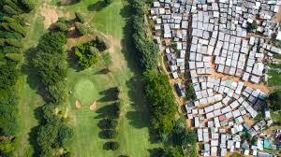
Land reform: South Africa and Zimbabwe
Settler communities (Europeans) owned much of the prime land
Since apartheid was abolished forced expropriation of white-owned farms and re-distribution of land to black Africans began in 1999
In Zimbabwe reforms widely criticized not only because of the resulting violence, but also because of favoritism
South Africa took a more cautious approach to land reform, with a target of redistributing 30% of white-owned land to black Africans

Slide 14
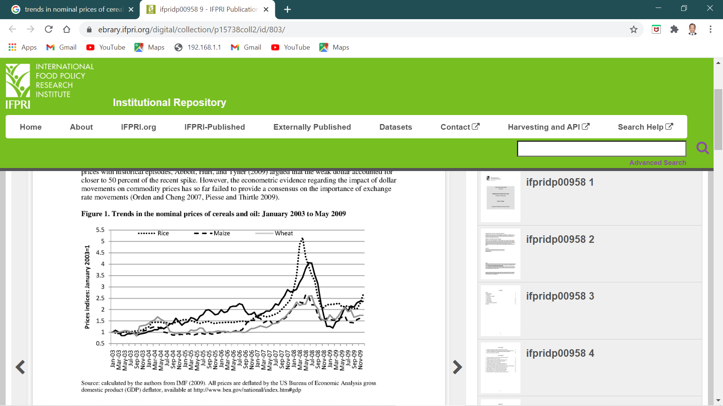
The 2008 glob al food crisis
During 2005-2008, the world suffered its most severe food crisis with a rapid increase in food prices since 2004
Triggered by a rise in petroleum prices since 2005
Price of rice tripled from $335 per ton to $$1,000 from October 2007 to April 2008; wheat and maize prices also went up, but to a lesser extent

Slide 15
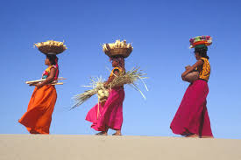
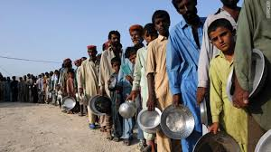
The 2008 glob al food crisis
Causes of the crisis
Growth in food demand from China and India
Speculation on financial markets
Hoarding and export restrictions, limits supply
Rising oil prices increases transport costs
Demand for biofuels, causes land competition
Depreciation of US dollar
In US, 25% of corn production was dedicated to biofuels, thereby raising corn prices
In 2007, India banned rice exports
In Australia, severe droughts increased wheat prices

Slide 16
Impacts of The 2008 glob al food crisis
Increased worldwide poverty rates by 4.5% with the rise in food prices
Shift in food consumption pattern (e.g., eating less rice or shifting from rice to tapioca)
Increased worldwide poverty count by 105 million
Policy implications: (i) the realization that agriculture sector is important, (ii) government should step up to increase sector productivity, (iii) incentives should be in place to ensure continuous and improved agricultural production

Slide 17
summary
The Green Revolution succeeded in increasing agricultural outputs through research and technology. This reduced prices of agricultural commodities and therefore, incentives to farmers in the long run
The agriculture sector in developing countries has unique characteristics, among others, that a large portion of GDP and employment is derived from the sector; that the sector’s outputs are directly consumed by producers and agricultur’e role as a resource reservoir
Agricultural systems include shifting cultivation, pastoral nomadism and settled agriculture

Slide 18
summary
Growth in agricultural productivity is a central component of agricultural development
Productivity growth in agriculture is constrained by lack of improved technology, unfavorable economic incentives and poor-quality institutions
Institutions governing land rights are of particular importance in shaping incentives and opportunities for farmers. Secure land tenure encourages farmers to produce more output

