Slide 1
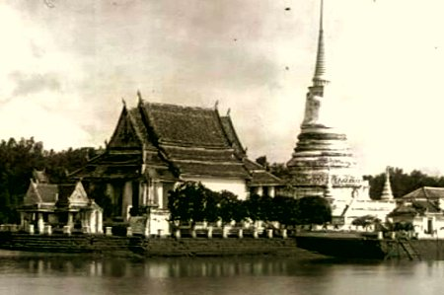
“Pre-historic Time”
TU111 Thai Civilization
Dr.Wankwan Polachan
Lecture 2

Slide 2
Today’s Outline: Pre-historic Time
The Tai and the Classical Empires
Dvaravati
Angkor
Politic and Religion Merge
A Tai Century
Kingdom of Lanna

Slide 3
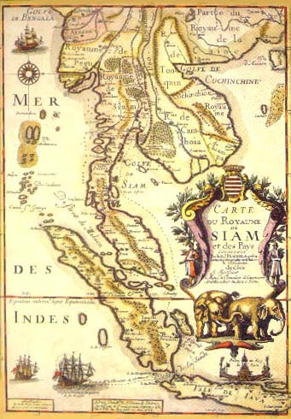
The Tai and the Classical Empires
The 11th – 12th century is such a dark and unknown period of Tai History
However, it is a “golden age” of the classical Indianized empires
The period when the Angkorian constructed the greatest monuments and left numerous stone inscriptions
The age of Angkor Wat, Angkor Thom, the Bayon
For the Tai peoples, this is the period of their Indianization and its acculturation into the civilization of lowland S/E Asia

Slide 4
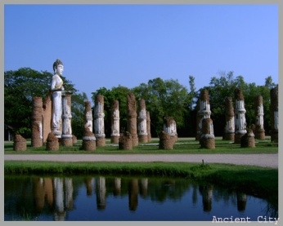
Dvaravati
The basis of a Buddhist civilization in central S/E Asia, was laid between the 6th and 9th centuries
A distinctive Buddhist culture and Mon people
Many of its inscriptions were in Mon language
Dvaravati arose more as a civilization than as an empire
Trade overland between the Gulf of Martaban and the Gulf of Siam (via the Three Pagoda Pass)
- extend westward to Burma
- eastward to Cambodia
- northward up to the Chaophraya River, valley to Chiang Mai, and
Northern Laos
- northeastward to the Khorat Plateau

Slide 5
Dvaravati
“Commercial orientation”
- beads, coins, lamps and imported statuary were found
- trade in metals, spices, forest products, and textiles
Perhaps deriving partly from its ethnic and linguistic identity as Mon, Dvaravati’s civilization had distinctive qualities of its own that sharply contrasted with those of the neighboring Khmer
During the Dvaravati period certain patterns of relationships between the local regions of central S/E Asia became well established
Regular contact between the head of the Gulf of Siam, the Upper Mekong (via Chiang Mai and Lamphun), the middle Mekong region (via the Khorat plateau), to Yunnan, Champa, Vietnam

Slide 6
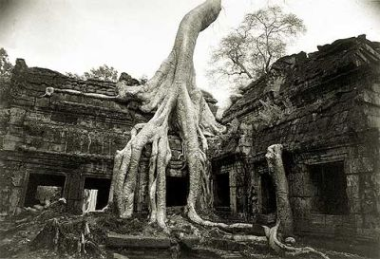
Angkor (the 11th – 12th century)
Its political history appears as clear as Dvaravati’s is dim
In the early 9th century, Jayavarman II established the capital in the Angkor region
The empire quickly expanded westward and northward, possibly by capturing the Dvaravati capital or by conquering its territories
Angkor succeeded in replacing Dvaravati’s hegemony over central S/E Asia by the end of the 9th century
Angkor had become the single most important power in most of the region by that time

Slide 7
Angkor (the 11th – 12th century)
Angkorian rulers employed a variety of means to control the fringe areas of the empire
Establishing their supremacy by force of arms or by the threat of force coupled with diplomacy
- placed governors on the most important provinces
- princes with claims to the Angkorian royal succession
Employ extensive retinue of officials: inspectors, tax collectors,
quartermasters, scribes, judges, legal scholars, assessors,
military garrison
religious men to maintain the established region,
whether brahmanical or Buddhist

Slide 8
Angkor (the 11th – 12th century)
From the reign of King Jayavarman VII (1181-1219), the empire was held together by a network of communications and institutions that must have affected the regions they reached
A system of highways, raised some meters above the plain and provided with bridges over watercourse, linked the core of empire (Phimai and Angkor)
Under patronage extended by the king in distant Angkor and by the local governor, major religious institutions were found in the fringe provinces. The most important of these are Mahayan Buddhist in inspiration (Buddhism was in fashion at court)
Saivite or Vaisnavite cults served by brahmanical priests and preceptors

Slide 9
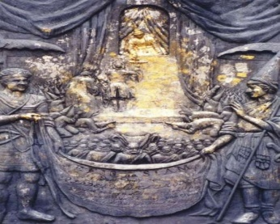
Politic and Religion Merge
These fringe and provincial areas, their resources, both in labor and in kind, were called upon to construct enormous religious monuments
Temple slaves are given in exchange of tax exemption
“These institutions were intended as pious homage to the god and religion and as religion-political devices to bind the society to the king”
“The king who was both ruler and god-Shiva, Vishnu, and/or Buddha”
- participation in the religious ceremonies that revolved around the temple was a political and a religious act

Slide 10
Politic and Religion Merge
During the 11th and 12th centuries, the ethnic composition of the population of the fringe areas of the Angkorian Empire became “Tai” both in the Lao areas of the central Mekong and the Siamese areas of central Thailand
- both these areas, indigenous religious practices and beliefs, although increasingly influenced by Theravada Buddhism, still bear some slight imprint of an earlier Mahayana Buddhist exposure (Buddhist terminology in Sanskrit from rather than in the Pali – language forms of the Theravada) especially are characterized by a lively admixture of brahmanical religion
In numerous ceremonies performed to ensure a good harvest, to restore health, to celebrate rites of passage (puberty, marriage, death)

Slide 11
Politic and Religion Merge
Non-Buddhist formulaic are used and beliefs are expressed that stem from the popular forms of brahmanical religion known to have been practiced in Angkorian days
Shiva-linga, the phallic representation of the god Shiva, enjoyed a place of respect in most villages and many towns until recent times (ปลัดขิก)
At that time the Tai people were absorbed into part-time laborers on great public works or as soldiers or temple slaves “they were not yet its ruling class”

Slide 12
Politic and Religion Merge
Who were the ruling classes of provincial Angkorian society?
- Most have been Khmer (the representatives of a distant capital sent out to the provinces for the story of god and King)
For example: Lopburi = the most important fringe province
- Earlier a major centre of Dvaravati civilization and with its own ruling house
- Later attacked by an army from Haripunchai, the Angkorian Monarch, Udayadity avarman, came to aid
As a province of Angkor, Lopburi was ruled by governors, however, Lopburi appears to have attempted to assert an independent role in the affairs of the region such as sending diplomatic missions to China in 1001, 1119 (in the wake of internal conflict in Cambodia), 1155 (after the death of Suryavarman II)

Slide 13
Politic and Religion Merge
Lopburi’s repeated attempts at independence
- Maintained a cultural and religious tradition as heir to Dvaravati
- Expressed a non-Khmer ethnic identity based on an earlier Mon-consciousness (Buddhist and Tai)
For Angkor, Lopburi seems to represent “Siam”
- See from a scene sculpted in the bas-reliefs of Angkor Wat ≈ mid 12th century (Siam Kok under the commander, more relaxed and undisciplined)
In this period, Tai chafed under the heavy exactions of Angkorian rule, the impersonality and arbitrariness of Angkorian law, and the rigid hierarchy of Angkorian society,
- all of which were opposed by the simpler and more personalized qualities of their own society

Slide 14
Politic and Religion Merge
In the 11th and 12th centuries, no Tai ruler developed a centralized administration by which to incorporate distant territory into his state
- No regional Tai states had yet emerged to dominate their neighbors
- What the Tai head and rulers have control over man power = source of potential strength and danger to the major empires

Slide 15
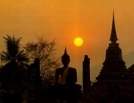
A Tai Century (1200-1351)
The 13th century
- In the early period, the great classical Indianized empires, great monuments were being constructed, works of art were produced, stone inscriptions were created
- By the end of the century “golden memories”
Three significant developments that transformed the mainland S/E Asia
1. “Most important” the beginning of a Tai century
- The Tai moved down from the upland valleys onto the plains formerly dominated by major empires
- in an attempt to imitate and supplant their rivals, these new states stretched all the way
- Assam in N/E India (west), Northern Laos (East), and Nakhon Si Thammarat (South) on the Malay Peninsula

Slide 16
A Tai Century (1200-1351)
2. The verification of Buddhism through contacts with Singhalese Buddhism
- Result in the foundation of strong, well-supported Buddhist monastic institutions
3. The political transformation of continental S/E Asia
- the rise to power of the Mongols in China, and their power extension into the region through diplomatic and military means
The political landscape of mainland S/E Asia by the end of the 13th century was fractured into numerous, much smaller states more equal in their political and religious power
These new communities lived according to Theravada Buddhism - Singhalese origin, performing arts with their own styles, literary arts with their own idioms and languages
For the Tai especially the Siamese, real history must have begun in the 13th century

Slide 17
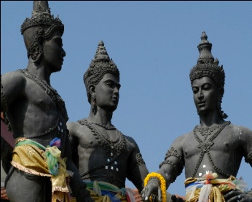
Kingdom of Lanna
The chronicles of Chiang Mai trace the ruling house of Lanna back to Chiang Saen in the Yonok region – currently Sipsong Panna
This is the world of the upper Mekong River, people by folk who called themselves Lao and whose lives were threatened by Vietnam and by Yunnan, that is “Nan-chao”
The founder of the Lanna kingdom of Chiang Mai, Mangrai was born in 1239 at Chiang Saen, he succeeded his dad as ruler of Chiang Saen in 1259
He had observed that all Tai principalities of the region were fighting among themselves
He stemmed from legitimate royal house, graced with the full Indie rites of coronation

Slide 18
Kingdom of Lanna
He determined to impose his own authority over them, he conquered his neighbors and placed his own officers over them
-He started to extend his power to the South
The network of relationships linking Mangrai to neighboring Tai princes was further strengthened when he was called upon to settle a dispute between Ngam Müang (the King of Phayao) and Ramkhamhaen of Sukhothai (Ramkhamhean had seduced Ngam Müang’s wife)
Mangrai had Ramkamhaen apologized to Ngam Müang and pay him an indemmity of 990.000 cowrie shells (they reconciled)
Three rulers swore a pact of eternal friendship

Slide 19
Kingdom of Lanna
The rulers of Chiang Saen, Chiang Rai, and Sukhothai were engaged in ambitious schemes for expansion. However, there were also greater dangers raised by Mongol incursions to Burma and Vietnam and threats against Angkorian Cambodia
Under this uncertain climate, three rulers laid stress upon their mutual ties, with their common identity as Tai
After taking kingdom of Haripunjaya (Lamphun) under his control, he established “Chiang Mai” as his capital in 1292
Mangrai’s power was based on a highly diverse population
- southern portions, Mon
- Lawa, other tribe people, variety of Tai

Slide 20
Kingdom of Lanna
The core of ruling elite was Tai through intermarriage with women of older indigenous ruling families and by the recruitment of specialists for royal service
Mangrai also began a legal tradition “The Judgements of King Mangrai”

