Slide 1

MK 322 Retail Management
Chapter 9: Human Resource Management
Part II
By Ajarn Suwalya K.

Slide 2

Designing the Organization Structure for a Retail Firm

Slide 3
Organization of a National Retail Chain
The management of a retail chain is complex
Managers must supervise units that are geographically diverse
Chief executive officer(CEO) is responsible for overseeing the entire organization
Reporting to the CEO are the presidents of global operations, the internet channels, and private-label management and senior vice presidents of merchandising, stores and administration
Notes:
1

Slide 4
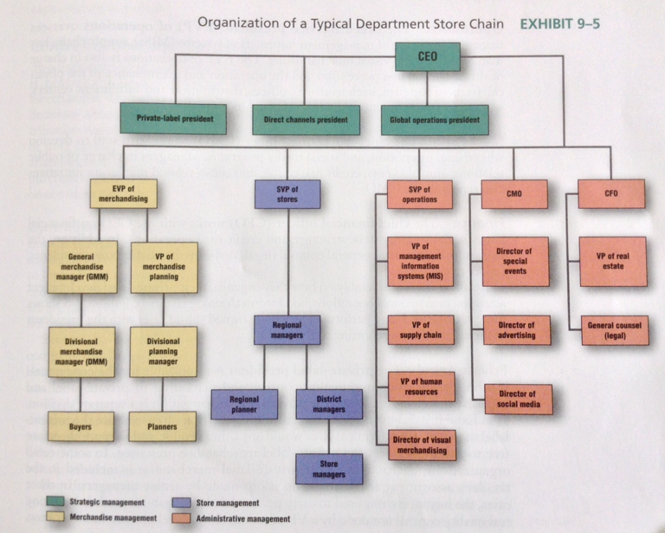
Organization of a National Retail Chain
Notes:
1

Slide 5

Merchandising
The senior vice president (SVP) of merchandising works with buyers and planners to develop and coordinate the management of the retailer's merchandise offering and ensure that it is consistent with the firm's strategy
The buyers in the merchandise division are responsible for determining the merchandise assortment, pricing, and managing relationships and negotiating with vendors
Notes:
1

Slide 6
Merchandising
The merchandising buyers are responsible for allocating merchandising and tailoring the assortment of several categories for specific stores in a geographic area
Notes:
1

Slide 7
Stores
The senior vice president (SVP) of stores supervises all activities related to stores, including working with regional managers, who supervise district managers, who supervise the individual store managers
Store managers in large stores have several assistant managers who report to them
One assistant manager is responsible for receiving, restocking,and presentation of merchandise in the store; HR activities and store maintenance and store security
Notes:
1

Slide 8
Stores
Each region has regional planners who work as liason between stores in their region and the corporate planners to ensure that the stores have the right merchandise, at the right time, and right quantities
Notes:
1

Slide 9
Operations
The executive vice president (EVP) of operations oversees managers in charge of the management information systems (MISs), supply chain, human resource, and visual merchandising
Notes:
1

Slide 10
Marketing
The chief marketing officer (CMO) works with staff to develop advertising, promotion, social media programs
Managers in charge of public relations, annual events, credit marketing, and cause-related marketing initiatives also report to CMO
Notes:
1

Slide 11
Finance
The chief finance officer (CFO) works with the CEO on financial issues such as equity-debt structure and credit card operations
In addition, the real estate division and general counsel (legal) divisions headed by vice president report to the CFO
Notes:
1

Slide 12
Private Label
The private-label president is responsible for conceptualization,design,sourcing,quality control, and marketing of private-label and exclusive merchandise
Notes:
1

Slide 13
Internet,Mobile,and Catalog, Channels
The president of direct channels is responsible for the selection and pricing of merchandise assortment offered via these channels, the maintenance and design of the retailer's website, customer call centers, and the fulfillment centers that fills orders for individual customers
Notes:
1

Slide 14
Global
The global operations president oversees retailing operations outside the home country
The global organization typically has merchandising, administration,stores,and operations divisions for each country and region
Notes:
1

Slide 15
Organization of a National Retail Chain
Notes:
1

Slide 16
Centralization and Coordination
Two important organizational issues are
The degree to which decision making is centralized or decentralized
The approaches used to coordinate merchandise and store management
Notes:
1

Slide 17
Centralization
Centralization occurs when the authority for retailing decisions is delegated to corporate managers rather than geographically dispersed managers
Decentralization occurs when authority for decisions are assigned to lower levels in an organization
Notes:
1

Slide 18
Coordinating Merchandise and Store Management
Small,independent retailers have little difficulty coordinating their stores' buying and selling activities. Store owners know what their customers want
In contrast, large retail firms organize buying and selling functions into separate divisions
Notes:
1

Slide 19
Coordinating Merchandise and Store Management
Three approaches large retailers use to coordinate buying and selling are
Improving buyers' appreciation for store environment
Making store visits
Assigning employees coordinating roles
Notes:
1

Slide 20
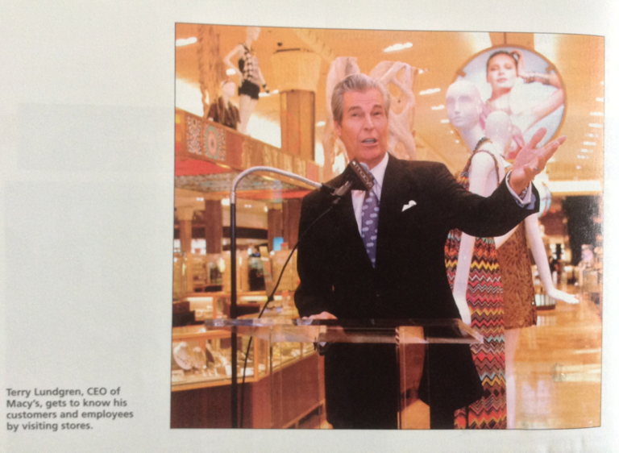
Coordinating Merchandise and Store Management
Notes:
1

Slide 21

Winning the Employee Talent War

Slide 22
Employment Branding
HR departments for Starbucks and Marriott are developing marketing programs to attract and retain the "Best and brightest"employees
Called employment branding or employment marketing involve in undertaking marketing research to understand what potential and current employees are seeking as well as what they think about retailer;developing value proposition and employment brand image;communicating the brand image to the potential employees;and then fulfilling the brand promise by ensuring that employee experience matches the image created
Notes:
1

Slide 23
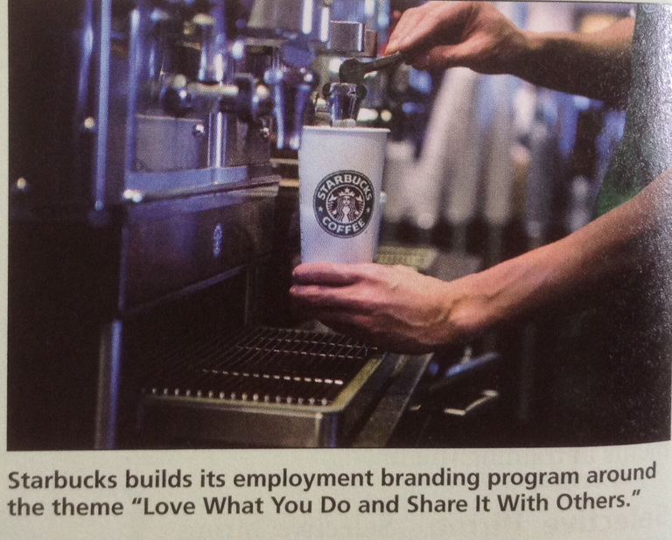
Employment Branding
Notes:
1

Slide 24

Developing Talent:
Selection and Training
Selective Hiring
Training
Notes:
1

Slide 25
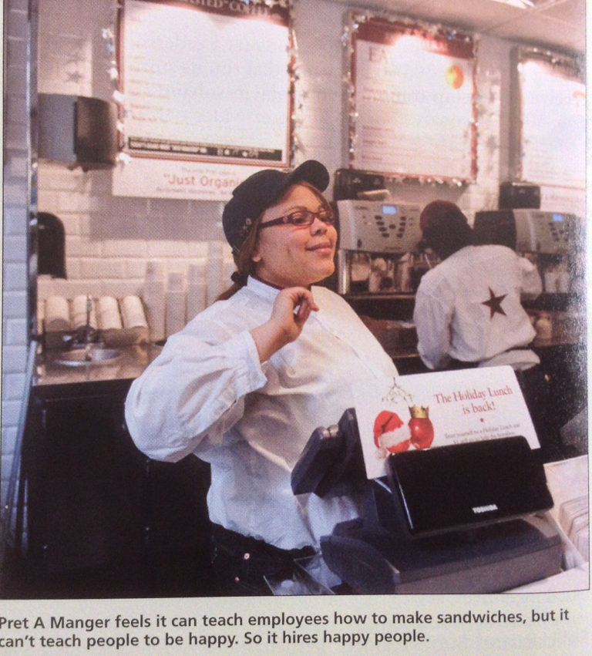
Developing Talent:
Selection and Training
Notes:
1

Slide 26
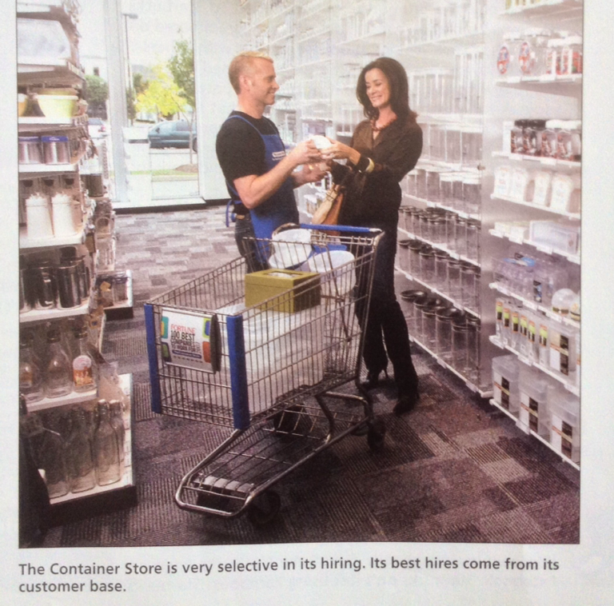
Developing Talent:
Selection and Training
Notes:
1

Slide 27
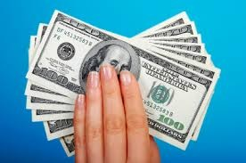
Motivating Talent: Aligning Goals
Policies and supervision – written
Compensation-based incentives- commissions, bonus, profit-sharing
Notes:
1

Slide 28

Organization Culture
An organizational culture is the set of values, traditions, and customs of a firm that guides employee behavior
Notes:
1

Slide 29
Other Important Goals
Keeping Talent-reduce turnover
Empowering employees
Engaging employees
Reduce Status Difference
Promote from Within
Balance Career and Family-Flexitime
Provide Benefits- Health care
Use social media- to communicate and engage employees
Notes:
1

Slide 30


