Slide 1
To illustrate the role of foreign exchange reserves
Foreign exchange reserves are the corresponding stock variable of balance of payment, reflect the stock of foreign asset or the external wealth.
Foreign exchange reserves are held by the central banks.

Slide 2
When a country experiences balance of payment surplus (net receipt in foreign exchange), an increase in foreign exchange reserves is observed.
It means if balance of payment is zero, there would not be any change in foreign exchange reserves.
Under what circumstances where balance of payment is zero?

Slide 3
Does it mean a country with floating exchange rate regime does not need foreign exchange reserves?
Definitely, no. Foreign exchange reserves are need, but less as opposed to a country with non-floating exchange rate regime.
As mentioned, foreign exchange reserves are foreign asset held by central bank. What is the central bank’s liability?

Slide 4
Simple Balance Sheet
Asset:
Foreign exchange reserves
Liability:
Printed Money (M1)
Equity: Profit=0

Slide 5
Recap:
M1 = notes, coins, and demand deposits (Outside the central bank)
M2 = M1+ Saving and time deposits
M1 = Liability of the central bank
(Paper printed by the bank for medium of exchange!!)

Slide 6
Consider these two circumstances,;
Country A : The bank has 20,000$ and prints money to be used for 100,000 local currency (every 5 units of local currency is backed up by 1 $).
Country B: The bank has 20,000$ and prints money to be used for 1,000,000 local currency (every 50 units of local currency is backed up by 1$).
If you have to choose to hold currency, which one you choose and why?

Slide 7
The correct answer is ‘depend on what the exchange rate is.
For a country to fix an exchange rate, say, 35 baht/$, what does it mean? Assume no creditability problem, people can convert baht for US dollar or vice versa anytime at the given rate.
If Country A set the exchange rate equals to 5 units of LC/$, do you hold Country A currency?

Slide 8
If we alter the given exchange rate to 10 units of LC/$, does it change your decision?
Are Country A’s foreign exchange reserves adequate to cover the printed LC circulated in the economy?
Similarly, if Country B fix the exchange rate at 5 units of LC/$, do you hold Country B’s currency?

Slide 9
In reality, there are rooms for discretion.

Slide 10
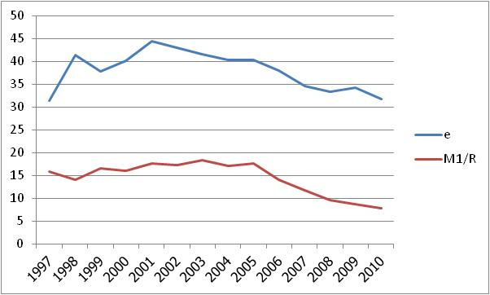
Thailand

Slide 11
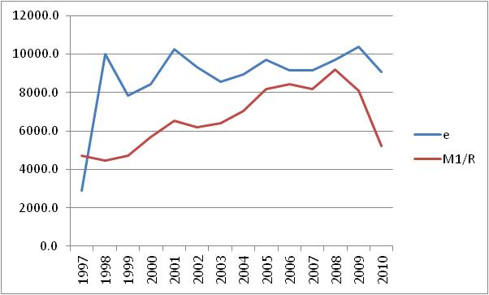
Indonesia

Slide 12
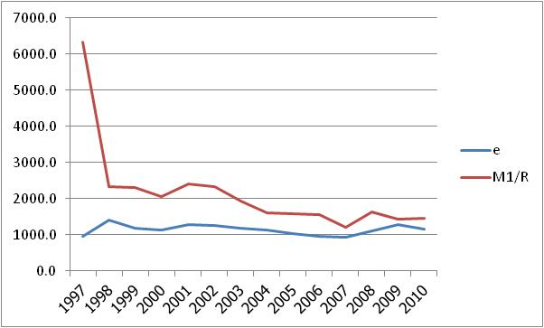
S. Korea

Slide 13
The link between M1 and foreign exchange reserves is more crucial for a country adopting a fixed exchange rate regime. (Clear commitment).
There is a strong positive but not one-to-one correlation.
Sterilization= the actions taken by a country's central bank to counter the effects on the money supply caused by a balance of payments surplus or deficit.

Slide 14
Reserve Adequacy
In practice, the reserve adequacy is measured with foreign exchange expenses or liability.
Foreign exchange expenses are largely referred to import (how long (months) foreign exchange reserves would cover import expenses)
Short-term capital flows (‘Hot’ Money) are used as proxy for foreign exchange liability.
Reference: Athukorala and Warr (2002)

