Slide 1
Topic 10 Extra
Game Theory
(Chapter 14)

Slide 2
A simple way to think about NE
NE is a situation where
you are doing your best given what the other player is doing AND the other player is doing his/her best given what you are doing.
NE is a “profile” of strategies (S₁ and S₂), with S₁ is for Player 1 and S₂ is for Player 2, such that
S₁ is the best response of Player 1 when Player 2 uses S₂,
AND S₂ is the best response of Player 2 when Player 1 uses S₁.
NE way of thinking…
I know that you know that I know that you know…

Slide 3
Dominant and Dominated Strategies
Dominant Strategy
IF a player has a dominant strategy which means that it always gives higher payoffs than ALL other strategies,
THEN that dominant strategy must be played in the NE.
Dominated Strategy
IF a player has a dominated strategy which means that there is AT LEAST ONE strategy that is better than it,
THEN that dominated strategy can be eliminated.

Slide 4
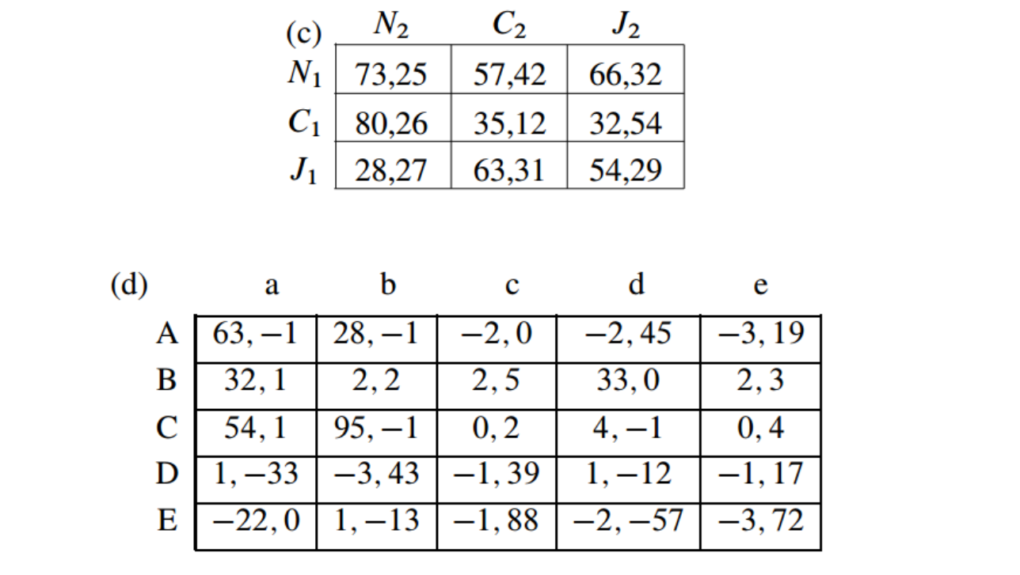
Ans
(A,a)
(A,a), (C,a)
(J,C)
(B,c)

