Slide 1
INTEGRATED BRAND COMMUNICATION
Massimiliano La Franca
Part 10

Slide 2
What do we mean by Integrated Communication?
INTEGRATED around a single idea
Encompasses ALL touch points
Exploitation of the idea across the most APPROPRIATE channels, phased, to meet OBJECTIVES
Planned in TALKABILITY
Notes:
Encompasses all touch points: = activation & communication, from TV to the pack to POS in-store – everything that touches the consumer, from a piece of TV communication to point of sale should be true to the brand’s communication idea
It’s about choosing the most appropriate channels – not more channels the better! Phasing: sequencing and layering of channels key
Talkability: planned in from the outset, not a happy accident – examples of this later on

Slide 3
What We’re Going to Do
Judging ideas is very difficult, a fine art between gut feel, experience and logic
It involves the right and the left part of the brain
In order to train ourselves and get better at judging we will define a simple guideline to keep in mind whenever we need to give our feedback

Slide 4
FIRST THINGS FIRST
When judging, ask yourself:
  Will this solve my Job to be Done?
  Is it on brief?
  Are you judging the idea or the execution?

Slide 5
First remember:
Ideas vs. Executions
An advertising idea can be executed in a number of different ways
  IDEA: what do we say?
  EXECUTION: how do we say it?
Keep in mind that the 2 things are different when you judge an idea
Remember to understand the idea first and judge the execution after
If the idea is good but the execution is not, you can change the execution, NOT the other way ‘round.

Slide 6
A simple guideline
A
Attention: Impact, enjoyment, involving
Branding: Intrinsically branded at the core
Communication: of the main point
B
C

Slide 7
In human beings words
A
Can I hear you (do I want to)?
What was your name?
What are you telling me?
B
C

Slide 8
Attention
Cuts through, has impact, is enjoyable and involving
Will the work cut through the clutter? Is it sufficiently different, involving, impactful?
Will it be relevant, interesting and entertaining enough for people to talk about?
Where appropriate, will people want to get involved and participate?
Is the idea relevant to the target and embedded in their popular culture? Is it likely to have “staying power” vs. a short term fad?

Slide 10
Branding
Is it branded intrinsically at the core? The idea needs to be of the brand, not just loosely attached to the brand.
Does it build upon the brand’s root strengths?
Is the idea ownable and differentiating? Will this be the first time this idea has been used in this way to communicate with this target?
Are the brand’s values and personality well reflected?
Would it be impossible to talk about the communication without mentioning the brand?
Are exsisting branding cues such as visual style, music, etc. being maximised?

Slide 11
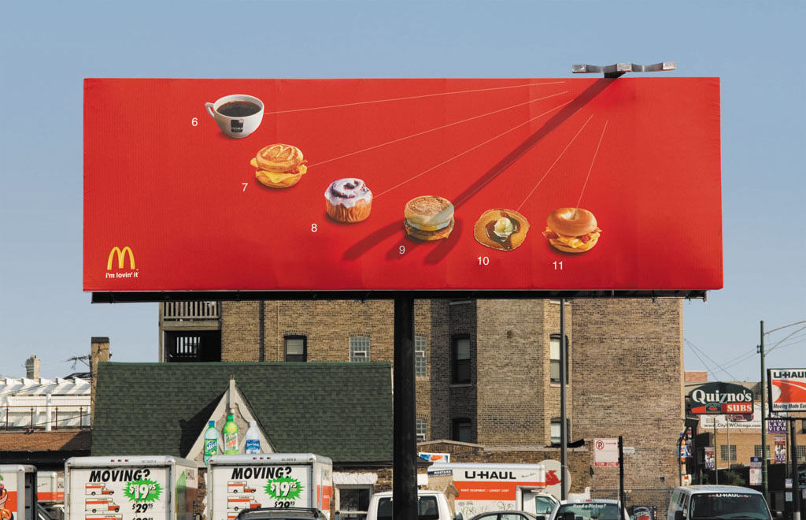

Slide 12
Communication
The message should be understood in a way that will lead to a positive change in behaviour.
Is the message easy for the target to understand?
Is the message convincing and persuasive - will it lead to behaviour change? Does it communicate the Brief?
Does it reflect a robust insight?
Is the communication objective at the heart of the idea?

Slide 13
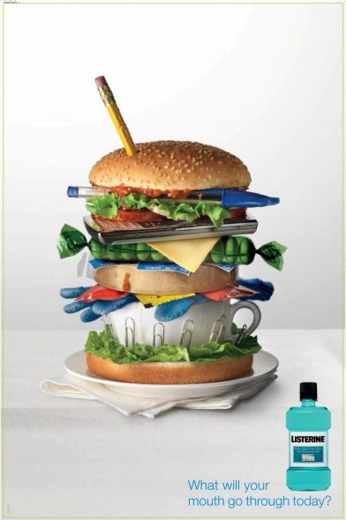
Listerine

Slide 14
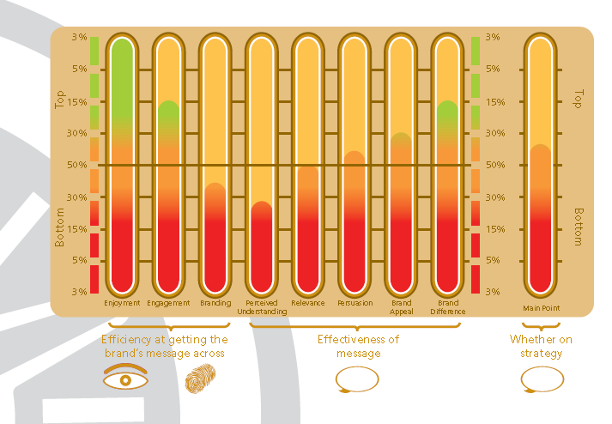
PREVIEW Research
Branding
Attention
Communication

Slide 15
JUDGEMENT WRITTEN RESPONSE TEMPLATE
1. Gut Reaction
2. Rigorous Judging
A | B | C
Attention Will it grab attention? | Branding Is it intrinsically branded at the core? | Communication Is it understandable? Does it communicate the main point?
3. Considered Reaction
4. Agency next steps
Notes:
15

Slide 16
LET’S TRY

