Slide 1

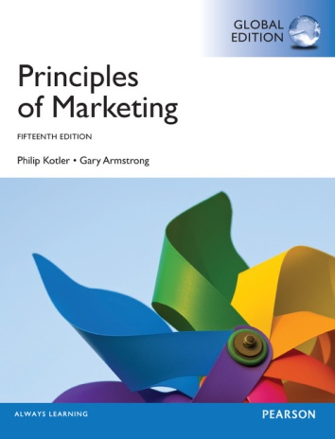
Distribution Channels Strategy II
CHAPTER 13: Retailing and Wholesaling
MK 202 Fundamentals of Marketing
By Aj.Suwalya K.

Slide 2
Objective Outline
Objective 1: Explain the roles of retailers in the distribution channel and describe the major types of retailers.
Objective 2: Describe the major retailer marketing decisions.
Objective 3: Describe the major trends and developments in retail
Objective 4: Explain the major types of wholesaler sand their marketing decisions

Slide 3
Objective 1
Retailing

Slide 4

BEKO produces a wide range of electronic goods, from washing machines to plasma TVs, demonstrating that Turkish engineering can offer quantity and quality.

Slide 5
Retailing
Retailing: All the Activities involved in selling goods or services directly to the final consumers for their personal, non-business use.
Retailer: A business whose sales come primarily from retailing
Shopper marketing: Using in-store promotions and advertising to extend brand equity to “the last mile” and encouraging favorable point-of-purchase decisions

Slide 6

Retailing
Shopper marketing: The dramatic growth of digital shopping has added a new dimension to “point of purchase”. Influencing consumer’s buying decisions as they shop involves efforts aimed at in-store, online and mobile shopping.

Slide 7
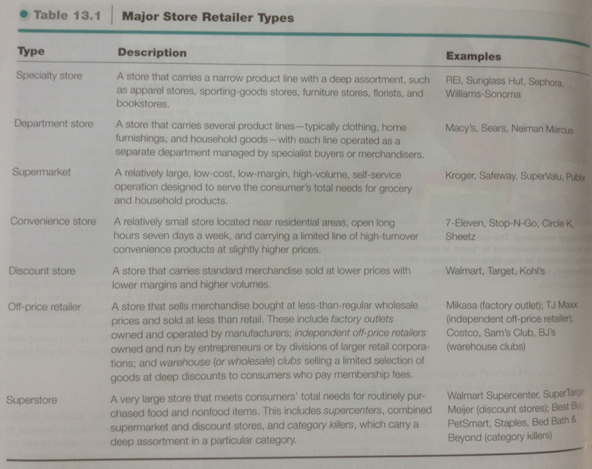

Slide 8
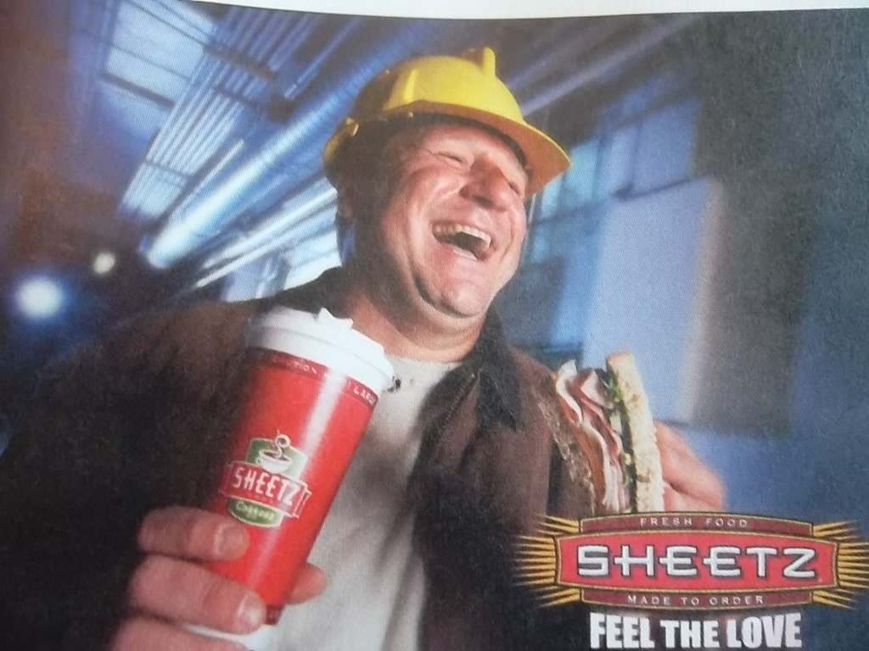
Convenience stores: Sheetz positions itself as more than just a convenience store. Driven by its Total Customer Focus mission and the motto-”Feel the Love” Sheetz aims to provide “convenience without compromise.”

Slide 9
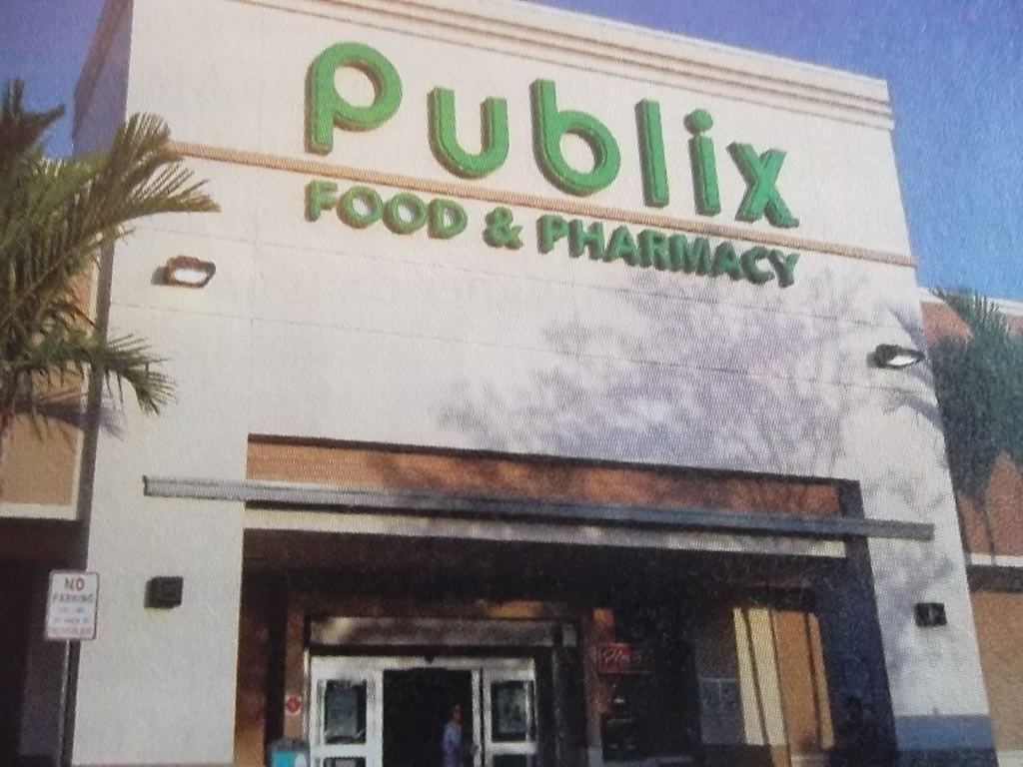
Despite recent belt-tightening by consumers, the Publix supermarket chain has succeeded by lowering prices and helping customers get the most out of today’s tighter food budgets.

Slide 10
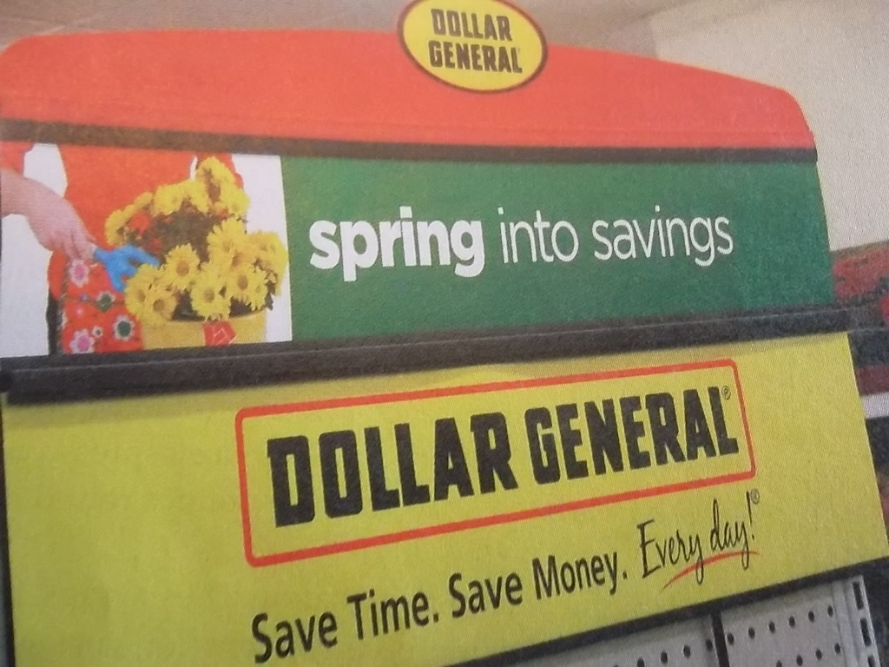
Discounter Dollar General, the nation’s largest small-box discount retailer, makes a powerful value promise for the times: “Save time, Save money. Every day.’

Slide 11
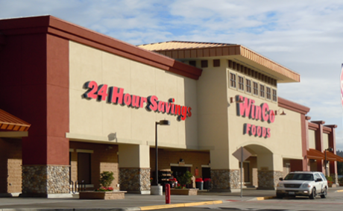
In the battle for "share of stomach", regional supermarket chain WinCo successfully competes head-on with large discounters such as Costco and Walmart. It's rapidly becoming "Walmart's worst nightmare."

Slide 12
Objective 2
Retailing Marketing Decisions

Slide 13
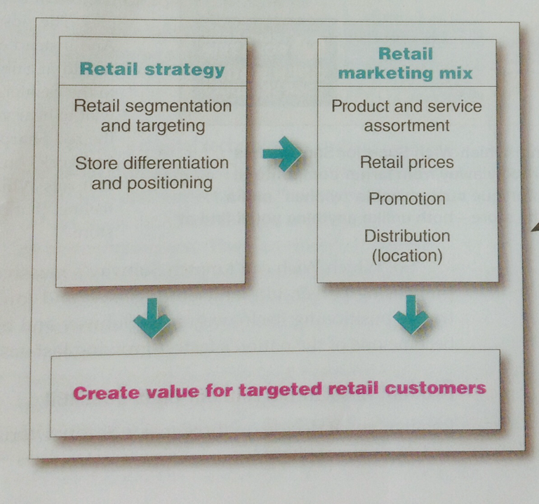
Retailing
Figure 13.1 Retailer Marketing Strategies
As with other types of marketers, the name of the game for retailers is to find the customer-driven marketing strategy and mix that will let them create value for customers and capture value in return. Remember Target’s “Expect more. Pay Less “value proposition? And Olive Garden’s “When you’re here, you’re family.

Slide 14

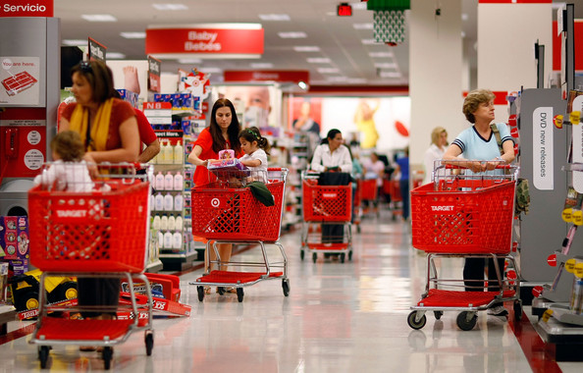

Slide 15
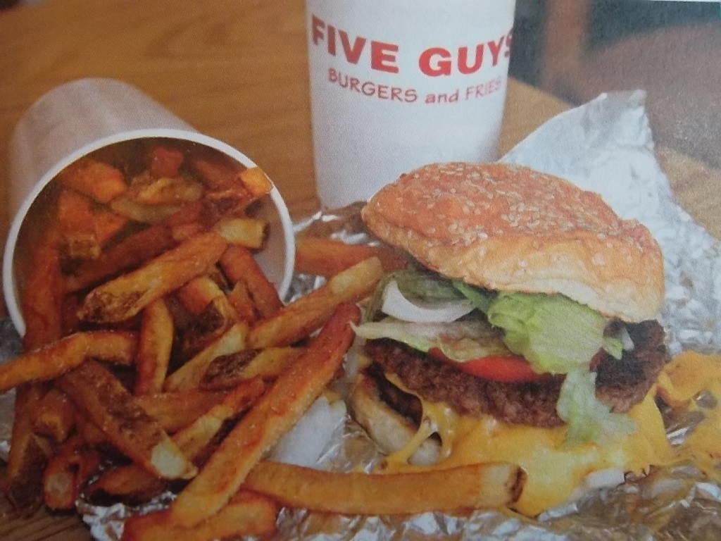
Retail targeting and positioning: Give Guys Burger and Fries succeeds by positioning itself strongly away from McDonald’s and other large fast-foods giants. The menu is very limited, but what you can get at Five Guys you simply can’t get at McDonalds.

Slide 16

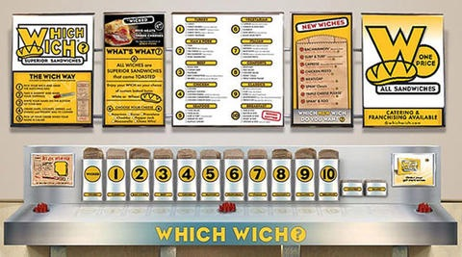
Retail targeting and positioning: Which Wich Superior Sandwiches succeeds by positioning itself strongly away from larger competitors.It offers more than 50 varieties of unique customizable "wiches" and a "positive energy" from being in the store – both unlike anything

Slide 17
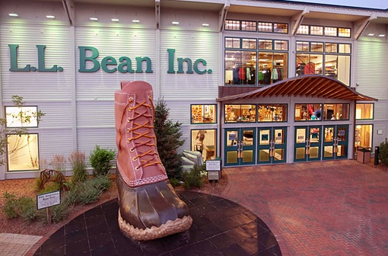
Experiential retailing: L.L. Bean has turned its flagship retail store in Freeport, Maine into an adventure center, where customers can experience goods before buying them.

Slide 18
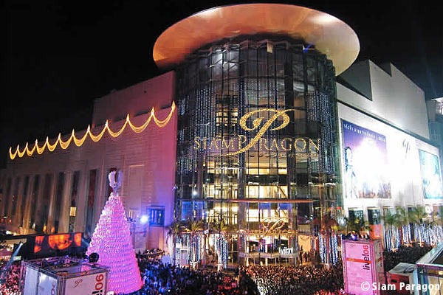
Siam Paragon: Department store

Slide 19
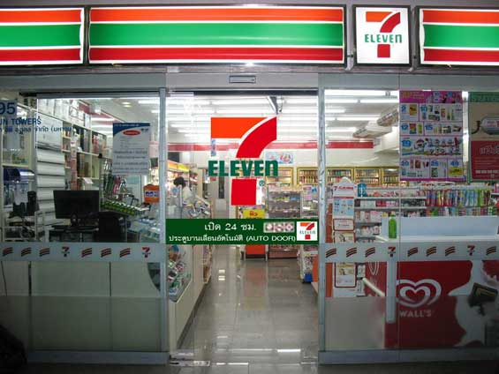
7-Eleven: Convenience Store

Slide 20
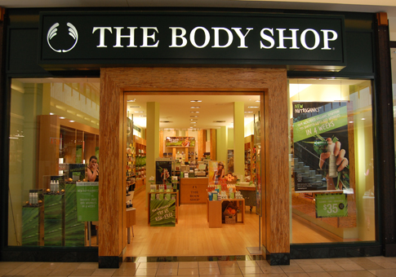

Slide 21
Objective 3
Retail Trends

Slide 22
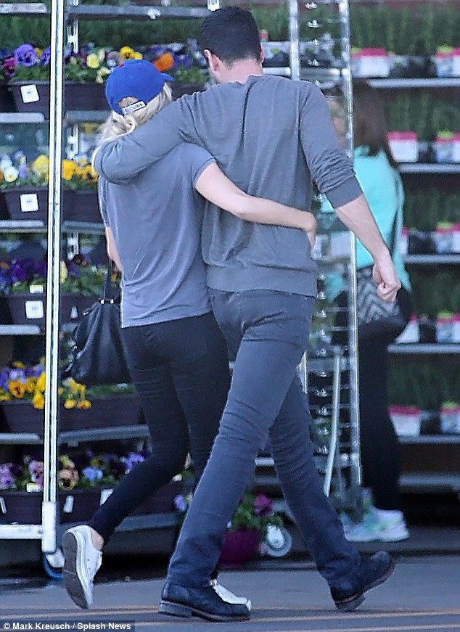
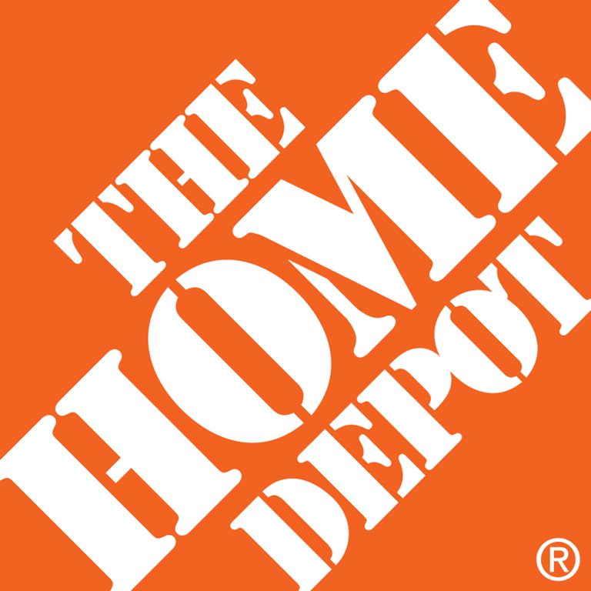
Trends in Retail
Tighter Consumer Spending
Value positioning: Facing tighter consumer spending, Home Depot adopted a thriftier theme: "More saving.More doing."

Slide 23
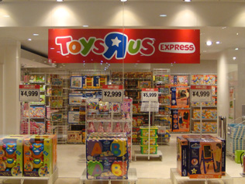
New retail forms: many retailers-such as Toys “R” Us- are setting up limited-time “pop-up” stores that let them promote their brands to seasonal shoppers and create buzz in busy areas. (pop up stores-temporarily)

Slide 24
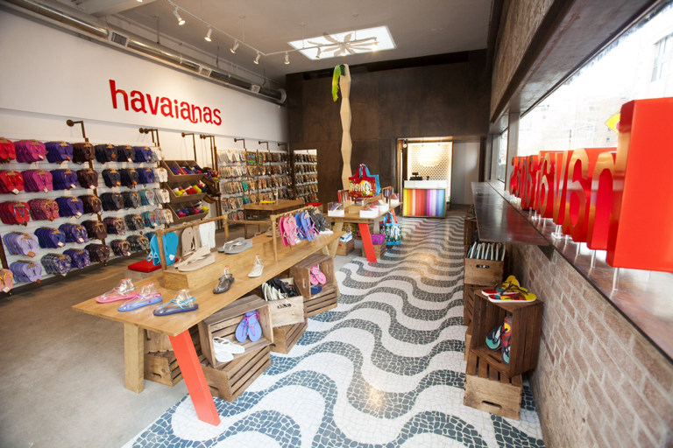
New retail forms: Many retailers, such as Brazilian sandal maker Havaianas use temporary pop-up shops to promote their brands to seasonal shoppers and create buzz in busy areas.

Slide 25
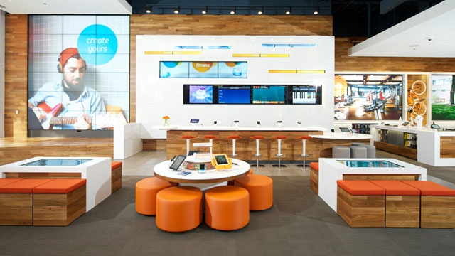
Real Marketing 13.1
Digitalizing the In-Store Retail Experience
Digitalizing in-store retail: AT&T flagship Chicago showroom infuses digital and online technologies into a physical store environment to let customers experience the impact of its devices and services on their lives. It's like walking into a Web site."

Slide 26
Growth of Direct, Online, Mobile and Social Retailing
Showrooming: The shopping practice of coming into a retail store showrooms to check out merchandise and prices but instead buying from online-only rival, sometimes while in the store.

Slide 27

The digital age has spawned a whole new breed of shopper- people who just can't buy anything unless they first look it up online and get the lowdown.

Slide 28
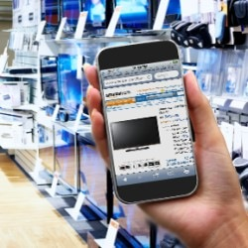
Real Marketing 13.2
Shopping in Stores But buying Online Versus Getting More in Store
Showrooming: The now-common practice of viewing products in stores but buying them online presents serious challenges to store retailers.Rather than fighting showrooming, store retailers should embrace it as a wat to showcase their strengths

Slide 29
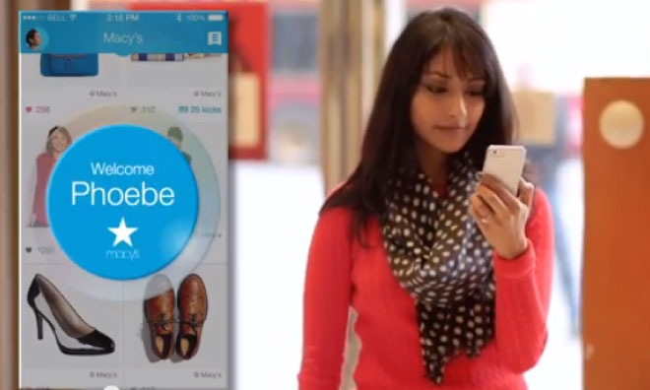
Retail technology: Macy's uses Shopkick's shopBeacon to engage consumers in the store and personalize their shopping experience.

Slide 30

Green retailing: Safeway offers its own Bright Green line of home care products, including cleaning and laundry products made from biodegradable and naturally derived ingredients.

Slide 31
Objective 4
Wholesaling

Slide 32
Wholesaling
Wholesaling: All the activities involved in selling goods and services to those buying for resale or business use.
Wholesaler: A firm engaged primarily in wholesaling activities.

Slide 33
Wholesaling
3 Major Groups
1. Merchant wholesaler: An independently owned wholesale business that title to the merchandise it handles.
2a. Broker: A wholesales who does not take title to goods and whose function is to bring buyers and sellers together and assist in negotiation.
2b.Agent: A wholesaler who represents buyers or sellers on a relatively permanent basis, performs only a few functions,and does not take title to goods.
3. Manufacturers’ sales branches and offices: Wholesaling by sellers or buyers themselves rather than through independent wholesalers

Slide 34
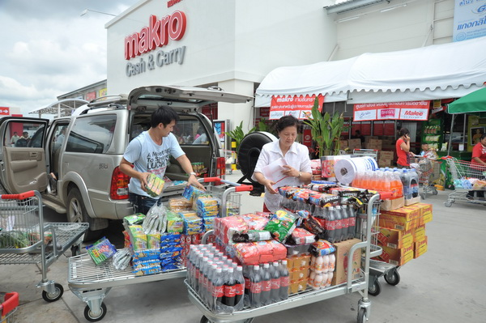

Slide 35



Slide 36
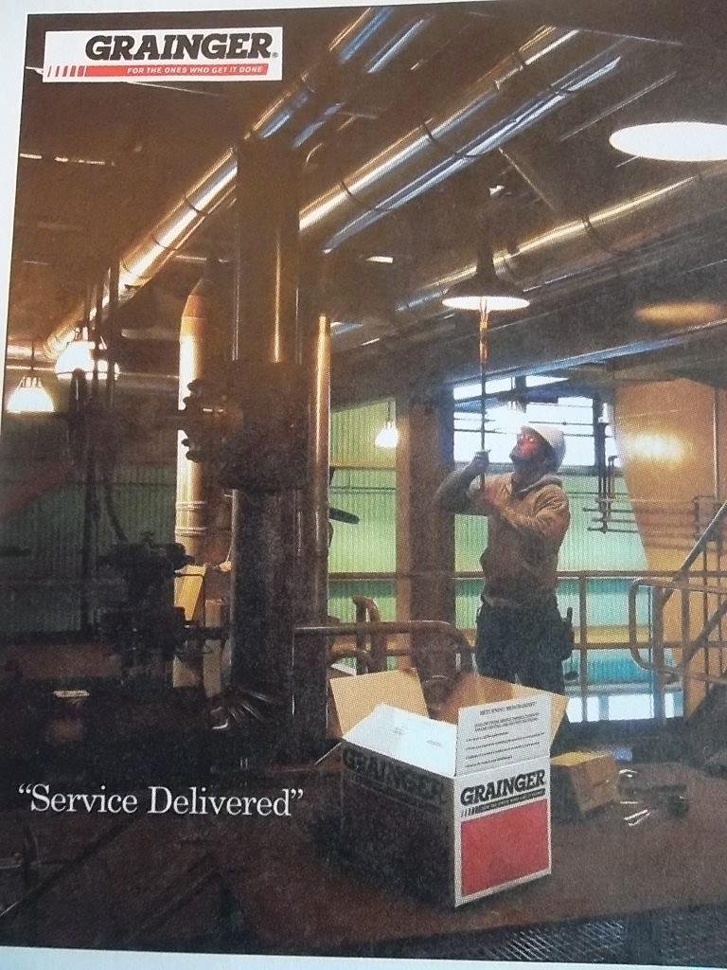
Wholesaling: Many of the nation’s largest and most important wholesalers-like Grainger- are largely unknown to final consumers. But they are very well known and much valued by the business customers they serve.

Slide 37
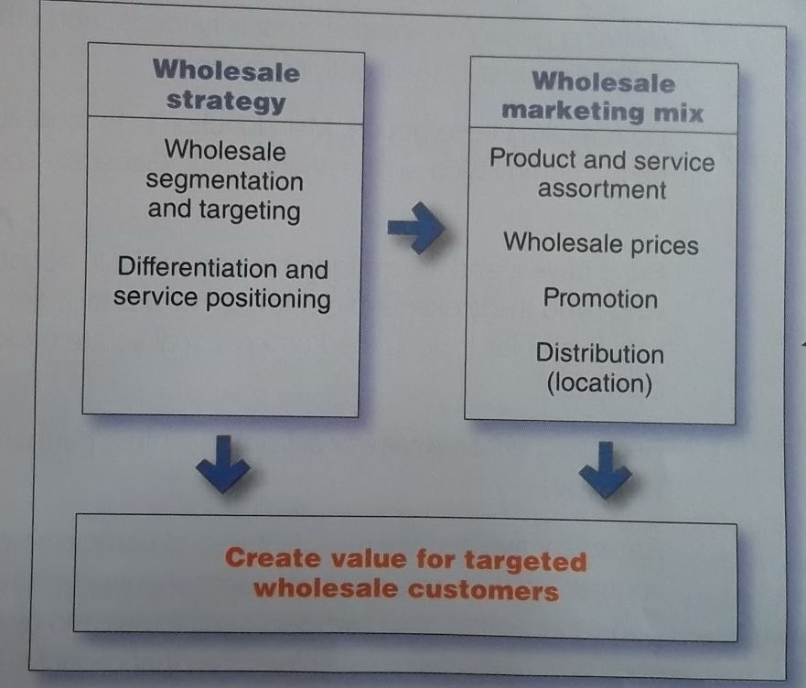
Wholesaling
Figure 13.2 Wholesaler Marketing Strategies
Why does this figure look so much like Figure 11.1. You guessed it. Like retailers, wholesalers must develop customer-driven marketing strategies and mixes that create value for customers and capture value in return. For example Grainger helps its business customers “save time and money by providing them with the right products to keep their facilities up and running.

Slide 38
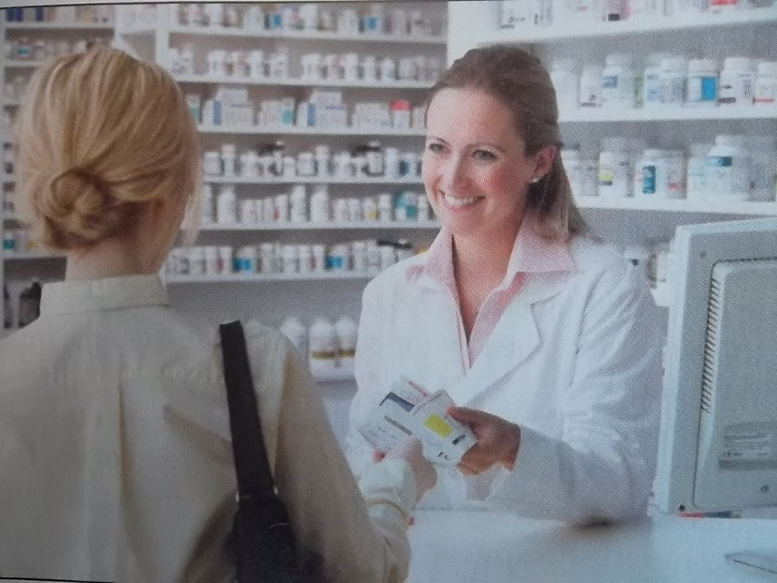
Trends in Wholesaling
Pharmaceuticals wholesaler McKesson helps its retail pharmacist customers be more efficient by offering a wide range of online resources. Retail pharmacists can even use the McKesson system to maintain medical profiles on their customers.

Slide 39
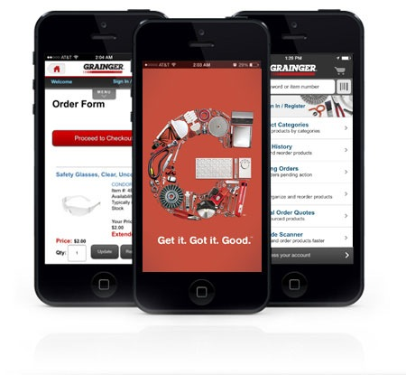
Trends in Wholesaling
Wholesaler marketing: progressive wholesalers like Grainger maintain an active presence online, mobile, and social media. For example online and mobile purchasing now account for 80 percent of Grainger's total sales.

