Slide 1
Equity Analysis and Valuation
OISHI Group Public Company Limited (OISHI)
Course instructor: Sirinattha Techasiriwan

Slide 2
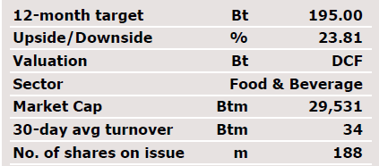
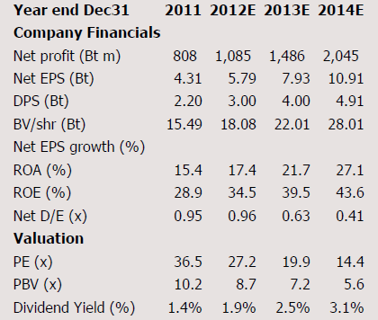
Investment Summary: OISHI
OISHI (SELL)
Close 157.50
(24/07/2012)
We recommend Buy OISHI with 2013 fair value of Bt99.78. Our fair value reflects PER, PBV and dividend yield of 21.6x, 5.17x and 2.2%.
We expect to see an improvement in Q42013 after Oishi regained its strength in RTD tea by focusing on new product development and international expansion into Southeast Asian markets.
With the management plan to open new 40 outlets each year, we expect to a slow recovery in revenue in 2014 mainly from food operation. We estimate 2014 YoY growth rate to be 10.5% and expect it to rise thereafter.
Key risks in the short term: 1) A heavy capex cycle due to the investment in CAFs; 2) Possible collection of excise tax on ready-to-drink tea (we estimate a decline in gross margin of around 1%).

Slide 3
OISHI’s Businesses
Figure x: xxxxxxxxxxxxxxxxxxxxxxx
Company’s products / services, customers / markets, key drivers for revenues
(if available) raw materials, (if available) key cost components
Company’s structure (subsidiaries, affiliates)
Management capability, shareholders, corporate governance
Max 3 pages

Slide 4
OISHI’s Recent Developments
Figure x: xxxxxxxxxxxxxxxxxxxxxxx
What are OISHI’s recent developments (expansions, new products)
Max 1 page

Slide 5
Industry Analysis
Figure x: xxxxxxxxxxxxxxxxxxxxxxx
What is the industry life cycle? How does growth looks like? Any seasonality?
Competition intensify and attractiveness of the industry. How does the industry life cycle affects competition intensify of the industry? How does Porter’s Five Forces driving competition intensify and attractiveness (i.e. overall profitability) of the industry?
Industry players. Market positioning of OISHI.
Max 3 pages

Slide 6
OISHI’s Sources of Competitive Edge
Figure x: xxxxxxxxxxxxxxxxxxxxxxx
By considering competitive behavior of the firm, what is OISHI’s sources of competitive advantage?
Max 2 pages

Slide 7
OISHI’s Threats and Weakness
Figure x: xxxxxxxxxxxxxxxxxxxxxxx
By considering the industry and competitive behavior of the firm, what is OISHI’s threats and weaknesses?
Max 1 pages

Slide 8
OISHI’s Recent Performance
Figure x: xxxxxxxxxxxxxxxxxxxxxxx
Analyze OISHI’s performance in 2015 and 2014.
  Net profit, net profit growth
  Sales growth, asset utilization
  Gross profit margin, operating profit margin, net profit margin
  ROIC – operating profit margin, capital turnover
  ROA, ROE – DuPont Analysis
  Short-term liquidity
  Long-term solvency
Max 3 pages

Slide 9
Earnings Outlook: OISHI
Figure x: xxxxxxxxxxxxxxxxxxxxxxx
Summary of the earnings outlook.
Gives reasons to support your forecasts.
Earnings outlook depends on an assessment of the firm’s strategy and future competitiveness in the future which is influenced by the industry structure and the firm’s competitive behavior. Future competitiveness could be analyzed from these following sources of information:
  macroeconomic and industry information that may impact future growth;
  information revealed by competitors on future prospects;
  firm-specific information that has been made public since the last earnings report (strategies, recent developments);
  public information other than earnings;
  private information about the firm.
Max 2 pages

Slide 10
Forecast Details: OISHI
Figure x: xxxxxxxxxxxxxxxxxxxxxxx
Forecasts for 2015, 2016 and expected trend in 2017 to 2019.
  Net profit, net profit growth
  Sales growth, asset utilization
  Gross profit margin, operating profit margin, net profit margin
  ROIC – operating profit margin, capital turnover
  ROA, ROE – DuPont Analysis
  Short-term liquidity
  Long-term solvency
Max 3 pages

Slide 11
Valuation Summary: OISHI
Figure x: xxxxxxxxxxxxxxxxxxxxxxx
What is the fair value?
Which valuation method that you choose?
Show summary of the result of each method.
Max 1 pages

Slide 12
DDM Valuation: OISHI
Figure x: xxxxxxxxxxxxxxxxxxxxxxx
Assumptions
Methodology
Result
Max 1 pages

Slide 13
FCFF Valuation: OISHI
Figure x: xxxxxxxxxxxxxxxxxxxxxxx
Assumptions
Methodology
Result
Max 1 pages

Slide 14
FCFE Valuation: OISHI
Figure x: xxxxxxxxxxxxxxxxxxxxxxx
Assumptions
Methodology
Result
Max 1 pages

Slide 15
Sensitivity Analysis: OISHI
Figure x: xxxxxxxxxxxxxxxxxxxxxxx
Assessing the Impact of Individual Drivers.
Max 1 pages

Slide 16
Peers Comparison: OISHI
Figure x: xxxxxxxxxxxxxxxxxxxxxxx
PE vs. growth
PBV vs. ROE
Dividend yield
EV/EBITDA
Max 1 pages

Slide 17
Group Members
Namenamename Namenamename IDIDIDIDIDIDID
Namenamename Namenamename IDIDIDIDIDIDID
Namenamename Namenamename IDIDIDIDIDIDID
Namenamename Namenamename IDIDIDIDIDIDID
Namenamename Namenamename IDIDIDIDIDIDID

