Slide 1
Urban development
EE463 Globalization and international development
Faculty of economics
Thammasat university

Slide 2
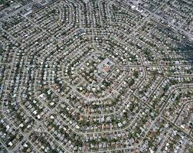
definitions
City. a permanent and densely settled place with defined administrative boundaries. A city has networks, systems, and services
Urban. has the characteristics of a city (being city)
Urban development. improvement/evolution of an urban area
Urbanization. the process of becoming urban; shift from agriculture land to urban land

Slide 3
definitions
periphery
City center. The central part or main area for administration, business and commerce
Suburb. an outlying district/area; usually associated with a residential area
Periphery. The fringe area of a city, may not necessarily be within the administrative boundaries of a city
suburb
city proper
city center
network
urban area

Slide 4
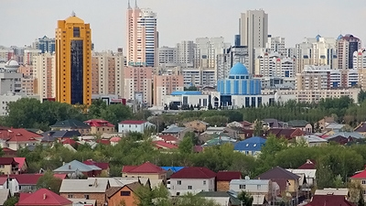
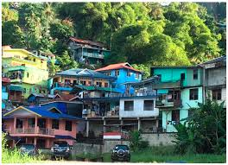
Urban development - overview
Currently 55% of the world’s population (4.2 billion) live in cities; by 2050, the figure is expected to be 70%
More than 80% of global GDP is generated in cities. Cities can contribute to sustainable growth if managed well by increasing productivity, allowing innovation and new ideas to emerge.
However, urbanization brings challenges. With a more people, there will be an accelerated demand for affordable housing, well-connected transport systems, infrastructure, basic services, and jobs.

Slide 5
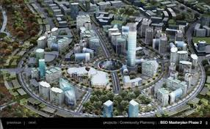
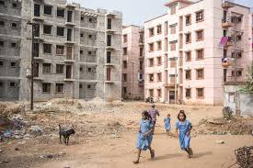
Why are cities important?
Cities play an important role in economic development; as centers of innovation, finance, administration, culture and education
Cities provide economies of scale and agglomeration; wealth is concentrated in cities
Cities provide infrastructure and services through concentration in transportation, communications, power, human interactions, water and sanitation services

Slide 6
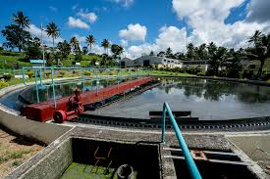
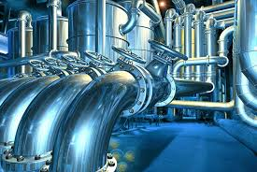
Impacts of urbanization
Investments in basic services and infrastructure (e.g., electricity, roads, water supply, wastewater, and solid waste management) improves standard of living
Improvements in health and education translates into enhanced people’s productivity and increases attractiveness for investment

Slide 7
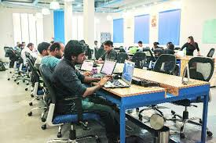
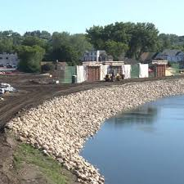
Impacts of urbanization
Provides labor pool and opportunities for employment
Improved climate resilience (e.g., through flood control measures) will mean reduced losses from climate change impacts

Slide 8
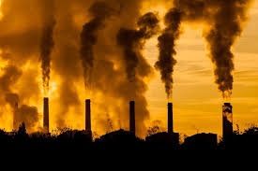
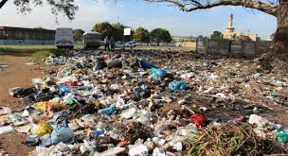
Negative impacts of urbanization
Increased density (people, cars, buildings) may lead to traffic jams, environmental pollution, problems of waste disposal, imbalance between supply and demand for urban services
Negative consequences on health due to overcrowding and environmental pollution

Slide 9
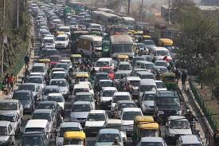
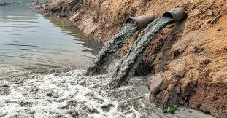
Negative impacts of urbanization
Shifts in behavior and cultural norms
Land competition and scarcity, leading to exponential increase in land prices
Higher cost of living
May lead to higher inequality

Slide 10
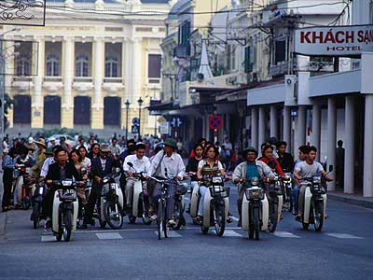
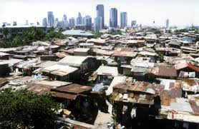
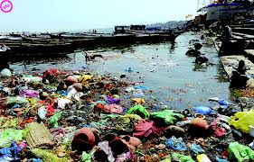
Key challenges in urbanization
Uncontrolled spatial development due to rapid population growth and lack of planning and development controls
Poverty and vulnerability as migration continues and jobs become scarce, inequality gap widens and becomes more visible
Lack of financing for infrastructure increased demand for infrastructure and services places financial burden on city officials to meet the growing demand

Slide 11
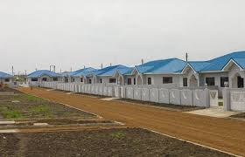
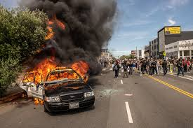
Key challenges in urbanization
Ineffective governance and institutions and lack of capacity to develop and maintain public services
Increasing land prices limit investments and infrastructure development
Less-than-sustainable development. Adding more built up areas increases environmental risks such as flooding and pollution
Non-inclusive development. Widening gap between the haves and have-nots due to exclusion of certain groups in society

Slide 12
Towards competitive, sustainable and liveable cities
Accelerate efforts to alleviate poverty
Promote better planning and land management
Identify potential revenue streams to finance urban infrastructure and public services
Improve accountability of government and institutions
Develop management plans and climate change adaptation and mitigation
Involve private sector and key societal actors

Slide 13
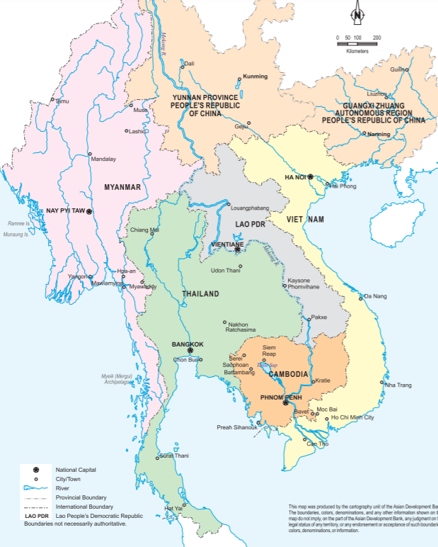
Urbanization in CMLV
Most of the large cities in CLMV were once the seats of ancient Kingdoms and are located along waterways needed for movement of goods and people
When European colonial powers came to the region, they established their ports of trade in these cities
With increased intra regional trade, border towns have gained importance in the region

Slide 14
Primary and Key Secondary cities in CLMV
Country | Primary City | Population (000) | Secondary Cities | Population (000)
Cambodia | Phnom Penh | 1,800 | Sihanoukville Battambang Siem Reap | 156 150 139
Lao PDR | Vientiane | 1,000 | Savannakhet Pakse Luang Prabang | 80 70 50
Myanmar | Nay Pyi Taw | 4,705 | Mandalay Mawlamyine Bago | 1,138 498 415
Viet Nam | Ho Chi Minh City | 7,100 | Ha Noi Hai Phong Can Tho | 6,270 1,241 1,108

Slide 15
Socioeconomic indicators, CLMV
Country/Region | HDI Rank | Pop 2012 (million) | Area (000km²) | GDP/cap (US$) | Urban pop (mill) | % urban
(a) | (b) | (c) | (d) | (d) | (e) | (f)
Cambodia | 138 | 14.5 | 181.4 | 1,268 | 2.9 | 20.1
Lao PDR | 137 | 6.4 | 236.8 | 1,840 | 1.2 | 18.1
Myanmar | 149 | 48.7 | 675.6 | 1,608 | 14.5 | 29.7
PRC Guangxi AR | 81 | 46.0 | 236.7 | 8,254 | 16.1 | 40.0
PRC Yunnan Province | 81 | 45.4 | 396.8 | 8,254 | 10.6 | 23.4
Thailand | 103 | 69.9 | 513.1 | 6,501 | 30.9 | 44.2
Viet Nam | 127 | 89.7 | 331.7 | 2,082 | 26.6 | 29.6
Total |  | 320.6 | 2572.1 |  | 102.8 | 32.1

Slide 16
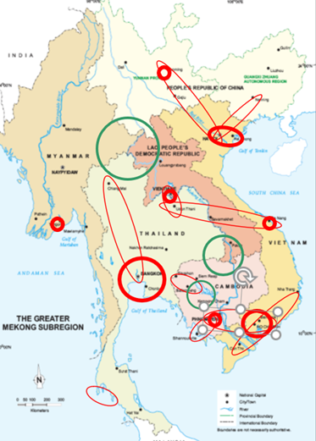
URBAN GROWTH CLUSTERS
Hanoi-Haiphong-Halong
Kunming-Hanoi
Nanning-Hanoi
Danang-Savannakhet-Udon Thani
Vientiane-Udon Thani
Bangkok Extended Metro Region
Bangkok-Chiangmai
Phuket
Siem Reap-Battambang
Phnom Penh-Sihanoukville
Phnom Penh-Ho Chi Minh City
Can Tho-HCMC-Nha Trang
Yangon
Rapid metropolitan development
Areas requiring special environmental/social protection measures
Corridor/sub-corridor towns

Slide 17
conclusion
Urban development in CLMV countries is rapid but uneven. Growth clusters and large urban areas will outpace their rural counterparts. Growth strategies must be inclusive and sustainable.
CMLV countries are becoming increasingly interconnected with the Greater Mekong Subregion. Governments must maintain a balance between the imperative to maintain national interests and potentials brought about by regional cooperation
Main areas for regional cooperation: cross border trade, transport and communications, power distribution, tourism

