Slide 1

France

Slide 2
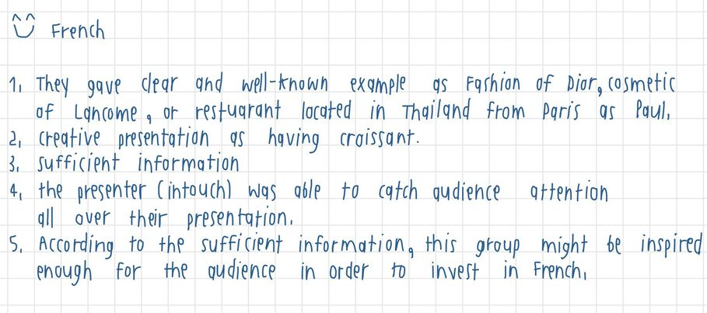

France
1.Interesting introduction of the presentation. 2. Present what other group doesn’t look into such as music or football 3. A lot of visual and graph are presented on the slide which boosting the trust from listeners 4.Good Q&A 5. Various types of information
1. good presentation best recognized.
2. have an extra demonstration and expression of the snacks of the represented country.
3. showing the information relationship with audience by using the easy or related common example.
4. the presentation was not taking too long and too wordy.
5. audience could see a clear market field of the country.

Slide 3
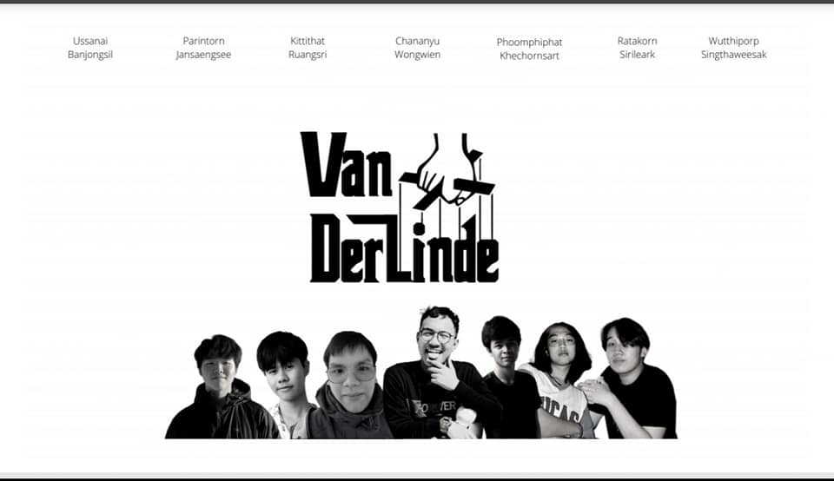
Italy

Slide 4
Italy
1
We all like the presentation of Italy ka because
1. Their slides and presentation is very nice and clear
2. They also use a lot of useful fact and information
3. love the way they present and they are so creative
4. History topic is very interesting
5. It also contains with every kind of data of Italy insights
We choose Italy because
The presentation is easy to understand.
The presentation is very lively and fun, which means they can attract audiences very well.
They also touched other topics apart from the economy.
Yet still be capable of presenting the economy part in details
They speak English well. The presentation was quite smooth.
Interesting introduction of the presentation.
2. Present what other group doesn’t look into such as music or football
3. A lot of visual and graph are presented on the slide which boosting the trust from listeners
4.Good Q&A 5. Various types of information

