Slide 1
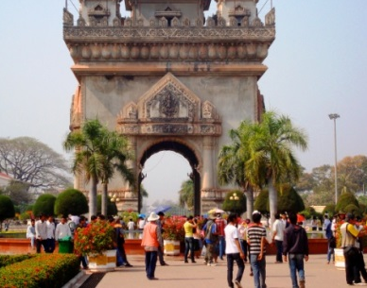
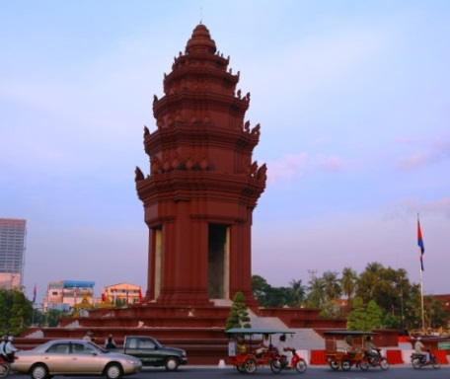
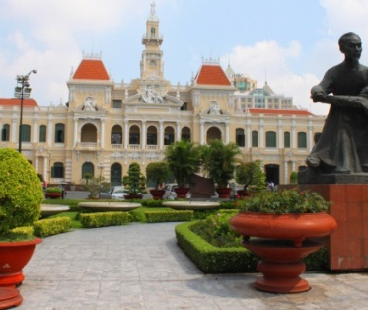
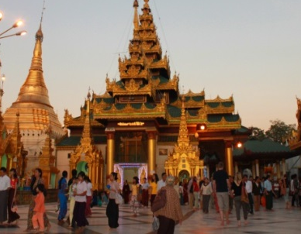
ECONOMIC DEVELOPMENT in CLMV
Dr. Januar Hakim, MURP
COURSE EE361/363
Faculty of Economics
Thammasat University
January 2021

Slide 2

Outline
Overview of CLMV within the GMS
Historical, socio-cultural and spatial development
Drivers of economic growth
Key trends and issues
Way forward and conclusion

Slide 3
OVERVIEW OF CLMV WITHIN THE GREATER MEKONG SUBREGION

Slide 4
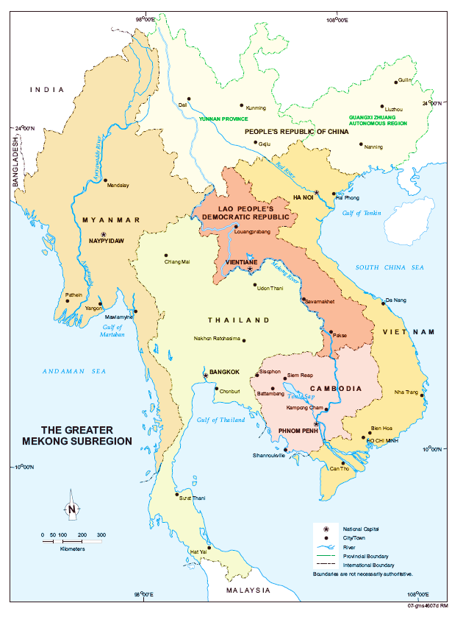
The Greater Mekong Subregion
A geographical entity: Cambodia, Lao PDR, Myanmar, Thailand, Vietnam; and Yunnan Province and Guangxi Special Autonomous Region (PR China)
Bound by geography, history, the Mekong river and history; yet diverse in culture, traditions and environment
One of the least urbanized areas in the world; yet rate of urbanization in accelerating

Slide 5
COMPARISON OF SOCIO-ECONOMIC INDICATORS
Country | HDI Rank | Pop 2017ª (million) | Area (000km²) | GNI/capª (US$) | Urban^{b} pop (mill) | % urban^{c}
(a) | (b) | (c) | (d) | (d) | (e) | (f)
Cambodia | 143 | 15.4 | 181.4 | 1,140 | 3.8 | 24.7
Lao PDR | 138 | 6.7 | 236.8 | 2,150 | 2.5 | 37.3
Myanmar | 145 | 53.0 | 675.6 | 1,190 | 16.5 | 31.1
Thailand | 87 | 67.7 | 513.1 | 5,640 | 34.6 | 51.1
Viet Nam | 115 | 93.4 | 331.7 | 2,060 | 34.7 | 37.2

Slide 6
HISTORICAL AND SOCIOCULTURAL DEVELOPMENT

Slide 7
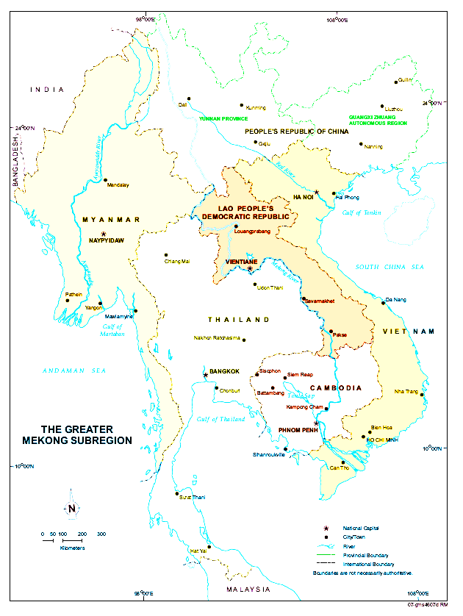
TERRITORIAL SHIFTS
(Pre-1800)
Bagan
Dai Viet
Rise and fall of kingdoms: Bagan, Thai, Khmer, Lan Xang and Dai Viet
Capital cities located along waterways and fertile valleys
Waterways are used to transport agricultural goods to capital cities
Buddhism as common belief
Lan Xang
Thai
Khmer

Slide 8
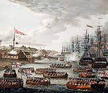
Colonial exploitation
(1800−1950)
Division and conquest
Resource extraction and exploitation
Rise of port cities
Migration of population to cities

Slide 9
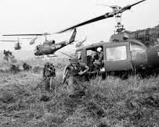
War and conflict
(1950−1990)
Political and economic instability
Stagnant development
De-population of urban areas
De-linking of urban and rural areas

Slide 10
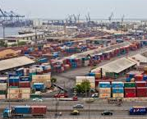
Political and economic
transformation
(1990−current)
Relative political stability
Political and economic reforms
Shift from command- towards market- based economies
Increased cross-border movement
Rapid urbanization and urban growth
Uncontrolled development

Slide 11
DRIVERS OF ECONOMIC GROWTH

Slide 12

GLOBAL TRENDS
Division of labor: movement towards higher value products
Global finance: movement of global capital to areas of high returns
Technology: movement towards higher technology and use of information systems
Regional cooperation: ease of cross-border movement of goods and people

Slide 13
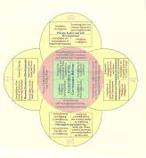
Government policies and strategies
Provides strategic policy direction: movement from command- to market based economies; agricultural reforms; decentralization (laws, development plan)
Provides operational guidelines (regulations, instructions)
Provides easement, incentives and constraints on development activities
Sets the enabling environment for business and societal activities

Slide 14
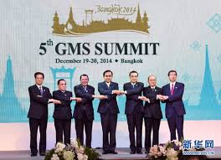
REGIONAL COOPERATION
Facilitation of economic exchange: cross-border trade, labor, capital
Human development: training, certification, cultural exchanges, prevention of spread of communicable disease, prevention of human traficking
Environmental and natural resource management; tourism
Largekly facilitated through the GMS Programme, launched in 1992

Slide 15
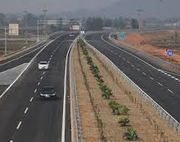
TRANSPORT AND TRADE FACILITATION
Improvements in physical connectivity: roads, airports, cross-border facilities, reduces travel time
Enhancements in competitiveness in the production of goods and services
Acceleration of economic growth and productivity through better movement and flow of people, goods and services
Opening up of remote and isolated areas

Slide 16

Foreign investment
Official Development Assistance
Foreign direct investment
Special Economic Zones
Partnerships: contract farming, public-private partnerships,

Slide 17
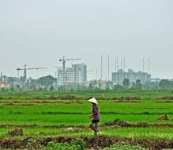
Rural-urban migration
Push and pull factors: environmental degradation, lack of employment and income, better job prospects in cities
Increased mobility due to decreasing transportation costs
Changes in spatial locations of economic activities
Opening up of remote areas

Slide 18
KEY TRENDS AND ISSUES

Slide 19
Reform efforts (and government policies following reforms) of CMLV countries in the 1980s and 1990s have greatly contributed to opening up the economy and facilitate foreign aid and investments and regional cooperation
Agriculture has been and will continue to play a dominant role in the economies of CLMV. However there is a shift towards decreasing share of agriculture and greater share of manufacturing and services.
Greater cooperation among countries in the Greater Mekong Subregion (CLMV + Thailand) presents opportunities for economic growth.
Although CLMV countries are experiencing rapid economic growth, there are challenges that need to be addressed. Among these are widening disparities between the rich and poor; environmental degradation in rural areas and infrastructure gaps and pollution in urban areas.

Slide 20
Social relationships and norms are changing because of increased physical and social mobility
People are moving to cities because of perception of better living; cities are therefore becoming larger.
Previously isolated areas are now more accessible. This provides opportunities for economic activity but at the same time poses environmental and social challenges (environmental degradation, human trafficking, shift in cultural norms).
Emergent spatial trends: development of border towns, areas of tourism and special economic zones.

Slide 21
CONCLUSION

Slide 22
CMLV countries have a shared history of trade, conflict and cooperation, and have had high and low points in history. Yet the countries have marked differences in their geography, culture and development trajectories.
Since the 1990s there has been a realization for the need to work together for mutual benefit. The GMS Programme which was initiated in 1992was instrumental in making this happen.
Agriculture has been and will continue to play a dominant role in the economies of CLMV. However there is a shift towards decreasing share of agriculture and greater share of manufacturing and services.
Despite significant progress in terms of economic growth, there are challenges that need to be addressed. Among these are widening disparities between the rich and poor; environmental degradation and pollution; and ensuring sustainable development.

