Slide 1
China???

Slide 2



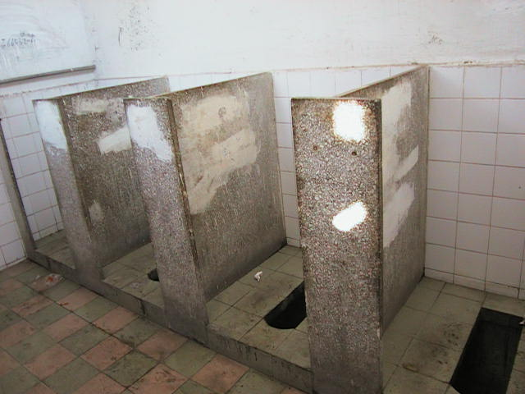
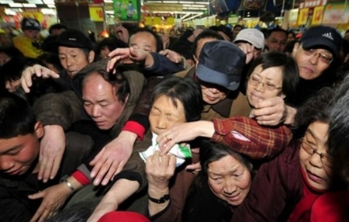

Slide 3
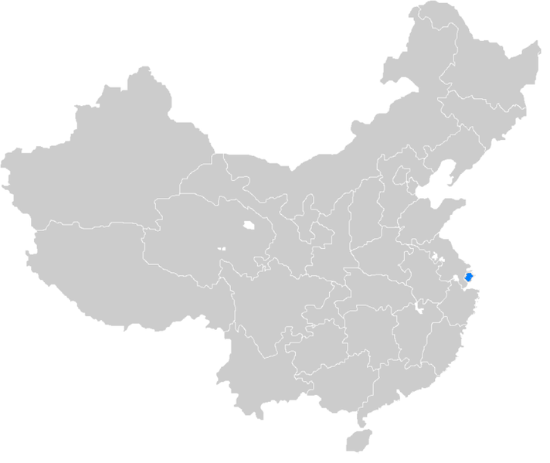
Chinese Economy and Globalization

Slide 4




Wan Thabkrajang
Education:
Bachelor of Economics, Thammasat University
Major in Business Economic
Minor in Marketing
School of Economic, Fudan University
Chinese Goverment Scolarship
Master of Chinese Economy and globalization
Working Experience:
Huawei Thailand Marketing Intern
JD Central Operation Manager Intern

Slide 5
AGENDA
The command economic system
Modern China after economic reformation
China Economic success & Leading industry
One Belt One Road Initiative
Unbalanced development
Conclusion

Slide 6
OBJECTIVE
Understand Chinese Economy and its impacts to world economy
Change in perspective toward China
Be prepared to face more competitions from Chinese firms

Slide 7
The Command Economic System
Great Leap Forward
Cultural revolution
Biggest failures from Chairman Mao

Slide 8
AFTER SINO-JAPANESE WAR & CIVIL WAR
The Command Economic system:
Government ownership
Allocate resources through government command
  What to product
  How much to produce
  Who is responsible to produce
Set relative good prices
Mao Zedong (1893-1976),
Chairman of the Communist Party and the founding father of PPC
100% State-owned

Slide 9
THE GREAT LEAP FORWARD (1958-1960)
Centralized production planning
HOW???
The central government: ↑ Economic growth & Promote government power
Goal: Reach the same level of industrialization as England & US in less than 15 years
Propaganda
Make everything GRAND, China is the best, Chairman is the best

Slide 10
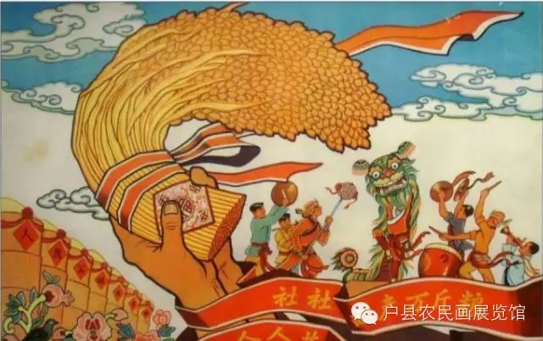
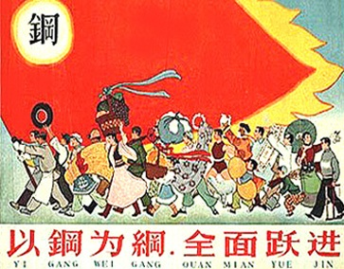
THE GREAT LEAP FORWARD (1958-1960)
Targeting 80% increase in grain production in 1 year
From 3million tons to 10 million tons production
(Within 2years)

Slide 11
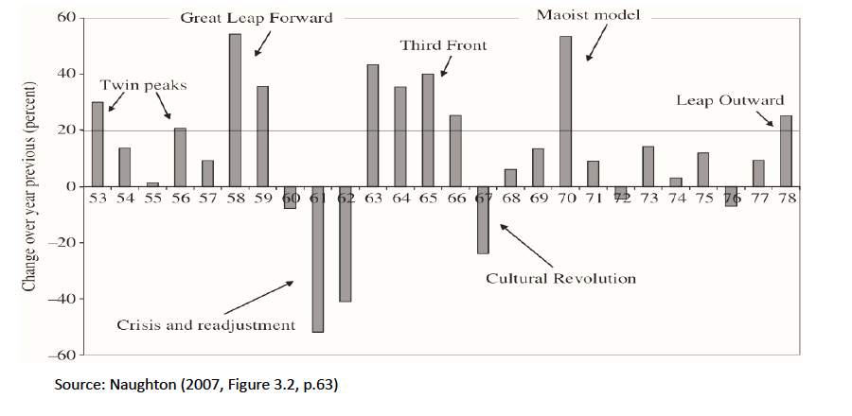


INVESTMENT CHANGE IN CHINA

Slide 12
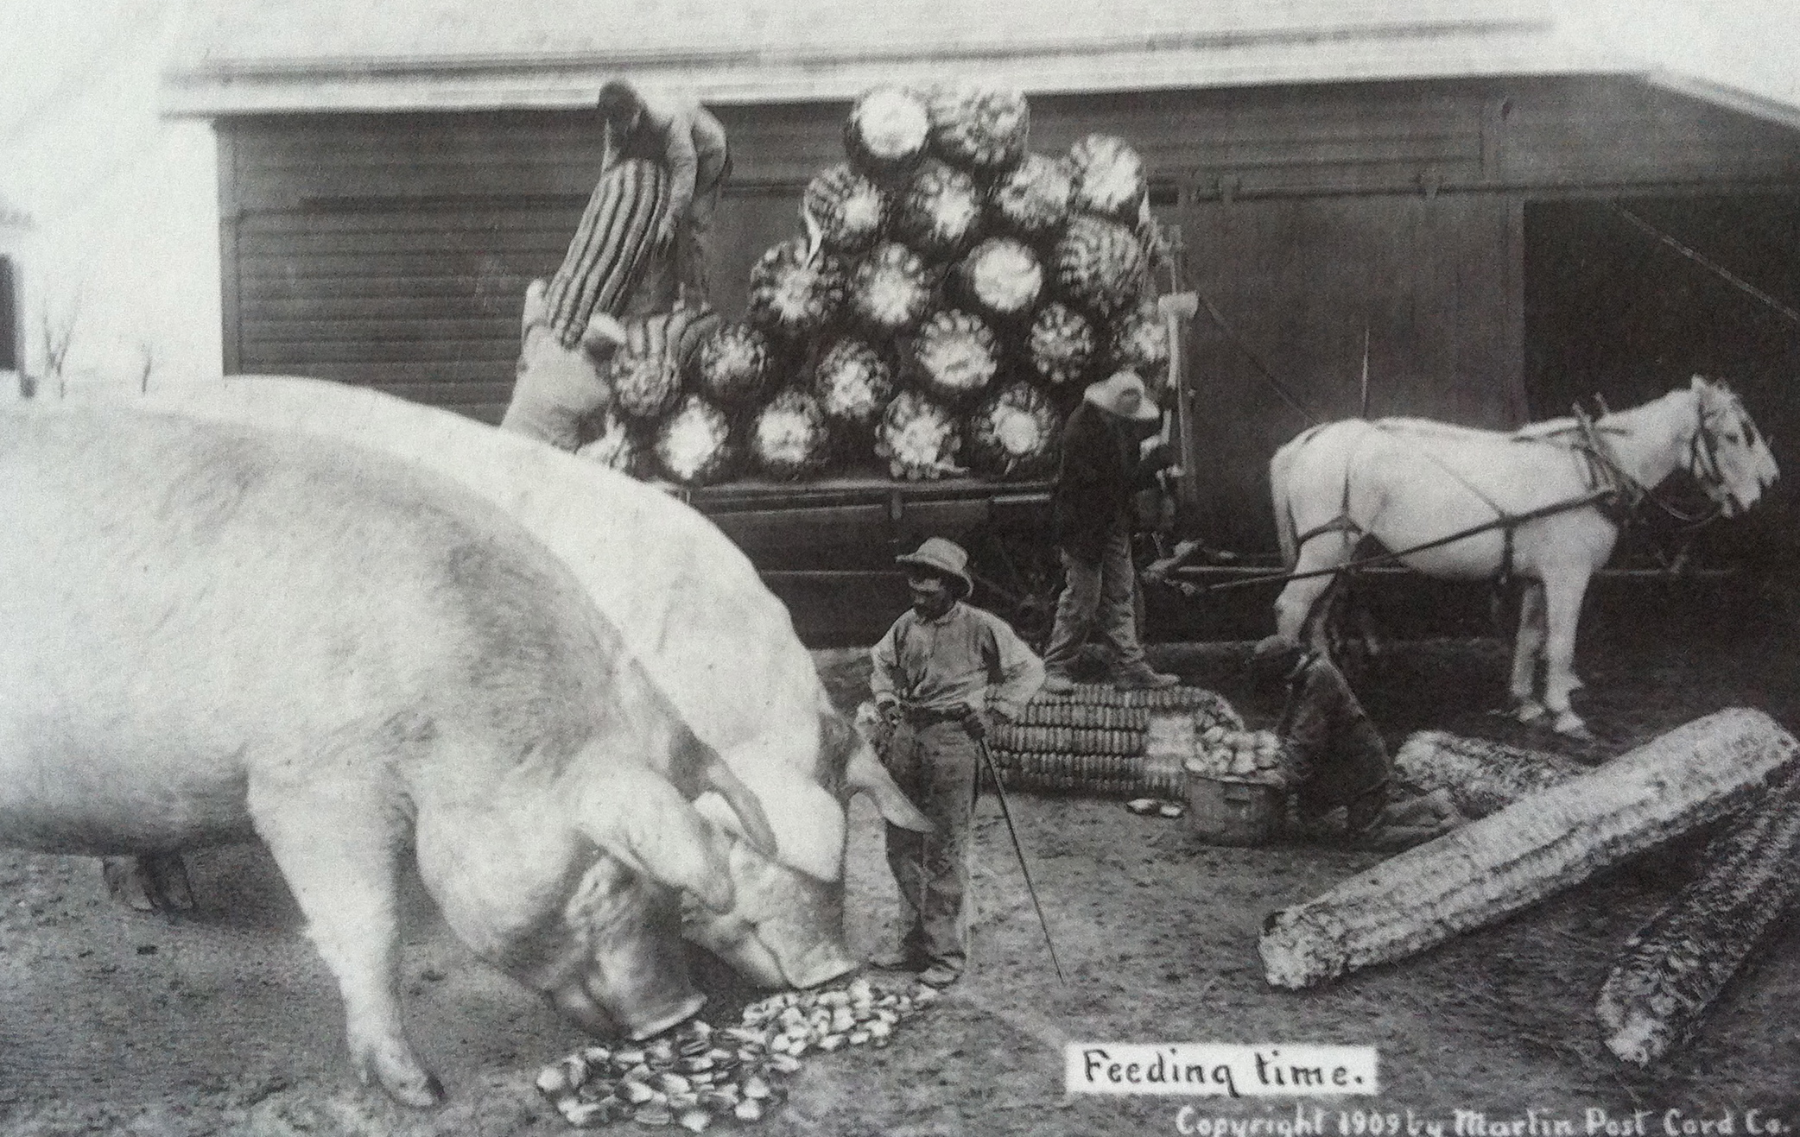
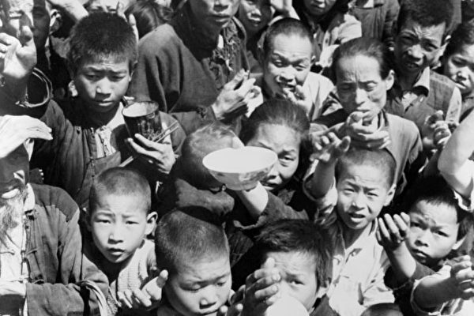
Massive propaganda
Reality

Slide 13

Failures: Wasted investment
Big farm
Large factory
Long railway
=
↑Infrastructure Investment
=
Inefficient distribution of resources
Low quality of steel
80% wasted from total production
Lag of production technology
Lag of expertise to direct the efficient production
Every household can produce ‘steel’
Unbelievable high target production rate
Lag of Economist
Wrong allocation of labor -> Put farmer to factory
Deforestation for fuel -> Leads to later natural desaster
***Production target must be achieved to appreciate the central government, or the Chairman MAO

Slide 14
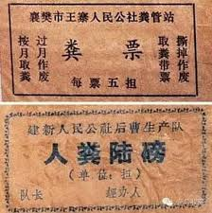
Due to the central planned policy, Rural farmers farmed very hard to get very little food for themselves
All the crops supplied to the city, and elites, farmers were starving to death
Farmers were producing steel in their house
Not enough crop produced

Slide 15
THE GREAT LEAP FORWARD (1958-1960)
”The worst manmade famine in history
Estimated ~30 million people died”
When the desaster come, no one can survive
How could this happen?
China: Communist -> Nomenklatula
Natural desaster
Local politicians were very radical
Excess procurement of grain, Inflated number reported

Slide 16
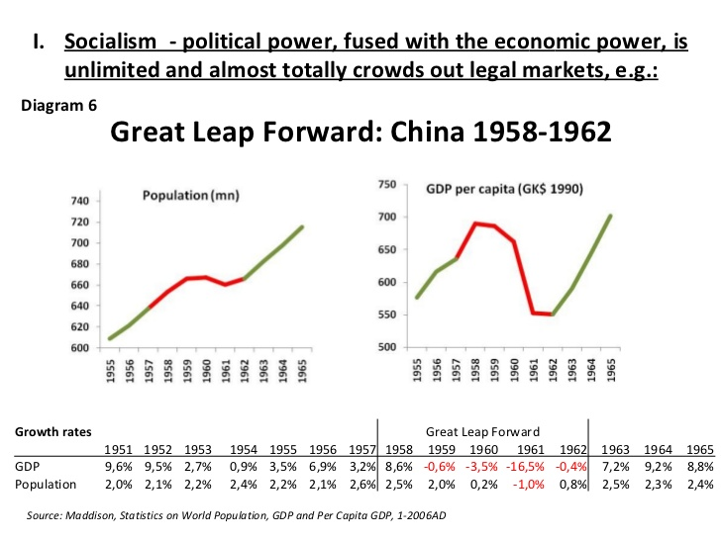
GDP GROWTH RATE & POPULATION

Slide 17
THE CULTURAL REVOLUTION(1966-1976)

Slide 18
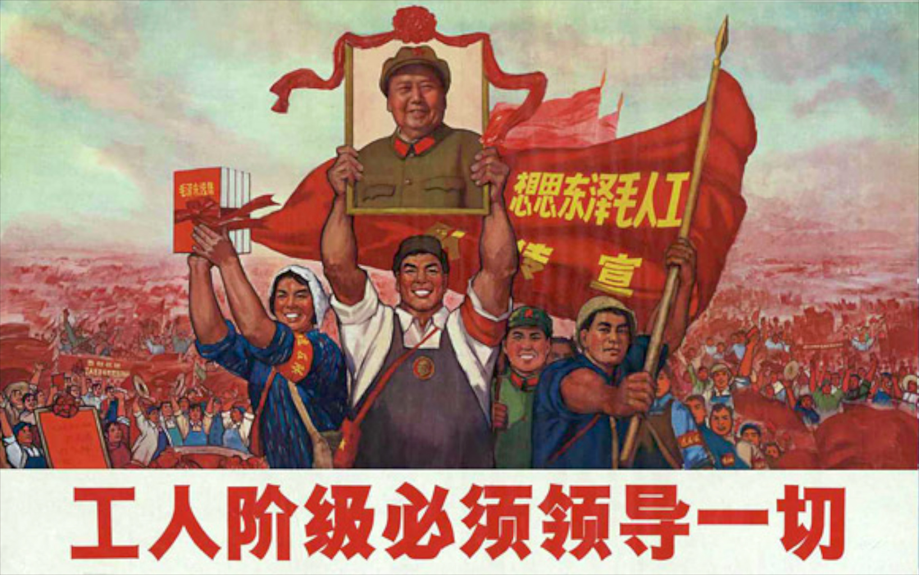

Slide 19
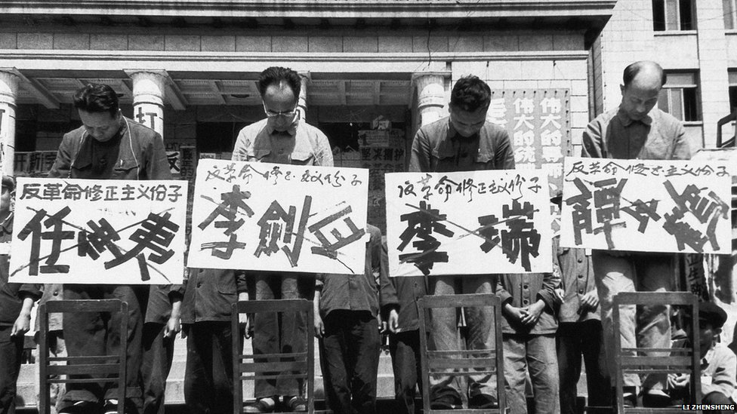
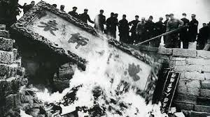
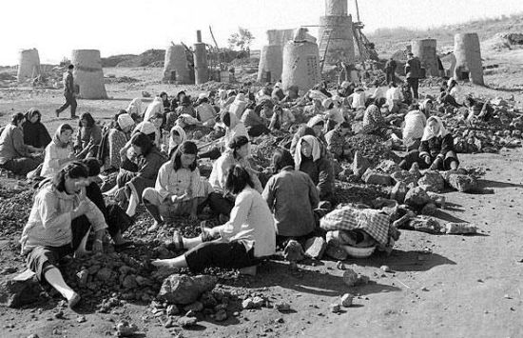
No culture
No Rich
No education
Only the Chairman

Slide 20
Consequences from the revolution
Huge loss of human capital
  Cost 1,613,000 lives (Rummel, 1991, P.9 )
  Many of those who died were very well educated people, including famous scholars, writers, professors, doctors and scientists
Schools were shut down
  Parents experienced Cultural Revolution placed less emphasis on their kids’ education (Kung et. al, 2017)
Traditional culture was challenged
  The trust among family, relatives, and friends was broken
  Loss of political elites who tried to promote the living standards of people

Slide 21
Why there’re many Chinese in Thailand, Singapore, Malaysia, and other SEA countries?
Are you Chinese or Thai?

Slide 22
LESSON LEARN FROM CHINA
Market oriented economy
Globalization
Efficient allocation of human capital and natural resources
No nomenklatula
Development of human capital
Notes:
Market oriented economy is necessary for economic growth

Slide 23
MODERN CHINA
Great step toward economic success

Slide 24
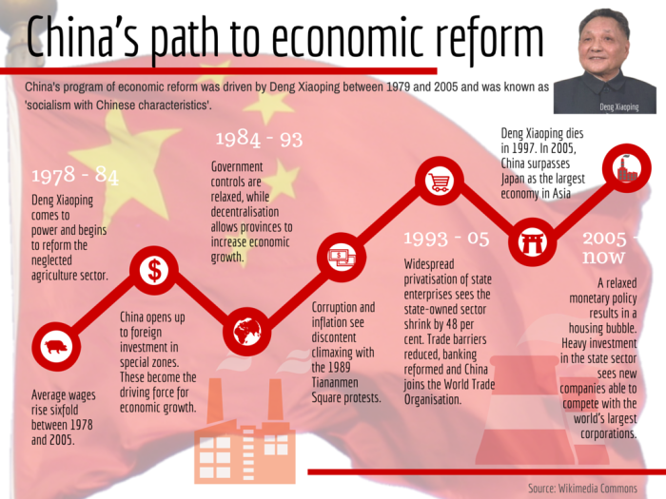
By Deng Xiao Ping after the death of the Chairman Mao
Gov. Decentralization
Reformation
Reformation
Decentralization
Openness
Privatization
Privatization
Open up for FDI

Slide 25



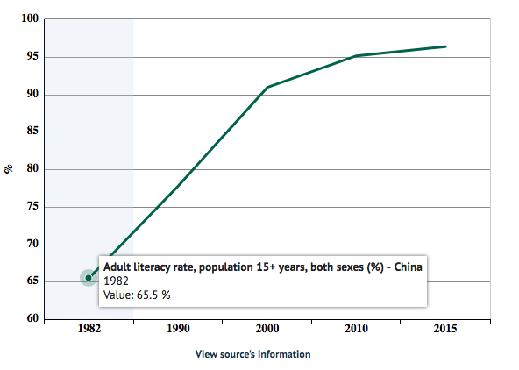
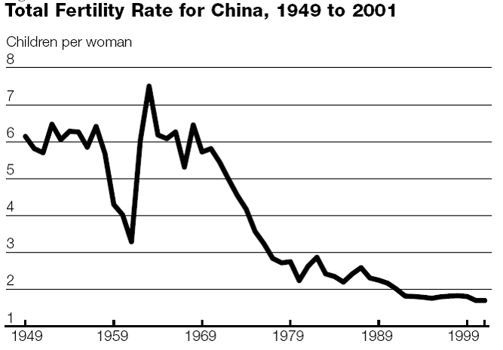
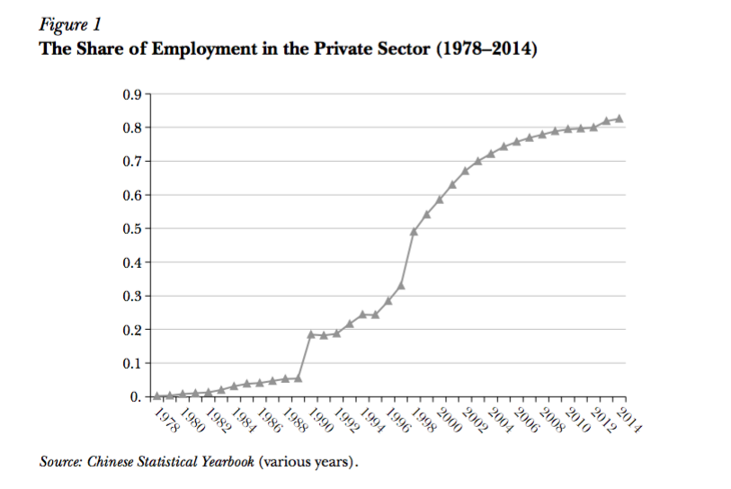
Economic Success Since 1978
ECONOMIC SUCCESS SINCE 1978
”After 1970s Economic Reformation, China experienced the demographic change in labor market”
Restore education after cultural revolution
Increase in enrollment to college
One-child policy
Fertility rate drops to 1.4/woman
Working-age population starts to decline
Employment structure
Labors move to private sector after the economic reformation
SOEs reduction
China adult literacy rate
Notes:
02165361944

Slide 26

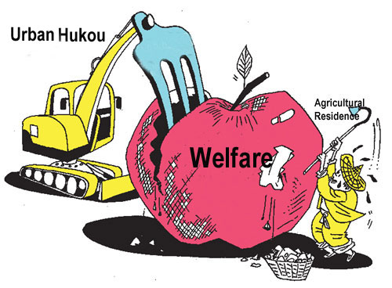
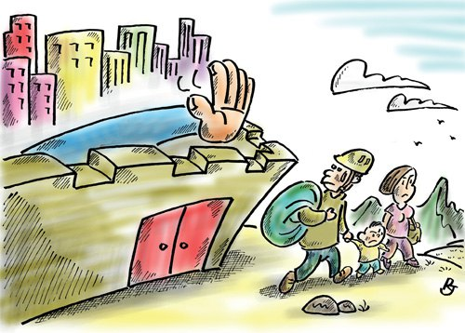
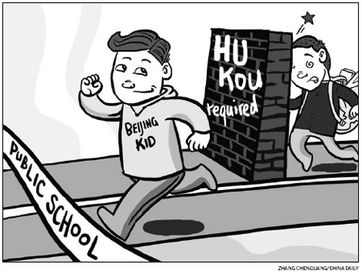
HOUSEHOLD REGISTRATION SYSTEM
China Household Registration System : Hukou
Contribute to China economic success
Divide China labor market into Rural and Urban segment
  The government provides different treatment to each hukou owner
Urban hukou receives better social welfare
Access to public school and university in cities
Allow to buy house in the city
Higher wage with urban hukou
Health insurance
=
Institutionalized
Discrimination

Slide 27
CHINA ECONOMIC SUCCESS

Slide 28
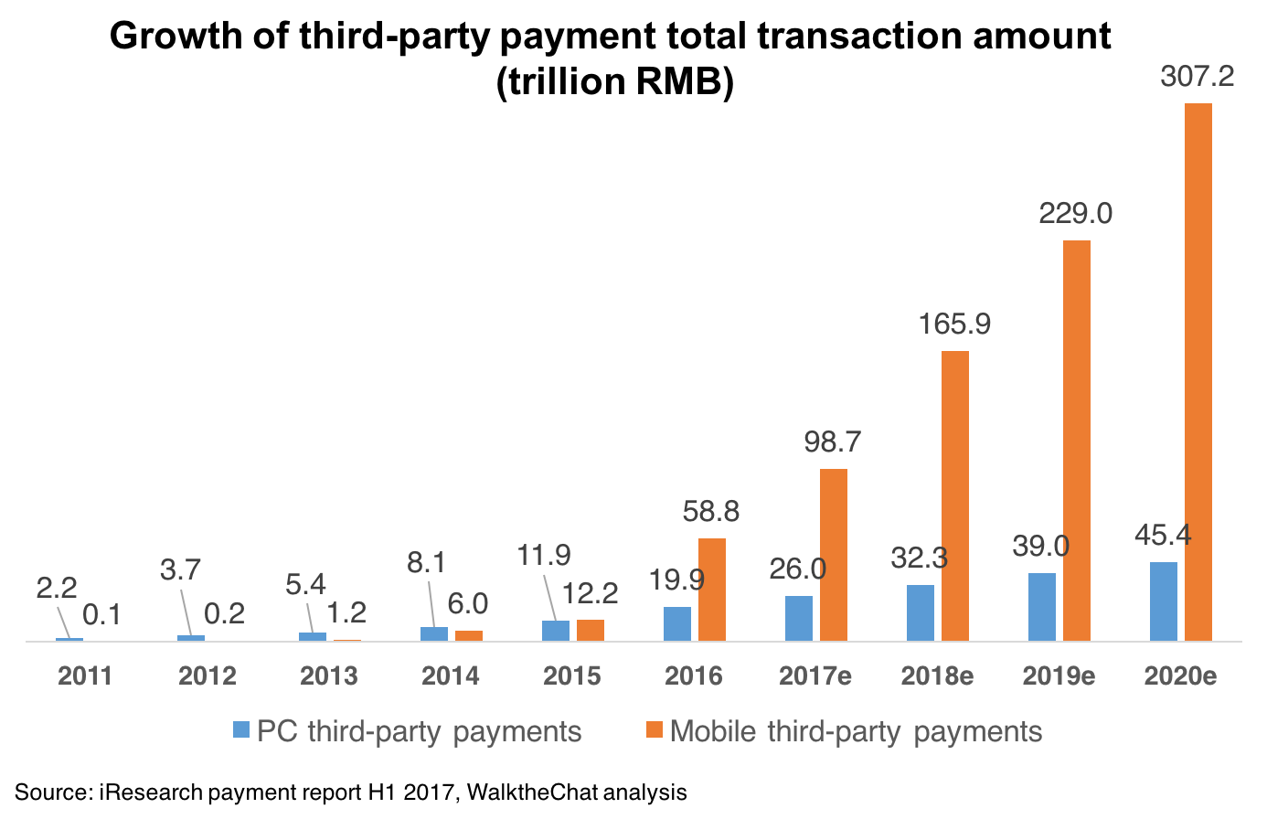
THIRD PARTY PAYMENT INDUSTRY
https://www.youtube.com/watch?v=rH4KXleHdWQ

Slide 29

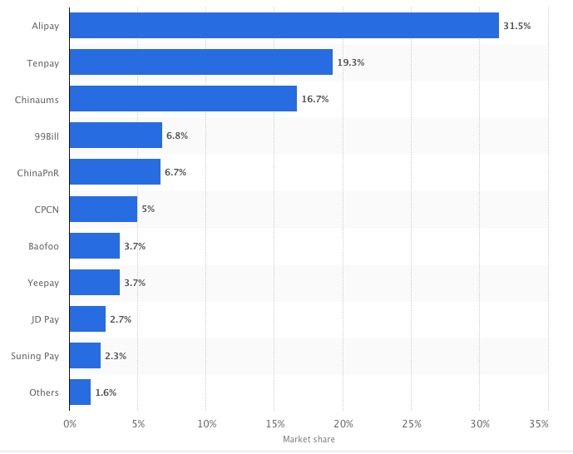

THIRD PARTY PAYMENT INDUSTRY
Market share of leading third party online payment providers in China in the second quarter of 2017
Alipay by Ant Financial is dominated the market
Tenpay = WeChat Pay
Government’s Action
  Prohibit Oligopoly/Monopoly
  Set up regulations
Oversea expansion

Slide 30
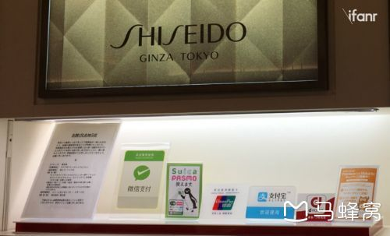

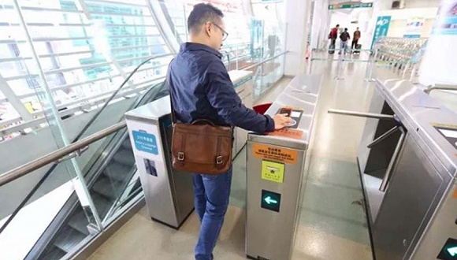

CASHLESS SOCIETY

Slide 31
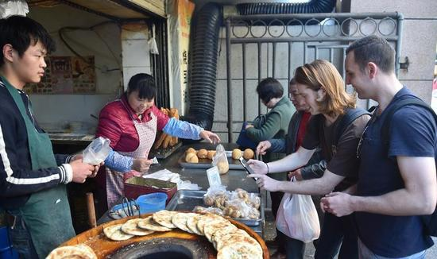
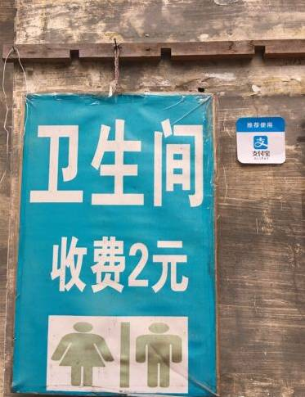
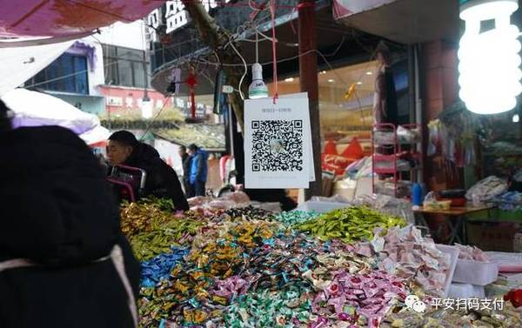
CASHLESS SOCIETY

Slide 32

CASHLESS SOCIETY

Slide 33
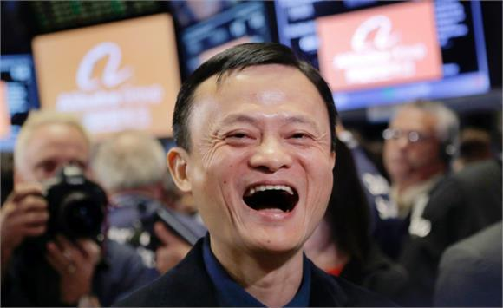
CASHLESS SOCIETY
Jack MA- Ranked the 2nd in the annual "World's 50 Greatest Leaders" list by Fortune. Founder of Alibaba group. Net worth $42.7 Billion

Slide 34
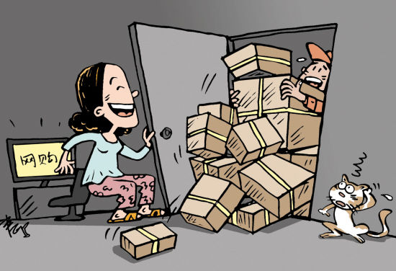
BOOMING E-COMMERCE INDUSTRY

Slide 35
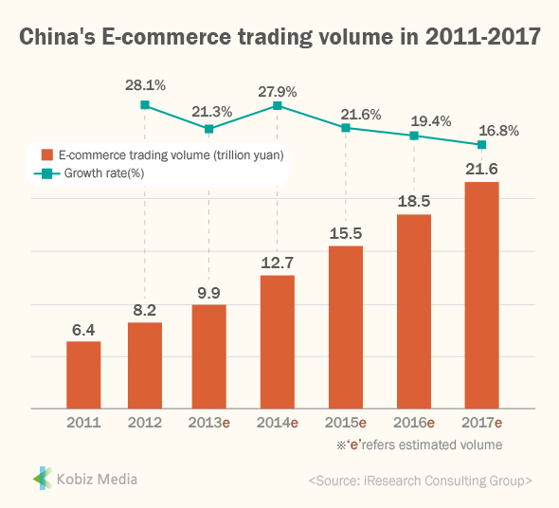
BOOMING E-COMMERCE INDUSTRY
https://www.youtube.com/watch?v=pIafcod_Bh4

Slide 36
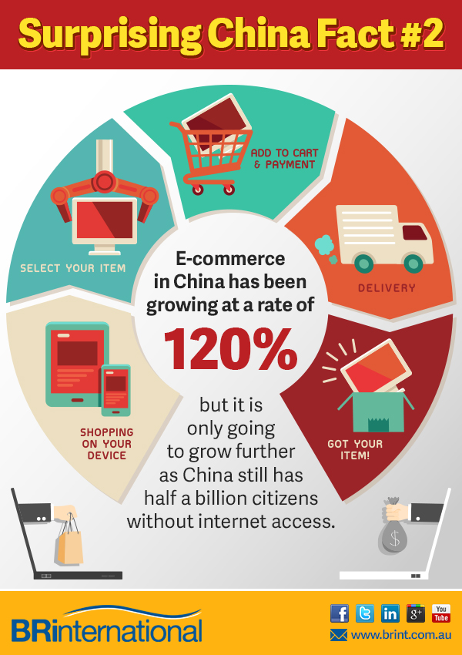
Factors accelerating the booming industry:
Third-Party-Payment
Mature logistic chain
Best service for the customer
Adapt technology into the warehouse management (VDO)
Sells EVERYTHING you can imagine
**Online-Shopaholic***
Notes:
https://www.youtube.com/watch?v=xI4yTta41No

Slide 37
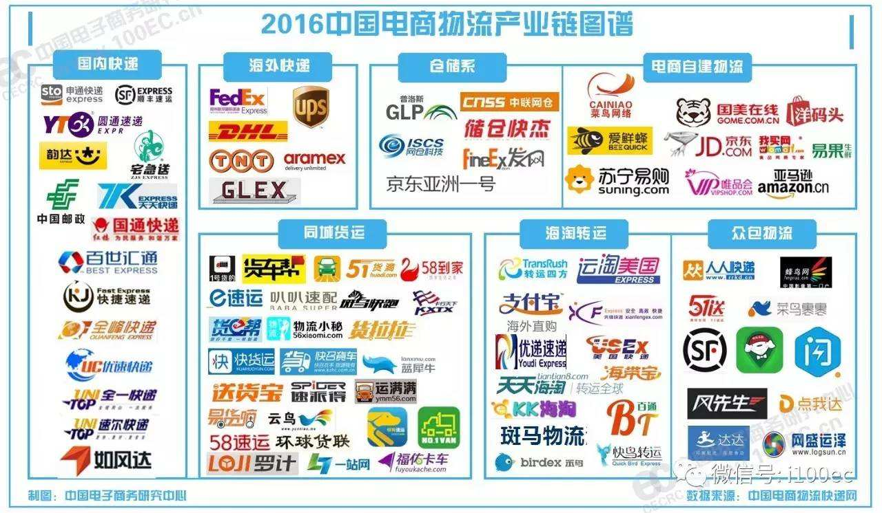

Slide 38
China’s ‘Going-Out’ Strategy

Slide 39


Slide 40
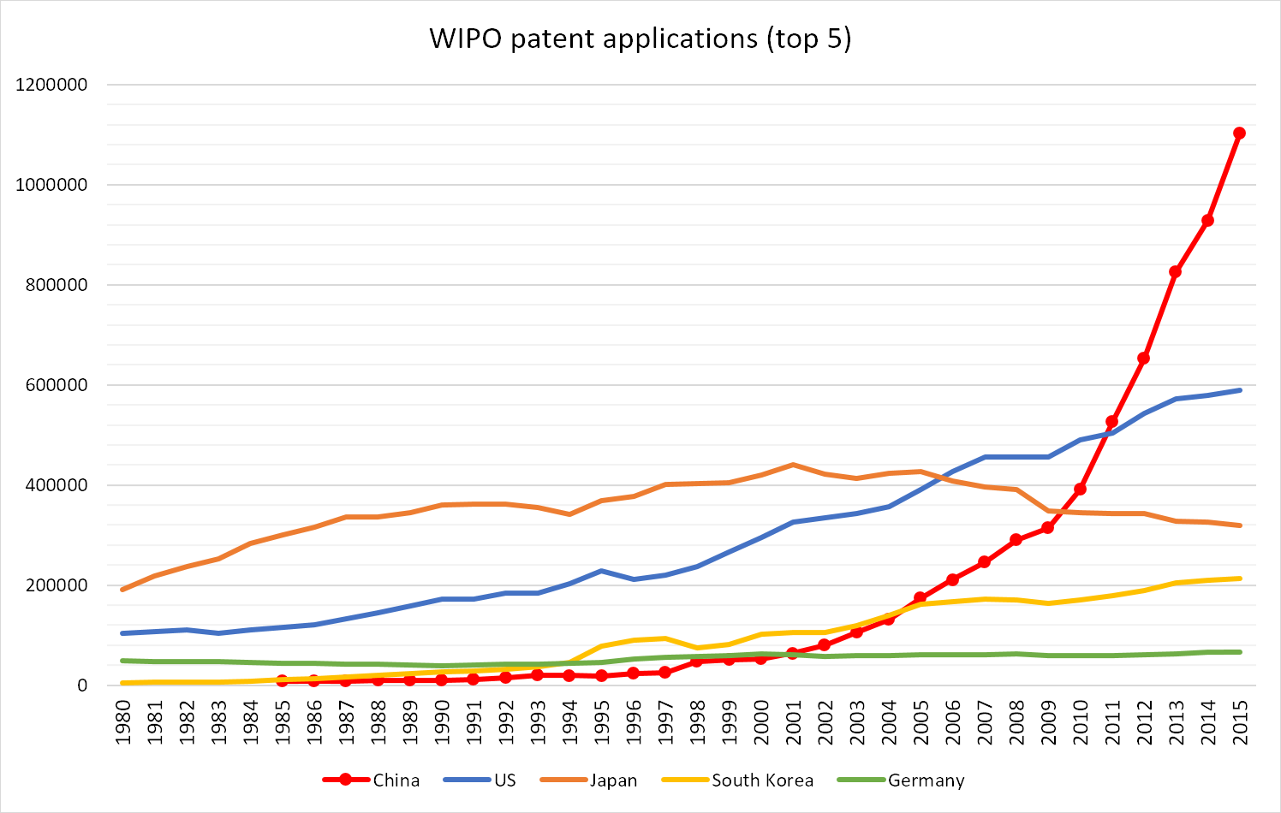
MADE IN CHINA TO ‘INNOVATE IN CHINA’
China ≠ Copy

Slide 41
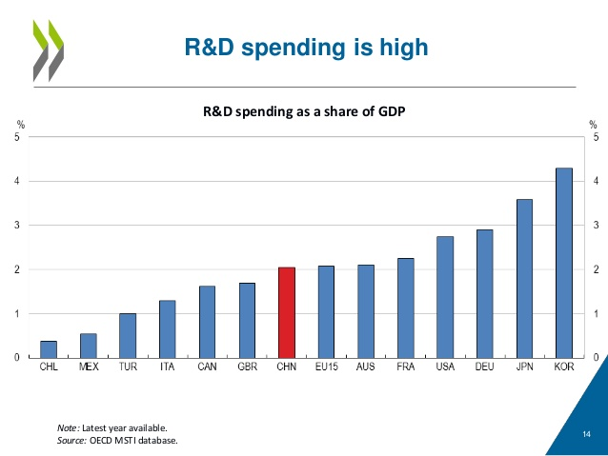
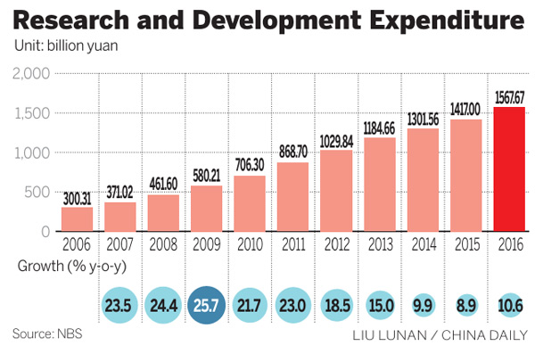
’Made In China’ to ‘Innovate In China’

Slide 42
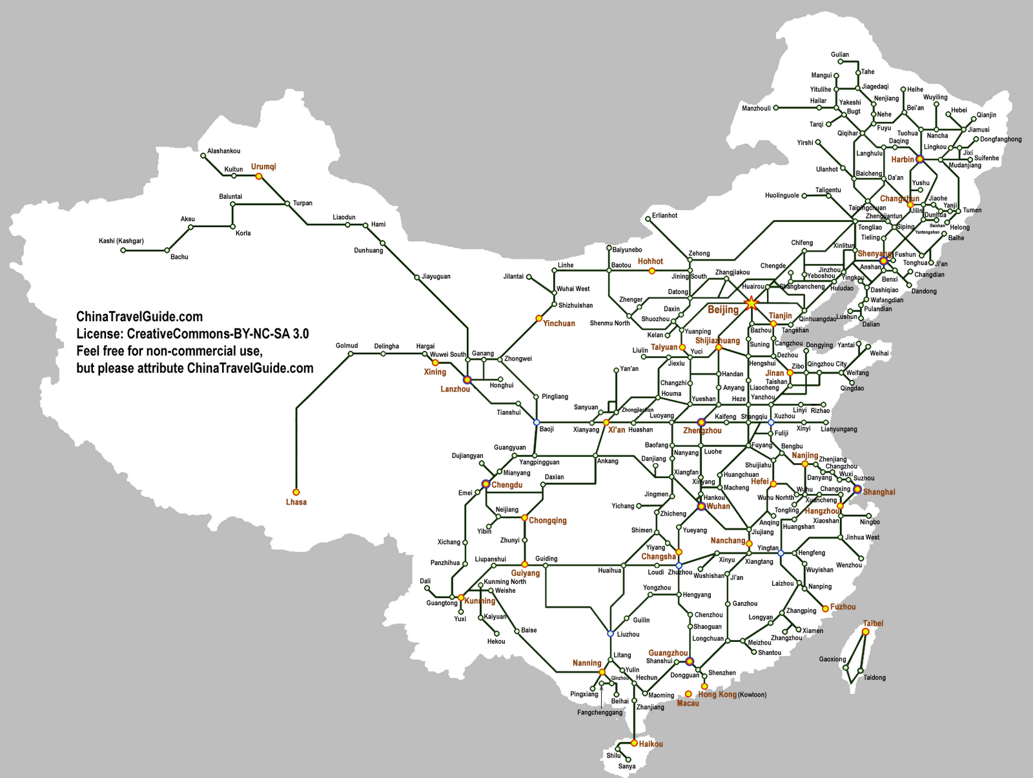
HIGH-SPEED RAILWAY
Best industrial technology
Biggest railway system & infrastructure
Longest railway
Fastest speed (316.6km/h)
~2hours from Bangkok– Chiangmai (680 km)

Slide 43
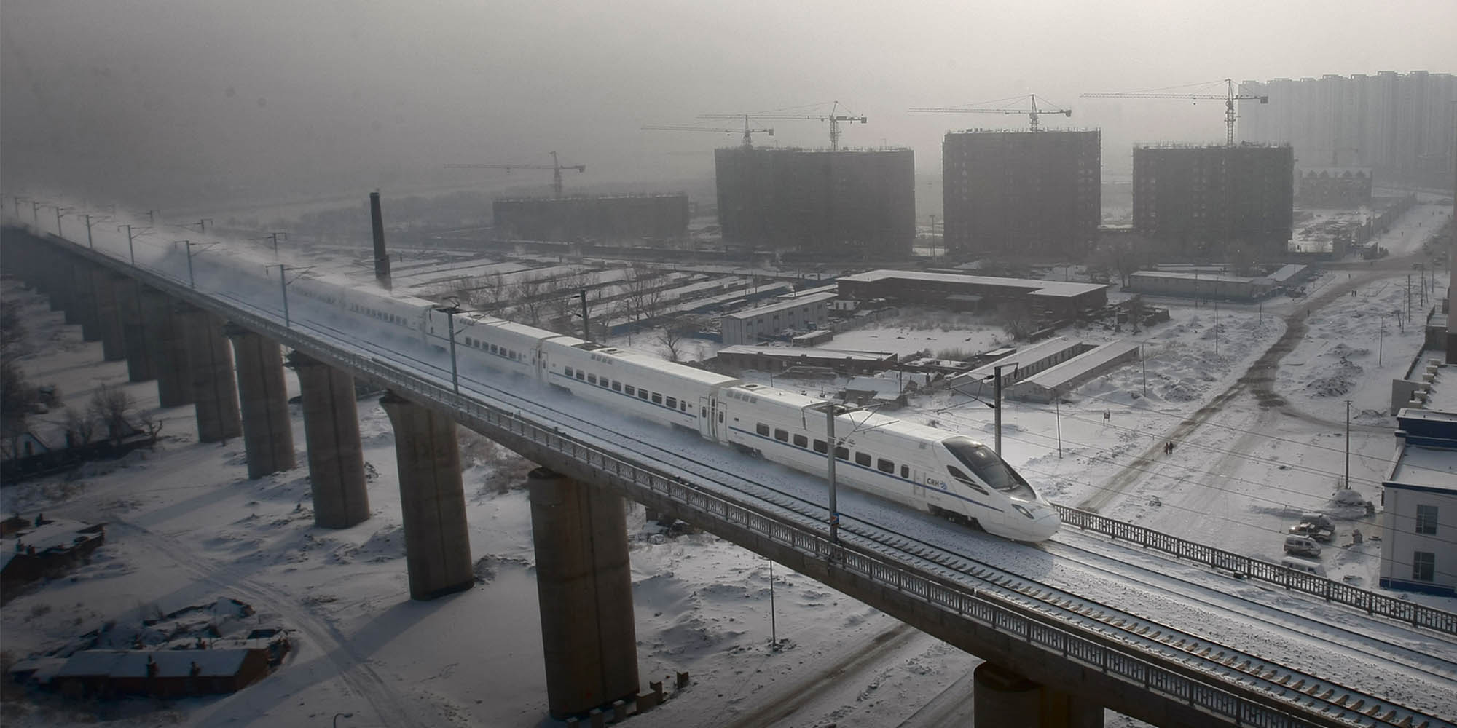
HIGH-SPEED RAILWAY
URBANIZATION & DEVELOPMENT
Urbanization

Slide 44
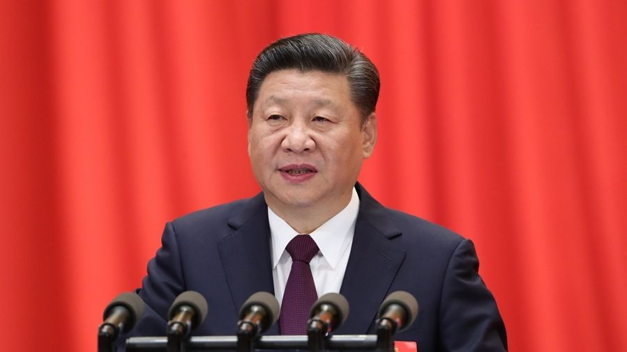
One Belt One Road Initiative
New Silk Road for 21st Century
By President Xi Jin Ping – 2013
New Economic path to link China and the world
2 Paths:
  Maritime Silk Road
  Land-based Silk Road
↑ Globalization

Slide 45
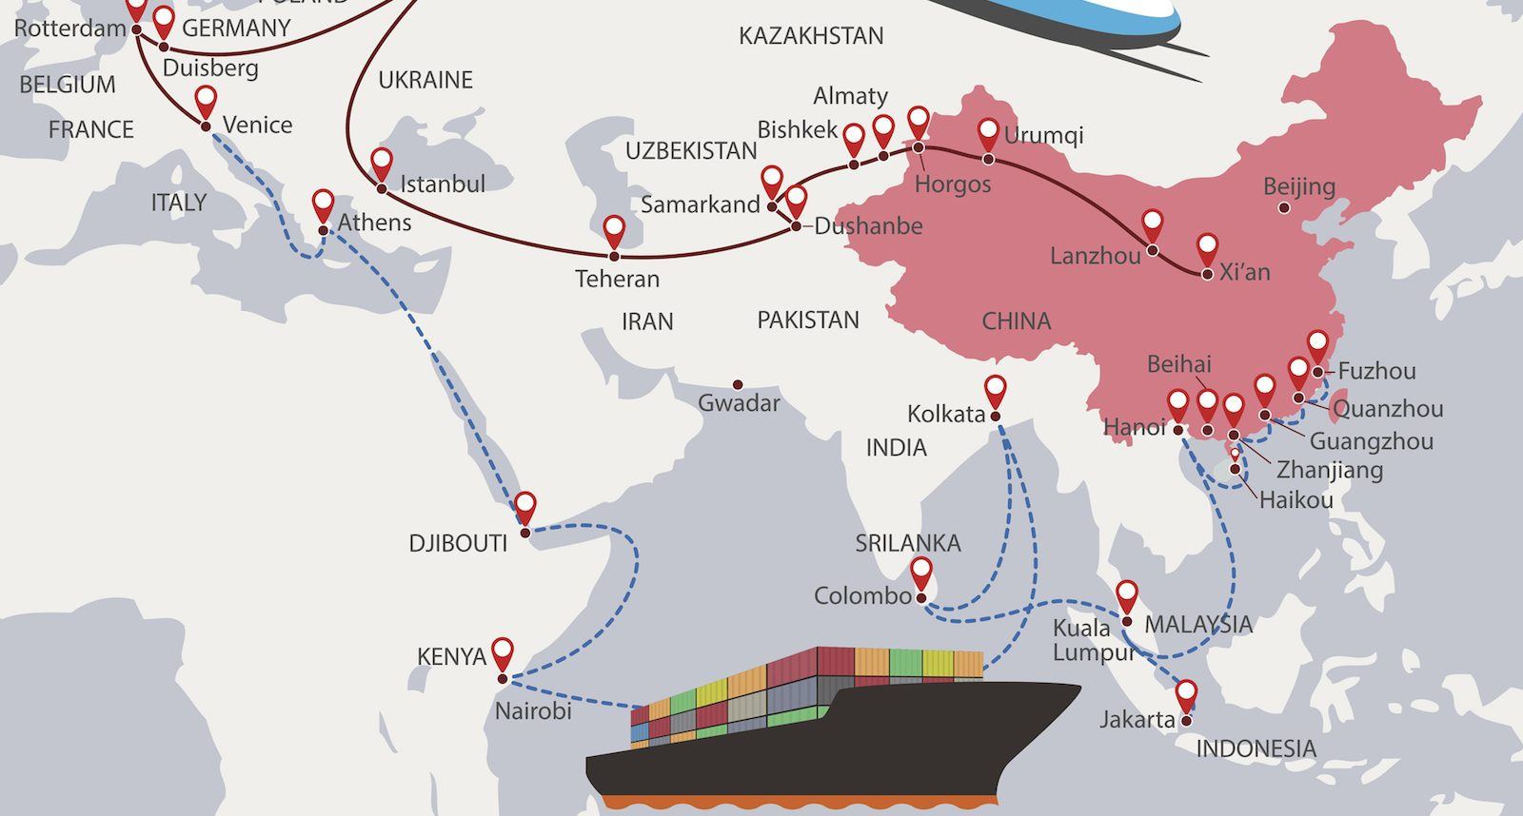
One Belt One Road Initiative
“A bid to enhance regional connectivity and embrace a brighter future"
Construct a unified large market
Full use of international and domestic markets
Cultural exchange and integration
Innovation pattern & capital inflows
Covering 60 countries
Initial $900 Billion Investment
“Infrastructure gap”

Slide 46
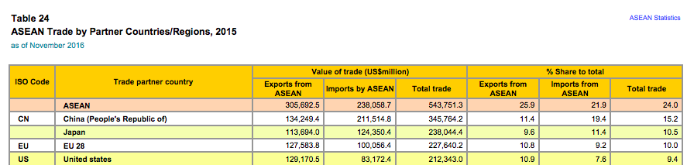
China & ASEAN
China is the biggest trade partner for ASEAN region

Slide 47
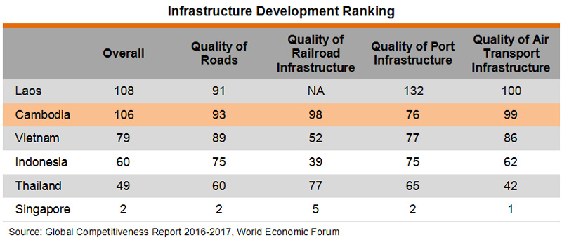
Why South-East ASIA (CLMV)?
Great opportunity to develop infrastructure

Slide 48
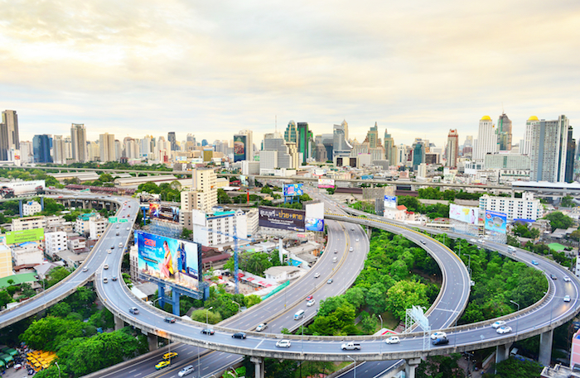

CHINA & CAMBODIA
Cambodia
Very low cost for factor of production
No capital and financial control
Free mobility
Very high openness toward FDI
Mainly develop its basic infrastructure by Chinese
Real estate in Phnom Penh
Highly attractive for Chinese investor

Slide 49
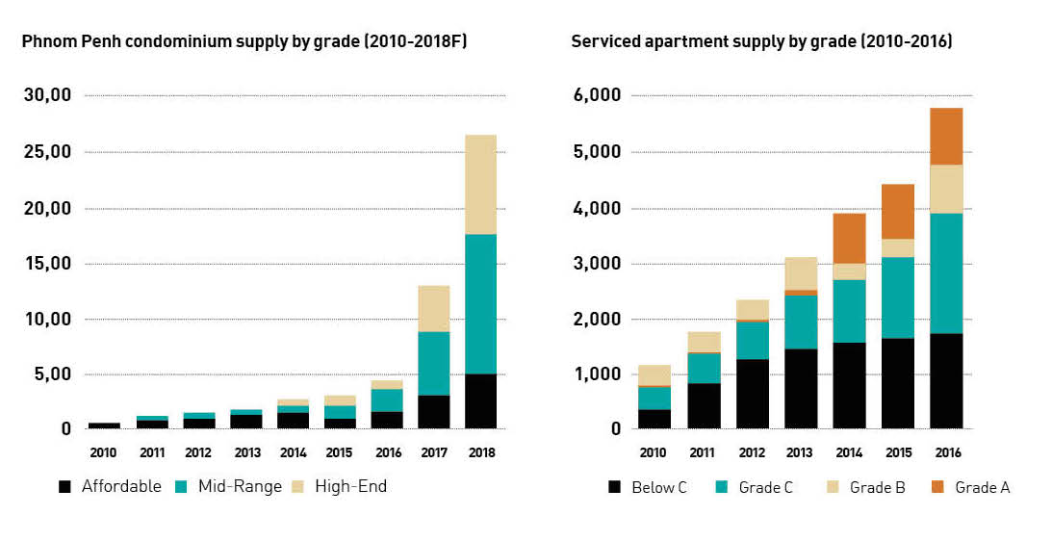
CHINA & CAMBODIA

Slide 50
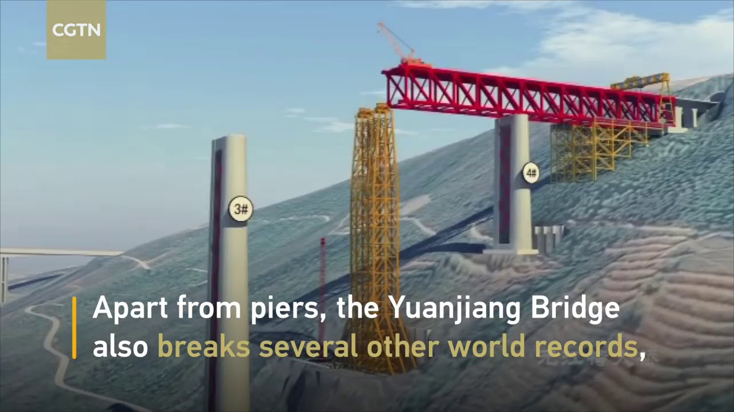

CHINA & LAOS
Laos
Natural resources: Mineral; Water; Forest; ETC.
Cheap factor of production
Supportive investment policy
Allow capital outflow
Tax allowance for many industries
Increase investment zone
China FDI in 2017:
Infrastructure
Electricity

Slide 51
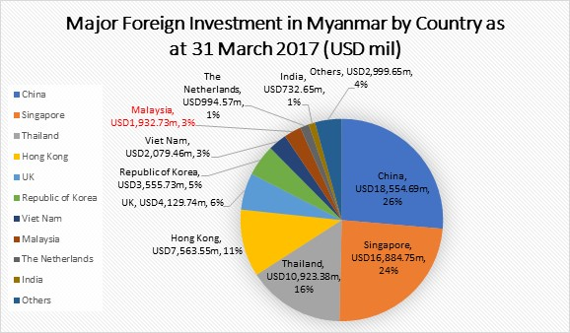
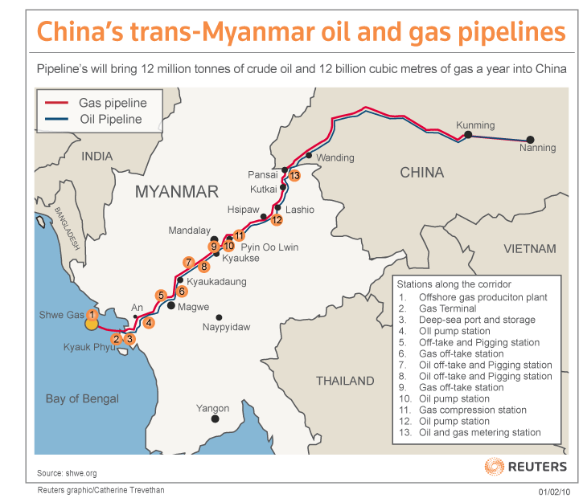
CHINA & MYANMAR
Operated since May, 2013
Myanmar
Natural resources: Petroleum & Gas
Cheap factor of production

Slide 52
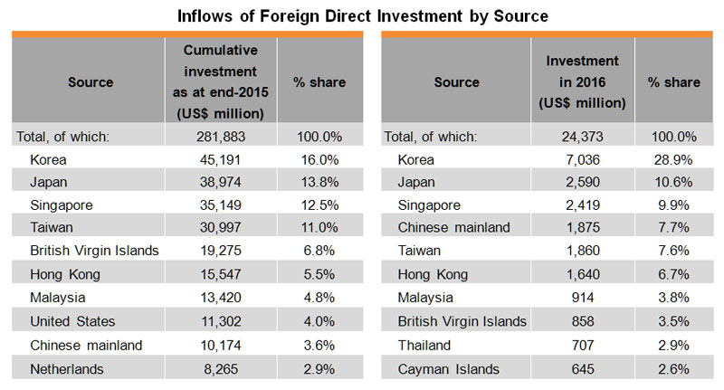
CHINA & VIETNAM

Slide 53
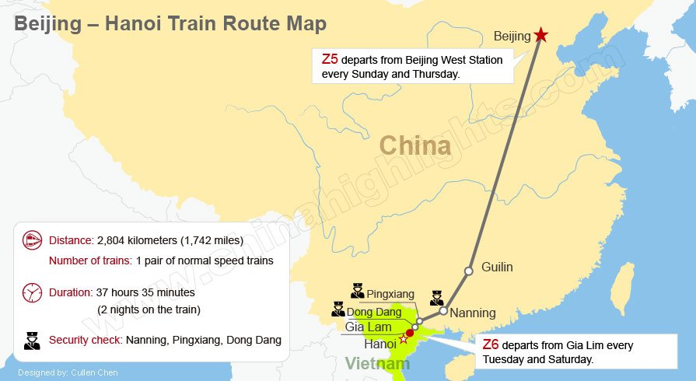
CHINA & VIETNAM
Vietnam
Higher cost for factor of production
Anti-China
Politic conflict
Compete for manufacturing
China tries to increase investment value
Expansion into higher value added sectors
Electricity
Infrastructure
Real estate

Slide 54
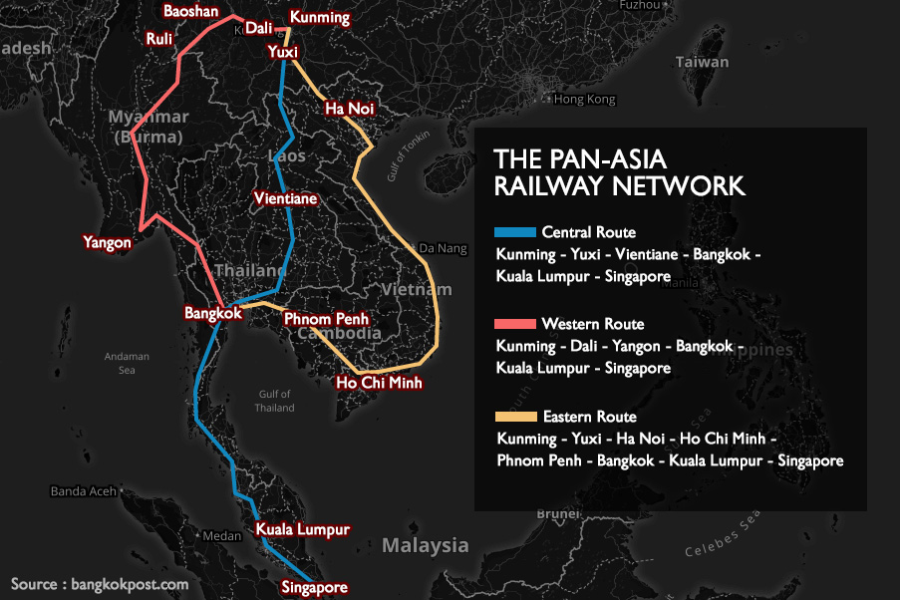
CHINA&THAILAND

Slide 55



CHINA&THAILAND
Kunming– Laos – Bangkok – Port of Laem Chabang
Thailand => Hub of SEA
Every railway goes through Bangkok
Laem Chabang port (Chachoengsao, Rayong and Chonburi)
The Eastern Economic Corridor (EEC)
Logistics hub for the AEC

Slide 56
WHAT ARE CHINA’S CONCERNS??

Slide 57


Education, Human Capital & Technology
(Annual Monitoring Survey on Rural workers 2014)
Rural labor force: Majority of population
1/3 migrates to the city
  57% works in industry
  43% workd in service sector
Remaining rural population are at age of 40+
Challenges:
Low support from the local government
Migrants were not covered by city’s social security, healthcare, unemployment insurance
Low education accessment

Slide 58

Unbalanced Regional Development
‘Let a part of population get rich first’
Imbalanced economic development
  Clear coastal-inland division
Special economic zones

Slide 59
Q & A

